Slide 1
Data-Explainable Website Fingerprinting with Network Simulation
Rob Jansen, U.S. Naval Research Laboratory
Ryan Wails, U.S. Naval Research Laboratory and Georgetown University
Rob Jansen, PhD
Computer Scientist and Principal Investigator
Center for High Assurance Computer Systems
U.S. Naval Research Laboratory
The 23rd Privacy Enhancing Technologies Symposium Lausanne, Switzerland
July 11th, 2023

Slide 2
How to Accelerate Website Fingerprinting Research!
sexy version:
Hint: stop crawling Tor to gather datasets, use network simulation instead
perfectly privacy preserving, no risk/load on Tor
unlimited source of accurately labeled data
higher data diversity
controlled network → explainable data
simulation-assisted WF outperforms standard methods

Slide 3
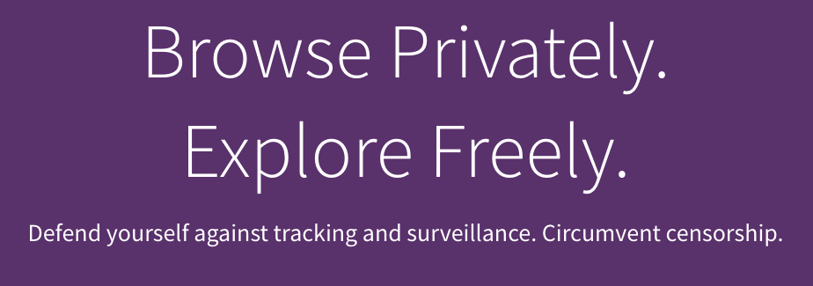






Anonymous Communication with Tor
Separates identification from routing
Provides unlinkable communication
Promotes user safety and privacy online

Slide 4
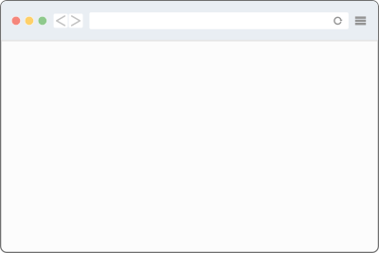



Website Fingerprinting (WF) Threat Model
WF Attacks:
Predict website visited by user
Break Tor’s anonymity
?
ML model
predict website

Slide 5
Website Fingerprinting (WF) Threat Model
WF Attacks:
Predict website visited by user
Break Tor’s anonymity
Requirements:
Observe entry-side packet traces
Labeled data to train ML models
?
ML model
predict website

Slide 6

Website Fingerprinting (WF) Threat Model
WF Attacks:
Predict website visited by user
Break Tor’s anonymity
Requirements:
Observe entry-side packet traces
Labeled data to train ML models
?
ML model
predict website
Genuine labels are encrypted by Tor

Slide 7
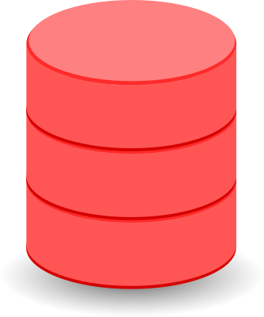
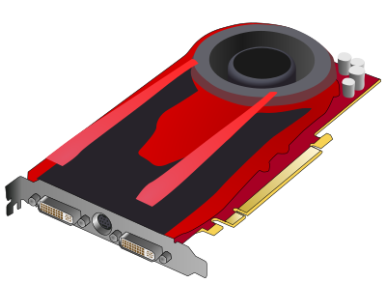



How Might an Adversary Train its ML Models?
Traditional method: (used almost exclusively in WF research)
labeled data
ML model
training
Use automated browser (selenium)
Crawl sites, collect traces+labels
Train ML models offline
Repeat continuously to stay
fresh

Slide 8
How Might an Adversary Train its ML Models?
Traditional method: (used almost exclusively in WF research)
labeled data
ML model
training
Use automated browser (selenium)
Crawl sites, collect traces+labels
Train ML models offline
Repeat continuously to stay
fresh
Problem: low-quality datasets!
(many variables affect data quality)
Browser version, config
URL choice, fetch order
Use of parallel tabs
Geo-location
Data staleness
Static, small, closed world
Relay churn, version, config
Relay congestion
Network usage fluctuations
Low bandwidth relays
DoS attacks
exit port exhaustion
censorship events

Slide 9

How Might an Adversary Train its ML Models?
Traditional method: (used almost exclusively in WF research)
labeled data
ML model
training
Use automated browser (selenium)
Crawl sites, collect traces+labels
Train ML models offline
Repeat continuously to stay
Used as a black-box
dataset generator
BUT
we have little control over Tor and don’t really understand the data!
fresh
Problem: low-quality datasets!
(many variables affect data quality)
Browser version, config
URL choice, fetch order
Use of parallel tabs
Geo-location
Data staleness
Static, small, closed world
Relay churn, version, config
Relay congestion
Network usage fluctuations
Low bandwidth relays
DoS attacks
exit port exhaustion
censorship events

Slide 10
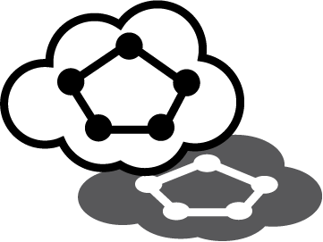


Our Research Direction: Explainable Datasets!
Use network simulation to:
Increase control over dataset collection
Augment training with more diverse data
Explain causal relationships in WF results
labeled data
ML model
training
Research Questions:
How well can WF attacks be simulated in Shadow?
How sensitive is WF to changing network conditions?
How can WF classifiers be made more robust to network effects?

Slide 11

RQ1: How well can WF attacks be simulated in Shadow?
Measurement experiment: (in both Tor and Shadow)
Chameleon Cloud
Wikipedia mirror
Set up Wikipedia mirror (23m pages)
Choose 98 pages at random
Fetch each page 200⨉
New York, USA
labeled data
patch

Slide 12

RQ1: How well can WF attacks be simulated in Shadow?
Measurement experiment: (in both Tor and Shadow)
Chameleon Cloud
Wikipedia mirror
Set up Wikipedia mirror (23m pages)
Choose 98 pages at random
Fetch each page 200⨉
&
Wrinkle: need to use wget2 (Firefox not yet supported in Shadow)
New York, USA
labeled data
patch

Slide 13
RQ1: How well can WF attacks be simulated in Shadow?
?

Slide 14
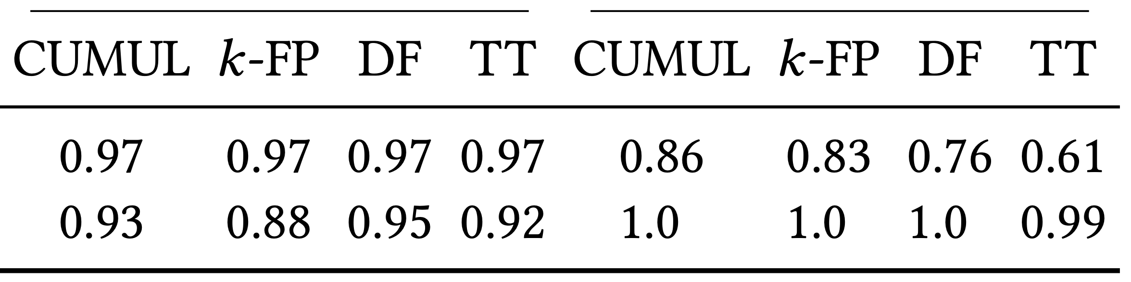
RQ1: How well can WF attacks be simulated in Shadow?
Classification experiment:
Multiclass closed world
60% train, 40% test (stratified)
Metric: accuracy (1/98 = random guess)
Train
Test

Slide 15
RQ1: How well can WF attacks be simulated in Shadow?
Classification experiment:
High accuracy: (when train-test on same data source)
Multiclass closed world
60% train, 40% test (stratified)
Metric: accuracy (1/98 = random guess)
Train
Test

Slide 16
RQ1: How well can WF attacks be simulated in Shadow?
Classification experiment:
>85% when training completely in simulation!
Multiclass closed world
60% train, 40% test (stratified)
Metric: accuracy (1/98 = random guess)
Train
Test

Slide 17
RQ2: How sensitive is WF to changing network conditions?
Simulation:
Tor is constantly changing
Composition: high relay churn
Congestion: variable network usage
Model with 9 private networks
Composition: re-randomize relays
 | Seed=1 | Seed=2 | Seed=3
Low (-25%)
Baseline
High (+25%)
Congestion: change traffic load

Slide 18

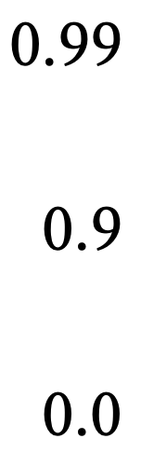
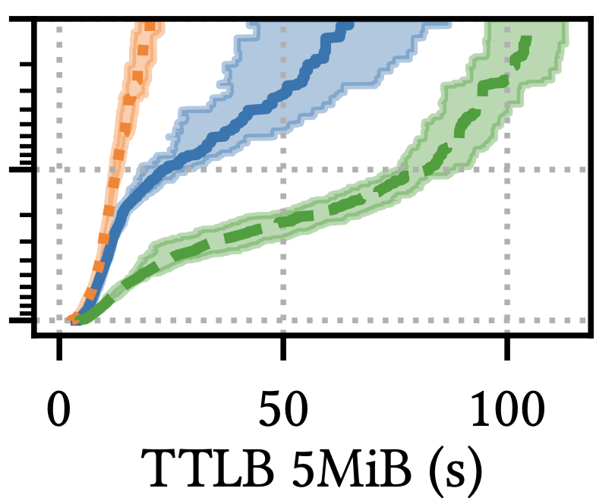
RQ2: How sensitive is WF to changing network conditions?
Simulation:
Tor is constantly changing
Composition: high relay churn
Congestion: variable network usage
Model with 9 private networks
Composition: re-randomize relays
 | Seed=1 | Seed=2 | Seed=3
Low (-25%)
Baseline
High (+25%)
Congestion: change traffic load

Slide 19
RQ2: How sensitive is WF to changing network conditions?
Simulation:
Datasets:
Tor is constantly changing
Composition: high relay churn
Congestion: variable network usage
Model with 9 private networks
Collect webpage traces (Shadow):
Labeled sensitive by adversary (5 pages, 300⨉)
Benign or unlabeled (30,000⨉)
Composition: re-randomize relays
 | Seed=1 | Seed=2 | Seed=3
Low (-25%)
Baseline
High (+25%)
Congestion: change traffic load

Slide 20
RQ2: How sensitive is WF to changing network conditions?
Simulation:
Datasets:
Tor is constantly changing
Composition: high relay churn
Congestion: variable network usage
Model with 9 private networks
Collect webpage traces (Shadow):
Labeled sensitive by adversary (5 pages, 300⨉)
Benign or unlabeled (30,000⨉)
Classification:
Composition: re-randomize relays
 | Seed=1 | Seed=2 | Seed=3
Low (-25%)
Baseline
High (+25%)
Congestion: change traffic load
Binary open world (is page sensitive?)
60% train, 40% test (stratified)
Train 4 classifiers in each of 9 networks
Test the 36 classifiers in each network

Slide 21
RQ2: How sensitive is WF to changing network conditions?
Results
Variable load had greater effect than variable seed
Train low load → test high load particularly poor
TPR | Baseline | Variable Load | Variable Seed
CUMUL | 0.99 | 0.89 | 0.89
K-FP | 0.97 | 0.78 | 0.86
DF | 0.99 | 0.89 | 0.93
TikTok | 0.98 | 0.89 | 0.93
19 point drop in TPR

Slide 22
RQ2: How sensitive is WF to changing network conditions?
Results
Variable load had greater effect than variable seed
Train low load → test high load particularly poor
Avg. FPR increases more for time-aware classifiers
FPR (⨉10⁻²) | Baseline | Variable Load | Variable Seed
CUMUL | 0.165 | 0.155 | 0.159
K-FP | 0.044 | 0.237 | 0.050
DF | 0.146 | 0.290 | 0.146
TikTok | 0.106 | 0.657 | 0.123
400-500% increase in FPR

Slide 23
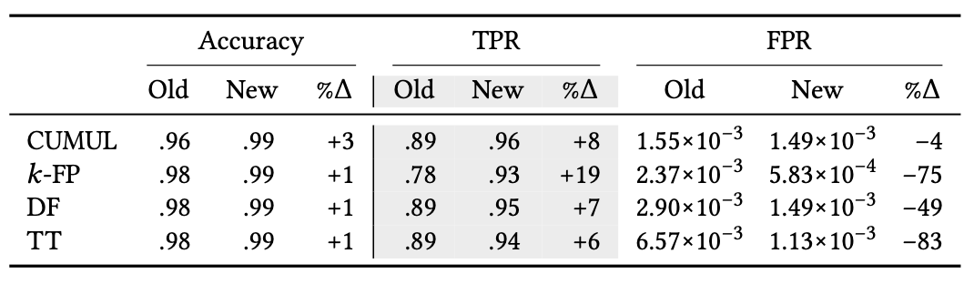
RQ3: How can WF be made more robust to network effects?
Mixture training experiment
Train using mixture dataset from “training” networks
Test using examples from independent test network

Slide 24
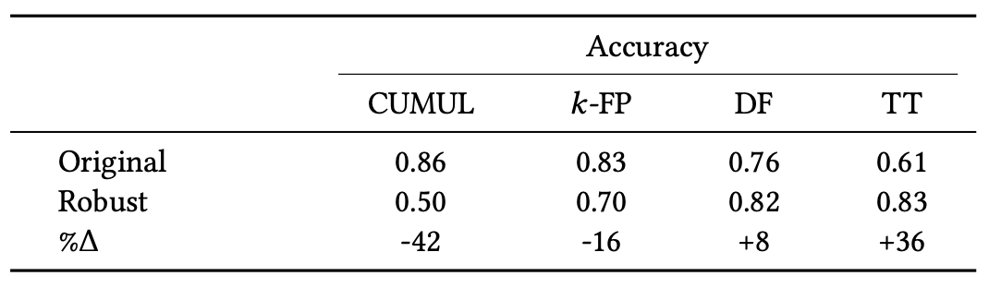
RQ3: How can WF be made more robust to network effects?
Robust classifiers from simulation
Use robust mixture training with 100% simulated data
Test using the wget2 dataset collected from real-world Tor
Works well for neural networks, esp. time-aware

Slide 25


Closing
Contact: rob.g.jansen@nrl.navy.mil robgjansen.com
Advantages:
perfectly privacy preserving, no risk/load on Tor
unlimited source of accurately labeled data
higher data diversity
controlled network → explainable data
simulation-assisted WF outperforms standard methods
labeled data
ML model
training
Future work:
Run Tor Browser directly in Shadow, systematically analyze browser effects
Expand analysis beyond Wikipedia
Independently useful thrust: study WF using genuine data
Read the paper!

