Slide 1
CellShift: RTT-Aware Trace Transduction for Real-World Website Fingerprinting
Rob Jansen, U.S. Naval Research Laboratory
Rob Jansen, PhD
Computer Scientist
Center for High Assurance Computer Systems
U.S. Naval Research Laboratory
The Network and Distributed System Security Symposium 2026 San Diego, CA, US
February 25th, 2026

Slide 2







Anonymous Communication with Tor
Separates identification from routing
Provides unlinkable communication
Promotes user safety and privacy online

Slide 3


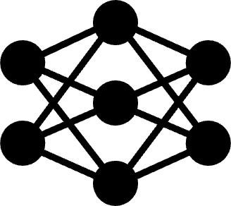
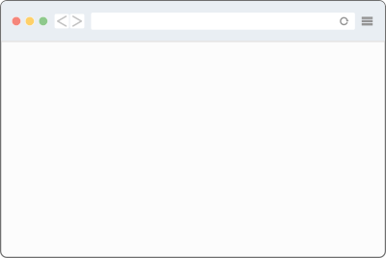
Website Fingerprinting Adversary Model
Website fingerprinting (WF) attacks can link a source to its destination, breaking Tor’s anonymity
Adversary can:
Obtain entry-side vantage point
Observe traffic patterns
Predict website visited by user using a trained ML model
foo.com
foo.com
unlabeled entry pattern
ML model
predicted website label

Slide 4


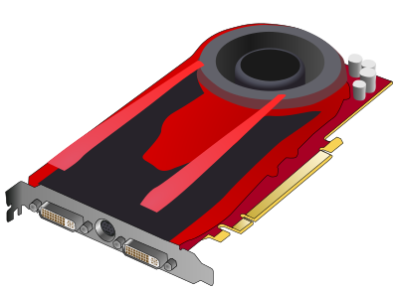
How Might Adversary Train ML Models?
Non-option: use entry examples
Need labeled examples of patterns
Onion-encryption hides labels
Observed examples are unlabeled
foo.com
unlabeled entry patterns
training
trained
ML model

Slide 5


How Might Adversary Train ML Models?
Option 1: synthetic data
Use automated browser (selenium) to replicate users’ behavior/diversity
Usually by crawling frontpages of top sites…
Problem
Modeling WF with synthetic user data oversimplifies the ML task [CCS’14, USENIX’22, PAM’26]
Browser version, configuration
URL choice, fetch order, usage of tabs
# of sites/pages, world size dynamics
Geo-location, concept drift
Tor network variation: relay churn, software versions, congestion, location…
foo.com
labeled entry patterns
training
trained
ML model

Slide 6


How Might Adversary Train ML Models?
Option 2: real Tor user data
Run exit relay, observe traffic
Traffic patterns from real Tor users
Website labels observed in DNS requests
Problem
Exit-entry position mismatch
Train on exit side, predict on entry side
Position “distortion” reduces performance
5-18% [USENIX’22]
17% median, 93% worse-case [WPES’24]
foo.com
labeled exit patterns
training
trained
ML model

Slide 7

Our Research Direction: Key Insights
 | Synthetic client | Real Tor exit
Ground-truth labels
Entry-side examples
Real Tor user data
Key insights:
If adversary would test on real user data, they should train on it too
Easier to mitigate entry-exit distortion than accurately replicate users
?
labeled entry patterns
training
trained
ML model

Slide 8

Research Question and Goals
 | Synthetic client | Real Tor exit
Ground-truth labels
Entry-side examples
Real Tor user data
Research question:
Can exit→entry transduction efficiently improve classifier robustness to an out-of-distribution testing position?
Goals:
To understand the real-world threat of WF to inform/prioritize defenses
Non-Goals:
Develop new WF attacks
Improve attacks to benefit adversary
foo.com
????
exit→entry
labeled entry patterns
training
trained
ML model

Slide 9
CellShift: exit→entry Cell Trace Transduction
 | Synthetic client | Real Tor exit
Ground-truth labels
Entry-side examples
Real Tor user data
Introducing CellShift
Transforms or “shifts” exit traces into entry traces
Uses existing cell trace metadata
Extract RTT estimates from cell trace
Estimate e2e latency and congestion
Rewrite cell times to simulate a shift in position from exit to entry
Uses only cell traces and … MATH!
foo.com
CellShift:
exit→entry
labeled entry patterns
training
trained
ML model

Slide 10
How does CellShift work?
A cell trace is a sequence of:
Timestamp:
when cell was observed
Direction:
+1 client→server, -1 server→client
Command:
type of protocol message
Example:
[
(0.1, +1, CREATE),
(0.5, -1, CREATED),
(0.9, +1, BEGIN),
(1.3, -1, CONNECTED),
(1.3, -1, DATA),
(1.3, -1, DATA),
…
]

Slide 11
How does CellShift work?
A cell trace is a sequence of:
Timestamp:
when cell was observed
Direction:
+1 client→server, -1 server→client
Command:
type of protocol message
Example:
Step 1: estimate circuit RTT from trace
During server connection:
BEGIN → CONNECTED → DATA
foo.com
[
(0.1, +1, CREATE),
(0.5, -1, CREATED),
(0.9, +1, BEGIN),
(1.3, -1, CONNECTED),
(1.3, -1, DATA),
(1.3, -1, DATA),
…
]
BEGIN
CONNECTED
DATA
RTT = time received DATA - time sent CONNECTED

Slide 12
How does CellShift work?
A cell trace is a sequence of:
Timestamp:
when cell was observed
Direction:
+1 client→server, -1 server→client
Command:
type of protocol message
Example:
Step 1: estimate circuit RTT from trace
During server connection:
BEGIN → CONNECTED → DATA
During relay phase
Every 31st DATA → SENDME
foo.com
[
(0.1, +1, CREATE),
(0.5, -1, CREATED),
(0.9, +1, BEGIN),
(1.3, -1, CONNECTED),
(1.3, -1, DATA),
(1.3, -1, DATA),
…
]
DATA
SENDME
RTT = time received SENDME - time sent 31st DATA

Slide 13
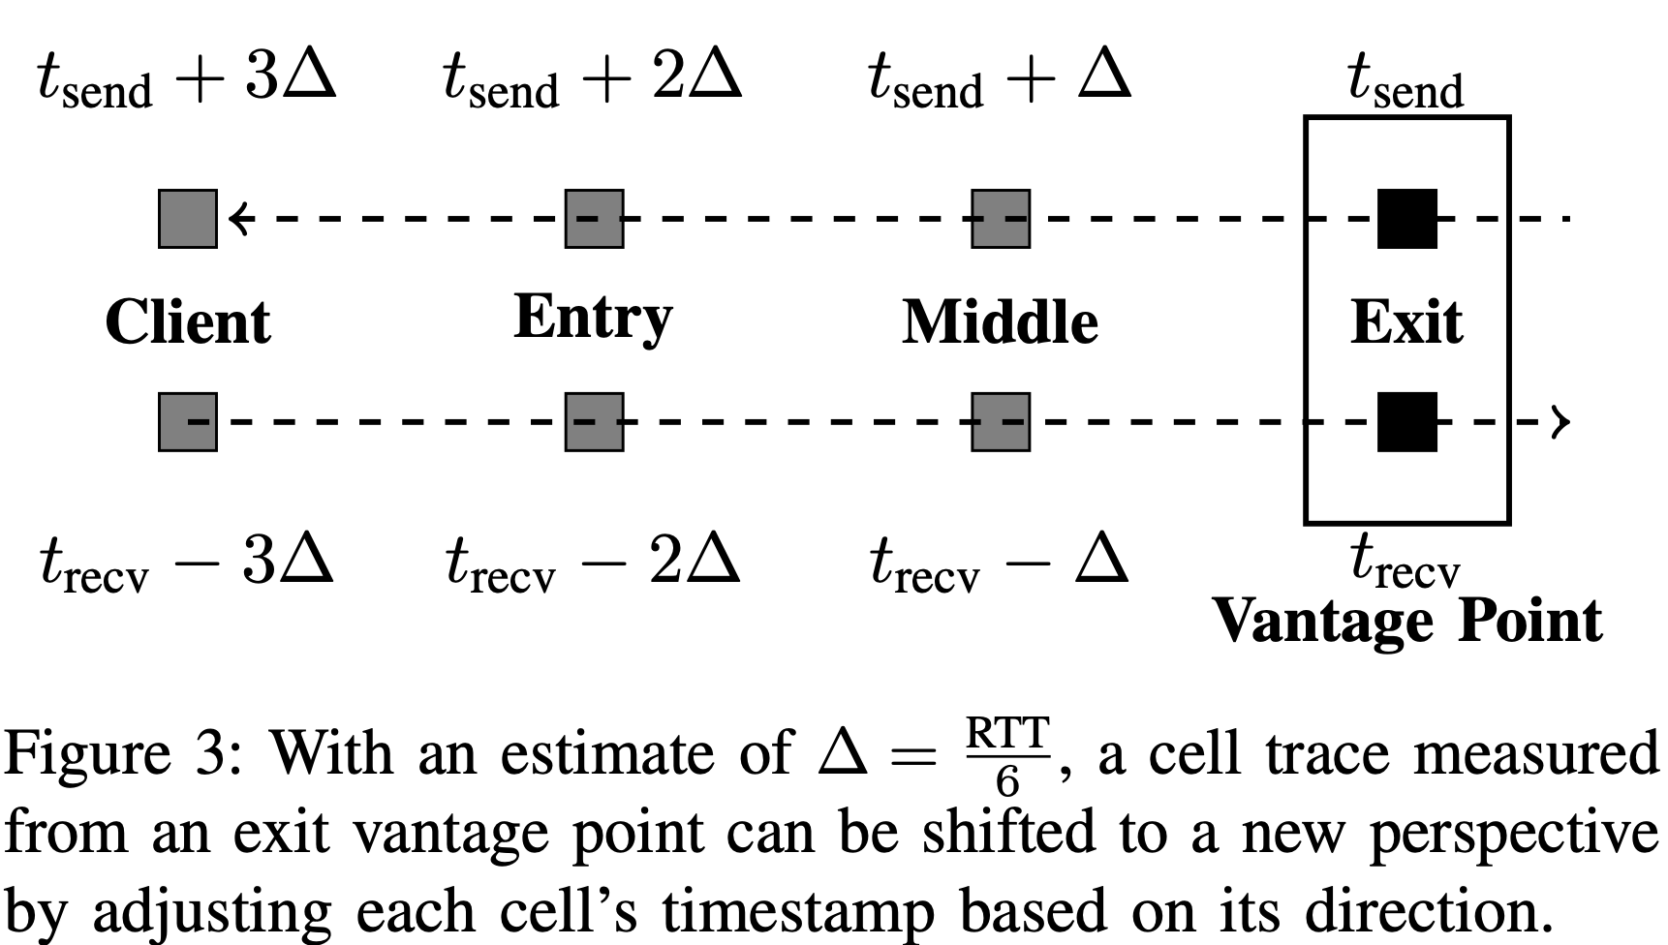
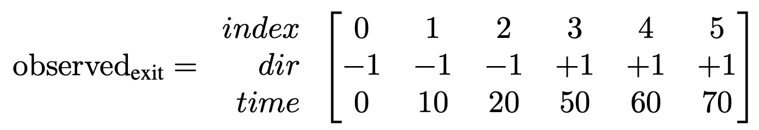
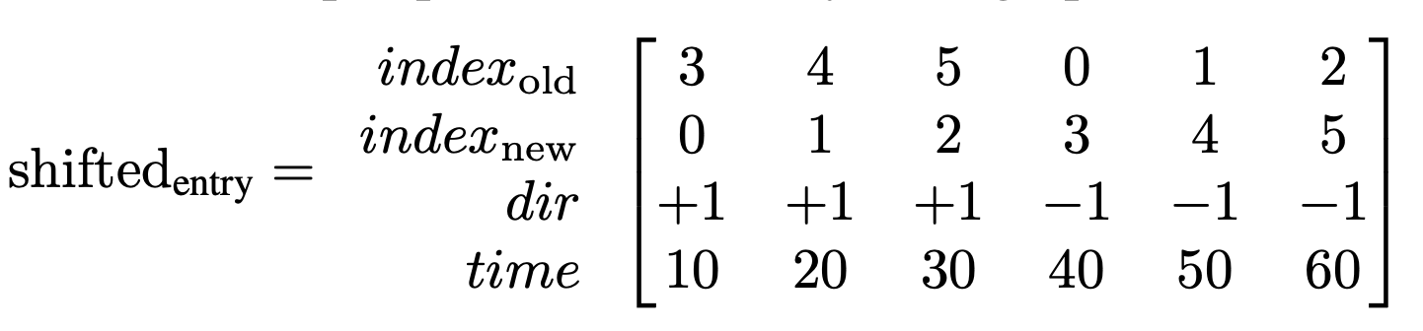
How does CellShift work? (continued)
Step 2: Use RTTs to rewrite cell times
Step 3: Re-sort the cells

Slide 14
Extensions for Augmented Training
Split RTT estimates into:
Propagation delay = RTT_{min}
Congestion_{i} = RTT_{i} - RTT_{min}
Can then be applied to other traces to produce new trace variations that augment the original trace
Producing augmented traces:
Simulates loading trace through a different path of relays
Step1: Create propagation delay P and congestion C distributions using the entire dataset
Step 2: For each trace, adjust times by sampling from P and C to produce n augmented traces

Slide 15


Evaluation: Trace Distance
Collect correlated entry-exit traces
Patched Tor to collect cell traces
Pinned entry+exit on each circuit
Fetch URLs multiple times each
Transduce exit→entry with CellShift
Entry
Exit
patched tor to collect cell traces
Exit
CellShift(Exit)
CellShift

Slide 16
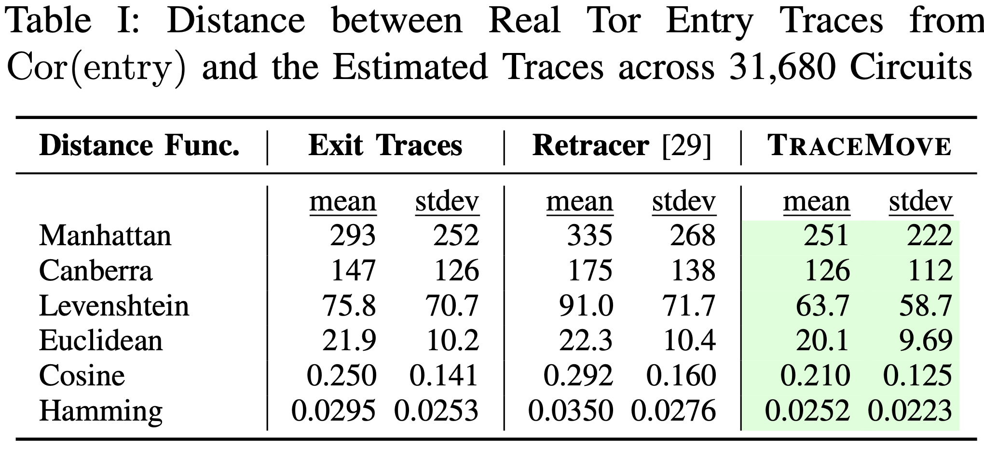
Evaluation: Trace Distance
Collect correlated entry-exit traces
Patched Tor to collect cell traces
Pinned entry+exit on each circuit
Fetch URLs multiple times each
Transduce exit→entry with CellShift
Compute distance to Entry
CellShift reduced distance across all tested distance functions
Entry
Exit
patched tor to collect cell traces
Exit
CellShift(Exit)
CellShift

Slide 17
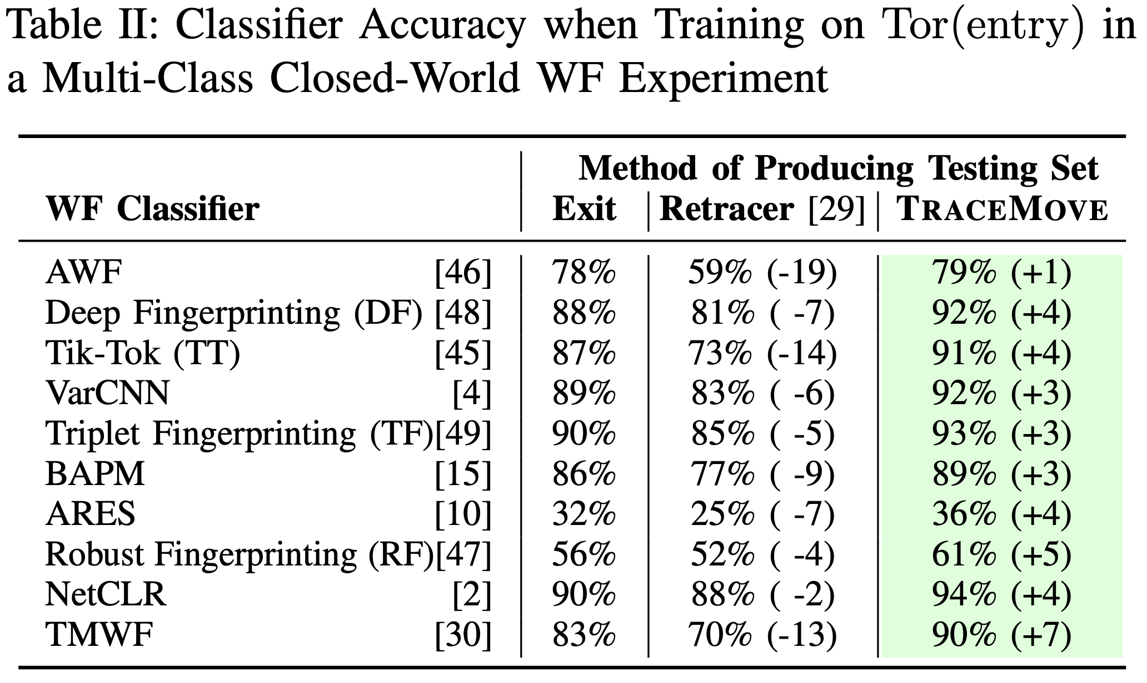
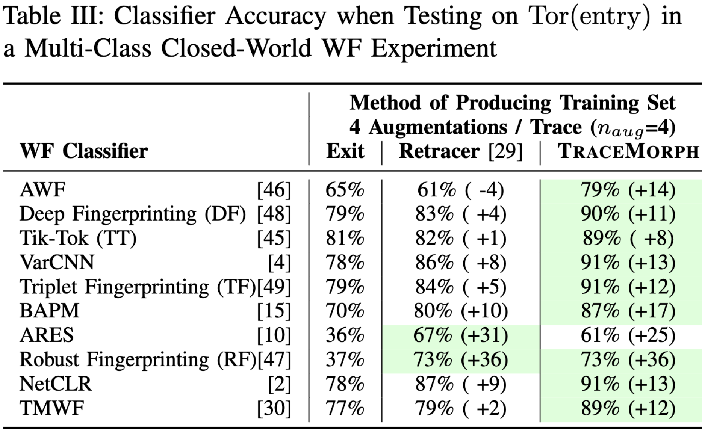
Evaluation: Closed-World WF with Synthetic Data
Hold training set constant, vary testing
Synthetic Entry/Exit data [WPES’24]
CellShift-based TraceMove improves WF accuracy across 10 tested classifiers by 1-7 pp
Hold testing set constant, vary training
Synthetic Entry/Exit data [WPES’24]
CellShift-based TraceMorph improves WF accuracy across 10 tested classifiers by 8-36 pp

Slide 18
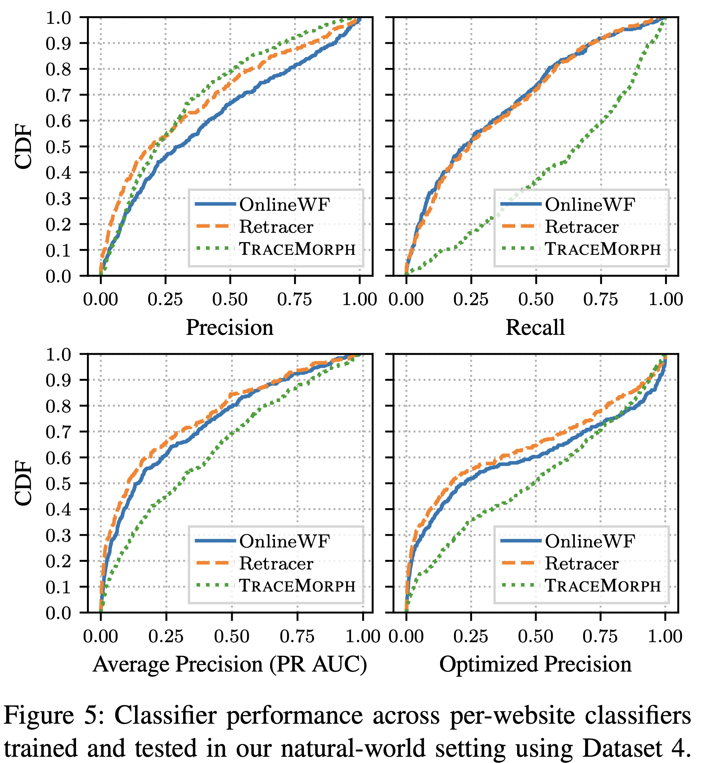
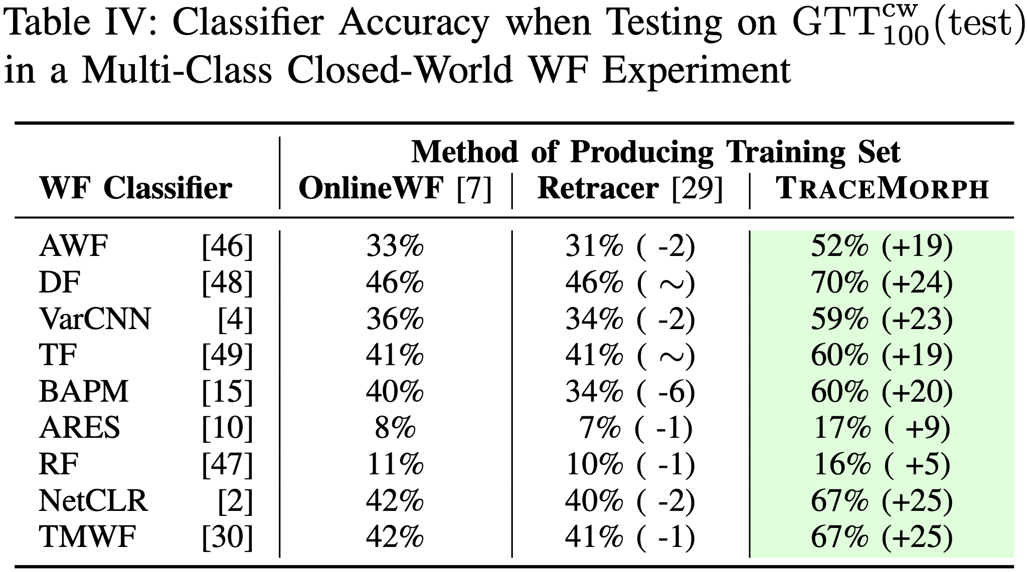
Evaluation: WF with Genuine Data
Genuine data from GTT23
13M traces from real Tor users, measured on Tor exits for 13 weeks
https://doi.org/10.5281/zenodo.10869889
Evaluated closed and natural world

Slide 19
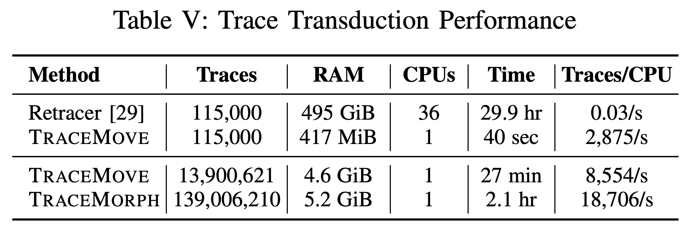
CellShift Transduction Performance
CellShift is very efficient
Can process tens of millions of traces per hour per CPU
Five orders-of-magnitude improvement relative to the state of the art
Can handle typical Tor exit relay circuit load

Slide 20


CellShift: RTT-Aware Trace Transduction for Real-World Website Fingerprinting
Contributions
CellShift for transducing exit→entry traces
An exit→entry distance evaluation
WF evaluation on synthetic data
WF evaluation on genuine data
Open-source Rust implementation
Future Work
Use CellShift to:
Evaluate defenses against genuine data
Drive development of more informed defenses
Read Paper!
Download Code!
Contact: robert.g.jansen7.civ@us.navy.mil robgjansen.com

