Slide 1
Co-opting Linux Processes for High-Performance Network Simulation
USENIX ATC’22 Best Paper Award!
Rob Jansen, U.S. Naval Research Laboratory
Jim Newsome, Tor Project
Ryan Wails, Georgetown University & U.S. Naval Research Laboratory
Rob Jansen, Ph.D.
Computer Security Research Scientist
Center for High Assurance Computer Systems
U.S. Naval Research Laboratory
USENIX Annual Technical Conference Carlsbad, CA, USA
July 11th, 2022

Slide 2







Main Takeaways
Read the paper!
shadow.github.io
Designed a new, hybrid network simulator/emulator
co-opts Linux processes into a discrete-event network simulation that emulates kernel functionality
enables large-scale, distributed system experiments
Merged into the open-source Shadow project and synonymous with Shadow v2
Artifacts: https://netsim-atc2022.github.io
2.3x faster than Shadow v1
3.4x faster than NS-3
43x faster than gRaIL [ToN’19]
Runtime (s)

Slide 3
Outline
motivation
design
evaluation

Slide 4

Requirements for Large Distributed System Experimentation
Important properties of test networks:
Controllable: isolate important factors
Replicable: identically replicate experiments (determinism)
Requirements for large distributed systems:
Accurate: directly execute system software (not an abstraction)
Scalable: decouple from time, computational constraints of host
Controllable
Scalable
Replicable
Accurate
Our approach
Notes:
Controllable:
Prevent confounding influence, cascading network effects
Replicable:
Enables results to be independently verified
Accurate:
Reproduce complex application-layer logic with high fidelity
Scalable:
Prevents over-provisioning and time-distortion
Enables larger scales (may run faster or slower than real time)
More confidence in results with fewer trials

Slide 5

Problems with Traditional Approaches
Simulation (e.g., ns-3)
Not realistic: runs abstractions instead of real applications
Hard to maintain and can lead to invalid results
Emulation (e.g., mininet)
Not controllable: results will not be identical
Not scalable: CPU overload → time distortion
Mininet
> sudo mn

Slide 6
Problems with Traditional Approaches
Simulation (e.g., ns-3)
Not realistic: runs abstractions instead of real applications
Hard to maintain and can lead to invalid results
Emulation (e.g., mininet)
Not controllable: results will not be identical
Not scalable: CPU overload → time distortion
Mininet
> sudo mn
Forwarding capacity limited: fewer packets than expected are forwarded
CPU overload with >20 hosts

Slide 7


Hybrid Architectures and Challenges
Hybrid architecture
Network simulation, but directly execute application code
Enjoys advantages of both simulation and emulation
Best opportunity to scale to large-scale distributed systems
Architecture | Example Tool | Scalability | Realism | Control
Emulation | Mininet
Simulation | NS-3
Hybrid | This work
Notes:
scalability: Experiments scale independent of CPU constraints
realism: Unmodified apps can be directly run without rebuilding
control: Results can be deterministically replicated

Slide 8
Limitations of Hybrid Architectures (1)
Executing application code via plugin (link-map) namespaces
appid = dlmopen(app.so)
func = dlsym(appid, “main”)
func()
NS-3-DCE, Shadow
Limitations
Compatibility (must build PIC/PIE)
Correctness (intercept libcalls only)
Maintainability (custom ld, threading)

Slide 9
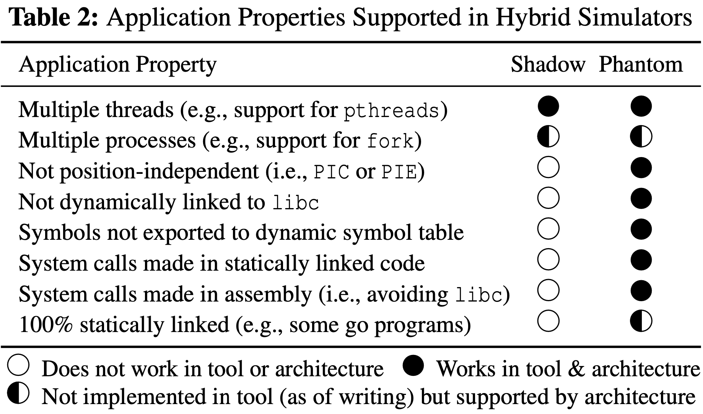
Limitations of Hybrid Architectures (1)
Executing application code via plugin (link-map) namespaces
appid = dlmopen(app.so)
func = dlsym(appid, “main”)
func()
NS-3-DCE, Shadow
Limitations
Compatibility (must build PIC/PIE)
Correctness (intercept libcalls only)
Maintainability (custom ld, threading)

Slide 10
Limitations of Hybrid Architectures (2)
Executing code via Linux processes
fork() + exec() → ptrace()
gRaIL [ToN’19]
Limitations: ptrace is slow!
Process control: overhead quadratic in total number of processes
Syscall interception: 4 context switches for every syscall
Data transfer: extra syscall + mode change for every word of memory
Runtime (s)
gRaIL (on ns-3) is 13x slower than ns-3 alone

Slide 11
Our Research Challenge
Can we design a tool with the performance benefits of a uni-process plugin-based architecture AND the improved modularity and isolation of a mutli-process architecture?

Slide 12

Our Research Challenge

Slide 13
Outline
motivation
design
evaluation

Slide 14
Design Overview
parallel workers
direct execution
syscall interposition
syscall emulation
IPC
process control
CPU affinity
Discrete-event packet-level network simulator
Directly executes apps as standard Linux processes
Intercepts all system calls made by apps and emulates them
Simulates system call behavior and networking
File descriptors (files, sockets, pipes)
Event notification (poll, epoll, select)
Networking (buffers, protocols, ifaces)
DNS and routing (latency, bandwidth)

Slide 15
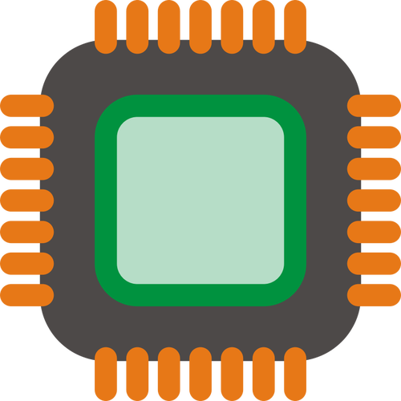
Parallel Worker Threads
parallel workers
direct execution
syscall interposition
syscall emulation
IPC
process control
CPU affinity
Goal: efficiently parallelize simulation workload
Sim Controller Process
CPU
CPU
CPU
CPU
Physical processors

Slide 16


Parallel Worker Threads
parallel workers
direct execution
syscall interposition
syscall emulation
IPC
process control
CPU affinity
Goal: efficiently parallelize simulation workload
Sim Controller Process
Virtual hosts and processes
CPU
CPU
CPU
CPU
Physical processors

Slide 17
Parallel Worker Threads
parallel workers
direct execution
syscall interposition
syscall emulation
IPC
process control
CPU affinity
Goal: efficiently parallelize simulation workload
Sim Controller Process
Virtual hosts and processes
How many worker threads should we run?
CPU
CPU
CPU
CPU
Physical processors

Slide 18
Parallel Worker Threads
parallel workers
direct execution
syscall interposition
syscall emulation
IPC
process control
CPU affinity
Goal: efficiently parallelize simulation workload
Sim Controller Process
How many worker threads should we run?
CPU
CPU
CPU
CPU

Slide 19
Parallel Worker Threads
parallel workers
direct execution
syscall interposition
syscall emulation
IPC
process control
CPU affinity
Goal: efficiently parallelize simulation workload
Sim Controller Process
Virtual hosts and processes
One thread per host!
CPU
CPU
CPU
CPU
Physical processors

Slide 20
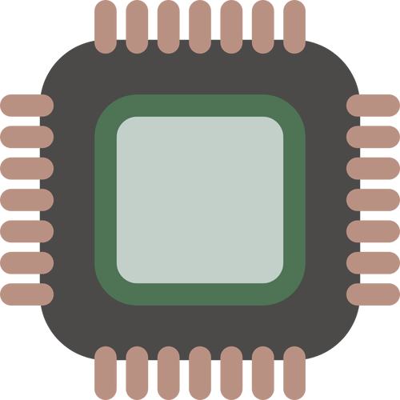
Parallel Worker Threads
parallel workers
direct execution
syscall interposition
syscall emulation
IPC
process control
CPU affinity
Goal: efficiently parallelize simulation workload
Sim Controller Process
Virtual hosts and processes
One thread per host
LP
LP
LP
LP
Logical processors (avoid CPU oversubscription)
CPU
CPU
CPU
CPU
Physical processors

Slide 21
Parallel Worker Threads
parallel workers
direct execution
syscall interposition
syscall emulation
IPC
process control
CPU affinity
Goal: efficiently parallelize simulation workload
Thread scheduling:
Work stealing
Each LP starts a thread
Runs all assigned events in current round (1 ms)
Set thread to waiting
Starts next waiting thread (if any)
When all threads waiting
Advance round clock
Repeat
Sim Controller Process
Virtual hosts and processes
One thread per host
LP
LP
LP
LP
Logical processors (avoid CPU oversubscription)
CPU
CPU
CPU
CPU
Physical processors

Slide 22
Direct Execution
parallel workers
direct execution
syscall interposition
syscall emulation
IPC
process control
CPU affinity
Sim Controller Process
Linux Kernel Syscall API
Linux Kernel, Devices, Network

Slide 23
Direct Execution
parallel workers
direct execution
syscall interposition
syscall emulation
IPC
process control
CPU affinity
LD_PRELOAD=shim.so
IPC=“ipc.shm”
vfork() + execvpe()
App Process
Sim Controller Process
Injected shim.so library
Linux Kernel Syscall API
Linux Kernel, Devices, Network

Slide 24
Direct Execution
parallel workers
direct execution
syscall interposition
syscall emulation
IPC
process control
CPU affinity
Attach to “ipc.shm” for IPC
App Process
Sim Controller Process
IPC
Injected shim.so library
Linux Kernel Syscall API
Linux Kernel, Devices, Network

Slide 25
Direct Execution
parallel workers
direct execution
syscall interposition
syscall emulation
IPC
process control
CPU affinity
App is running and can communicate with controller
App Process
Sim Controller Process
IPC
Injected shim.so library
Linux Kernel Syscall API
Linux Kernel, Devices, Network

Slide 26
Syscall Interposition
parallel workers
direct execution
syscall interposition
syscall emulation
IPC
process control
CPU affinity
Linked libraries
Linked libraries
Application Code
Library 1 (e.g. libc)
…
Library N
Lib 0
Controller Code
Controller Libraries
Injected shim.so library
Linux Kernel Syscall API
Linux Kernel, Devices, Network

Slide 27
Syscall Interposition
parallel workers
direct execution
syscall interposition
syscall emulation
IPC
process control
CPU affinity
1. Intercept libcalls (LD_PRELOAD)
Application Code
Library 1 (e.g. libc)
…
Library N
Lib 0
Controller Code
Controller Libraries
Injected shim.so library
Linux Kernel Syscall API
Linux Kernel, Devices, Network

Slide 28
Syscall Interposition
parallel workers
direct execution
syscall interposition
syscall emulation
IPC
process control
CPU affinity
1. Intercept libcalls (LD_PRELOAD)
Application Code
Library 1 (e.g. libc)
…
Library N
Lib 0
Controller Code
Controller Libraries
Injected shim.so library
Linux Kernel Syscall API
Linux Kernel, Devices, Network
2. Intercept syscalls (seccomp)

Slide 29
Syscall Interposition
parallel workers
direct execution
syscall interposition
syscall emulation
IPC
process control
CPU affinity
1. Intercept libcalls (LD_PRELOAD)
Application Code
Library 1 (e.g. libc)
…
Library N
Lib 0
Controller Code
Controller Libraries
Injected shim.so library
Linux Kernel Syscall API
2. Intercept syscalls (seccomp)
Linux Kernel, Devices, Network

Slide 30
Syscall Interposition
parallel workers
direct execution
syscall interposition
syscall emulation
IPC
process control
CPU affinity
1. Intercept libcalls (LD_PRELOAD)
Application Code
Library 1 (e.g. libc)
…
Library N
Lib 0
Controller Code
Controller Libraries
Injected shim.so library
Linux Kernel Syscall API
2. Intercept syscalls (seccomp)
Linux Kernel, Devices, Network

Slide 31
Syscall Emulation
parallel workers
direct execution
syscall interposition
syscall emulation
IPC
process control
CPU affinity
Application Code
Library 1 (e.g. libc)
…
Library N
Lib 0
Controller Code
Controller Libraries
IPC
Injected shim.so library
Linux Kernel Syscall API
File descriptors (files, sockets, pipes)
Event notification (poll, epoll, select)
Networking (buffers, protocols, ifaces)
DNS and routing (latency, bandwidth)
Linux Kernel, Devices, Network

Slide 32
Syscall Emulation
parallel workers
direct execution
syscall interposition
syscall emulation
IPC
process control
CPU affinity
Emulate in Shim
faster
for hotpath syscalls (time)
Application Code
Library 1 (e.g. libc)
…
Library N
Lib 0
Controller Code
Controller Libraries
IPC
Injected shim.so library
Linux Kernel Syscall API
File descriptors (files, sockets, pipes)
Event notification (poll, epoll, select)
Networking (buffers, protocols, ifaces)
DNS and routing (latency, bandwidth)
Linux Kernel, Devices, Network

Slide 33
Syscall Emulation
parallel workers
direct execution
syscall interposition
syscall emulation
IPC
process control
CPU affinity
Emulate in Shim
faster
for hotpath syscalls (time)
Emulate in Controller
slower (IPC overhead)
IPC: syscall args/data
Application Code
Library 1 (e.g. libc)
…
Library N
Lib 0
Controller Code
Controller Libraries
IPC
Injected shim.so library
Linux Kernel Syscall API
File descriptors (files, sockets, pipes)
Event notification (poll, epoll, select)
Networking (buffers, protocols, ifaces)
DNS and routing (latency, bandwidth)
Linux Kernel, Devices, Network

Slide 34
Inter-Process Communication
parallel workers
direct execution
syscall interposition
syscall emulation
IPC
process control
CPU affinity
App Process
Injected shim.so library
IPC
Sim Controller Process

Slide 35
Inter-Process Communication
parallel workers
direct execution
syscall interposition
syscall emulation
IPC
process control
CPU affinity
App Process
Injected shim.so library
shared memory
Sim Controller Process

Slide 36
Inter-Process Communication
parallel workers
direct execution
syscall interposition
syscall emulation
IPC
process control
CPU affinity
App Process
Shared memory + semaphores is the fastest IPC method for two processes running on
the same core
Injected shim.so library
shared memory
Sim Controller Process

Slide 37
Inter-Process Communication
parallel workers
direct execution
syscall interposition
syscall emulation
IPC
process control
CPU affinity
App Process
1. Fixed-size control block
Injected shim.so library
syscall registers
semaphores
shared memory
simulation time
Sim Controller Process

Slide 38
Inter-Process Communication
parallel workers
direct execution
syscall interposition
syscall emulation
IPC
process control
CPU affinity
App Process
1. Fixed-size control block
Injected shim.so library
syscall registers
semaphores
shared memory
simulation time
app stack
app heap
Sim Controller Process
2. remap app memory to directly read/write data buffers

Slide 39
Inter-Process Communication
parallel workers
direct execution
syscall interposition
syscall emulation
IPC
process control
CPU affinity
App Process
1. Fixed-size control block
Injected shim.so library
syscall registers
semaphores
shared memory
simulation time
app stack
app heap
Sim Controller Process
2. remap app memory to directly read/write data buffers

Slide 40
Process Control
parallel workers
direct execution
syscall interposition
syscall emulation
IPC
process control
CPU affinity
App Process
Injected shim.so library
syscall registers
semaphores
shared memory
simulation time
app stack
app heap
Sim Controller Process

Slide 41
Process Control
parallel workers
direct execution
syscall interposition
syscall emulation
IPC
process control
CPU affinity
App Process
Write syscall registers
Signal controller semaphore
Wait on app semaphore
Injected shim.so library
syscall registers
semaphores
shared memory
simulation time
app stack
app heap
Sim Controller Process

Slide 42
Process Control
parallel workers
direct execution
syscall interposition
syscall emulation
IPC
process control
CPU affinity
App Process
Write syscall registers
Signal controller semaphore
Wait on app semaphore
Injected shim.so library
syscall registers
semaphores
shared memory
simulation time
app stack
app heap
Sim Controller Process
Read syscall registers
Return if nonblocking else leave app idle and return when ready
Signal app semaphore
Wait on controller semaphore

Slide 43
Process Control
parallel workers
direct execution
syscall interposition
syscall emulation
IPC
process control
CPU affinity
Properties:
Controller worker thread and its app process run synchronously
Ensures nonconcurrent access to app stack and heap memory
App Process
Write syscall registers
Signal controller semaphore
Wait on app semaphore
Injected shim.so library
syscall registers
semaphores
shared memory
simulation time
app stack
app heap
Sim Controller Process
Read syscall registers
Return if nonblocking else leave app idle and return when ready
Signal app semaphore
Wait on controller semaphore

Slide 44
Process Control
parallel workers
direct execution
syscall interposition
syscall emulation
IPC
process control
CPU affinity
Use CPU pinning to pin each worker thread and all of its managed processes to the same core
App Process
Injected shim.so library
shared memory
Sim Controller Process

Slide 45
Outline
motivation
design
evaluation

Slide 46
Evaluation: Large P2P Benchmarks
Faster and more scalable than the uni-process, plugin architecture!
Uses significantly less memory than the uni-process, plugin architecture!

Slide 47
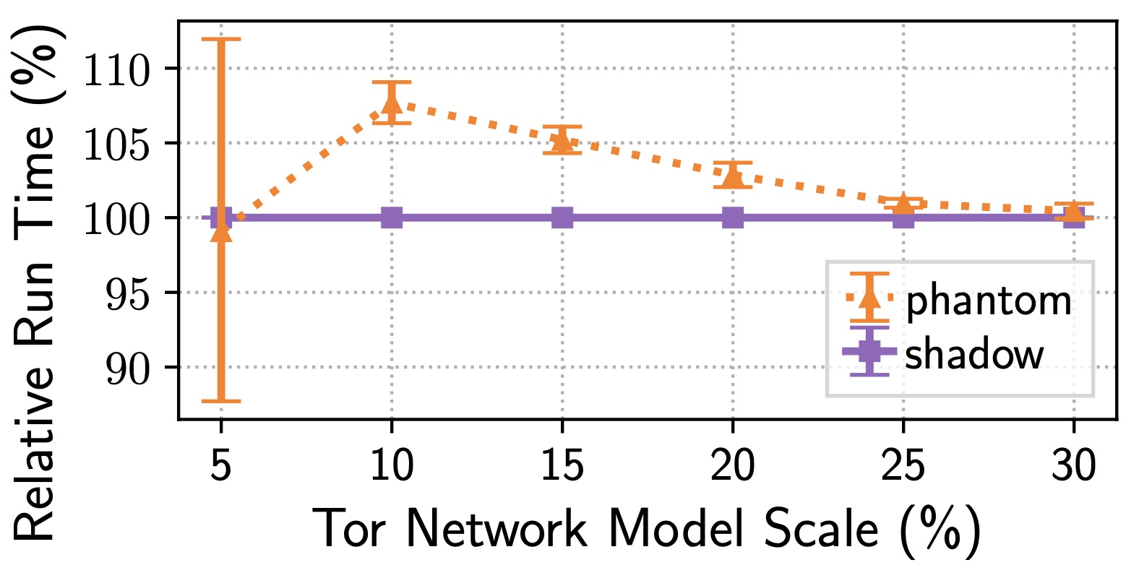
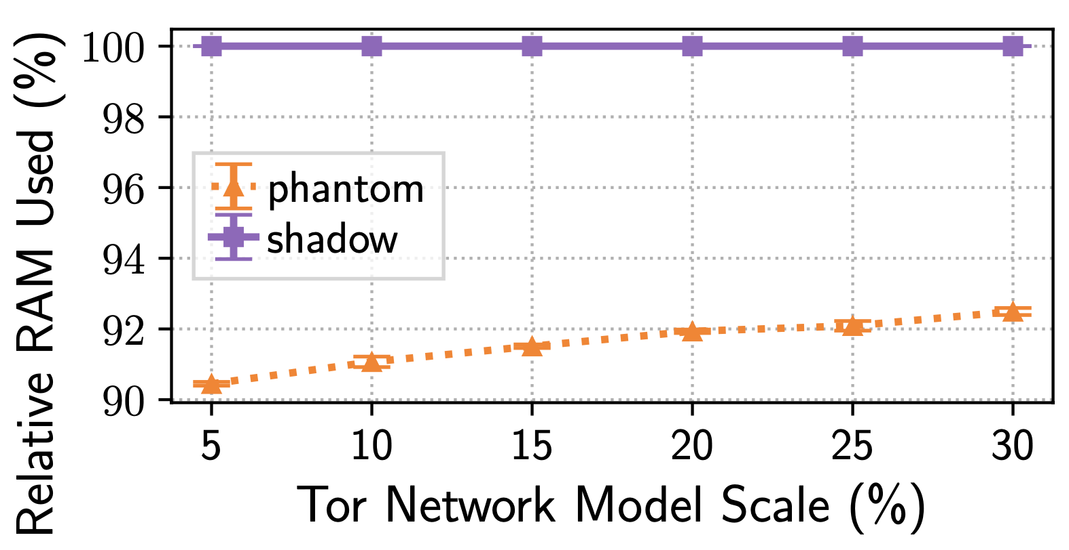
Evaluation: Large Tor Networks
Performance comparable to the state of the art for large Tor networks
Uses significantly less memory than the uni-process, plugin architecture!

Slide 48
Main Takeaways
Read the paper!
shadow.github.io
Designed a new, hybrid network simulator/emulator
co-opts Linux processes into a discrete-event network simulation that emulates kernel functionality
enables large-scale, distributed system experiments
Merged into the open-source Shadow project and synonymous with Shadow v2
Artifacts: https://netsim-atc2022.github.io
2.3x faster than Shadow v1
3.4x faster than NS-3
43x faster than gRaIL [ToN’19]
Runtime (s)

