Slide 1
A Measurement of Genuine Tor Traces for Realistic Website Fingerprinting
Rob Jansen, U.S. Naval Research Laboratory
Ryan Wails, Georgetown University
Aaron Johnson, U.S. Naval Research Laboratory
Rob Jansen, PhD
Computer Scientist
Center for High Assurance Computer Systems
U.S. Naval Research Laboratory
The Passive and Active Measurement Conference 2026 Virtual Event
March 25th, 2026

Slide 2






Anonymous Communication with Tor
Separates identification from routing
Provides unlinkable communication
Promotes user safety and privacy online

Slide 3
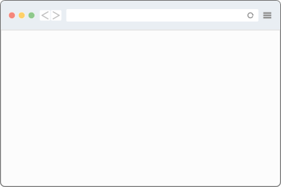
Website Fingerprinting Adversary Model
Website fingerprinting (WF) attacks can link a source to its destination, breaking Tor’s anonymity
Adversary can:
Obtain entry-side vantage point
Observe traffic patterns
Predict website visited by user using a trained ML model
foo.com
foo.com
unlabeled entry pattern
ML model
predicted website label

Slide 4
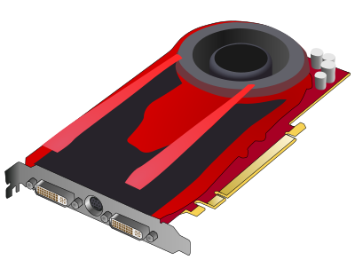
How Might Adversary Train ML Models?
Non-option: use entry examples
Need labeled examples of patterns
Onion-encryption hides labels
Observed examples are unlabeled
foo.com
unlabeled entry patterns
training
trained
ML model

Slide 5
How Might Adversary Train ML Models?
Option 1: synthetic data
Use automated browser (selenium) to replicate users’ behavior/diversity
Usually by crawling frontpages of top sites…
Problems
Modeling WF with synthetic user data oversimplifies the ML task [CCS’14, USENIX’22, PoPETs’23]
Browser version, configuration
URL choice, fetch order, usage of tabs
# of sites/pages, world size dynamics
Geo-location, concept drift
Tor network variation: relay churn, software versions, congestion, location…
foo.com
labeled entry patterns
training
trained
ML model

Slide 6
How Might Adversary Train ML Models?
Option 2: real Tor user data
Run exit relay, observe traffic [USENIX’22]
Traffic patterns from real Tor users
Website labels observed in DNS requests
Problems
Study done in online setting [USENIX’22]
Data was not persistently stored
Results cannot be replicated
Difficult to build on the methodology without new measurements
Exit-entry position mismatch
Train on exit side, predict on entry side
Position “distortion” reduces performance
5-18% [USENIX’22]
17% median, 93% worse-case [WPES’24]
foo.com
labeled exit patterns
training
trained
ML model

Slide 7
Our Research Direction: Key Insights
 | Synthetic client | Real Tor exit
Ground-truth labels
Entry-side examples
Real Tor user data
Key insights:
If adversary would test on real user data, they should train on it too
The real network is the best place to get traffic patterns of real users
Easier to mitigate entry-exit distortion than accurately replicate users
Now mitigated with exit→entry transducers:
Retracer: using network simulation [WPES’24]
CellShift: using cell RTTs and math [NDSS’26]
foo.com
labeled exit patterns
training
trained
ML model

Slide 8
Our Research Direction: Key Insights
 | Synthetic client | Real Tor exit
Ground-truth labels
Entry-side examples
Real Tor user data
Key insights:
If adversary would test on real user data, they should train on it too
The real network is the best place to get traffic patterns of real users
Easier to mitigate entry-exit distortion than accurately replicate users
Now mitigated with exit→entry transducers:
Retracer: using network simulation [WPES’24]
CellShift: using cell RTTs and math [NDSS’26]
foo.com
transduce
exit→entry
labeled entry patterns
training
trained
ML model

Slide 9
Our Goals in this Work
 | Synthetic client | Real Tor exit
Ground-truth labels
Entry-side examples
Real Tor user data
Goals:
Create a persistent dataset to improve the study of real-world WF
Understand disparities between synthetic datasets and real data
Inform/prioritize WF defenses
Non-Goals:
Develop new WF attacks
Improve attacks to benefit adversary
foo.com
transduce
exit→entry
labeled entry patterns
training
trained
ML model

Slide 10
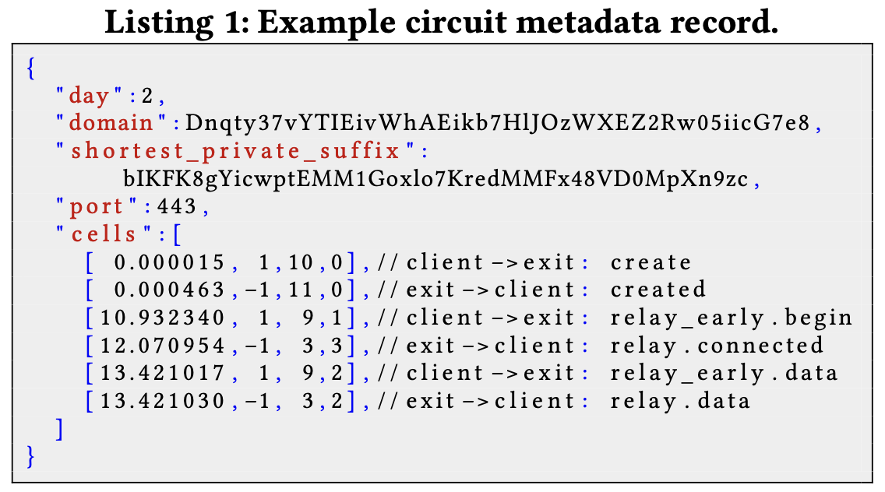
GTT23: A dataset of Genuine Tor Traces
Introducing GTT23
A dataset of genuine Tor traces of real Tor user traffic patterns
13.9M traces to 1.1M unique domains measured over 13 weeks
Measured from Tor exit relays
Traffic traces of normal activities
The first 5,000 cells on a Tor circuit
Natural, real-world website base rates
No PII is recorded, website labels are protected with HMAC
Measurement plan reviewed by IRB, Tor Research Safety Board
foo.com
GTT23: a dataset of
labeled exit patterns

Slide 11
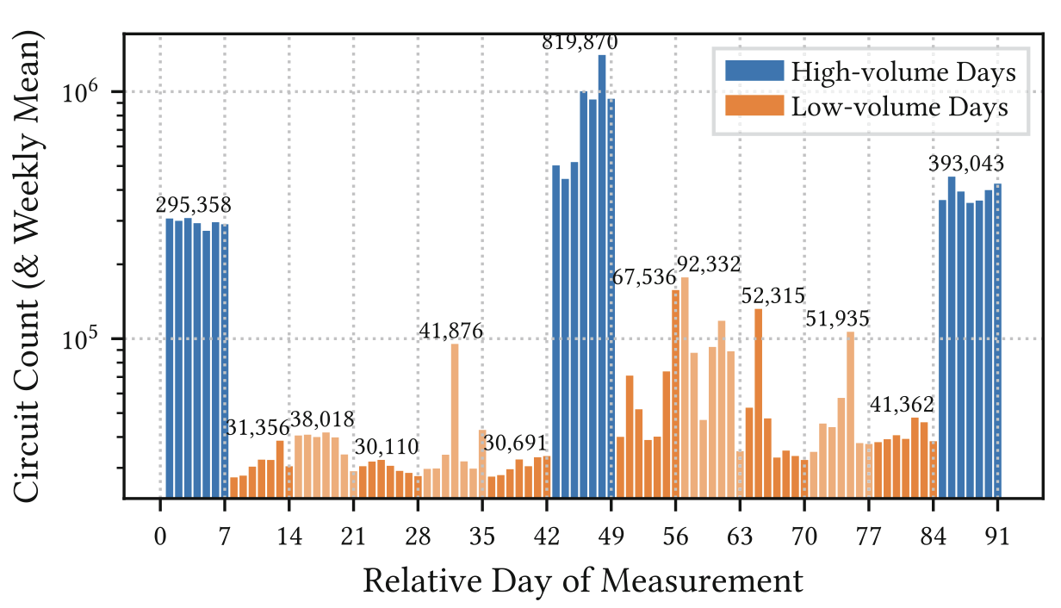
Temporal Composition of GTT23
13.9M traces across the
13 week measurement

Slide 12
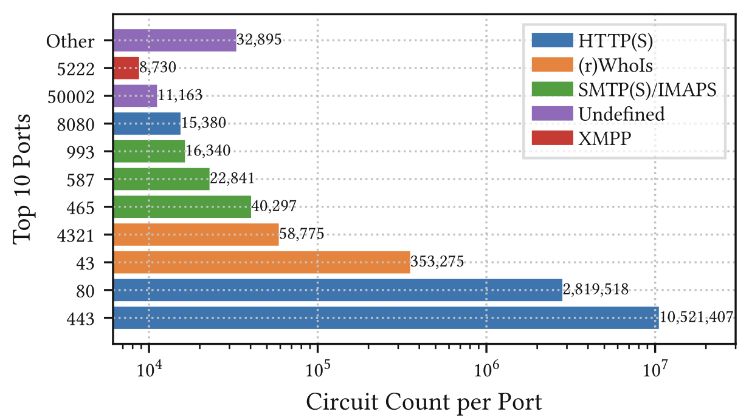
IANA-assigned Service (Port) Composition
68 unique destination
service
ports

Slide 13
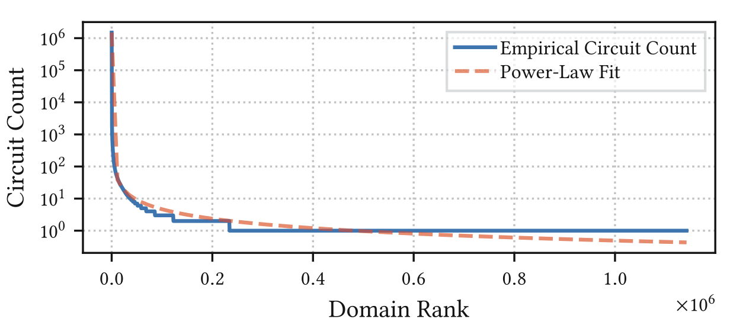
Circuit Count per Domain is Similar to Internet Traffic
1.1M unique destination domains

Slide 14
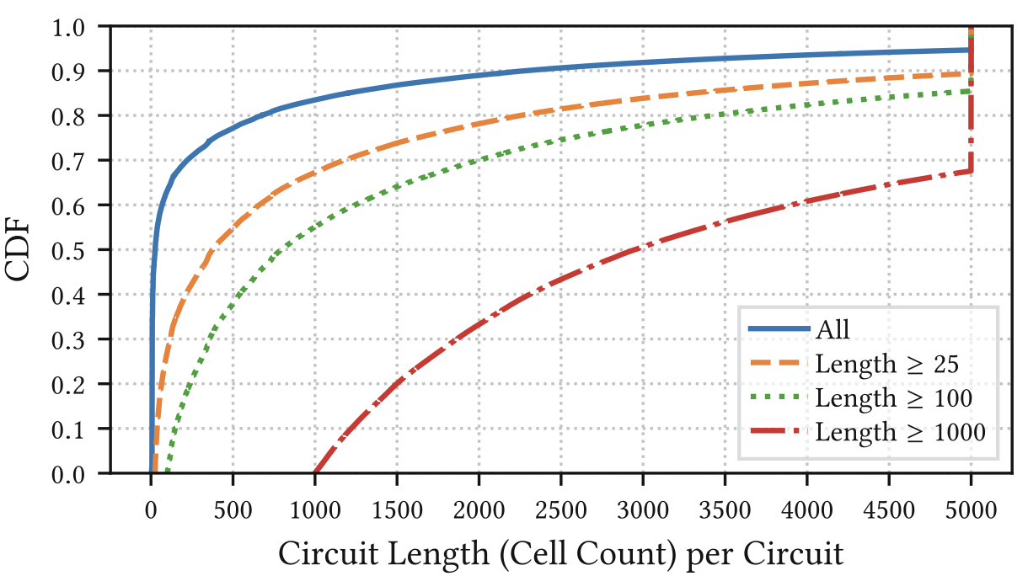
Most Circuits are Much Shorter than Expected
HTTP Archive: 90% of webpages are > 450 KB
Median circuit is 10.5 KB (25 cells)

Slide 15
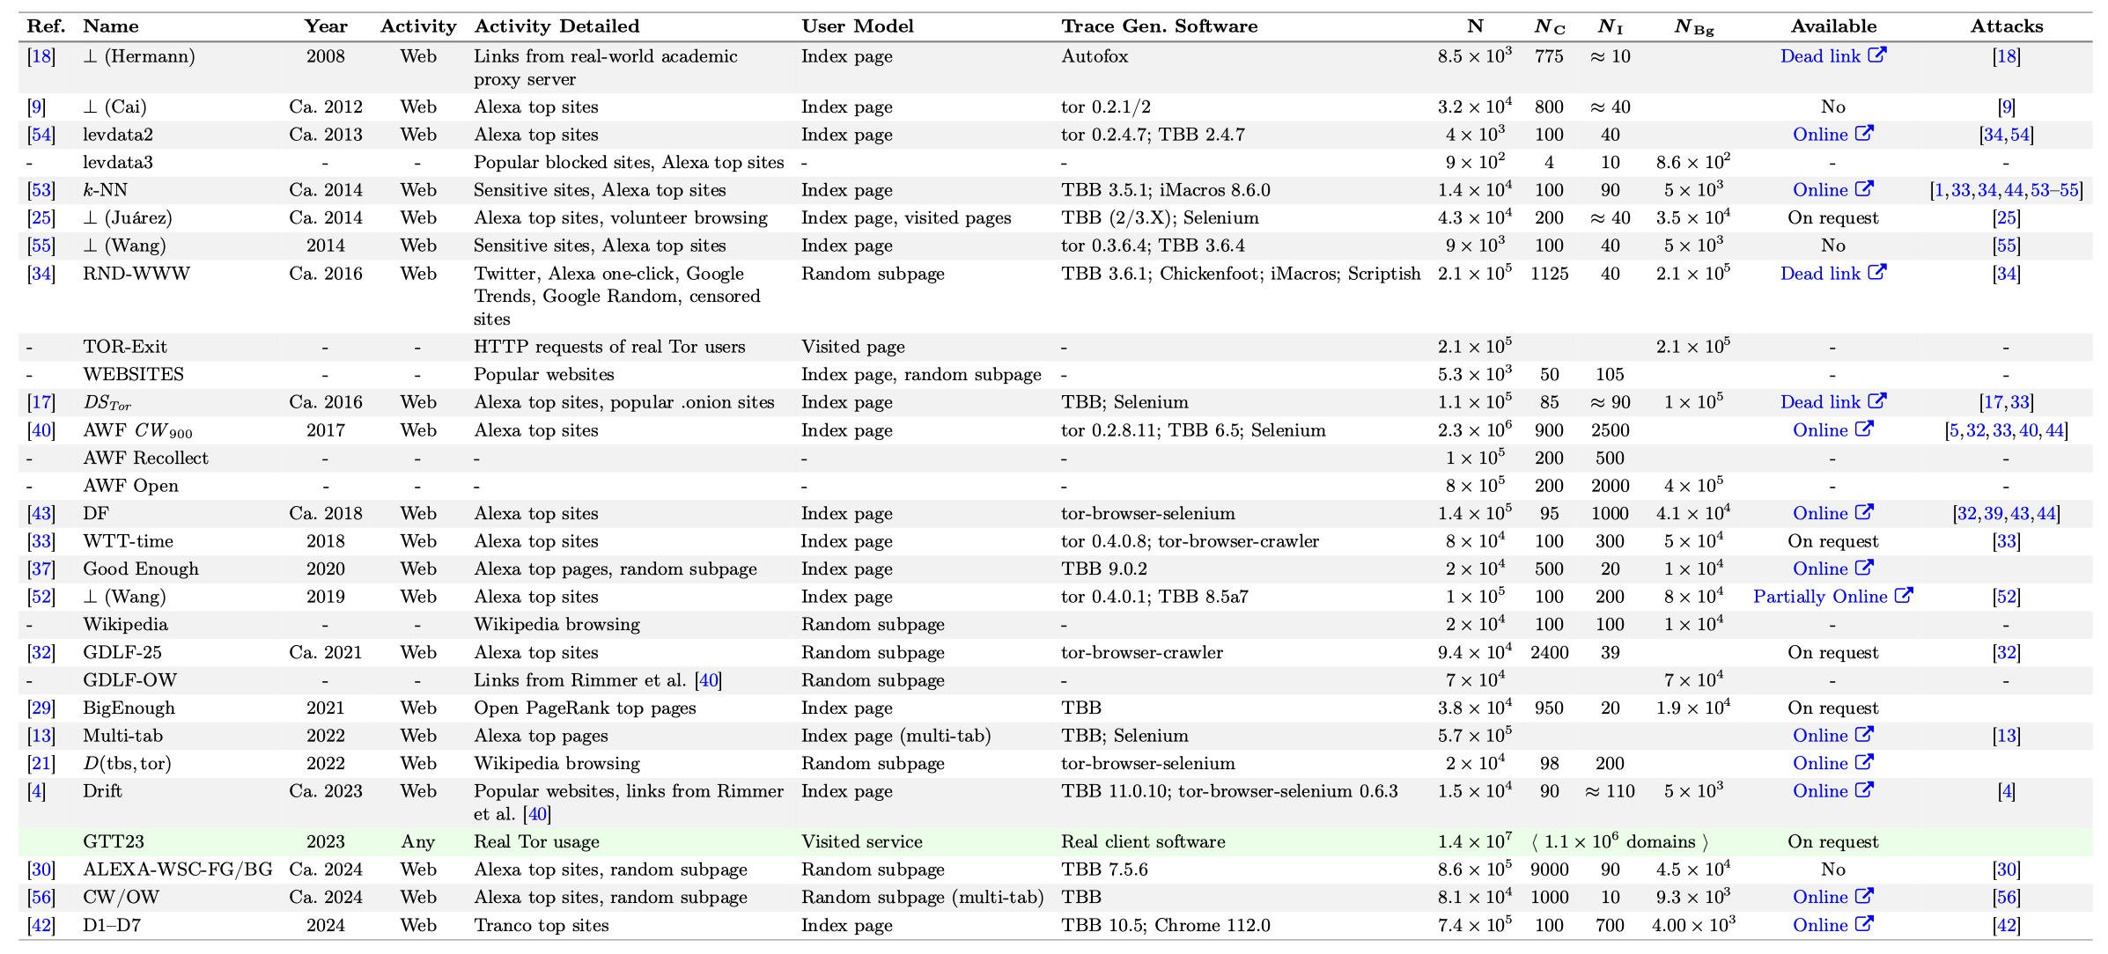
We surveyed 28 WF datasets published since 2008

Slide 16
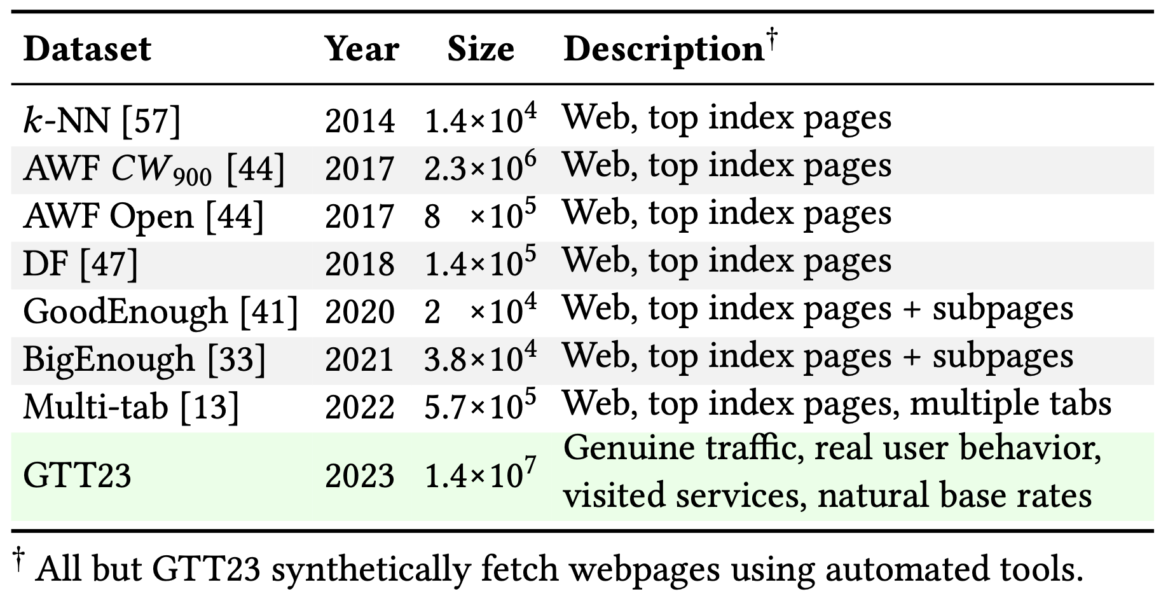
Summary of Comparisons to Synthetic Datasets
Most synthetic datasets contain traces of index pages fetched with automated tools
GTT23 is larger than any existing WF dataset by an order of magnitude
No other WF dataset contains genuine traces of real Tor user behavior

Slide 17
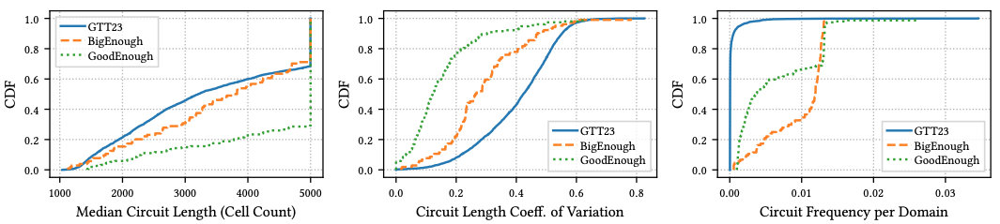
Disparities between GTT23 and Synthetic Datasets
BigEnough and GoodEnough have 10 pages per website
Highest website diversity among synthetic datasets
Compared to GTT23, data is still too homogeneous
Chosen domains are over-represented, traffic variation is still too low

Slide 18


A Measurement of Genuine Tor Traces for Realistic Website Fingerprinting
Read the Paper!
Access the Dataset!
Contributions – GTT23
The first dataset of labeled genuine Tor traces
13.9M traces, 1.1M unique domains, 68 unique ports
An order-of-magnitude larger than existing WF datasets
Analysis of its statistical properties
Analysis of disparities between characteristics of genuine and synthetic datasets
Impact and Future Work
Already has ~30 approved users
E.g., used to study trace transduction [WPES’24, NDSS’26]
Genuine traces could inform the study of:
WF attacks/defenses, end-to-end correlation attacks/defenses, Tor user patterns, Tor performance characteristics, …
Contact: robert.g.jansen7.civ@us.navy.mil robgjansen.com

