Slide 1
Shadow: Real Applications, Simulated Networks
Dr. Rob Jansen
U.S. Naval Research Laboratory
Center for High Assurance Computer Systems
Cyber Modeling and Simulation Technical Working Group
Mark Center, Alexandria, VA
October 25th, 2017

Slide 2

What is Shadow?
Open-source network simulator / emulator hybrid
Directly executes real applications like Tor and Bitcoin over a simulated network topology
Efficient, scalable, deterministic, accurate, and more!

Slide 3
How does Shadow Work?
App
OS Kernel
TCP IP
Internet
App
OS Kernel
TCP IP
App
OS Kernel
TCP IP

Slide 4
How does Shadow Work?
Shadow - OS emulation and network simulation
App
OS Kernel
TCP IP
Internet
App
OS Kernel
TCP IP
App
OS Kernel
TCP IP

Slide 5
Why should you care?
Expedite research and development
Evaluate software mods or attacks without harming real users
Understand holistic effects before deployment
Shadow supports simulation for general-purpose applications

Slide 6
Talk Outline
Experimentation options and tradeoffs
Shadow design
Simulation use cases – The Tor Anonymity Network
Gentle Tor introduction
Congestion problems
Scheduling algorithms
Performance enhancing algorithms
Denial of service attacks
Conclusion

Slide 7
Experimentation Options

Slide 8

Desirable Experiment Properties
Controllable
Scalable
Reproducible
Accurate
Shadow’s design goal

Slide 9
Live Network Experiments
Experimenting in a deployed distributed system
Pros
Most realistic
The target environment
Cons
Hard to manage/debug
Lengthy deployment
Security risks

Slide 10
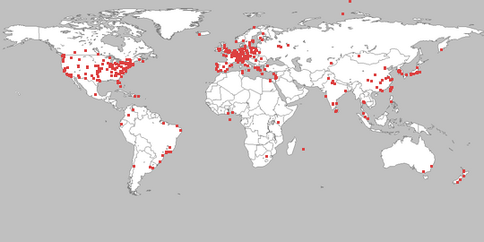
Testbed Network Experiments
Experimenting in a distributed testbed (e.g. PlanetLab)
Pros
Close to target environment
Runs on the Internet or uses Internet protocols
Cons
Hard to manage and debug
Doesn’t scale well in low-resource environs
Can be hard to model network properties

Slide 11

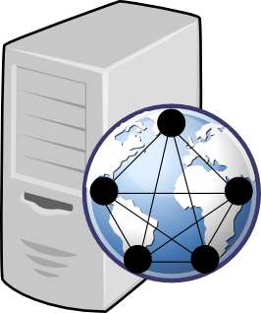
Network Emulation
Experimenting with network emulators (e.g. Modelnet)
Pros
Runs on the target OS and uses Internet protocols
Can model various network properties
Cons
Requires multiple machines and custom installed OS
Must run in real time
Per-process overhead may cause kernel issues

Slide 12
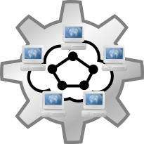
Network Simulation
Experimenting with network simulators (e.g. NS3)
Pros
Deterministic (reproducible)
Can model various network properties
Can scale very well
Cons
Application model can be too abstract
Abstractions can lead to inaccurate results

Slide 13
Simulation vs. Emulation: Realism
Simulation | Emulation
Abstracts away most system components | Runs the real OS, kernel, protocols, applications
Simulator is generally only internally consistent | Software is interoperable with external components
Less resource intensive | More resource intensive

Slide 14
Simulation vs. Emulation: Time
Simulation | Emulation
“As-fast-as-possible” | Real time
Control over clock, can pause time without issue | Time must advance in synchrony with wall-clock
Weak hardware extends total experiment runtime | Weak hardware causes glitches that are difficult to detect and diagnose

Slide 15
Shadow Design

Slide 16
Shadow Overview
Parallel discrete-event network simulator
Models routing, latency, bandwidth
Simulates time, CPU, OS
TCP/UDP, sockets, queuing, threading
Emulates POSIX C API on Linux
Directly executes apps as plug-ins

Slide 17

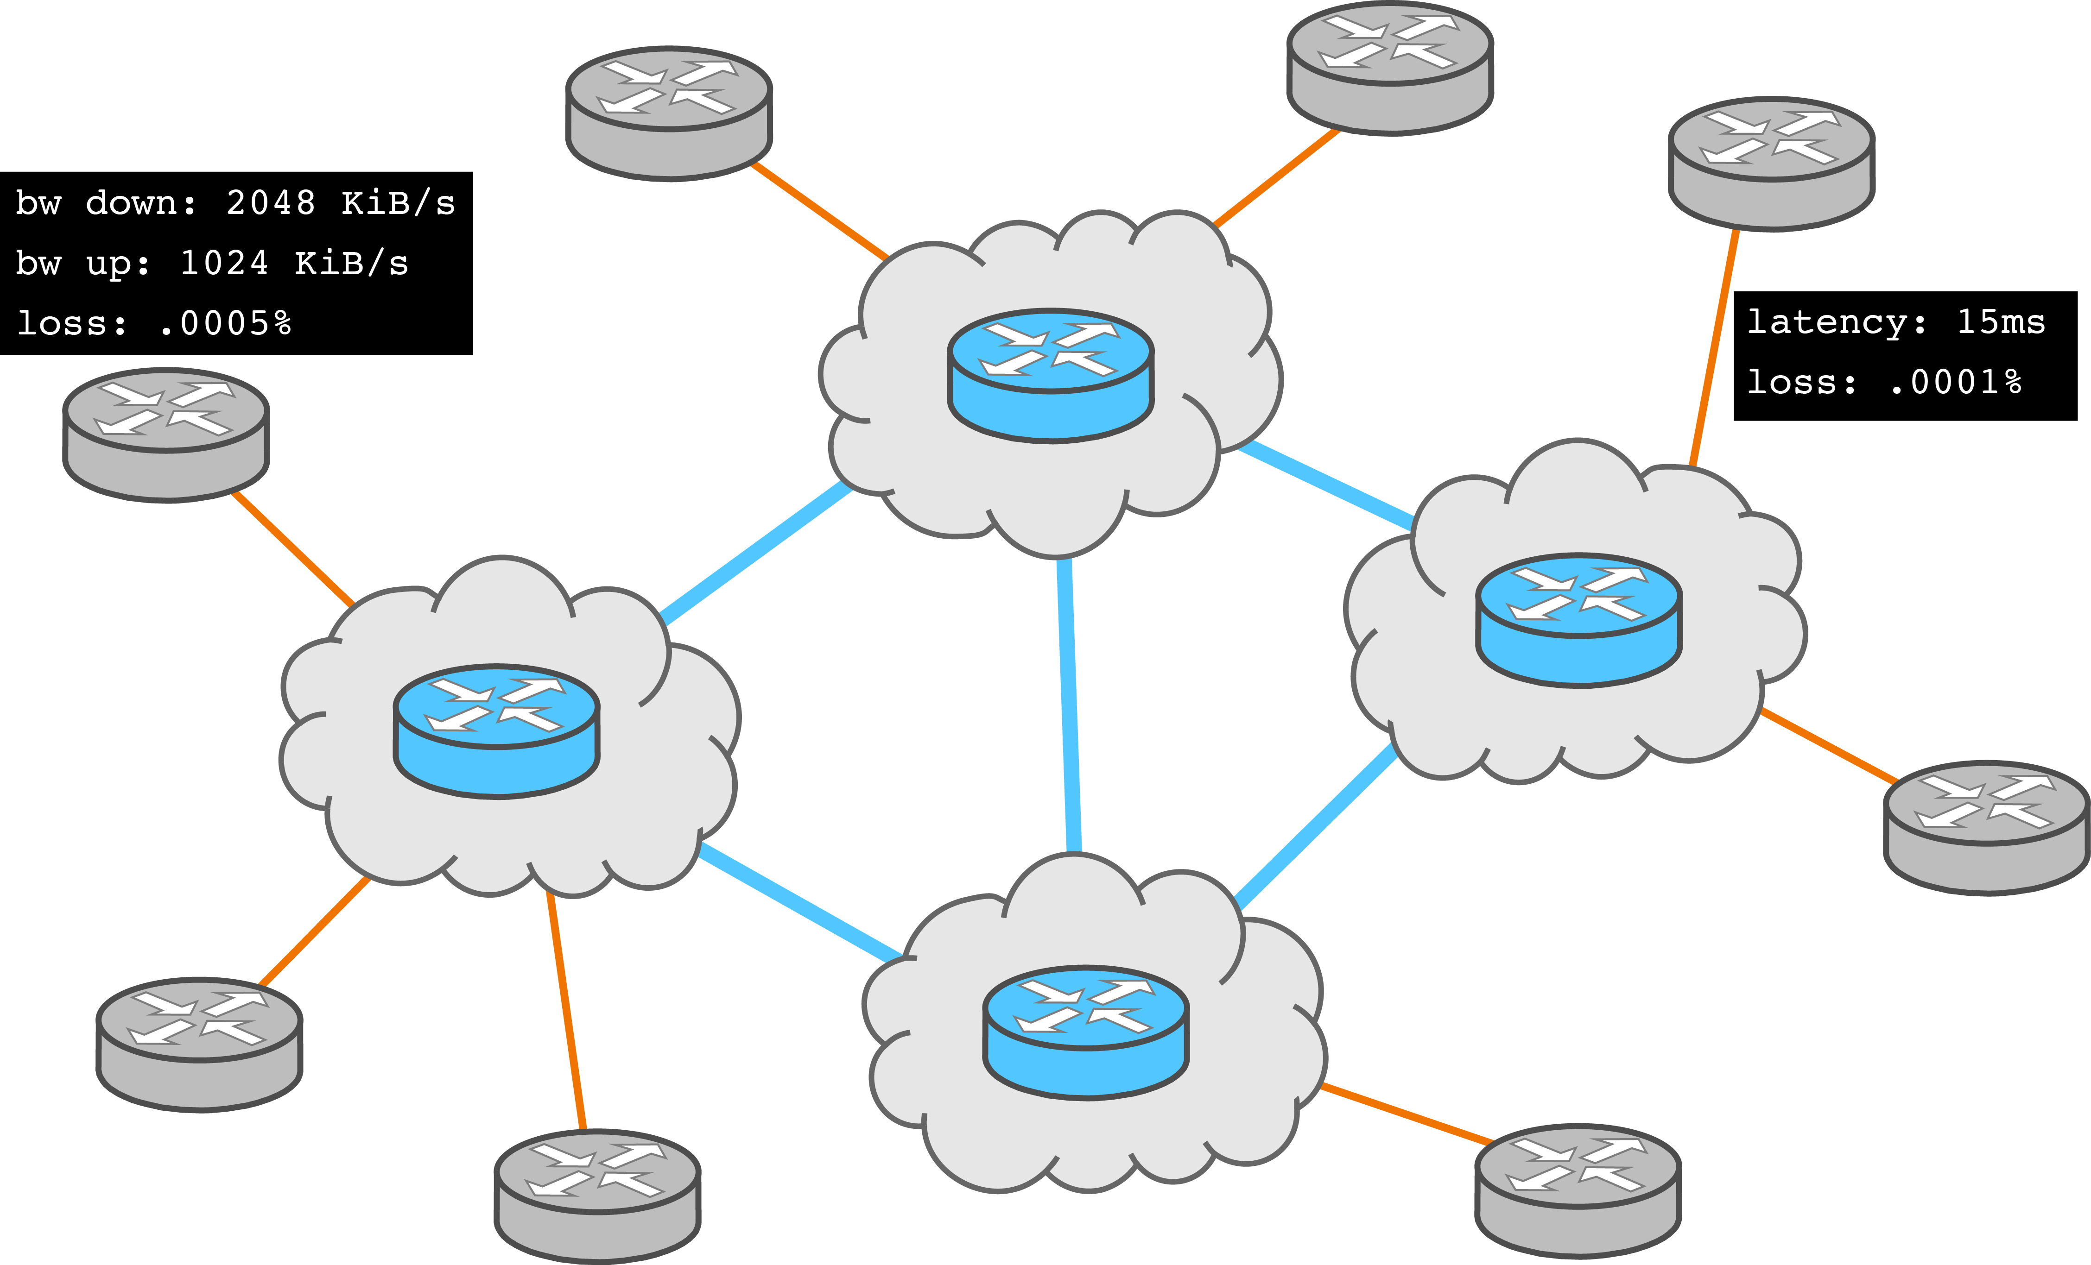
Initializing the Simulation
Load network model, create virtual hosts

Slide 18



Shadow Simulation Layout
Network model
Global simulation clock
Discrete event queue
Shadow worker threads
Virtual hosts
Virtual processes (i.e. namespaces)
Virtual threads
Directly executed software plug-ins

Slide 19
App Memory Management
Apps loaded in independent namespaces, copy-on-write
Namespace 1
Namespace 2
Namespace 3
Library Code (read-only)
Library Data 1
Library Data 2
Library Data 3
Plug-in Code (read-only)
Plug-in Data 1
Plug-in Data 2
Plug-in Data 3

Slide 20
Direct Execution in a Simulator
Namespace 1
Namespace 2
Namespace 3
libc
libc
libc
Shadow – Simulated Linux Kernel Libraries and Network Transport
Function Interposition
Function Interposition
Function Interposition
libc API (send, write, etc.)
libc API
(send, write, etc.)
libc API
(send, write, etc.)
Application
Application
Application

Slide 21
Simulation Use Cases – The Tor Anonymity Network

Slide 22
Gentle Tor Introduction

Slide 23



Tor Overview
Tor: a censorship resistant, privacy-enhancing anonymous communication system
Estimated ~1.75 M. Users/Day (metrics.torproject.org)

Slide 24
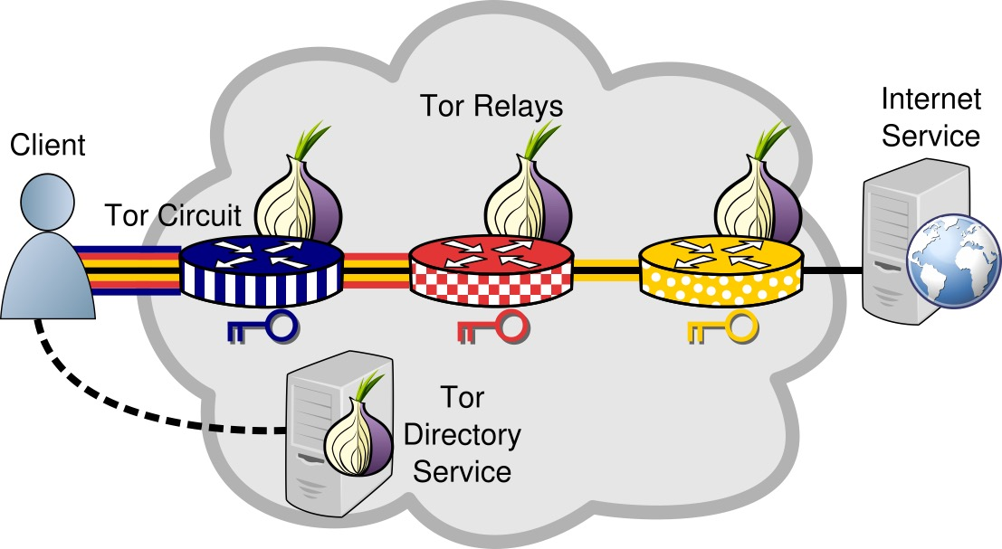
Anonymous Communication

Slide 25
Congestion Analysis

Slide 26

Multiple Hops – Tor is Slower

Slide 27
Buffers in a Tor Relay
Kernel Input
Tor Input
Tor Circuits
Tor Output
Kernel Output

Slide 28
Tracking Congestion in Tor
Track the Unique ID
Unique ID
Unique ID
Track the Unique ID
Kernel Input
Tor Input
Tor Circuits
Tor Output
Kernel Output

Slide 29
Tracking Congestion in Tor
Track the Unique ID
Congestion occurs
almost exclusively in
outbound kernel buffers
Unique ID
Unique ID
Track the Unique ID
Kernel Input
Tor Input
Tor Circuits
Tor Output
Kernel Output

Slide 30
Scheduling Analysis

Slide 31
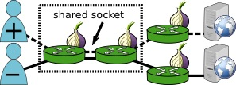
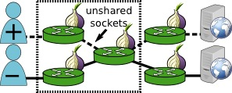
Tor Circuit Priority
Scenarios to understand outbound queue congestion

Slide 32
Tor Circuit Priority
Scenarios to understand outbound queue congestion
Correctly differentiated
No differentiation

Slide 33
Tor Circuit Priority
Scenarios to understand outbound queue congestion
Correctly differentiated
No differentiation
99.775% of any two circuits are unshared

Slide 34
Performance Analysis

Slide 35
Kernel-Informed Socket Transport
Queuing delays in kernel output buffer
Problem 1: Circuit scheduling
Solution:
Don’t handle sockets individually
Process flush requests from all writable sockets
Problem 2: Flushing to sockets – buffer bloat
Solution:
Don’t write if kernel can’t send
Use TCP info to bound kernel writes

Slide 36
Network Simulation with Shadow
Enhanced Shadow with several missing TCP algorithms
CUBIC congestion control
Retransmission timers
Selective acknowledgements (SACK)
Forward acknowledgements (FACK)
Fast retransmit/recovery
Designed largest known private Tor network
3600 relays and 12000 simultaneously active clients
Internet topology graph: ~700k vertices and 1.3m edges
Analyze network-wide effects

Slide 37
KIST Reduces Kernel Congestion

Slide 38
KIST Improves Network Latency

Slide 39
Denial of Service Attacks

Slide 40
The Sniper Attack
Memory-based denial of service (DoS) attack
Exploits vulnerabilities in Tor’s flow control protocol
Can be used to disable arbitrary Tor relays

Slide 41

The Sniper Attack
Start Download
entry
exit
Request

Slide 42
The Sniper Attack
Package and Relay DATA
DATA
Reply
entry
exit
DATA

Slide 43
The Sniper Attack
Stop Reading from Connection
DATA
DATA
R
entry
exit
DATA

Slide 44
The Sniper Attack
Flow Window Closed
DATA
DATA
DATA
R
entry
exit
DATA

Slide 45
The Sniper Attack
DATA
DATA
DATA
R
entry
exit
DATA
Periodically Send SENDME
SENDME

Slide 46
The Sniper Attack
Flow Window Opened
DATA
DATA
DATA
DATA
DATA
DATA
DATA
R
entry
exit
DATA
SENDME

Slide 47
The Sniper Attack
DATA
DATA
DATA
DATA
DATA
Out of Memory, Killed by OS
DATA
DATA
DATA
DATA
DATA
DATA
Flow Window Opened
DATA
DATA
DATA
DATA
DATA
DATA
DATA
DATA
R
entry
exit
DATA
Periodically Send SENDME
SENDME
SENDME

Slide 48
The Sniper Attack: Results
Implemented Sniper Attack Prototype
Control Sybils via the Tor control protocol
Tested in Shadow for safety
Measured:
Victim memory consumption rate
Adversary bandwidth usage
Developed defense, tested in Shadow, merged in Tor

Slide 49
RAM Consumed at Victim

Slide 50
Bandwidth Consumed at Adversary

Slide 51
Speed of the Sniper Attack
 |  | Direct |  | Anonymous
Relay Groups | Select % | 1 GiB | 8 GiB | 1 GiB | 8 GiB
Top Entry | 1.7 | 0:01 | 0:18 | 0:02 | 0:14
Top 5 Entries | 6.5 | 0:08 | 1:03 | 0:12 | 1:37
Top 20 Entries | 19 | 0:45 | 5:58 | 1:07 | 8:56
Top Exit | 3.2 | 0:01 | 0:08 | 0:01 | 0:12
Top 5 Exits | 13 | 0:05 | 0:37 | 0:07 | 0:57
Top 20 Exits | 35 | 0:29 | 3:50 | 0:44 | 5:52
< 1 GiB RAM < 50 KiB/s Downstream BW
< 100 KiB/s Upstream BW
Time (hours:minutes) to Consume RAM

Slide 52
Conclusion

Slide 53
Other Shadow Uses
Tor
Latency and throughput correlation attacks
Denial of Service attacks (sockets, RAM, bandwidth)
Changes to path selection algorithms
Traffic admission control algorithms
Traffic scheduling and prioritization algorithms
Network load balancing algorithms
Process RAM consumption and optimization
Network and memory attacks in Bitcoin
Distributed secure multiparty computation algorithms
Software debugging

Slide 54
Future Shadow Enhancements
Distribute across physical machines
Support for multiple programming languages
Host mobility
Internet routing, network modeling
User behavior modeling
CPU performance modeling
User interface
Support additional applications (HTTP clients/server, bitcoin, etc.)
Improve code stability, documentation, testing, etc.

Slide 55
Questions
Dr. Rob Jansen
U.S. Naval Research Laboratory
Center for High Assurance Computer Systems
rob.g.jansen@nrl.navy.mil
robgjansen.com, @robgjansen
The Shadow Simulator
shadow.github.io
github.com/shadow

