Slide 1
Online Website Fingerprinting: Evaluating Website Fingerprinting Attacks on Tor in the Real World
Distinguished Paper Award, Internet Defense 2nd Prize!
Giovanni Cherubin, Alan Turing Institute Microsoft Research
Rob Jansen, U.S. Naval Research Laboratory
Carmela Troncoso, EPFL SPRING Lab
Rob Jansen, Ph.D.
Computer Security Research Scientist
Center for High Assurance Computer Systems
U.S. Naval Research Laboratory
31st USENIX Security Symposium Boston, MA, USA
August 10th, 2022

Slide 2







How Tor Works
Anonymous Communication and Tor
Separates identification from routing
Provides unlinkable communication
Promotes user safety and privacy online

Slide 3
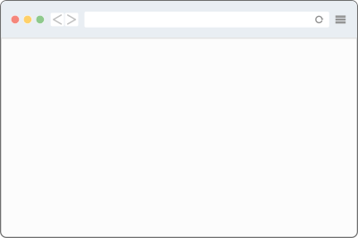


Deanonymizing Tor Users
Website fingerprinting attack
Predict website visited by user
Requires access to entry side only
?
predict website

Slide 4

Deanonymizing Tor Users
Website fingerprinting attack
Predict website visited by user
Requires access to entry side only
Problem:
Need labels to train ML classifiers for website prediction
Genuine labels are encrypted
?
predict website
Encrypted by Tor

Slide 5


Website Fingerprinting Threat Model
Step 1: gather data & labels
Use automated browser (selenium) to crawl websites
xyz.com
xyz.com

Slide 6


Website Fingerprinting Threat Model
Step 1: gather data & labels
Use automated browser (selenium) to crawl websites
xyz.com
Step 2: train ML classifier
Use collected data & labels
xyz.com

Slide 7
Website Fingerprinting Threat Model
Step 1: gather data & labels
Use automated browser (selenium) to crawl websites
xyz.com
Step 2: train ML classifier
Use collected data & labels
xyz.com
cats.com
?
Step 3: deploy against users
Use ML model to predict website
cats.com

Slide 8
Criticisms of Website Fingerprinting Threat Model
Step 1: gather data & labels
Use automated browser (selenium) to crawl websites
Synthetic → too simple & unrealistic!
browser: version, config, location
behavior: URL choice, tabs, order
world: static, small, closed
xyz.com
Step 2: train ML classifier
Use collected data & labels
xyz.com
cats.com
?
Step 3: deploy against users
Use ML model to predict website
cats.com

Slide 9


What is the threat of WF attacks in the real world?
Synthetic model
Overly simple and unrealistic
High ML accuracy in simple model
Genuine model
Consider genuine data & labels from a Tor exit relay
Our new approach
Stop using!!

Slide 10

Key Insight: Exits Observe Genuine Data & Labels
Step 1: gather data & labels
Run a Tor exit relay and use to to collect genuine Tor traffic
Exit can observe:
New circuit
DNS lookup
Website load
Genuine labels: resolved domains
Genuine data: circuit traffic patterns
cats.com?
DNS
198.71.232.3
cats.com
198.71.232.3

Slide 11
Key Insight: Exits Observe Genuine Data & Labels
Step 1: gather data & labels
Run a Tor exit relay and use to to collect genuine Tor traffic
Exit can observe:
New circuit
DNS lookup
Website load
Genuine labels: resolved domains
Genuine data: circuit traffic patterns
Step 2: train ML classifier
Use collected data & labels
cats.com?
DNS
198.71.232.3
cats.com
198.71.232.3

Slide 12
Key Insight: Exits Observe Genuine Data & Labels
Step 1: gather data & labels
Run a Tor exit relay and use to to collect genuine Tor traffic
Exit can observe:
New circuit
DNS lookup
Website load
Genuine labels: resolved domains
Genuine data: circuit traffic patterns
Step 2: train ML classifier
Use collected data & labels
cats.com?
cats.com
DNS
198.71.232.3
?
cats.com
Step 3: deploy against users
Use ML model to predict website
198.71.232.3

Slide 13
Key Insight: Exits Observe Genuine Data & Labels
Benefits
Captures real world diversity of browsers, behavior, world size, choice of pages
Can stop trying to fix the synthetic model
Exit can observe:
New circuit
DNS lookup
Website load
Genuine labels: resolved domains
Genuine data: circuit traffic patterns
cats.com?
cats.com
DNS
198.71.232.3
?
cats.com
198.71.232.3

Slide 14
Key Insight: Exits Observe Genuine Data & Labels
Benefits
Captures real world diversity of browsers, behavior, world size, choice of pages
Can stop trying to fix the synthetic model
Exit can observe:
New circuit
DNS lookup
Website load
Genuine labels: resolved domains
Genuine data: circuit traffic patterns
cats.com?
cats.com
DNS
198.71.232.3
Caveats
Train at exit, deploy at entry → noise
Domain, not page label
Need safe eval methods
?
cats.com
198.71.232.3

Slide 15
Safe Evaluation using Online Learning
Our safe evaluation plan:
Hash domain labels using keyed HMAC
Never learn true labels
data: (-1,+1,…)
label: HMAC(cats.com)
DNS
cats.com?
cats.com
198.71.232.3

Slide 16
Safe Evaluation using Online Learning
k-nn model
Our safe evaluation plan:
Hash domain labels using keyed HMAC
Never learn true labels
Use online learning
Adapted Triplet Fingerprinting [CCS’19]
Compute means in real time, discard data
Individual data items never stored
1. predict label
HMAC(cats.com)
correct? yes or no
?
2. update k-nn mev
data: (-1,+1,…)
label: HMAC(cats.com)
DNS
triplet feature extractor
cats.com?
cats.com
198.71.232.3

Slide 17
Safe Evaluation using Online Learning
k-nn model
Our safe evaluation plan:
Hash domain labels using keyed HMAC
Never learn true labels
Use online learning
Adapted Triplet Fingerprinting [CCS’19]
Compute means in real time, discard data
Individual data items never stored
Other safety precautions
Never deanonymizes Tor users
Destroyed models, HMAC key after eval
Tor Safety Board reviewed plan
See paper for details!
1. predict label
HMAC(cats.com)
correct? yes or no
?
2. update k-nn mev
data: (-1,+1,…)
label: HMAC(cats.com)
DNS
triplet feature extractor
cats.com?
cats.com
198.71.232.3

Slide 18
Evaluation
Train and evaluate at exit relay
No noise from transferring to entry
Upper bound on attack accuracy
Details
1 week evaluation
3.9M data sequences, 671k unique sites
Multi-class classification
predict a monitored site, or ‘unmonitored’
Performance metric
instant accuracy (i.e., moving average)
# correct / # total predictions (10k window)

Slide 19
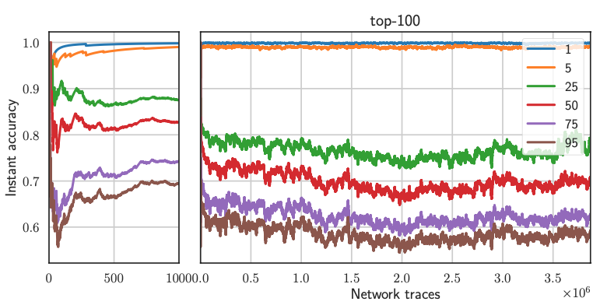
Evaluation
Train and evaluate at exit relay
No noise from transferring to entry
Upper bound on attack accuracy
Details
1 week evaluation
3.9M data sequences, 671k unique sites
Multi-class classification
predict a monitored site, or ‘unmonitored’
Performance metric
instant accuracy (i.e., moving average)
# correct / # total predictions (10k window)

Slide 20

Evaluation
accuracy above 95% when monitoring $≤$ 5 sites
Train and evaluate at exit relay
No noise from transferring to entry
Upper bound on attack accuracy
Details
1 week evaluation
3.9M data sequences, 671k unique sites
Multi-class classification
predict a monitored site, or ‘unmonitored’
Performance metric
instant accuracy (i.e., moving average)
# correct / # total predictions (10k window)

Slide 21
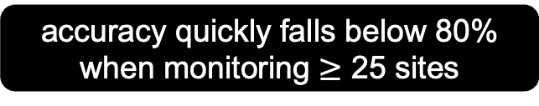
Evaluation
accuracy above 95% when monitoring $≤$ 5 sites
Train and evaluate at exit relay
No noise from transferring to entry
Upper bound on attack accuracy
Details
1 week evaluation
3.9M data sequences, 671k unique sites
Multi-class classification
predict a monitored site, or ‘unmonitored’
Performance metric
instant accuracy (i.e., moving average)
# correct / # total predictions (10k window)
accuracy quickly falls below 80% when monitoring $≥$ 25 sites

Slide 22
Genuine vs. Synthetic Data
Offline phase
Crawl ‘synthetic’ list of domains
Synthetic: use crawl to train a classifier offline
Online phase
Train two classifiers online
Hybrid: update copy of synthetic classifier with genuine data
Real: train new classifier on genuine data only
1 week evaluation
1.2M data sequences
observed 183 of 1,074 ‘synthetic’ domains
Binary classification
monitored set contains 5 sites
predict either ‘monitored’ or ‘unmonitored’

Slide 23
Genuine vs. Synthetic Data
Offline phase
Crawl ‘synthetic’ list of domains
Synthetic: use crawl to train a classifier offline
Online phase
Train two classifiers online
Hybrid: update copy of synthetic classifier with genuine data
Real: train new classifier on genuine data only
1 week evaluation
1.2M data sequences
observed 183 of 1,074 ‘synthetic’ domains
Binary classification
monitored set contains 5 sites
predict either ‘monitored’ or ‘unmonitored’
synthetic classifier performs poorly against genuine data

Slide 24
Genuine vs. Synthetic Data
synthetic data does not improve model over genuine data
Offline phase
Crawl ‘synthetic’ list of domains
Synthetic: use crawl to train a classifier offline
Online phase
Train two classifiers online
Hybrid: update copy of synthetic classifier with genuine data
Real: train new classifier on genuine data only
1 week evaluation
1.2M data sequences
observed 183 of 1,074 ‘synthetic’ domains
Binary classification
monitored set contains 5 sites
predict either ‘monitored’ or ‘unmonitored’
synthetic classifier performs poorly against genuine data

Slide 25
Training and Testing on Opposite Ends
Fully synthetic evaluation
Crawled 1k URLs 10x each
Pinned entry and exit on each circuit
Collected data sequences in both positions on each circuit
Closed-world batch classification
50%-50% train-test split
Monitored set size: | 5 | 50 | 750
Train and test on exit | 91.2% | 76.2% | 52.2%
Train on exit, test on entry | 86.4% | 65.1% | 34.1%
Loss in accuracy: | 4.8% | 11.1% | 18.1%
loss in accuracy is low for feasible (i.e. small) monitored sets

Slide 26


Main Takeaways
Insights
WF can be feasible with genuine data and small monitored sets, online learning can mitigate concept drift
Synthetic data is not useful when the adversary deploys in the real world
Simple defenses may be more effective than we thought
Adversary has to simulate defense on top of undefended exit data
Contact
rob.g.jansen@nrl.navy.mil
robgjansen.com
@robgjansen
Future Research Areas
Improve accuracy when training on genuine data
Reduce distortion when transferring models from exit to entry
Defenses that make it harder to learn from genuine data, increase distortion
Read the paper!

