Slide 1
iGaming Data – Integrity and Security
Jeff Allen, Bally Technologies, Inc.

Slide 2

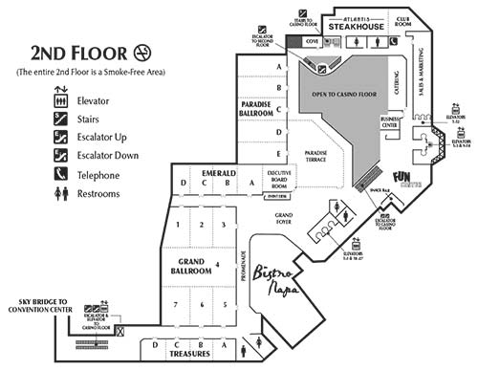



Land-Based Data & Virtual Data
=
Content
iGaming Platform
SMS/CMS

Slide 3

What Data Are We Talking About?
=
Content
iGaming Platform
SMS/CMS
Name
Email
Address
Phone
Bonuses
Deposits
Activity
Performance
Players
Transactions
Exceptions
Registrations
Deposits
Withdrawals
Revenue

Slide 4
Data Integrity and Security Is Important
There are regulatory requirements, so you have to do it!
Well designed systems employ strong data integrity and security architecture!
It’s your data and it’s very valuable, it should be secure!

Slide 5
Examples of Regulatory Requirements
Some excerpts from gaming regulations related to security and integrity of data ……
Must log to protect against loss of irrecoverable customer data...
Must backup all critical data to allow recovery in event of interruption…
Must encrypt sensitive data when passed over communication lines…
Must have an internal control operational security plan…
Must use message authentication for critical messages…
Must use an application-level firewall for gaming platform connections…
Must use SSL and security certificates for player authentication…
Must use an approved method for critical file authentication (MD5)…

Slide 6
Addressing Data Integrity and Security
Common Ways Integrity and Security Requirements Are Addressed……
Protecting Access to Player and Game Critical and Sensitive Information
Protecting Data Through Encryption
Protecting Credit Card and Payment Information
Protecting Against System Failures and Post-Failure Recovery
Protecting Against Theft of Your Proprietary Information
Implementing an Operational Security Plan

Slide 7
Thank You

