Slide 1
Internet Gaming – Getting Ready
Southern Gaming Summit
May 8, 2013
Kevin L. Buntrock, Business Affairs

Slide 2
Who Are Your Online Players?
The Internet player is not your customer in the casino now.
Internet players are: younger, connected and mobile
100 million Americans play games on a smartphone, tablet, or similar device
Games are the most popular mobile app category
Did you know? By 2015, more people will surf the web on their phones than on their desktop computers.

Slide 3
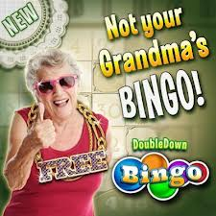
Why Do Players Play Online?
A new generation of players seeks a more complex mix of play experiences
Influenced by online/mobile games and by personal gaming devices
Types of play experiences players seek:
Downtime play
Skills play
Social play
Thrilling play
Players crave a “balanced diet”
When games at hand do not satisfy, people seek ways to augment or convert available experiences into new ones

Slide 4
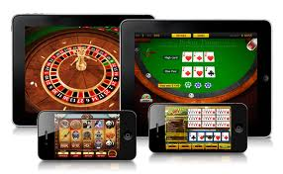
What Can You Do Right Now?
Increase your on-line presence:
Offer a social casino site
Offer online “play for free” games
Given player habits, an
effective online strategy
is essential - whether or not real
money Igaming is a possibility.

Slide 5
Play for Free-your own site
Considerations
Upfront capital costs-ongoing costs
Need to create liquidity
You are on an island, you need to gather liquidity to make your site exciting
Limited game content
Perhaps best choice if real money IGaming is imminent
All players are yours, data exclusive

Slide 6
Social Gaming Site
Instant liquidity, millions of other players for your customer
More game choices and options for your customer
Social component for your customer(s)
No upfront costs/fees, minimal operating costs
Possible revenue share in Social gaming model
The more popular the more exciting the experience the longer the player stays, the better the marketing opportunity

Slide 7
Social Gambling Growth
Social casinos are an estimated $2.1B industry growing to $2.7B by 2015 (13% CAGR)
Since 2010, the number of social gamers who play casino games has doubled (173MM today)
In the US there are 35.4MM monthly social casino players
Today North America represents 41% ($863MM) of the $2.1B worldwide social casino market

Slide 8

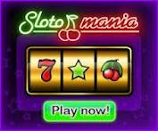
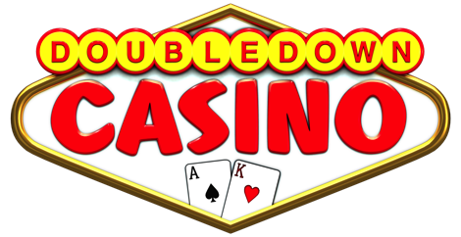



Social Gaming Has Slots Appeal
Slot games are big on Facebook
Facebook Daily Active Users
Slingo by Zynga – 2.9mm
Slotomania by Caesars – 2.1mm
DoubleDown Casino by IGT – 1.5mm
Games By GSN Game Show Network – 1.3mm
Lucky Slots by Blue Shell Games – 840,000
Source: AppData.com (as of 9/19/12)

Slide 9
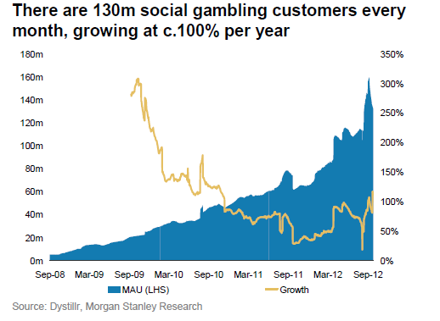
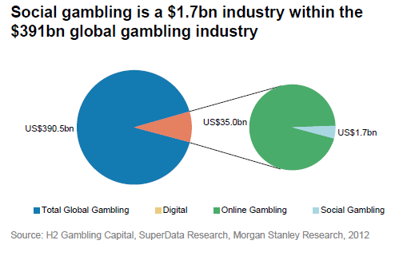
Social Casino Market

Slide 10
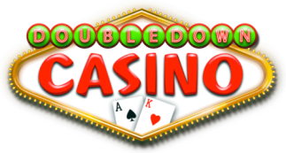
Customer Business Value
Reach, Retention & Revenue
Great opportunity to leverage the social gaming segment together with the leading social gaming experts. A turn key social media solution.
Significant benefits
Build an online community - Reach
Get your players engaged even when they are not on your floor
Top Marketing Tool - Retain
Use the Double Down casino to retain users on your site for upwards of 29 minutes per day
With customers playing on your site, expose them to key marketing messages and cross promotions instantly
Take advantage of the perfect stage to launch new products and services
Gain social media experience
Market and promote to your audience
A unique opportunity to capture player behavior
No fees to IGT – Free service - Revenue
Plus revenue share from virtual currency purchases

Slide 11
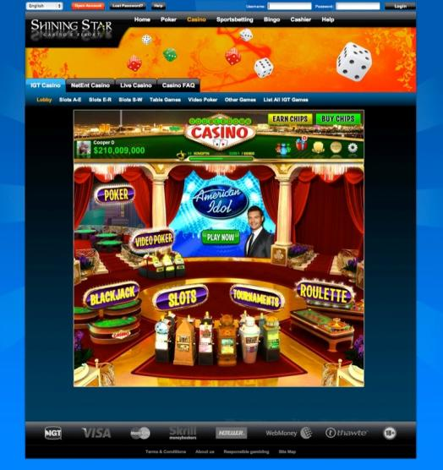
Your Web Page, Your Messages, Your Customer
Upcoming events
Book a room
Specials
Recent winners

