Slide 1
iGaming Landbased Operators Survey
Presented by:
Paul Girvan
Managing Director
The Innovation Group
New Orleans
2013

Slide 2
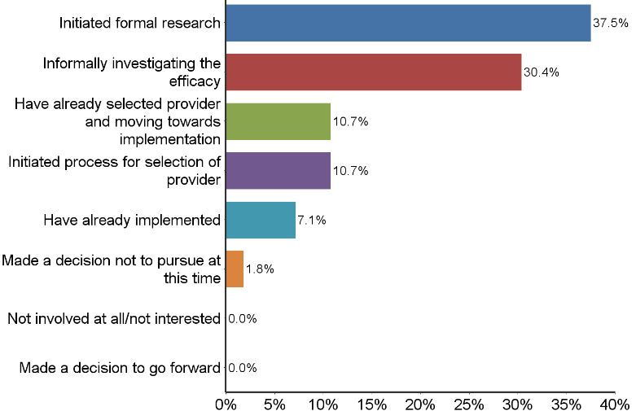
Status of IGaming
68% either formally or informally investigating iGaming,
11% initiated provider selection process,
11% already selected provider,
and 7% have already implemented, only 2% have decided not to pursue

Slide 3
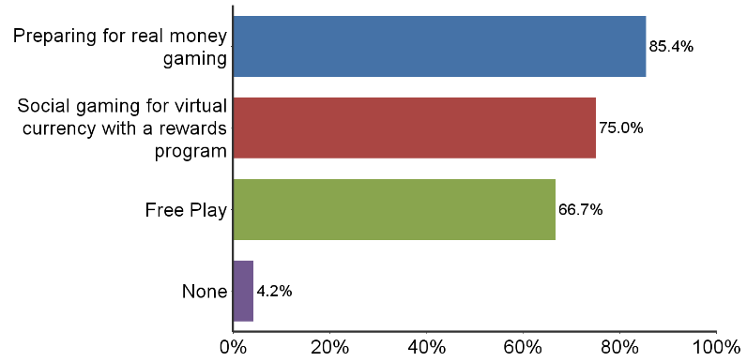
Form of iGaming
85% preparing for real money gaming
75% focusing on social gaming
67% focusing on free play

Slide 4
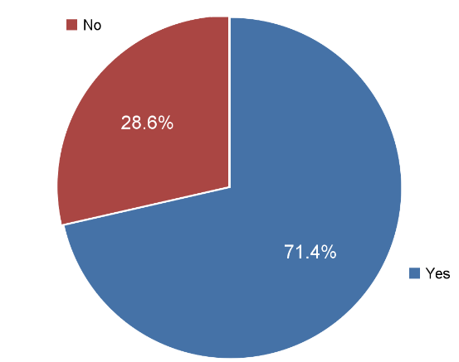
iGaming Staffing and Salary Expectations
71% planning to add new staff dedicated to iGaming ranging from 2 to 30
Average 6 FTE’s
Total salaries from $60,000 to $750,000 + with average of $306,000
Native American casinos more likely to add staff compared to Commercial casinos
Cost Expectation
Average start up costs=$2.4 million
Average annual operating costs = $568,000

Slide 5
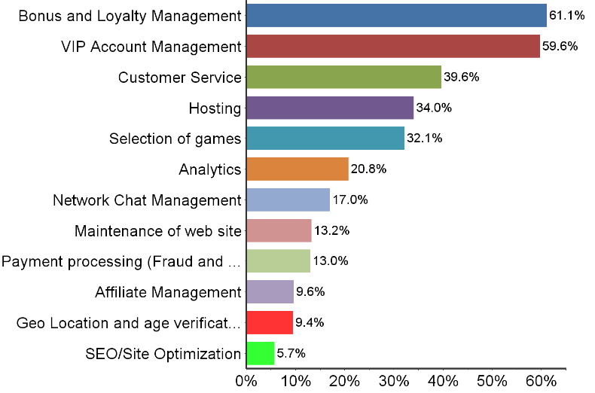
In House Functions
Landbased operators are keeping in house functions that touch the customer such as:
Bonus and Loyalty programs
VIP account management
Customer Service
Own the database
Also looking to have control retaining functions such as:
Hosting
Selection of Games
Analytics

Slide 6
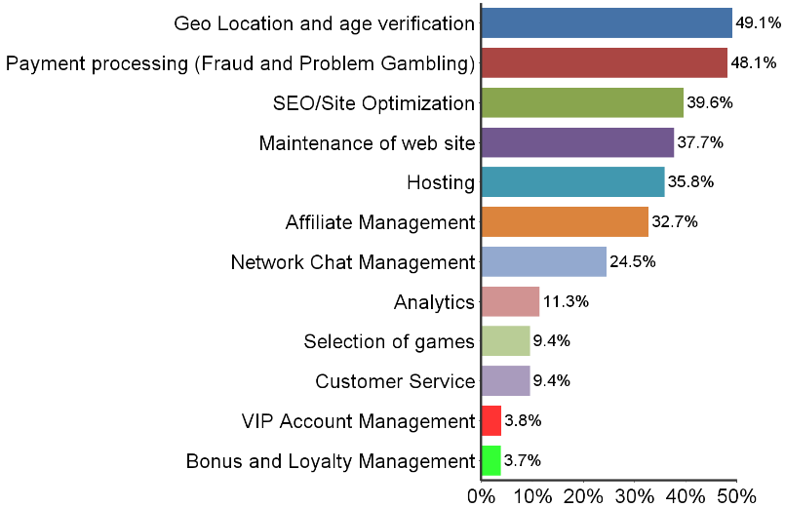
Out Source Functions
Landbased operators are outsourcing :
Payment and Fraud Protection
Geo-Location & Age Verification
SEO/Site Optimization
Web site maintenance
Affiliate management
Hosting
Network chat maintenance

Slide 7
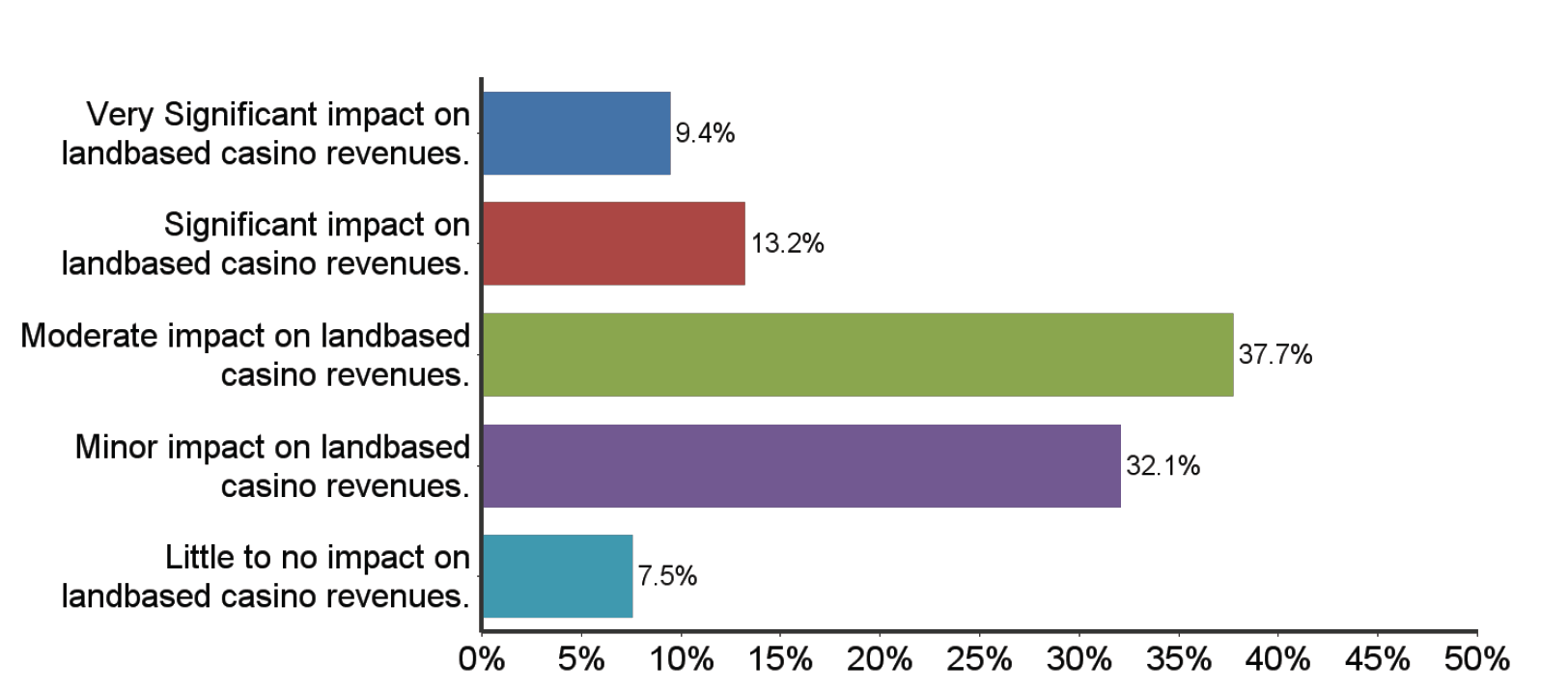
Impact on Landbased Revenues
40% see no or minor impacts on landbased revenues, 38% see a moderate impact while 22% see a significant or very significant impact

Slide 8
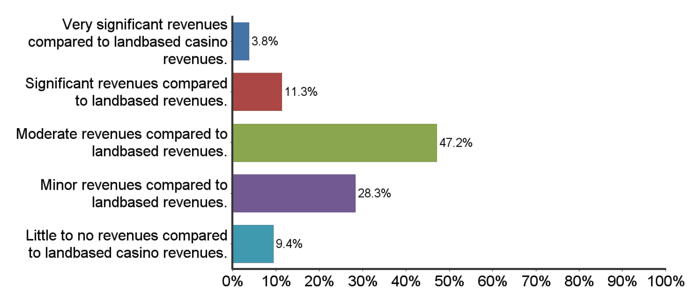
iGaming Revenues
74% of respondents see iGaming revenues as minor to moderate in comparison to landbased revenues

Slide 9
Major Concerns voiced internally within your organization as it relates to online gaming?
24% | Regulation/Compact/Legality Concerns
19% | Cannibalization / Profitability / ROI
13% | Cost of System and Developing Capabilities
10% | Integration with Landbased

Slide 10
Main Concerns with the software solutions that have been
presented to you?
30% | Data Protection/Reliability/Stability/Security
14% | Cost
11% | Integration

Slide 11
In terms of factors, processes, and/or software functions, what are the three most important technology advances that you would like to see providers integrate into their offerings?
19% | Integration/Compatibility
13% | Flexibility/Variety/More Games/Mobile apps
13% | Player Identification/Verification/Security

Slide 12
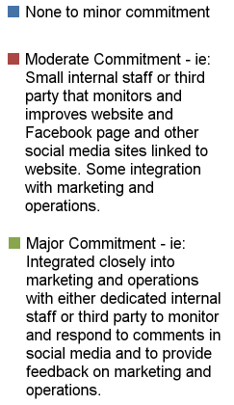
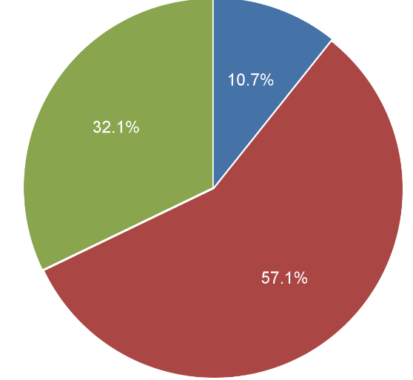
Current Level of Commitment to Social Media

Slide 13
Social Gaming and Convergence with Real Money Gaming
I see this this as the most likely and effective channel of development
Offers short term free play and monetized option that is legal
Can be converted to real money
Long term can offer both free play and real money gaming
Provides a broader platform to better engage players and drive them to land based casinos
More innovative environment with low barriers to entry
Most casinos already have some level of commitment to social media on which to build

Slide 14
Benefits of iGaming to Land Based Casino & Cannibalization?
Maryland Live
More than 165,000+ registered online players.
12% of online free-play database come into the casino to play for real money.
These come 40% more frequently, worth 20% more per visit, stayed 10% longer.
Casino X Free Play Site
22,000 active poker players in 5 months, 15,000 were not in casino database.
8% to 10% converted to land based players.
Land based revenues increased, have a database for when real money iGaming starts.
British Columbia
Land based casino revenues continued to grow despite concurrent growth in iGaming (PlayNow) 2004-present.
Primary Research
Surveys conducted by The Innovation Group, (national and regional) IPSOS (Canada) and US Gaming Survey (Northeast US) all agree that impact on land based gaming revenue will be a slight positive-NO CANNIBALIZATION.

Slide 15
Thank You!
For more information email: pgirvan@theinnovationgroup.com

