Slide 1
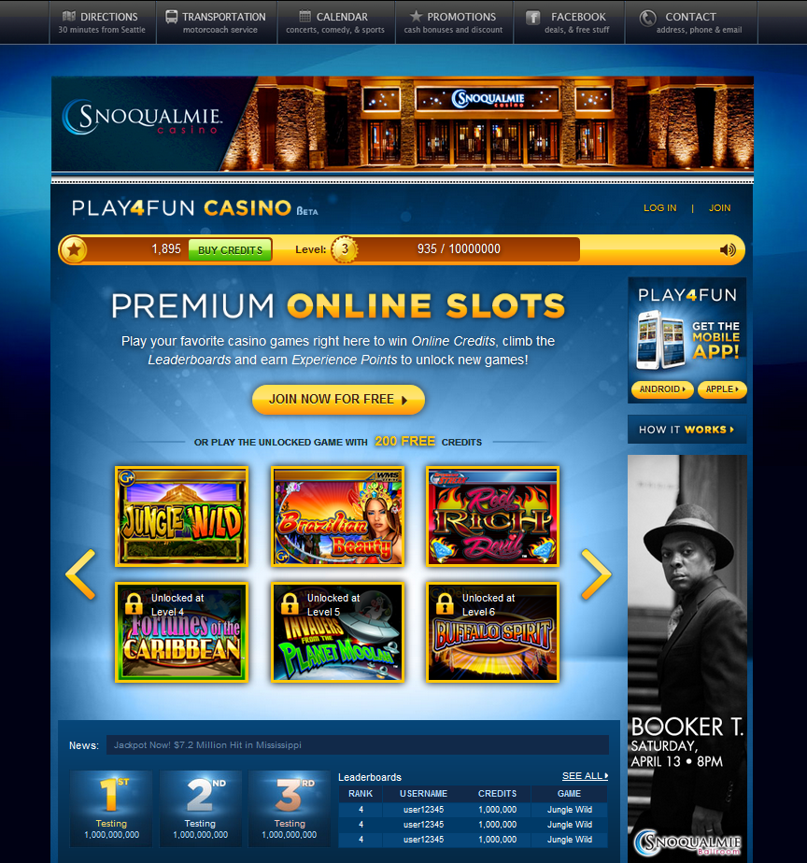
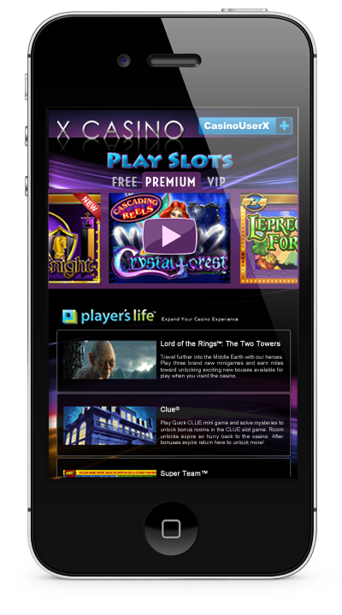
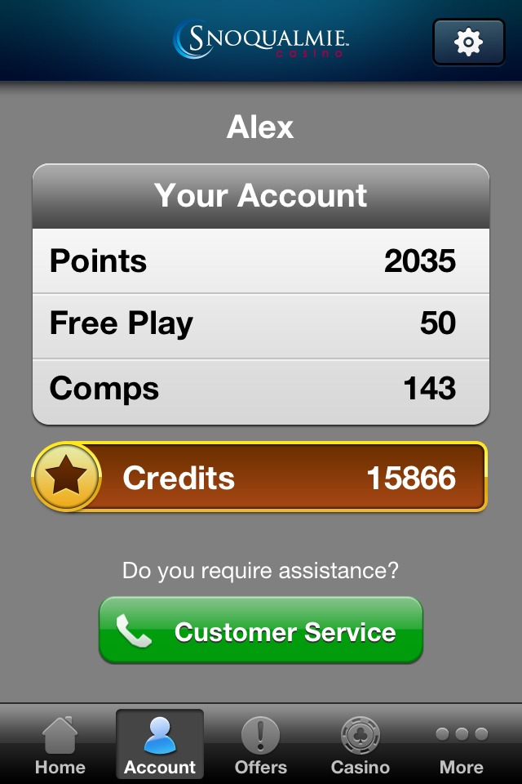

Slide 2
Operator Goals
Marketing
Virtual Currency Revenue
Hybrid Model

Slide 3
Virtual Currency Revenue
Goal
Investment vs. Operator Benchmark
Brand
Casino Brand vs. New Brand
Reach of Brand
Roadmap
Service Provider Roadmap
Investment into Platform

Slide 4
Marketing
360 View
CMS Integration
Flexibility of PII Capture
Holistic System
Desktop / Mobile / Tablet
Control of the System
Staff
Internal Team
Supplier Support

Slide 5
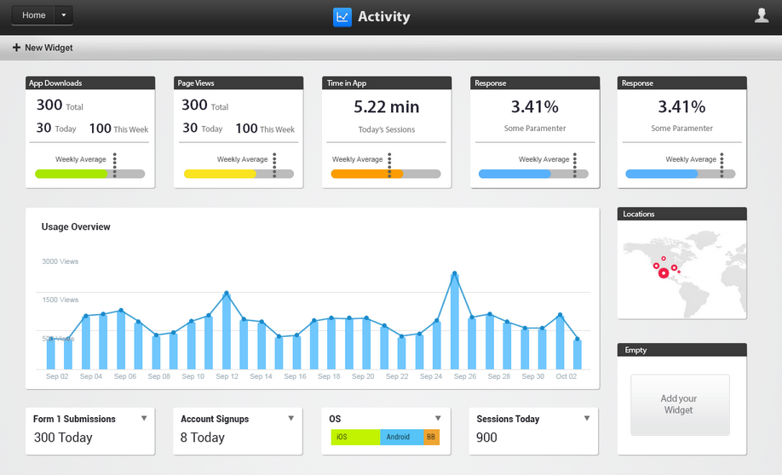

Slide 6
Commercials
Set Up
Maintenance
Rev. Share

