Slide 1

Lecture 2: Dealing with Data
COSC 426 / 526: Introduction to Data Mining

Slide 2
Text Representation and Handling
2

Slide 3
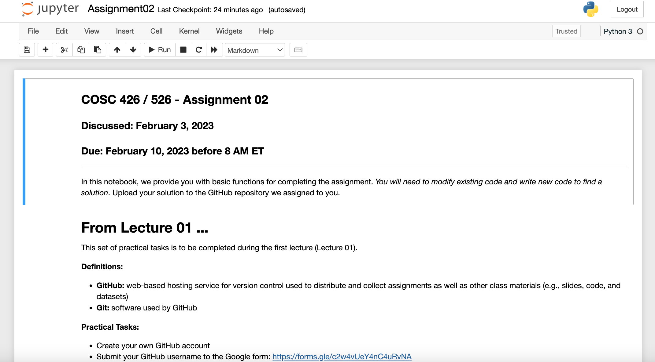

Slide 4
Assignment 2: Dealing with Text
Reading in, parsing, and processing delimiter-separated values stored in files – comma-separated values (CSV) and tab-separated values (CSV)
Count (and print) the number of rows of data (header is excluded) in the CSV file
Count (and print) the number of columns of data in the CSV file
Calculate (and print) the average of the values that are in the "age" column - You can assume each age in the file is an integer, but the average should be calculated as a float

Slide 5
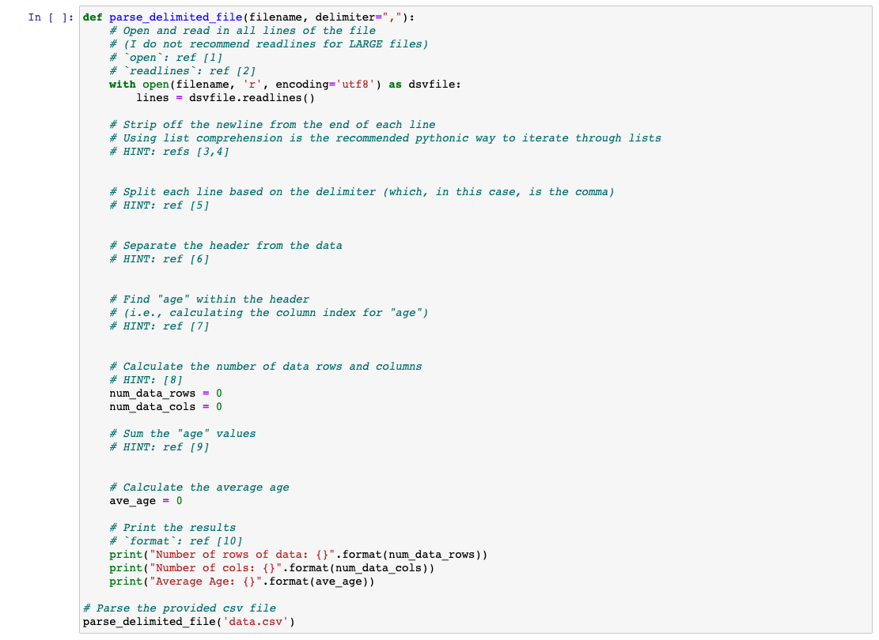
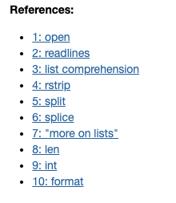
comma-separated values (csv)

Slide 6
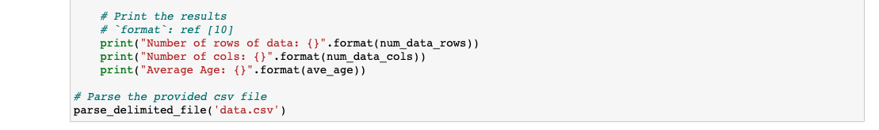
tab-separated values (tsv)

Slide 7
Assignment 2: Dealing with different encoding
Standards for encoding text:
ASCII
Use numeric codes to represent characters
Unicode:
Map every character to a specific code U+<hex-code>, ranging from U+0000 to U+10FFFF
Define Unicode transformation formats: UTF-8, UTF-16, and UTF-32
Converting the Unicode-formatted names into ASCII-formatted names
Use the provided transliteration dictionary that maps several common Unicode characters to their ASCII transliteration to convert the Unicode strings to ASCII

Slide 8
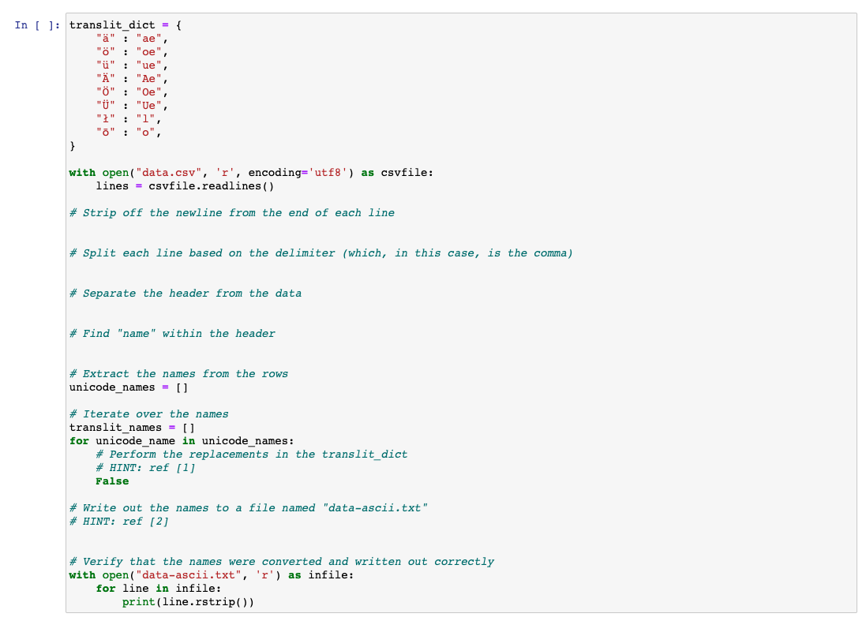
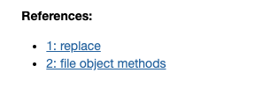
convert unicode strings to ascii

Slide 9
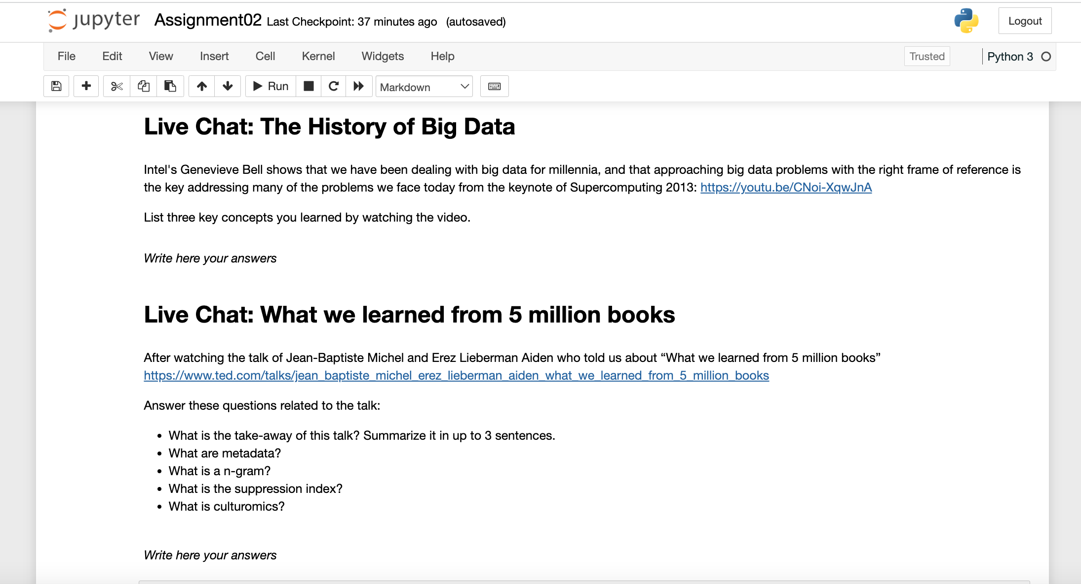
Do not forget to answer the questions at the end

Slide 10
Commit and push in your repository regularly

