Slide 1

Lecture 2: Data Science Concepts and MapReduce Programming Model
COSC 426 / 526:
Introduction to Data Mining
1

Slide 2
The Canonical MapReduce Programming Model
2

Slide 3


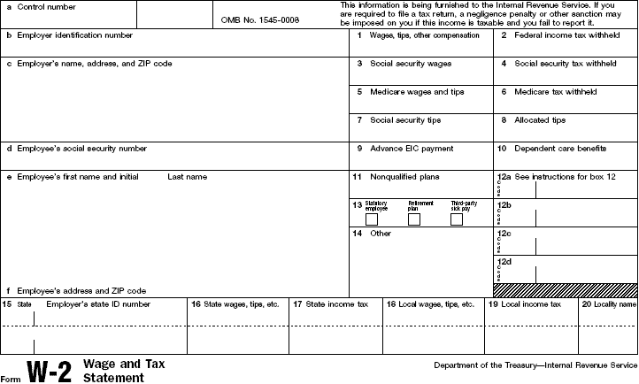
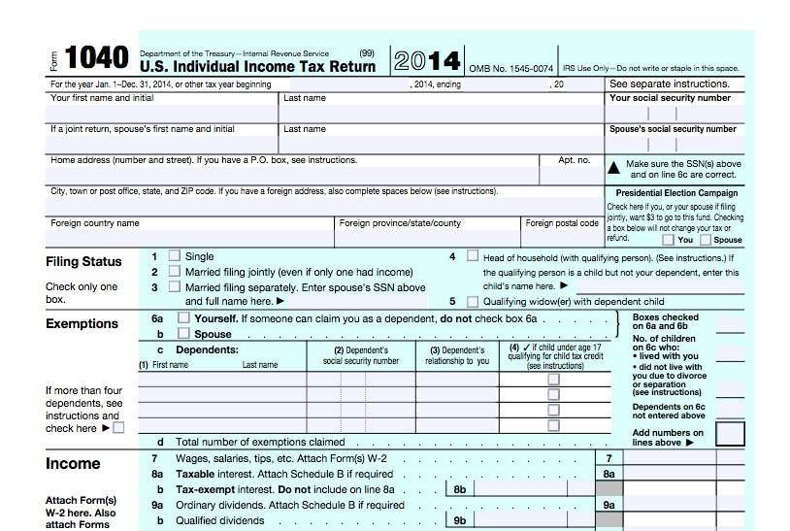



The MapReduce Workflow
Map
Shuffle
Reduce
3

Slide 4
The MapReduce Workflow
The Value is the content, the Key groups content that should be processed by the same reduce task.
Value
Key
Value
Step 1: Map
Key
Value
The map task creates a set of Key-Value pairs and hands them off to the sorting/shuffling task.
Key
4

Slide 5
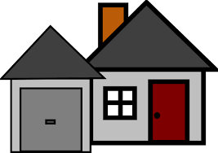
The MapReduce Workflow
Step 2: Sort/Shuffle
The sorting and shuffling tasks collect all the key-value pairs and deliver all the values with the same key to a reduce task.
Value 1
Key
Value 2
Key
Value 3
Key
5

Slide 6
The MapReduce Workflow
Step 3: Reduce
The reduce task receives all the values with the same key and combines them into the final output.
Value 1
Key
Value 1
Value 2
Key
Output
Value 2
Value 3
Value 3
Key
6

Slide 7
Map
The map function is implemented by the user.
Each map task processes a single line of an input file simultaneously.
Map tasks do not communicate with other map tasks.
Map tasks communicate with reduce tasks only through the content of the value in the KV pair.
A single map task may emit any number of KV pairs (including none).
Sort/Shuffle
The sorting and shuffling process is implemented at the framework level and is opaque to the user.
Reduce
The reduce function is implemented by the user.
Each reduce task receives all the values associated with a given key.
Reduce tasks do not communicate with each other
A single reduce task may emit any number of result values for each key it processes.
7

Slide 8

WordCount: an example of MapReduce
Map
Key
Value
When tweetle beetles fight,
it’s called a tweetle beetle battle.
And when they battle in a puddle,
it’s a tweetle beetle puddle battle.
And when tweetle beetles battle with paddles in a puddle,
They call it a tweetle beetle puddle paddle battle.
(When, 1), (tweetle, 1), (beetles, 1), (fight, 1)
(it’s, 1), (called, 1), (a, 1), (tweetle, 1), (beetle, 1), (battle, 1)
(And, 1), (when, 1), (they, 1), (battle, 1), (in, 1), (a, 1), (puddle, 1)
(it’s, 1), (a, 1), (tweetle, 1), (beetle, 1), (puddle, 1), (battle, 1)
(And, 1), (when, 1), (tweetle, 1), (beetles, 1), (battle, 1),
(with, 1), (paddles, 1), (in, 1), (a, 1), (puddle, 1)
(They, 1), (call, 1), (it, 1), (a, 1), (tweetle, 1), (beetle, 1),
(puddle, 1), (paddle, 1), (battle, 1)
8

Slide 9
WordCount: an example of MapReduce
Reduce
Sort/Shuffle
(tweetle, 1), (tweetle, 1), (tweetle, 1), (tweetle, 1), (tweetle, 1)
(tweetle, 5)
(When, 1), (tweetle, 1), (beetles, 1), (fight, 1)
(it’s, 1), (called, 1), (a, 1), (tweetle, 1), (beetle, 1), (battle, 1)
(And, 1), (when, 1), (they, 1), (battle, 1), (in, 1), (a, 1), (puddle, 1)
(it’s, 1), (a, 1), (tweetle, 1), (beetle, 1), (puddle, 1), (battle, 1)
(And, 1), (when, 1), (tweetle, 1), (beetles, 1), (battle, 1),
(with, 1), (paddles, 1), (in, 1), (a, 1), (puddle, 1)
(They, 1), (call, 1), (it, 1), (a, 1), (tweetle, 1), (beetle, 1),
(puddle, 1), (paddle, 1), (battle, 1)
(When, 1)
(When, 1)
(when, 1), (when, 1)
(when, 2)
(battle, 1), (battle, 1), (battle, 1), (battle, 1), (battle, 1)
(battle, 5)
(puddle, 1), (puddle, 1), (puddle, 1), (puddle, 1)
(puddle, 4)
(beetle, 1), (beetle, 1), (beetle, 1)
(beetle, 3)
(beetles, 1), (beetles, 1)
(beetles, 2)
9

Slide 10
Canonical MapReduce
MapReduce runtime handles the parallel job execution, communication, and data movement
Users provide the map and reduce functions
Wordcount example:
<Hello,1>
Hello
World
<world,1>
reduce
<Hello, 2>
map
Shuffle
Hello
World
map
reduce
<World, 2>
<Hello,1>
<world,1>
10

Slide 11
The Canonical MapReduce
a
b
c
c
a
c
b
b
Mappers: applied to all input
data
mapper
mapper
mapper
mapper
Arbitrary number of
key-value pairs
a
1
b
1
c
1
c
1
a
1
c
1
b
1
b
1
Barrier:
distributed
sort and group by key
Shuffle and sort: aggregate values by key
a
1
1
b
1
2
c
2
1
Reducers: applied to
all values associated with the same key
reducer
reducer
reducer
a
2
b
3
c
3
11

Slide 12
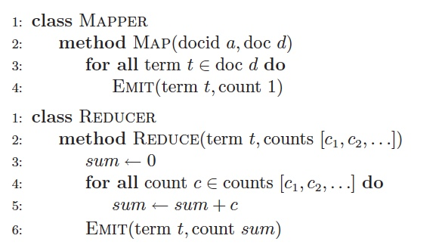
Pseudo-code: WordCount in MapReduce
12

Slide 13
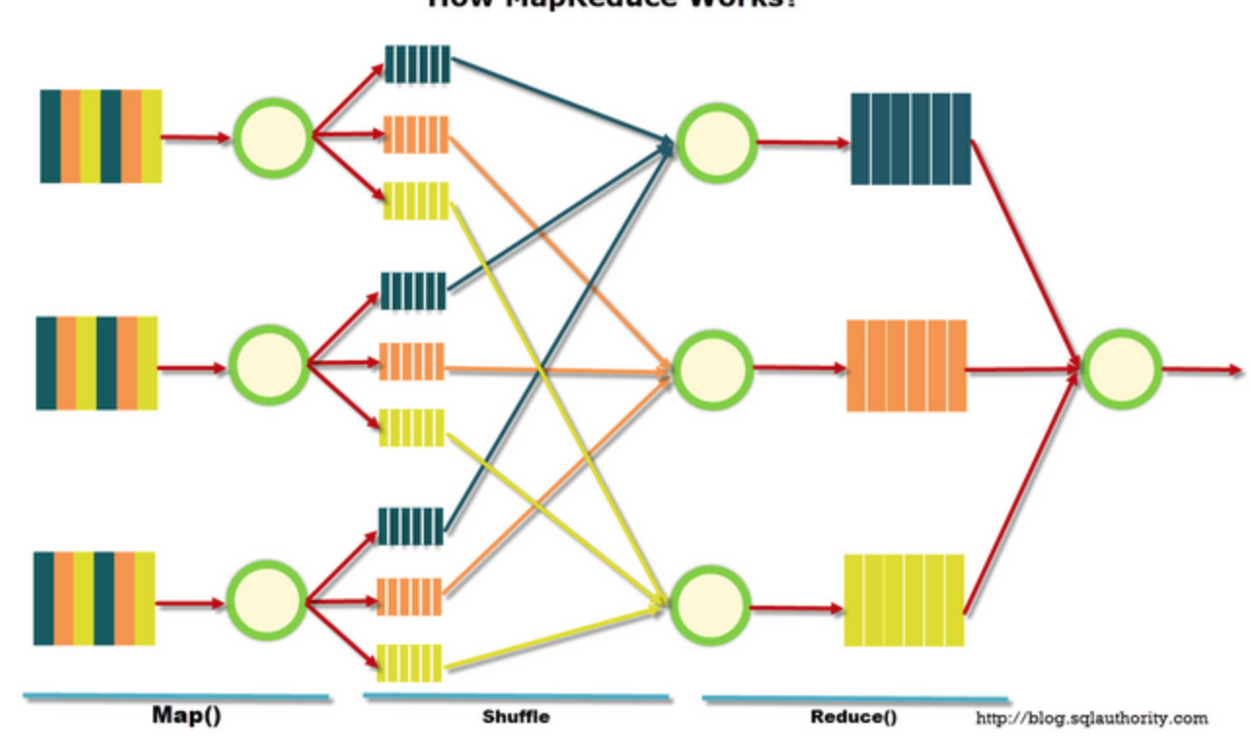
How MapReduce works
13

Slide 14
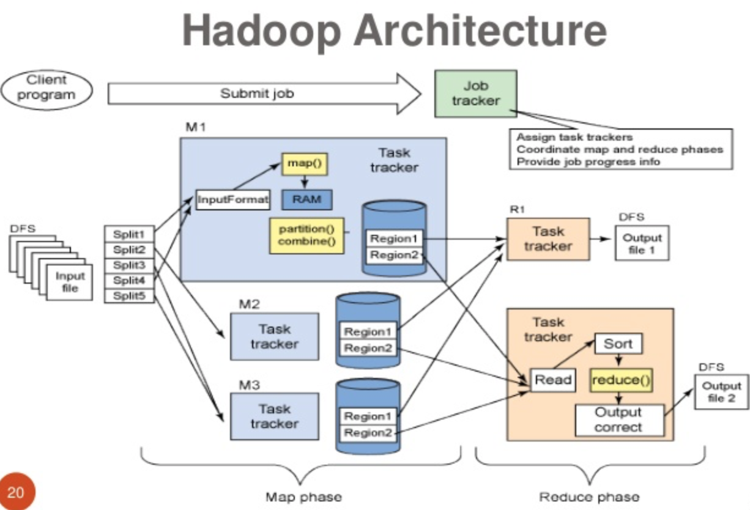
Architecture: Hadoop
https://commons.wikimedia.org/wiki/File:Big-data-concepts-20-638.jpg
14

Slide 15
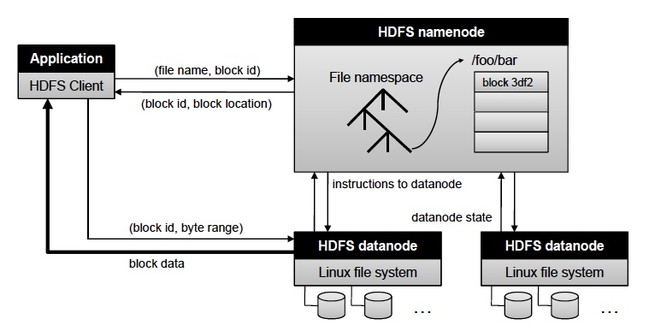
The Hadoop File System
HDFS = Hadoop File System
master
Move metadata
worker
worker
Move real data
HDFS keeps multiple, separate copies of each data block to ensure reliability, availability, and performance
Actual data organized in blocks

