Slide 1

Lecture 2: How to read a paper
COSC 426 / 526: Introduction to Data Mining

Slide 2
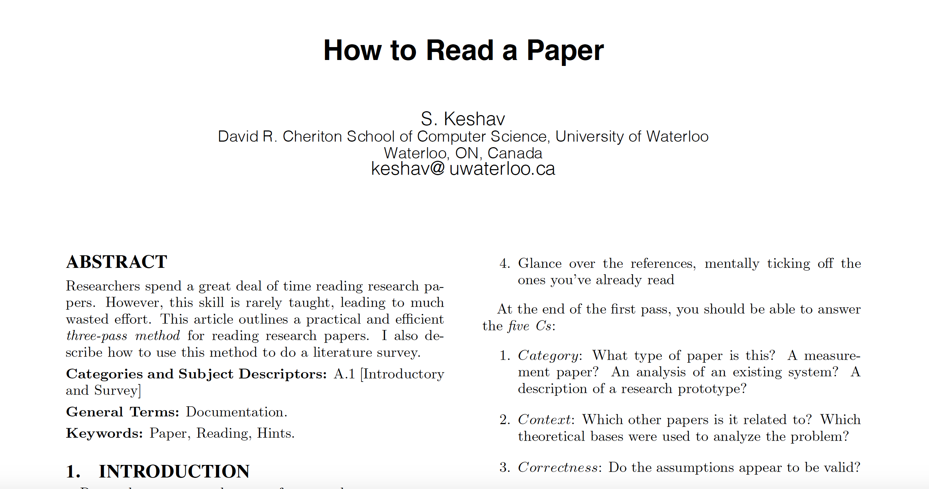
Read a Paper: THE THREE-PASS APPROACH by S. Keshav
2

Slide 3
Step 1 (I)
Carefully read the title, abstract, and introduction.
Read the section and sub-section headings, but ignore everything else.
Read the conclusions.
Glance over the references, mentally ticking off the ones you’ve already read.
Note the year when the publications were published.
3

Slide 4
Step 1 (II)
Category: What type of paper is this? A measurement paper? An analysis of an existing system? A description of a research prototype? A definition of a concept or a paradigm?
Context: Which other papers is it related to? Which theoretical bases were used to analyze the problem?
Correctness: Do the assumptions appear to be valid?
Contributions: What are the paper’s main contributions?
Clarity: Is the paper well written?
4

Slide 5
Step 2 (I)
Look carefully at the paper's figures, diagrams, and other illustrations. Pay special attention to graphs. Are the axes adequately labeled? Are results shown with error bars so that conclusions are statistically significant? Common mistakes like these will separate rushed, shoddy work from the truly excellent.
5

Slide 6
Step 2 (II)
Remember to mark relevant unread references for further reading (this is an excellent way to learn more about the background of the paper)
You can now choose to:
(a) set the paper aside, hoping you don’t need to understand the material to be successful in your career
(b) return to the paper later, perhaps after reading background material or
(c) persevere and go on to the third pass
6

Slide 7
Step 3
Attempt to virtually re-implement the paper
Make the same assumptions as the authors
Re-create the work
Identify (and challenge) every assumption
Think about how you would present a particular idea
Jot down ideas for future work
7

Slide 8
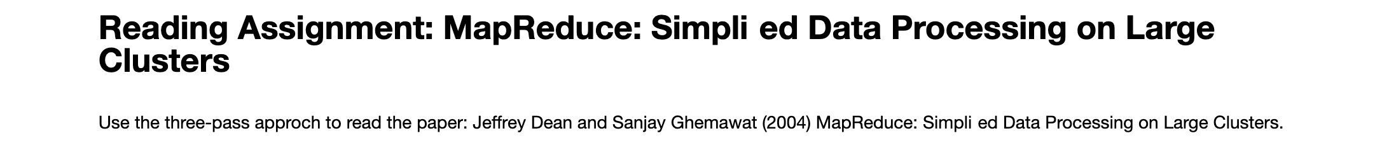
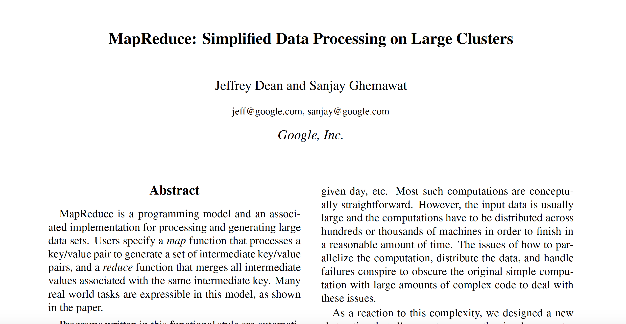
8

