Slide 1

Lecture 2: Video + Discussion
COSC 426/526: Introduction to Data Mining

Slide 2
Live Chat: What we learned from 5 million books

Slide 3
A video on processing text to learn
What we learned from 5 million books:
“Have you played with Google Labs' Ngram Viewer? It's an addicting tool that lets you search for words and ideas in a database of 5 million books across centuries. Erez Lieberman Aiden and Jean-Baptiste Michel show us how it works and a few surprising things we can learn from 500 billion words.”
https://bit.ly/409oHNV

Slide 4
Discussions
Jean-Baptiste Michel and Erez Lieberman Aiden tell us “What we learned from 5 million books.”
https://www.ted.com/talks/jean_baptiste_michel_erez_lieberman_aiden_what_we_learned_from_5_million_books
Answer these questions related to the talk:
What is the takeaway of this talk? Summarize it in up to 3 sentences.
What is metadata?
What is an n-gram?
What is the suppression index?
What is culturomics?

Slide 5
For next week ….
5

Slide 6
For the next week ….
Get your solutions for Assignment 2 done before our next class
Push your key into your repos
Papers to read:
S. Keshav How to Read a Paper
Jeffrey Dean and Sanjay Ghemawat (2004) MapReduce: Simplified Data Processing on Large Clusters
Next week ….
More about MapReduce and its optimizations
More practical problems …
6

Slide 7
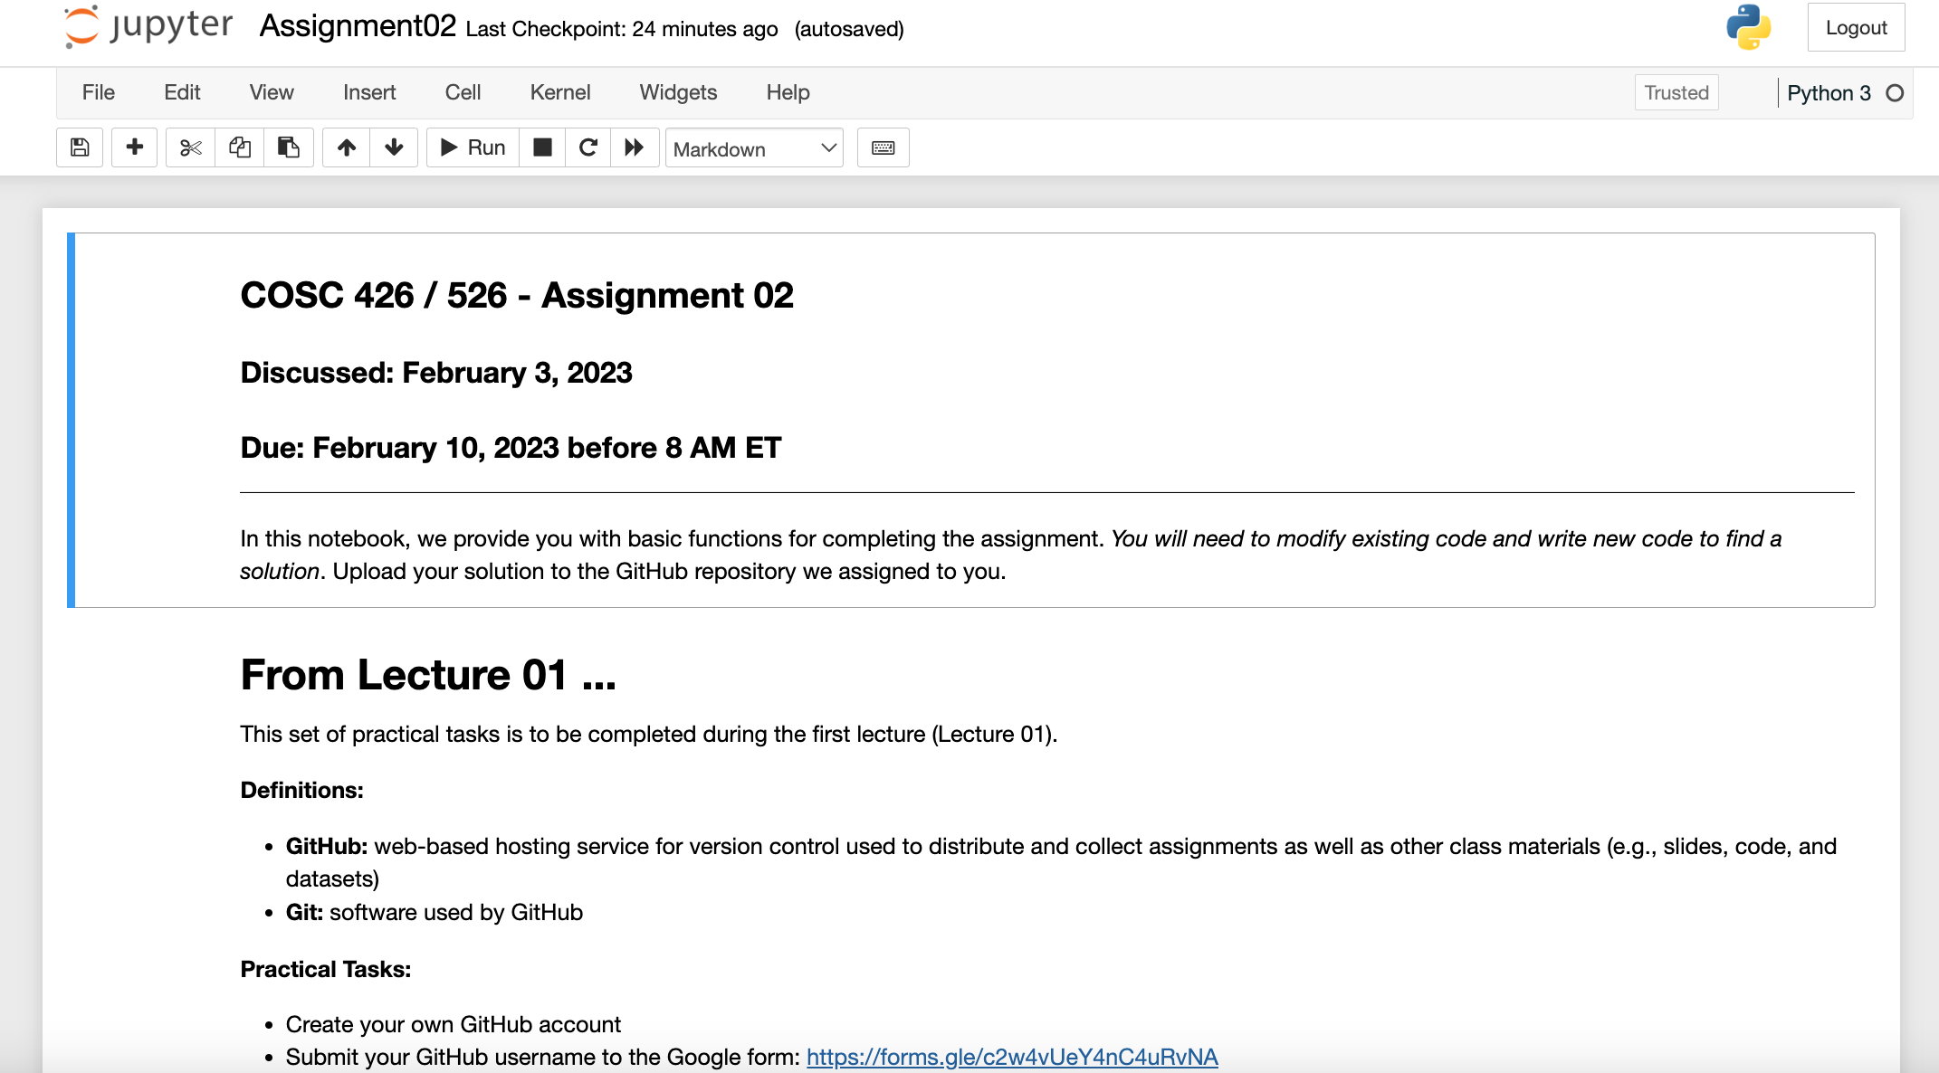
For next week (I)
Complete and push Assignment 02 to your private repository
7

Slide 8
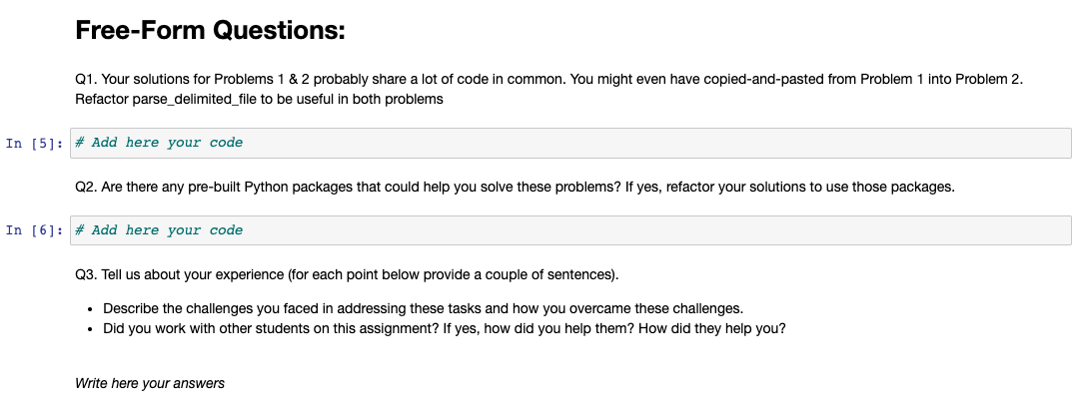
8

Slide 9
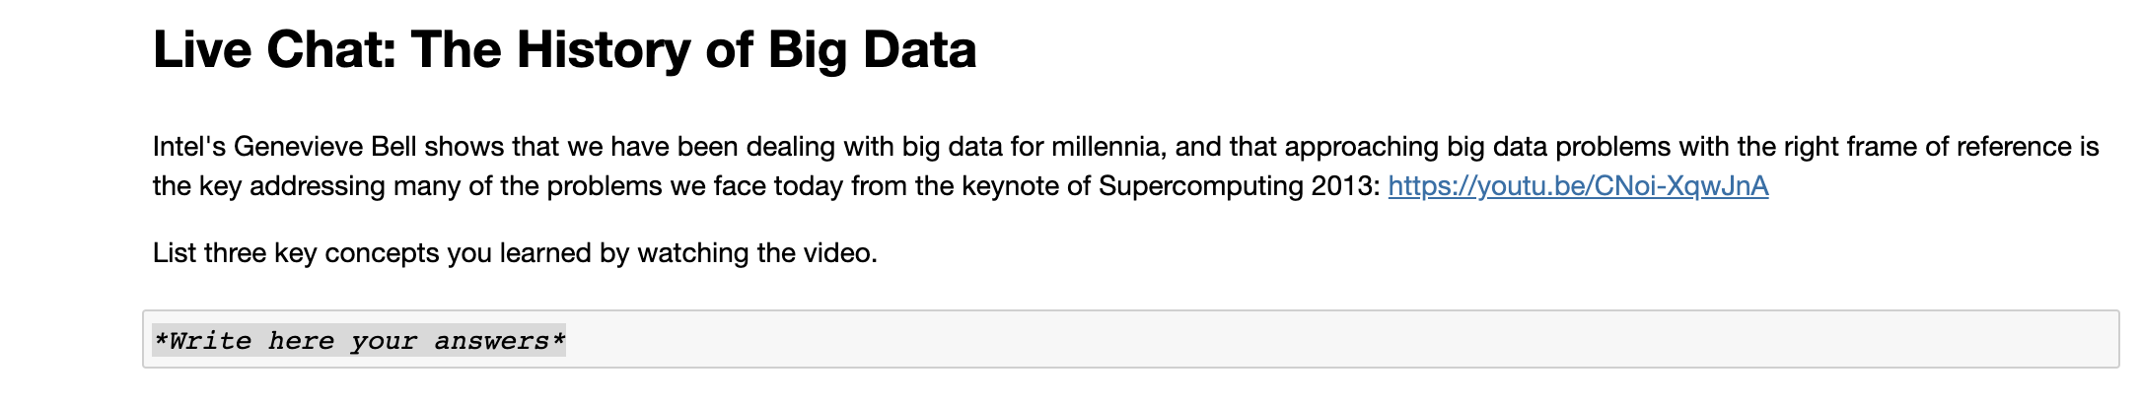
9

Slide 10
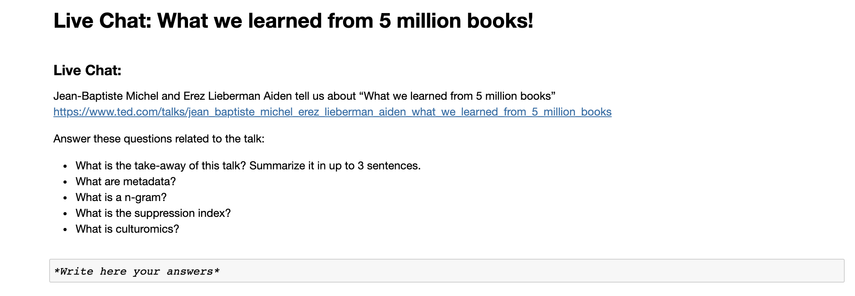
10

Slide 11
ALERT!!!!
If you miss one submission, your final score is F

