Slide 1
Terse: Creating a Programming Language
By Robert Glossop

Slide 2
Why a Programming Language?
Notes:
Why did I choose to make a programming language?
Because I find them fascinating.

Slide 3
Human-Machine Interaction
Allows communication with the machine
Fully general
Notes:
Basis of human-machine interaction
Not limited as with applications

Slide 4
A Context for Modeling Thought
Or: a way to think about solving problems
English is bad
  ambiguous
  long
Programming languages: unambiguous, mathematically verifiable
  sometimes
Notes:
Huh?
A language better suited than natural language for solving problems
(by “english” mean any natural language)
Mathematically verifiable: lisp in particular, also functional languages

Slide 5
Changes how you Think About Problems
Same way as natural language lets you think about the world
Gives you powerful tools to think logically
  Good programming languages (and language developers) expand how users think about problems
Notes:
This is a lot of what fascinates me about writing a language: showing people new ways of thinking

Slide 6
What goes into a language?
Notes:
When designing a language, which factors are important

Slide 7
Language Power
Loosely “how much work you have to do to describe a solution”
Varies between languages
Higher is better, generally
Notes:
Language power will sometimes be sacrificed in systems languages to let them run faster; this “feature” is undesirable to most developers.

Slide 8
Language Properties
Paradigm
  Procedural, functional, object oriented
Type system
  Static, dynamic, untyped
Runtime
  Compiled, interpreted
Notes:
Paradigm: how you are expected to try to solve a problem
- also what tools the language will provide to help
- Multi-paradigm allows more freedom, less help
Type System: how the language identifies data
- Static: well-specified, inflexible
- Dynamic: less checking, more freedom
- Untyped: abandon hope, all ye who enter here
Compiler: faster, tougher, less flexible
Interpreter: slower, easier, allows dynamic

Slide 9
Why choose Interpreter?
Easier to write
Can piggy-back off of parent language

Slide 10
What about Terse?

Slide 11
A Summary
Procedural
Dynamically-typed
First-class functions
“Minimalist”
Interpreted
Notes:
First-class functions doesn't really make it “functional”: there are still side-effects
Sometimes “minimalist” means “mathematically concise.” That isn't this. This is “what can I possibly leave out and still make it work?”

Slide 12
A Simple Example
fmap.fun,list\
vcount.0
wc<.vcount,clength.vlist\
cfun.clist.vcount
vcount.c+.vcount,1\\
This snippet defines a function “map” which calls the passed-in function “fun” over each element in “list”.
Notes:
Step through

Slide 13
Syntactic Structure
As demonstrated, very consistent
  Not necessarily a good thing
Operations are distinguished by their first letter
  c: call; v: variable; f: define function; w: while; i: if; e: else
Arguments passed with “.”, additional arguments passed with “,”
  e.g. cprint.1,2 calls “print” with both “1” and “2”
Notes:
Common wisdom in language design is that “different operations should look different.” These obviously do not.

Slide 14
Procedures
Procedures defined by “f”, an optional name, optional arguments, and a body
Body is executed when procedure is called
Binding is created
  Variables used inside the procedure aren't visible outside
  Not actually working at the moment

Slide 15
Type System
Types are integers, floating-point numbers, strings, lists, and nil
No static declarations
Piggy-backs entirely off of Lisp's own type system
Notes:
The type system required almost no work on my part; it's handled entirely by Lisp.

Slide 16
How is it written?
Notes:
Implementation time!

Slide 17
Shortly
Whole package about 600 lines of code
Host language: Common Lisp
Much piggybacking off the host
Divided into Parser and Runtime components
Notes:
It may be “cheating”, but writing a language interpreter in a sufficiently high-level language becomes quite easy.

Slide 18
Parser
Top-level is a dispatch function PARSE
Notes:
Next slide quickly, example there

Slide 19
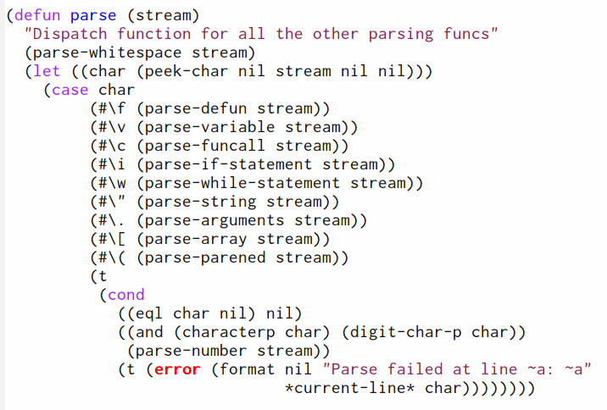

Slide 20
Huh?
Takes a single character
Dispatches to individual function
Notes:
All of the work is done by lower-level functions

Slide 21
Dispatched Functions
Do the real work
Assembles statements into lists
Notes:
Example of what the lists look like

Slide 22
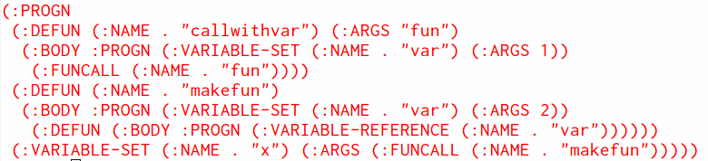
Rinse, Repeat
Builds up into a structure like this

Slide 23
How is it run?

Slide 24
Lambdas
Dispatch function COMPILE
  Selects based on PARSE's output
Assembles recursive calls into the final program

Slide 25
Environment
Single namespace
Functions have their own symbol table
Closures carry their parent environment with them
  Not working
Notes:
Single Namespace: functions & variables aren't looked up separately
Right now equivalent to early Lisp's dynamic scoping

Slide 26
Extras
Deployment: possible, executable weighs in at ~40megs
Error handling
  Ha!
Bugs
  Aforementioned namespace issue
  “f” can't operate on composite expressions
Notes:
Executable size is almost all Lisp environment

Slide 27
Credits
I created a programming language
I wrote a paper on the language
I wrote a presentation on the paper
ME!

Slide 28
Or...
The great help from Angela Overman and Jeff Curless

Slide 29
Demo time!

