Slide 1


Slide 2
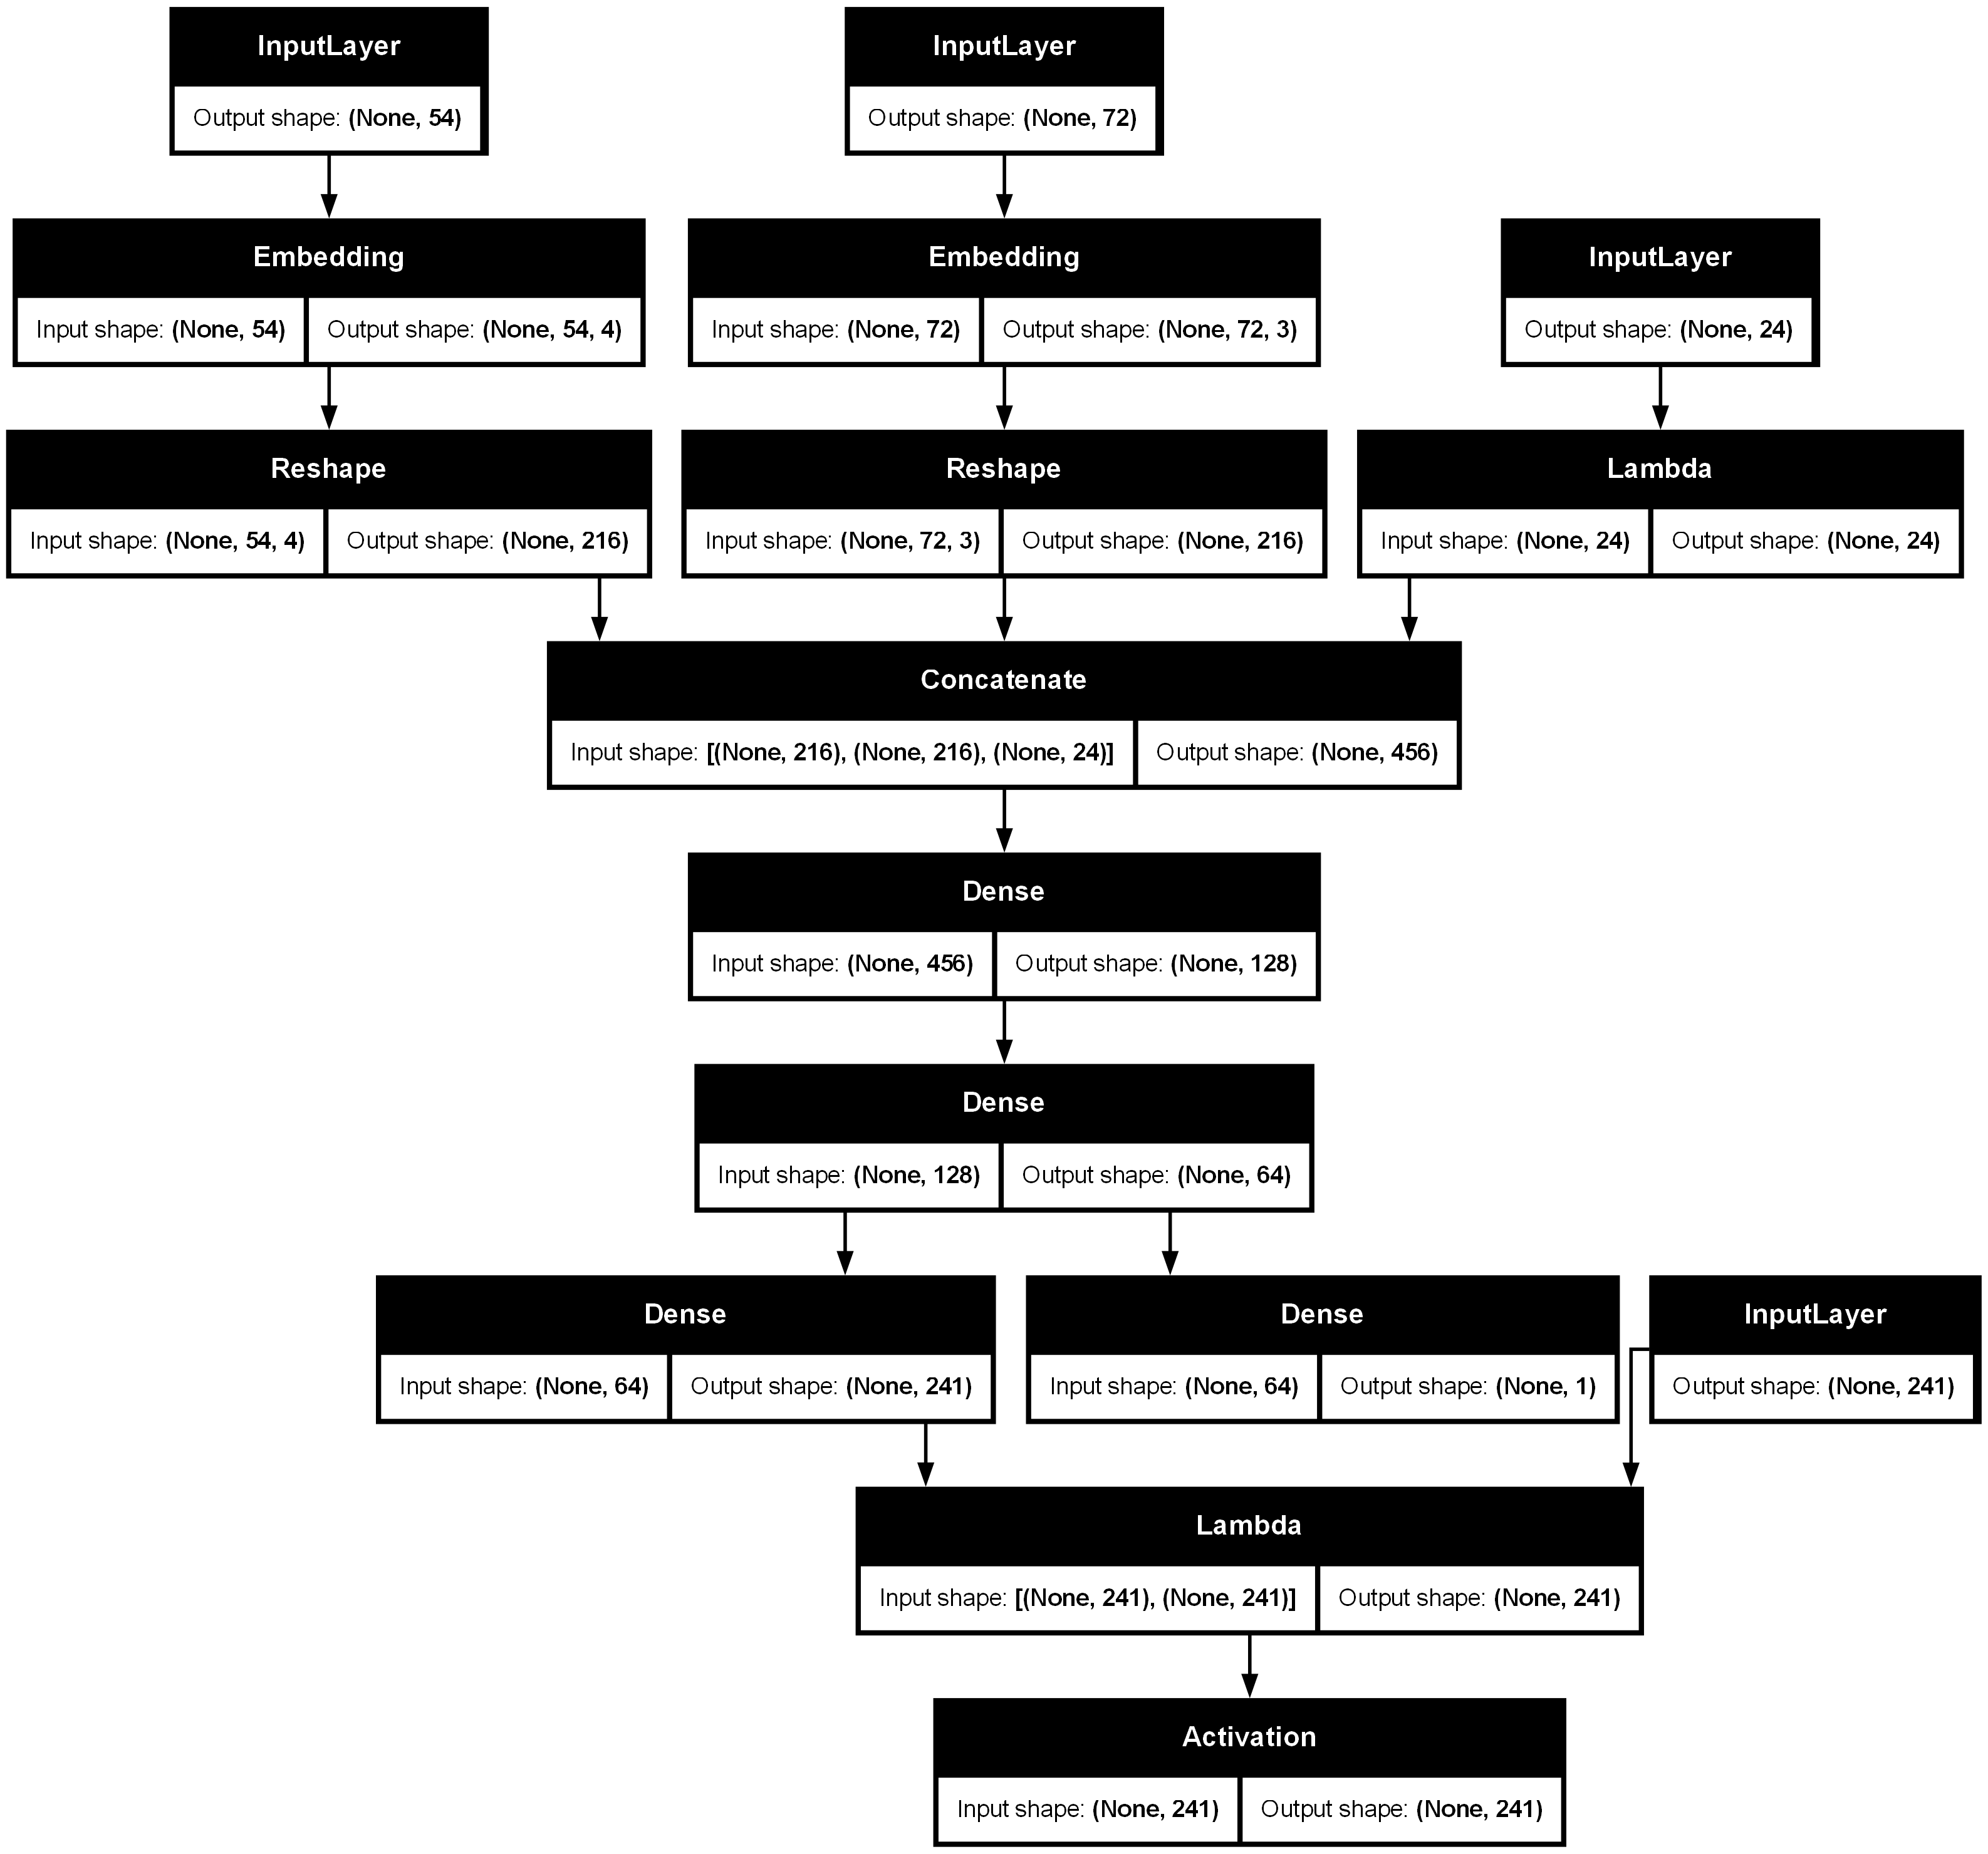
Nodes input
Edges input
Players hands input
Mask input
Value output
Policy output (probability)

Slide 3






Data storage
verbalization
Compute Power
AI DECISION MODELS
GAME LOGIC
visualization

Slide 4
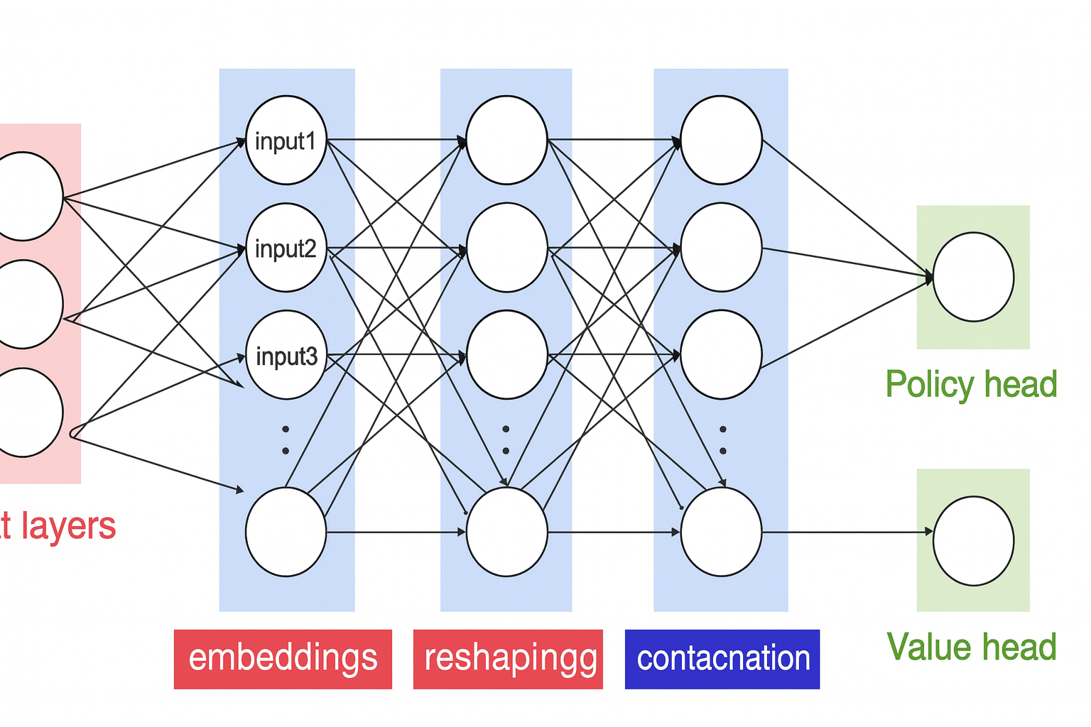

Slide 6
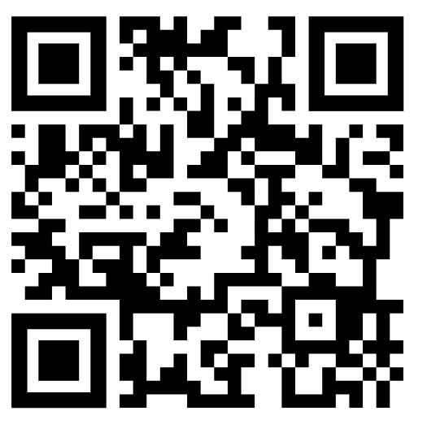

Project Repository
Project Website
https://github.com/robhendrik/PyCatan
https://robhendrik.github.io/PyCatan/

