Slide 1
Figure 1
[FIGURE 1 — header image, placed above or directly under the title] Caption: The game: Alice sees the whole battlefield, Bob operates the gun, and neither controls where it points. One bit connects them. Alt-text: An 8-by-8 naval battle grid with ships hidden in some cells. On one side a figure (Alice) in a watchtower overlooking the full grid; on the other a figure (Bob) at a gun aimed at a single highlighted cell. A single line between them carries the message "1 bit".

Slide 2
Alice
Bob
0 | 1 | 2 | 3
4 |  | 6 | 7
8 | 9 | 10 | 11
12 | 13 | 14 | 15
One bit communication
Alice knows the location of the enemy ships (and Bob does not).
Bob knows where the gun is pointing (and Alice does not).
Winning is:
Shoot the enemy
Not shoot an empty cell
Bob to decide:
Shoot
No shoot
Rules
Game is played on nxn grid
Each cell has equal probability to contain enemy ship
Alice knows the position of enemy ships
Bob knows where the gun is pointing
Alice communicates 1 bit to Bob
Bob decides whether to shoot, or not shoot the gun
If they hit the enemy or decide to not shoot an empty cell they win.
If they shoot an empty cell or not shoot the enemy, they lose.

Slide 3
Figure 2
[FIGURE 2 — placed after the paragraph above] Caption: Stripped of the ships: a 2×2 board read in a fixed order is a string of four bits — ship is 1, sea is 0. The gun's cell is Bob's index. Alt-text: Left: a 2-by-2 battle grid with a ship in the top-left and bottom-right cells, cells numbered 1 to 4 in reading order. Right: the same board written as the bitstring 1001. An arrow labelled "same game" connects them.

Slide 4
0 | 1 | 2 | 3
4 |  | 6 | 7
8 | 9 | 10 | 11
12 | 13 | 14 | 15
Hidden binary field (only known to Alice)
Alice’s bit string (representing the ships on the board)
Random query index (only known to Bob)
Bob’s assignment (representing gun position)
to guess the value at index 5 (first cell is index 0, last index 15)
1 | 1 | 0 | 1 | 1 | 0 | 1 | 0 | 0 | 1 | 1 | 1 | 1 | 0 | 1 | 0
Bob guesses: 0 ➔ Win!
1 ➔ Loss

Slide 5
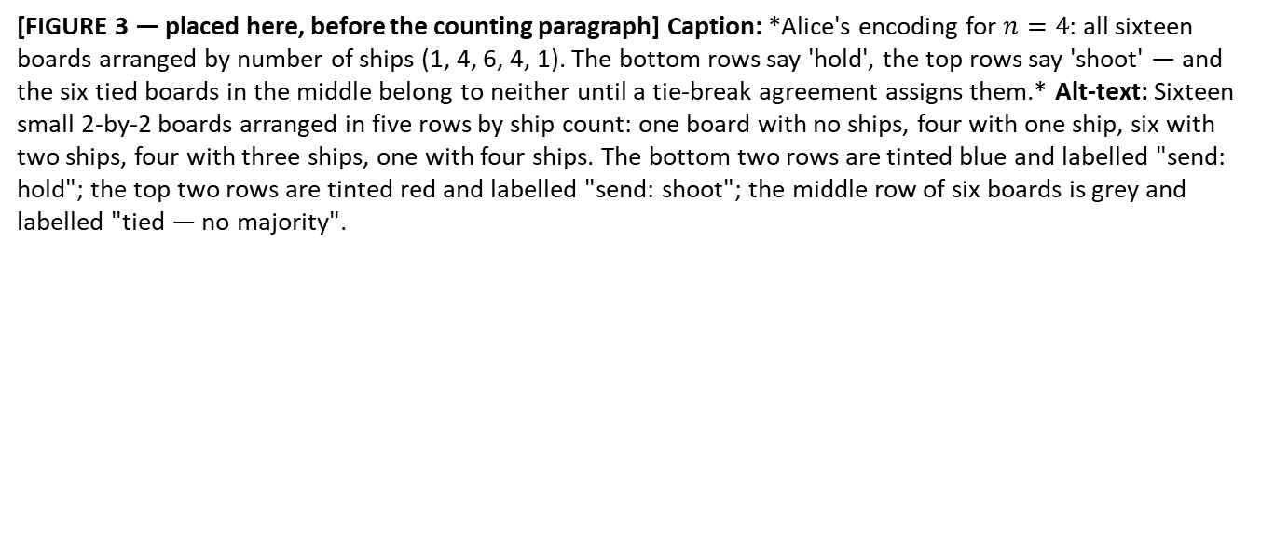
Figure 3
[FIGURE 3 — placed here, before the counting paragraph] Caption: *Alice's encoding for $n=4$: all sixteen boards arranged by number of ships (1, 4, 6, 4, 1). The bottom rows say 'hold', the top rows say 'shoot' — and the six tied boards in the middle belong to neither until a tie-break agreement assigns them.* Alt-text: Sixteen small 2-by-2 boards arranged in five rows by ship count: one board with no ships, four with one ship, six with two ships, four with three ships, one with four ships. The bottom two rows are tinted blue and labelled "send: hold"; the top two rows are tinted red and labelled "send: shoot"; the middle row of six boards is grey and labelled "tied — no majority".

Slide 6
Majority strategy: Alice sends the majority value, and Bob guesses whatever Alice sends
1 | 1 | 1 | 1
4 ships. Alice sends 1. Bob success rate: 100%. Occurrence: 1/16.
Hamming weight 4
1 | 1 | 1 | 0
1 | 1 | 0 | 1
3 ships. Alice sends 1. Bob success rate: 75%. Occurrence: 4/16
Hamming weight 3
1 | 0 | 1 | 1
0 | 1 | 1 | 1
1 | 1 | 0 | 0
1 | 0 | 1 | 0
1 | 0 | 0 | 1
2 ships. Alice sends ?. Bob success rate: 50%. Occurrence: 6/16
Hamming weight 2
0 | 1 | 1 | 0
0 | 1 | 0 | 1
0 | 0 | 1 | 1
1 | 0 | 0 | 0
0 | 1 | 0 | 0
1 ship. Alice sends 0. Bob success rate: 75%. Occurrence: 4/16
Hamming weight 1
0 | 0 | 1 | 0
0 | 0 | 0 | 1
0 ships. Alice sends 0. Bob success rate: 100%. Occurrence: 1/16
Hamming weight 0
0 | 0 | 0 | 0

Slide 7
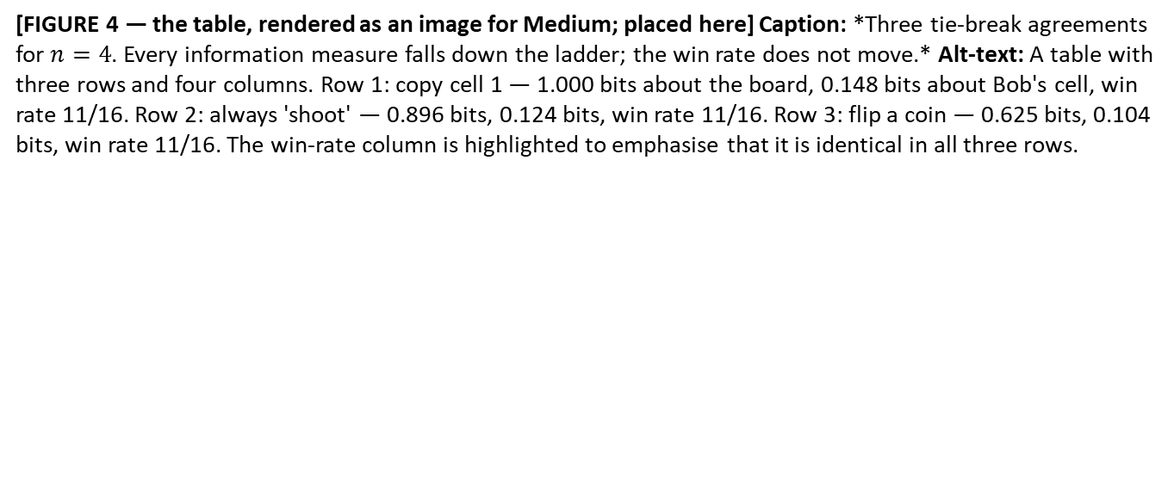
Figure 4
[FIGURE 4 — the table, rendered as an image for Medium; placed here] Caption: *Three tie-break agreements for $n=4$. Every information measure falls down the ladder; the win rate does not move.* Alt-text: A table with three rows and four columns. Row 1: copy cell 1 — 1.000 bits about the board, 0.148 bits about Bob's cell, win rate 11/16. Row 2: always 'shoot' — 0.896 bits, 0.124 bits, win rate 11/16. Row 3: flip a coin — 0.625 bits, 0.104 bits, win rate 11/16. The win-rate column is highlighted to emphasise that it is identical in all three rows.

Slide 8
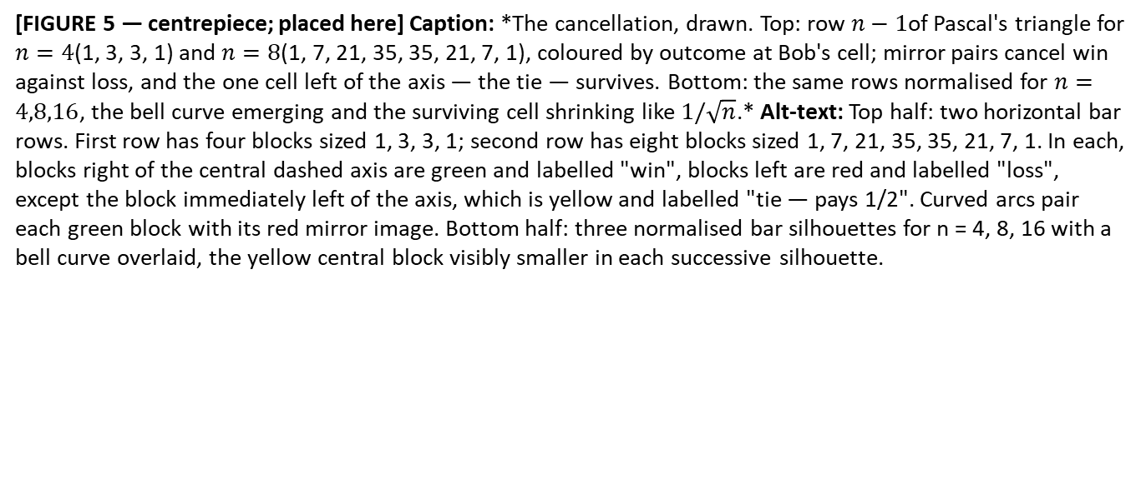
Figure 5
[FIGURE 5 — centrepiece; placed here] Caption: *The cancellation, drawn. Top: row $n−1$of Pascal's triangle for $n=4$(1, 3, 3, 1) and $n=8$(1, 7, 21, 35, 35, 21, 7, 1), coloured by outcome at Bob's cell; mirror pairs cancel win against loss, and the one cell left of the axis — the tie — survives. Bottom: the same rows normalised for $n=4,8,16$, the bell curve emerging and the surviving cell shrinking like $1/\sqrt{n}$.* Alt-text: Top half: two horizontal bar rows. First row has four blocks sized 1, 3, 3, 1; second row has eight blocks sized 1, 7, 21, 35, 35, 21, 7, 1. In each, blocks right of the central dashed axis are green and labelled "win", blocks left are red and labelled "loss", except the block immediately left of the axis, which is yellow and labelled "tie — pays 1/2". Curved arcs pair each green block with its red mirror image. Bottom half: three normalised bar silhouettes for n = 4, 8, 16 with a bell curve overlaid, the yellow central block visibly smaller in each successive silhouette.

Slide 9
For n = 8, if Bob has to guess ‘1’ on the his index. How likely is Alice to send a ‘1’?
Group 128 possible values of the other indices by the number of 1’s (by Hamming weight)
Win/lose
Exactly
cancel
1/128
7/128
21/128
35/128
35/128
21/128
7/128
1/128
7x
1
6x
1
5x
1
4x
1
3x
1
2x
1
1x
1
0x
1
0x
0
1x
0
2x
0
3x
0
4x
0
5x
0
6x
0
7x
0
Blue arrow: Alice sends A ‘1’, irrespective of the value at Bob’s index
Red arrow: Alice sends A ‘0’, irrespective of the value at Bob’s index
Only if the other bits are nearly tied (majority of +1/-1) do the in win/loss rates not cancel. The extra win is in the 50% of cases Alice sends a ‘1’ for a tied string ➔ Win rate = ½ + ½ P_{tie}

Slide 10
For n = 8, imagine Bob has to guess ‘1’ on the his index to win. How likely is Alice to send a ‘1’?
Group 128 possible strings by the number of 1’s (by Hamming weight)
1
7
21
35
35
21
7
1
0
8x ‘1’
7x ‘1’
6x ‘1’
5x ‘1’
4x ‘1’
3x ‘1’
2x 1’
1 x ‘1’
0 x ‘1’
Blue: Alice sends A ‘1’, irrespective of the value at Bob’s index
Red: Alice sends A ‘0’, irrespective of the value at Bob’s index
Grey: Alice sends a random ‘0’ or ‘1’.
If Alice would send a 0 for the tied string the win rate would be exactly 50% (as many cases where Alice sends a ‘0’ or a ‘1’). The win is in the 50% of cases Alice sends a ‘1’ for a tied string
➔ Win rate = ½ + ½ P_{tie}

Slide 11

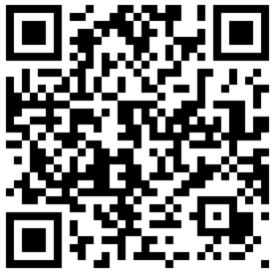
https://robhendrik.github.io/QSeaBattle/
(or check out the repo at https://github.com/robhendrik/QSeaBattle)

Slide 12
ARCHIVE

Slide 13
1/8
3/8
3/8
3/8
1 | 1 | 1
1 | 1 | 0
1 | 0 | 0
0 | 0 | 0
All bits other than the one Bob has to guess (8 options).
1 | 0 | 1
0 | 1 | 0
0 | 1 | 1
0 | 0 | 1
The bit Bob has to guess
1/16
4/16
6/16
4/16
1/16
Alice’s bits (16 options)
1 | 1 | 1 | 1
1 | 1 | 1 | 0
1 | 1 | 0 | 0
1 | 0 | 0 | 0
0 | 0 | 0 | 0
1 | 1 | 0 | 1
1 | 0 | 1 | 0
0 | 1 | 0 | 0
1 | 0 | 1 | 1
1 | 0 | 0 | 1
0 | 0 | 1 | 0
0 | 1 | 1 | 1
0 | 1 | 1 | 0
0 | 0 | 0 | 1
0 | 1 | 0 | 1
0 | 0 | 1 | 1
Alice communicates ‘1’ if the majority is ‘1’
Alice communicates ‘0’ if the majority is ‘0’
When string is ‘tied’ Alice sends a random ‘1’ of ‘0’

Slide 14
For n = 8, if Bob has to guess ‘1’ on the first index. How likely is Alice to send a ‘1’
Evaluate the other 7 bits on their Hamming weight.
1/128
7/128
21/128
35/128
35/128
21/128
7/128
1/128
7x
1
6x
1
5x
1
4x
1
3x
1
2x
1
1x
1
0x
1
0x
0
1x
0
2x
0
3x
0
4x
0
5x
0
6x
0
7x
0
64 out of 128 cases:
Alice sends a ‘1’, 100% win rate
29 out of 128 cases:
Alice sends a ‘0’, 0% win rate
35 out of 128 cases:
Alice sends randomly ‘1’ or ‘0’
50% win rate
Win rate = 64/128 + 1/2 x 35/128
Win rate = ½ + ½ Ptie

Slide 15
Instead of asking how likely is Bob to guess right, we can ask the question: Given that Bob has to guess ‘1’ in the first index, how likely is Alice to send this value?
There are 8 possible strings determined by the values of the other bits. If these 3 other bits have a majority of 1’s Alice will send a 1 and they will win with 100% certainty. If the there is no ‘1’ in the other three bits Alice will send a ‘0’ and have 0% change of winning. Only if the there is just one ‘1’ in the other three bits Alice will send a random bit and the win rate is 50%.
1/8
3/8
3/8
3/8
1 | 1 | 1
1 | 1 | 0
1 | 0 | 0
0 | 0 | 0
All bits other than the one Bob has to guess (8 options).
1 | 0 | 1
0 | 1 | 0
0 | 1 | 1
0 | 0 | 1
Alice sends ‘1’, 100% win
A sends random
50% win
Alice sends ‘0’, 0% win
1 | 1 | 1 | 1
1 | 1 | 1 | 0
1 | 1 | 0 | 0
1 | 0 | 0 | 0
0 | 0 | 0 | 0
Alice’s bits (8 options given that Bob has to guess ‘1’ to win.)
1 | 1 | 0 | 1
1 | 0 | 1 | 0
0 | 1 | 0 | 0
1 | 0 | 1 | 1
1 | 0 | 0 | 1
0 | 0 | 1 | 0
0 | 1 | 1 | 1
0 | 1 | 1 | 0
0 | 0 | 0 | 1
0 | 1 | 0 | 1
0 | 0 | 1 | 1
Ptie = 6/16 = 3/8
Win rate = 1 x 1/8 + 1 x 3/8 + 1/2 x 3/8 = 11/16
Win rate = ½ + ½ Ptie

