Slide 1
Feature image

Slide 2

Alice
Bob
0 | 1 | 2 | 3
4 |  | 6 | 7
8 | 9 | 10 | 11
12 | 13 | 14 | 15
One bit
Alice knows the location of the enemy ships (and Bob does not).
Bob knows where the gun is pointing (and Alice does not).
Bob has to make a binary decision: Shoot or Hold Fire.

Slide 3
Figure 1
[FIGURE 1 — header image, placed above or directly under the title] Caption: The game: Alice sees the whole battlefield, Bob decides whether to shoot the gun (or not), and neither controls where the gun points. Alice can share one bit. Alt-text: A 4-by-4 naval battle grid with ships hidden in some cells. On one side a figure (Alice) overlooking the full grid; on the other a figure (Bob) at a gun aimed at a single highlighted cell. A single line between them carries the message "1 bit".

Slide 4
Alice
Bob
0 | 1 | 2 | 3
4 |  | 6 | 7
8 | 9 | 10 | 11
12 | 13 | 14 | 15
One bit communication
Alice knows the location of the enemy ships (and Bob does not).
Bob knows where the gun is pointing (and Alice does not).
Winning is:
Shoot the enemy
Not shoot an empty cell
Bob to decide:
Shoot
No shoot
Rules
Game is played on nxn grid
Each cell has equal probability to contain enemy ship
Alice knows the position of enemy ships
Bob knows where the gun is pointing
Alice communicates 1 bit to Bob
Bob decides whether to shoot, or not shoot the gun
If they hit the enemy or decide to not shoot an empty cell they win.
If they shoot an empty cell or not shoot the enemy, they lose.

Slide 5
Figure 2
[FIGURE 2 — placed after the paragraph above] Caption: Stripped of the ships: a 4×4 board read in a fixed order is a string of four bits — ship is 1, sea is 0. The gun's cell is Bob's index. Alt-text: Top: a 4-by-4 battle grid with a ship in the top-left and bottom-right cells, cells numbered 0 to 15 in reading order. Bottom: the same board written as the bitstring. An arrow labelled "same game" connects them.

Slide 6
0 | 1 | 2 | 3
4 |  | 6 | 7
8 | 9 | 10 | 11
12 | 13 | 14 | 15
Hidden binary field (only known to Alice)
Alice’s bit string (representing the ships on the board)
Random query index (only known to Bob)
Bob’s assignment (representing gun position)
to guess the value at index 5
(first cell is index 0, last index 15)
1 | 1 | 0 | 1 | 1 | 0 | 1 | 0 | 0 | 1 | 1 | 1 | 1 | 0 | 1 | 0
Bob guesses: 0 ➔ Win!
1 ➔ Loss

Slide 7

Figure 3
[FIGURE 3 — placed here, before the counting paragraph] Caption: *Alice's encoding for $n=4$: all sixteen boards arranged by number of ships (1, 4, 6, 4, 1). The bottom rows say 'hold', the top rows say 'shoot' — and the six tied boards in the middle belong to neither until a tie-break agreement assigns them.* Alt-text: Sixteen small 4-bit strings arranged by ship count: one board with no ships, four with one ship, six with two ships, four with three ships, one with four ships. The bottom two rows are tinted red and labelled "send: hold"; the top two rows are tinted blue and labelled "send: shoot"; the middle row of six boards is grey and labelled "tied — no majority".

Slide 8
Majority strategy: Alice sends the majority value, and Bob guesses whatever Alice sends
1 | 1 | 1 | 1
4 ships. Alice sends 1. Bob success rate: 100%. Occurrence: 1/16.
Hamming weight 4
1 | 1 | 1 | 0
1 | 1 | 0 | 1
3 ships. Alice sends 1. Bob success rate: 75%. Occurrence: 4/16
Hamming weight 3
1 | 0 | 1 | 1
0 | 1 | 1 | 1
1 | 1 | 0 | 0
1 | 0 | 1 | 0
1 | 0 | 0 | 1
2 ships. Alice sends ?. Bob success rate: 50%. Occurrence: 6/16
Hamming weight 2
0 | 1 | 1 | 0
0 | 1 | 0 | 1
0 | 0 | 1 | 1
1 | 0 | 0 | 0
0 | 1 | 0 | 0
1 ship. Alice sends 0. Bob success rate: 75%. Occurrence: 4/16
Hamming weight 1
0 | 0 | 1 | 0
0 | 0 | 0 | 1
0 ships. Alice sends 0. Bob success rate: 100%. Occurrence: 1/16
Hamming weight 0
0 | 0 | 0 | 0

Slide 9
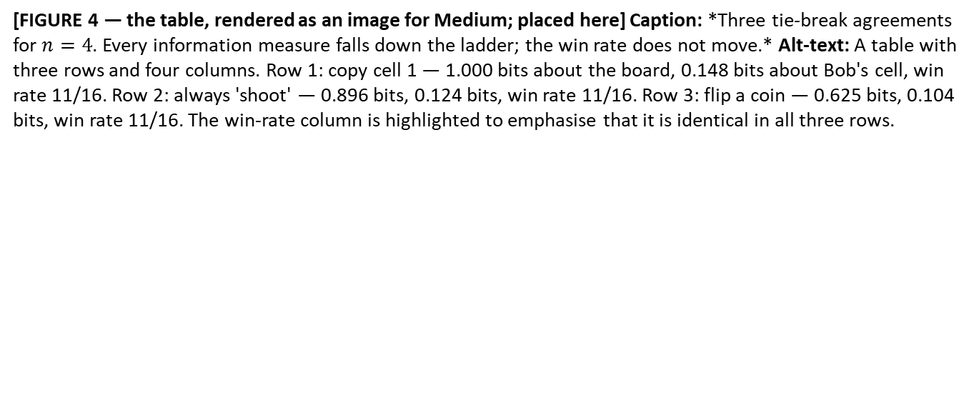
Figure 4
[FIGURE 4 — the table, rendered as an image for Medium; placed here] Caption: *Three tie-break agreements for $n=4$. Every information measure falls down the ladder; the win rate does not move.* Alt-text: A table with three rows and four columns. Row 1: copy cell 1 — 1.000 bits about the board, 0.148 bits about Bob's cell, win rate 11/16. Row 2: always 'shoot' — 0.896 bits, 0.124 bits, win rate 11/16. Row 3: flip a coin — 0.625 bits, 0.104 bits, win rate 11/16. The win-rate column is highlighted to emphasise that it is identical in all three rows.

Slide 10
Tie-break rule | Information Alice reveals about her board | RAC win rate
Copy a fixed cell | 1.000 bits | 11/16
Always 'shoot' | 0.896 bits | 11/16
Flip a coin | 0.625 bits | 11/16

Slide 11

[FIGURE 5 — centrepiece; placed here] Caption: *Top: row $n−1$of Pascal's triangle for $n=8$(1, 7, 21, 35, 35, 21, 7, 1), coloured by the bit send by Alice; mirror pairs cancel win against loss, and the one cell left of the axis — the tie — survives. Bottom: the same rows normalised for $n=4,8,16$, the bell curve emerging and the surviving cell shrinking like $1/\sqrt{n}$.* Alt-text: Top half: two horizontal bar rows. First row has four blocks sized 1, 3, 3, 1; second row has eight blocks sized 1, 7, 21, 35, 35, 21, 7, 1. In each, blocks right of the central dashed axis are green and labelled "win", blocks left are red and labelled "loss", except the block immediately left of the axis, which is yellow and labelled "tie — pays 1/2". Curved arcs pair each green block with its red mirror image. Bottom half: three normalised bar silhouettes for n = 4, 8, 16 with a bell curve overlaid, the yellow central block visibly smaller in each successive silhouette.

Slide 12
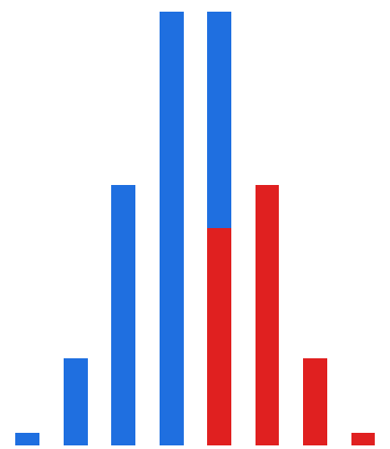

For n = 8, imagine Bob has to guess ‘1’ on his index to win.
How likely is Alice to send a ‘1’?
Group 128 possible strings by the number of 1’s (by Hamming weight)
Alice sends a 1: Win
Alice sends a 0: Loss
Nr of 1’s:
8x ‘1’
7x ‘1’
6x ‘1’
5x ‘1’
4x ‘1’
3x ‘1’
2x ‘1’
1 x ‘1’
Tied strings: Alice sends a random ‘0’ or ‘1’.
Win rate: $P= \frac{1}{2}+ \frac{1}{2} ∙P_{tie}$

Slide 13

[FIGURE 6 — centrepiece; placed here] Caption: *The cancellation, drawn. Top: row $n−1$of Pascal's triangle for $n=8$(1, 7, 21, 35, 35, 21, 7, 1), coloured by the bit send by Alice; mirror pairs cancel win against loss, and the one cell left of the axis — the tie — survives. Bottom: the same rows normalised for $n=4,8,16$, the bell curve emerging and the surviving cell shrinking like $1/\sqrt{n}$.* Alt-text: Top half: two horizontal bar rows. First row has four blocks sized 1, 3, 3, 1; second row has eight blocks sized 1, 7, 21, 35, 35, 21, 7, 1. In each, blocks right of the central dashed axis are green and labelled "win", blocks left are red and labelled "loss", except the block immediately left of the axis, which is yellow and labelled "tie — pays 1/2". Curved arcs pair each green block with its red mirror image. Bottom half: three normalised bar silhouettes for n = 4, 8, 16 with a bell curve overlaid, the yellow central block visibly smaller in each successive silhouette.

Slide 14
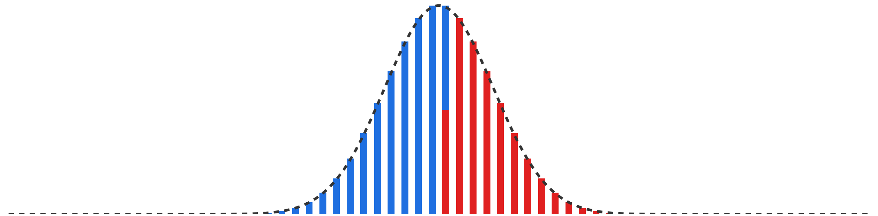
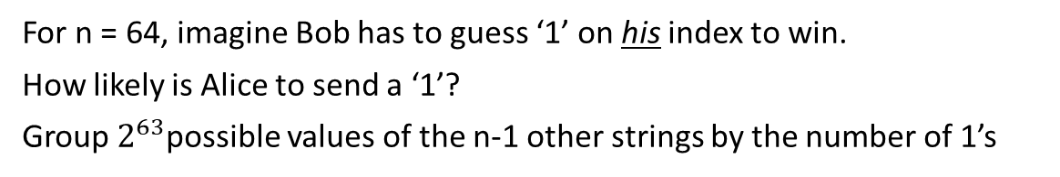
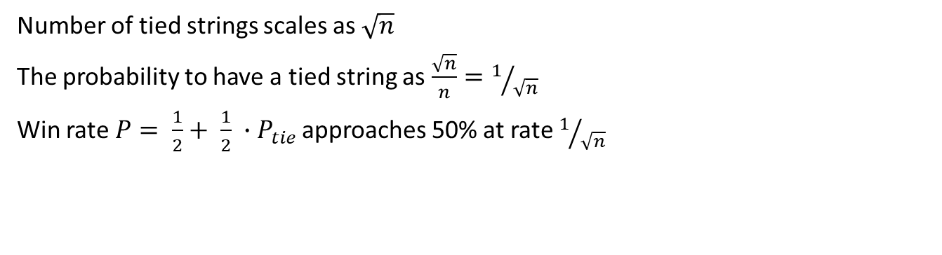
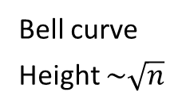
For n = 64, imagine Bob has to guess ‘1’ on his index to win.
How likely is Alice to send a ‘1’?
Group $2^{63}$possible values of the n-1 other strings by the number of 1’s
Bell curve
Height $\sim \sqrt{n}$
Nr of 1’s:
64 x ‘1’
33 x ‘1’
31x ‘1’
1 x ‘1’
String has mostly 1’s
Alice sends A ‘1’
String has mostly 0’s
Alice sends A ‘0’
32 x ‘1’
Tied strings: Alice sends a random ‘0’ or ‘1’.
Number of tied strings scales as $\sqrt{n}$
The probability to have a tied string as $\frac{\sqrt{n}}{n}=1/{\sqrt{n}}$
Win rate $P= \frac{1}{2}+ \frac{1}{2} ∙P_{tie}$ approaches 50% at rate $1/{\sqrt{n}}$

Slide 15

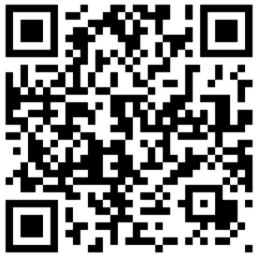
https://robhendrik.github.io/QSeaBattle/
(or check out the repo at https://github.com/robhendrik/QSeaBattle)

