Slide 1

QSeaBattle A two-player game where success is limited by information flow
How to benefit from (quantum) non-locality in an information game.
Rob Hendriks, January 2026

Slide 2
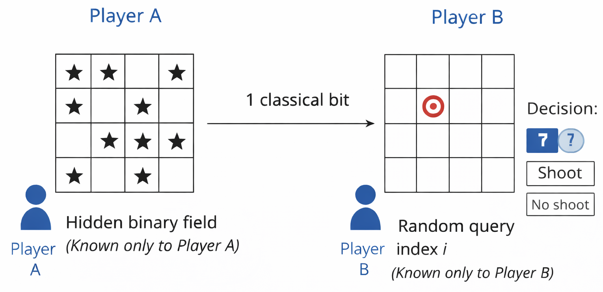
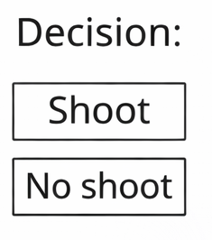
Winning is:
Shoot the enemy
Not shoot an empty cell
Rules
Game is played on nxn grid
Each cell has equal probability to contain enemy ship
Alice knows the position of enemy ships
Bob knows where the gun is pointing
Alice communicates m bits to Bob
Bob decides whether to shoot, or not shoot the gun

Slide 3
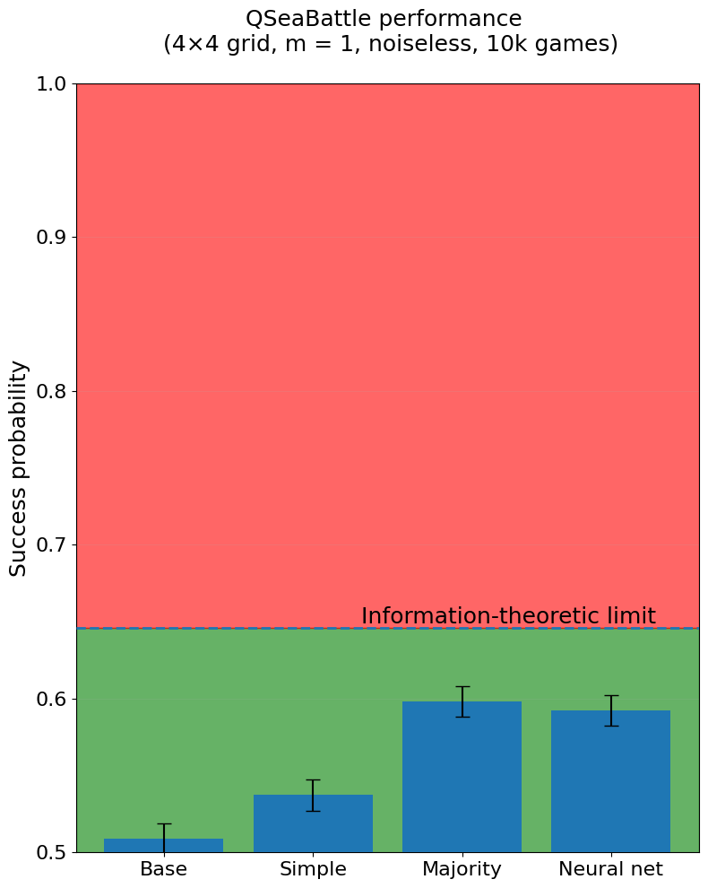
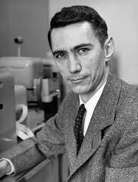
Classical players
Base players: Random guess
Simple players: Communicate the value of first cell
Majority players: Communicate the value that occurs most
AI players: Neural networks learning from scratch
Claude Shannon

Slide 4
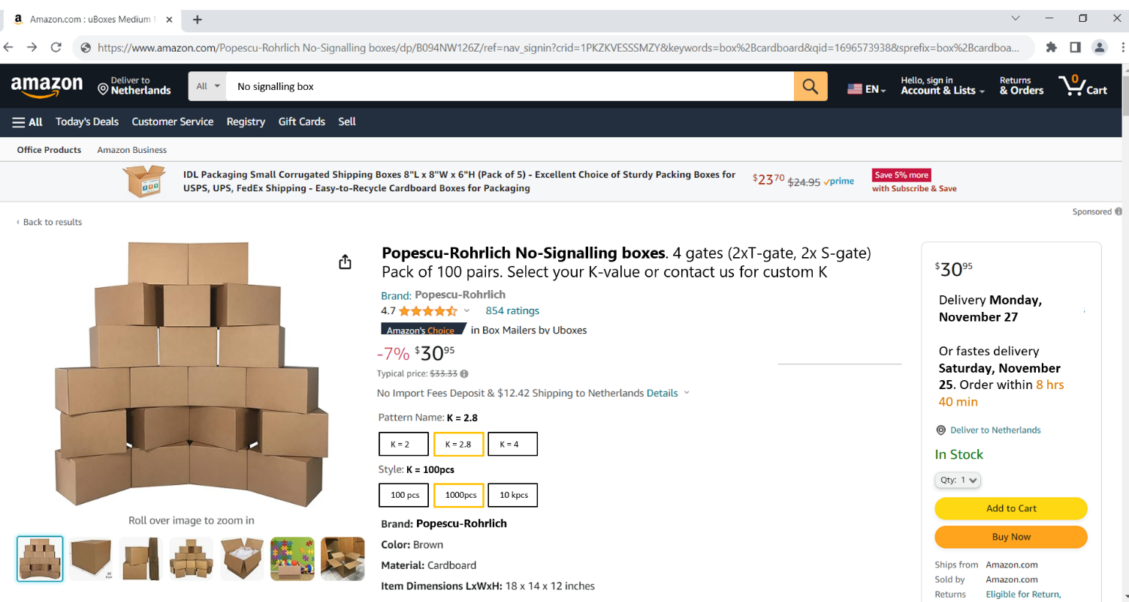
Box rule:
Box can be opened from the Top (T) or Side (S). This is destructive!
Individually what they find in the box is random (e.g., Barbie or Ken with 50%)
Alice and Bob always find the same present, except when they both open from the top: Then they always find a different present
Boxes come with a ‘quality’ K:
K = 4: Boxes always obey the rule,
K < 4: P boxes obey and ‘1-P’ boxes deviate from the rule.
K = 0: Boxes are random (P = 50%)
The boxes do not contain information, and cannot be used to signal information
$$K=|<SS> +<ST> + <TS> − <TT>|$$

Slide 5

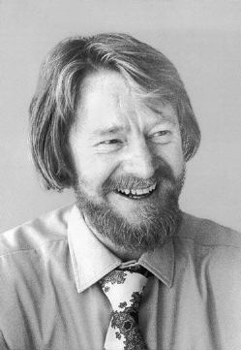
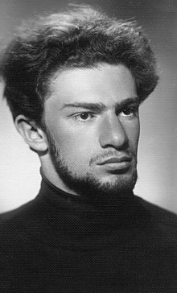





Boundaries
$$K=|<SS> +<ST> + <TS> − <TT>|$$
P = 50%
P = 75%
P = 85%
P = 100%
Classical
Quantum
Post-Quantum
K $=0$
$$K=4$$
K $≤2$
$$2<K≤2\sqrt{2}$$
$$2\sqrt{2}<K≤4$$
Bell inequality
Tsirelson bound

Slide 6
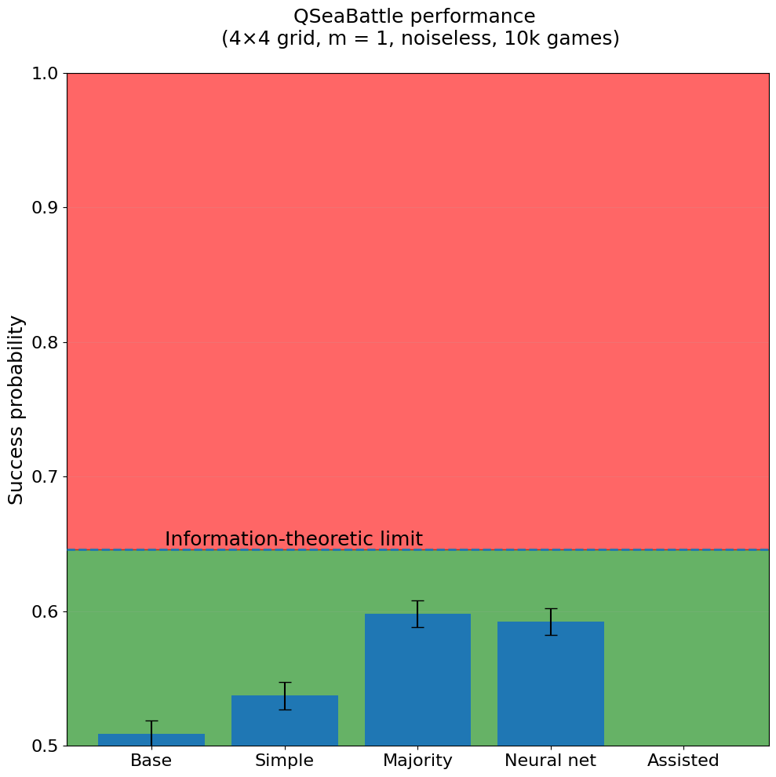
Assisted players
AI’s that combine ‘standard’ layers with
‘entangled’ layers (consisting of our ‘boxes’)
For now we take P=100%:
Boxes always obey ‘the rule’.
Same game settings as before.
The AI’s achieve a success rate that corresponds to sharing 16bits of information!
Remember:
The boxes do not contain information
The boxes cannot be used to channel information
We break Shannon and Tsirelson in one go!

Slide 7
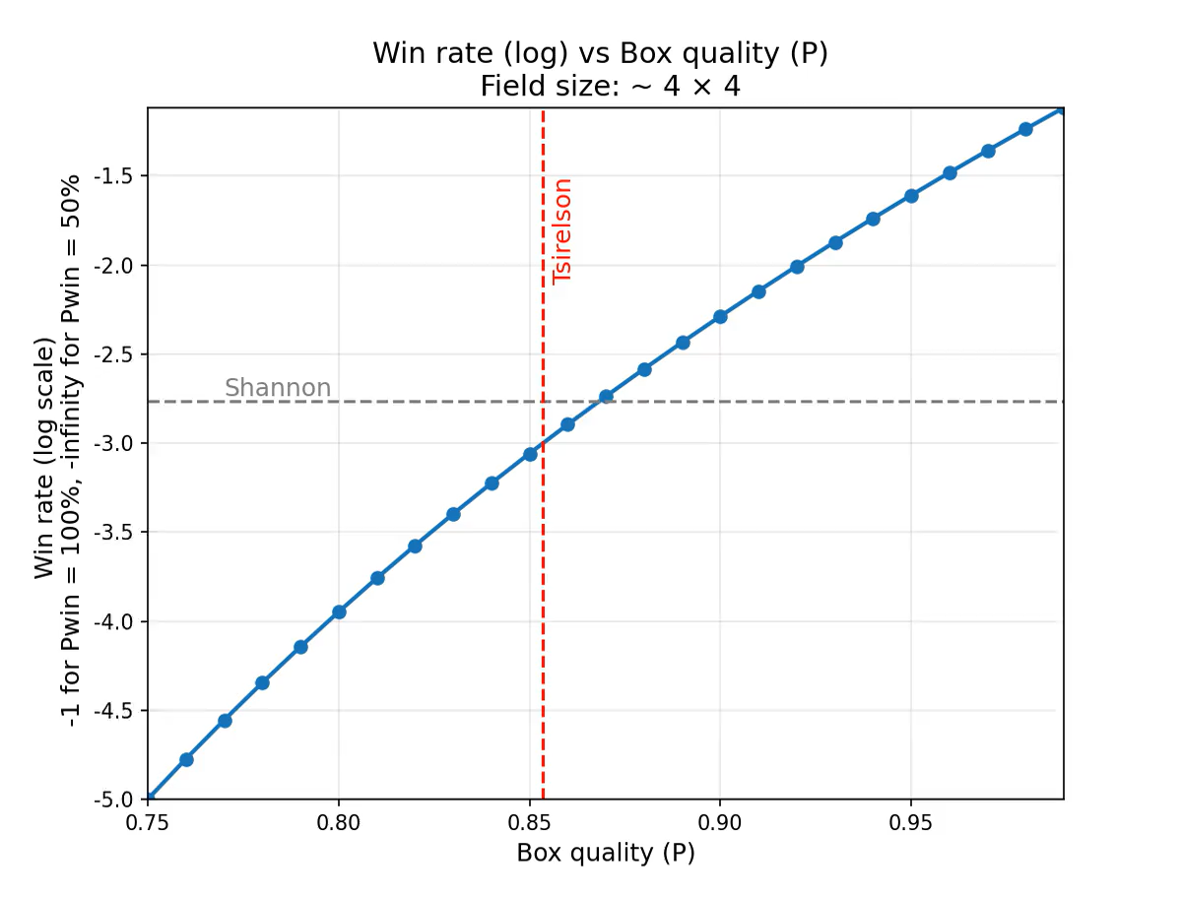
Large field limit

Slide 8

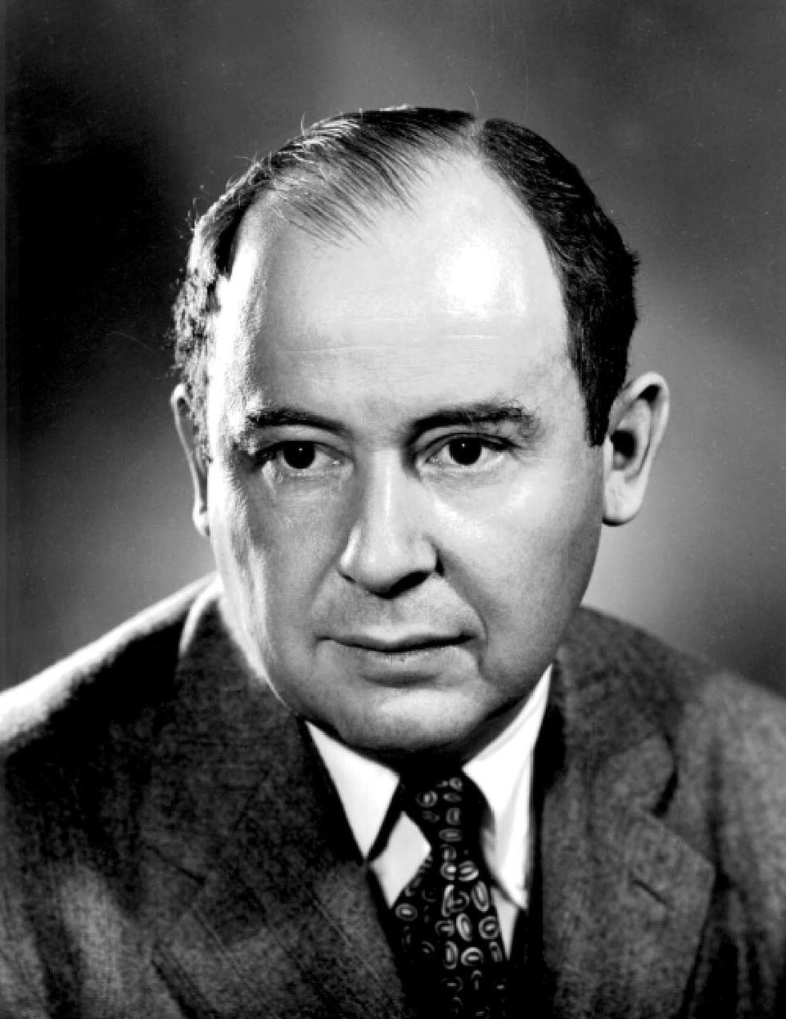


Two starting point leading to same boundary on non-locality What is the connection?
Starting from John von Neumann’s quantum mechanics: Hilbert space, (non-)commuting operators, ….
Starting from Shannon’s information theory: Entropy, mutual information, …
$$K=2\sqrt{2}$$
$$K= 2\sqrt{2}$$
Is there a deeper principle connecting these fields, and what does this teach us about the foundations of quantum mechanics?

Slide 9

References
W. van Dam Implausible consequences of superstrong nonlocality Natural Computing 12, 9–12 (2013) (original result: communication complexity collapse)
B. S. Tsirelson Quantum generalizations of Bell’s inequality Letters in Mathematical Physics 4, 93–100 (1980) (derivation of the Tsirelson bound)
F. Clauser, M. A. Horne, A. Shimony, and R. A. Holt
Proposed Experiment to Test Local Hidden-Variable Theories.
Phys. Rev. Lett., 23, 880– 884 (1969)
M. Pawłowski, T. Paterek, D. Kaszlikowski, et al. Information causality as a physical principle Nature 461, 1101–1104 (2009) (information-theoretic explanation of Tsirelson’s bound)
J. Bub Bananaworld: Quantum Mechanics for Primates In: Interpreting Quantum Mechanics, Cambridge University Press (2016) (conceptual explanation of nonlocal correlations)
J. Foerster, Y. M. Assael, N. de Freitas, S. Whiteson Learning to Communicate with Deep Multi-Agent Reinforcement Learning Advances in Neural Information Processing Systems (NeurIPS) 2016 (Introduces DIAL and the Discretize/Regularize Unit (DRU) for learning communication under bandwidth constraints)
QSeaBattle Documentation
https://robhendrik.github.io/QSeaBattle/
(or check out the repo at https://github.com/robhendrik/QSeaBattle)

Slide 11
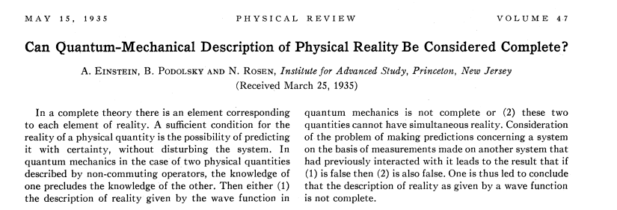
EPR 1935 / Alain Aspect 1982
One source, two measuring parties
Each party selects between 2 measurements (T/S)
For every measurement they get 1 outcomes from two possibilities(1/0)
➔ 16 ‘situations’
Measurement Alice | Measurement Bob | Outcome Alice | Outcome Bob | Correlation
T | T | 1 | 0 | ‘TT’ = -1
T | T | 0 | 0 | ‘TT’ = 1
S | T | 1 | 0 | ‘ST’ = -1
T | S | 1 | 1 | ‘TS’ = 1
etc | etc | etc | etc | etc
$$CHSH correlation=|<SS> +<ST> + <TS> − <TT>|$$

