Slide 1
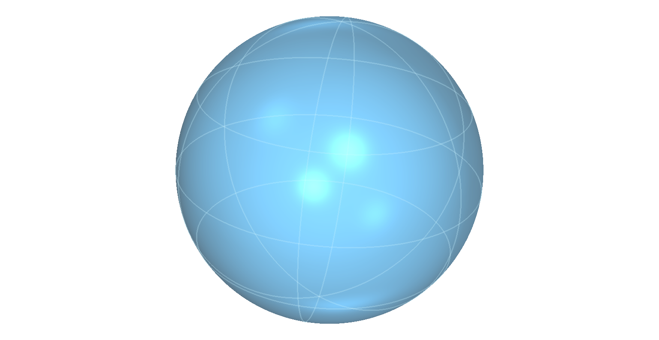

0 | 1 | 2 | 3
4 |  | 6 | 7
8 | 9 | 10 | 11
12 | 13 | 14 | 15
Alice
One bit
Bob

