Slide 1
Yelp me Yelp you:
Can Existing Restaurant Reviews Help Predict
Optimal Locations for Aspiring
Restauranteurs?

Slide 2
Goals:
1. Predict popularity score of a restaurant:
Build a model that can use restaurant category features (ethnicity, venue type, food type) to
Predict whether a potential restaurant has an overall good rating
2. Predict best city for restaurant:
Build a model that can use restaurant category features to predict best city to establish restaurant

Slide 3
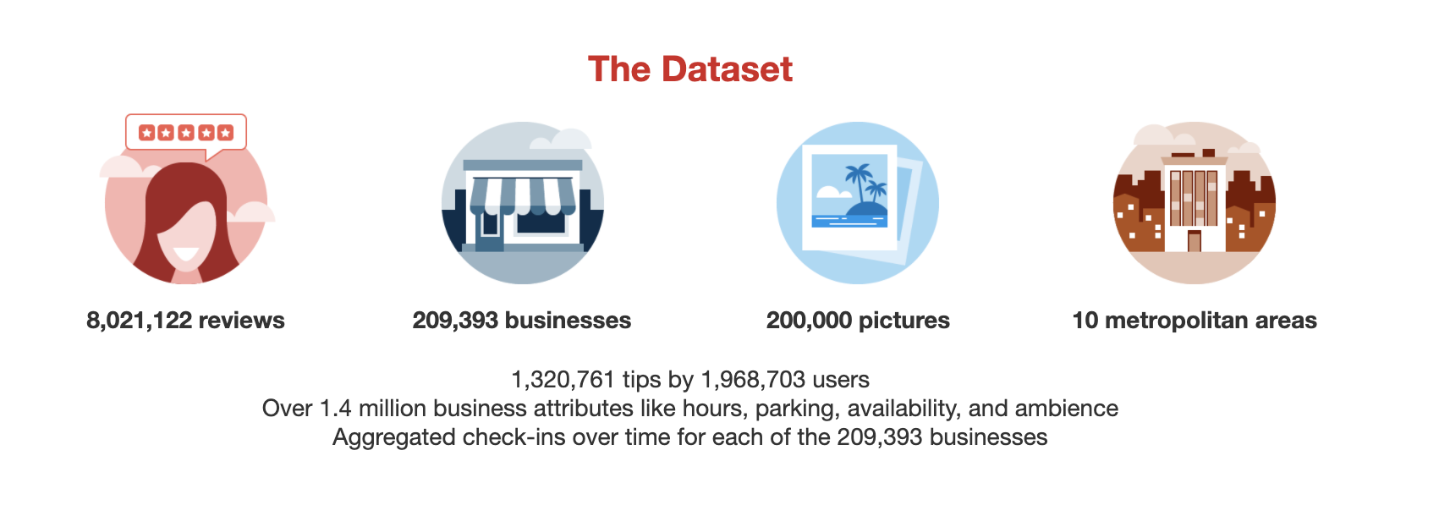

https://www.yelp.com/dataset

Slide 4
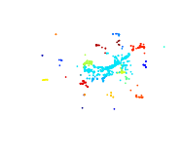
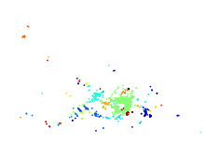
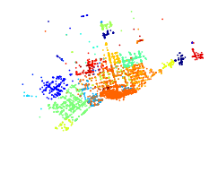
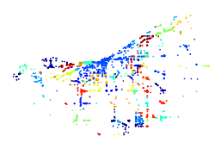
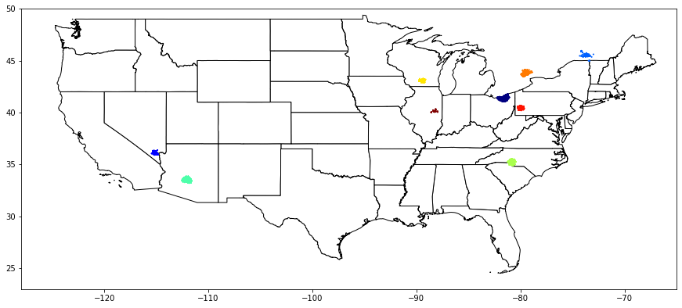
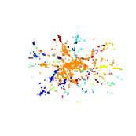
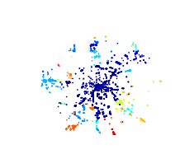
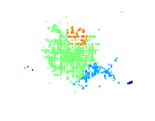
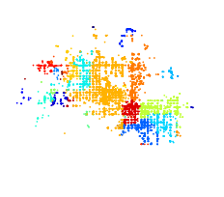
Madison
Toronto
Montreal
Business reviews by location
Cleveland
QC
WI
ON
PA
Pittsburg
NV
OH
AZ
NC
Charlotte
Las Vegas
Phoenix

Slide 5
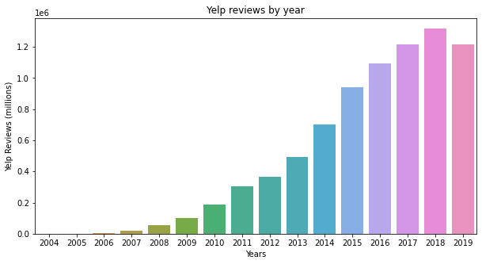
Business reviews by year

Slide 6
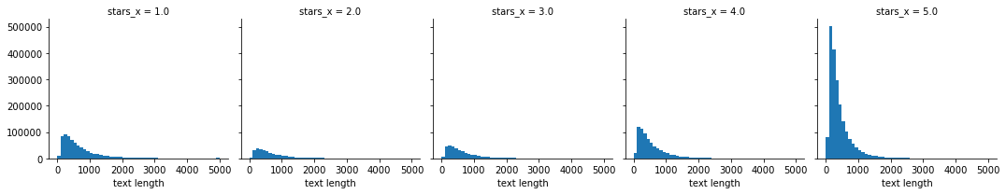
Restaurant review stars vs length of review

Slide 7
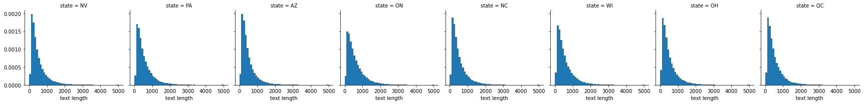
Restaurant length of review by city

Slide 8
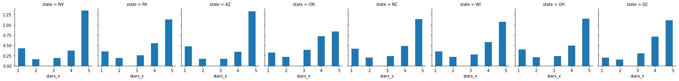
Restaurant review stars by city

Slide 9
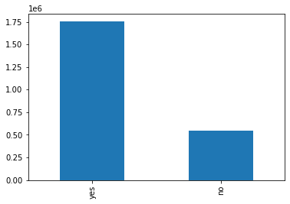
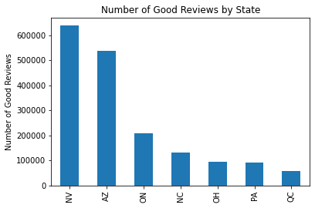
Class Imbalance
Predict overall popularity
Predict Best city
Total Reviews (all citiess)
Good Reviews by City
Number of Reviews
Good
Reviews
Bad
Reviews
Down-sample both sets of data

Slide 10
Selected regions
Used for building model
Toronto
Montreal
Cleveland
ON
Pittsburg
NV
OH
AZ
NC
Charlotte
Las Vegas
Phoenix

Slide 11
Making the models
Features
Labels
1
Score
prediction
Restaurant word
vectorization
by TF-IDF
Binary score:
Good (reviews with 4 and 5 stars)
Bad (reviews with 1 and 2 stars)
Best city:
Las Vegas (NV)
Phoenix (AZ)
Pittsburg (PA)
Montreal (QC)
Toronto (ON)
Cleveland (OH)
Charlotte (NC)
2
Restaurant word
vectorization
by TF-IDF
only from positively
reviewed restaurants
Best city
prediction

Slide 12
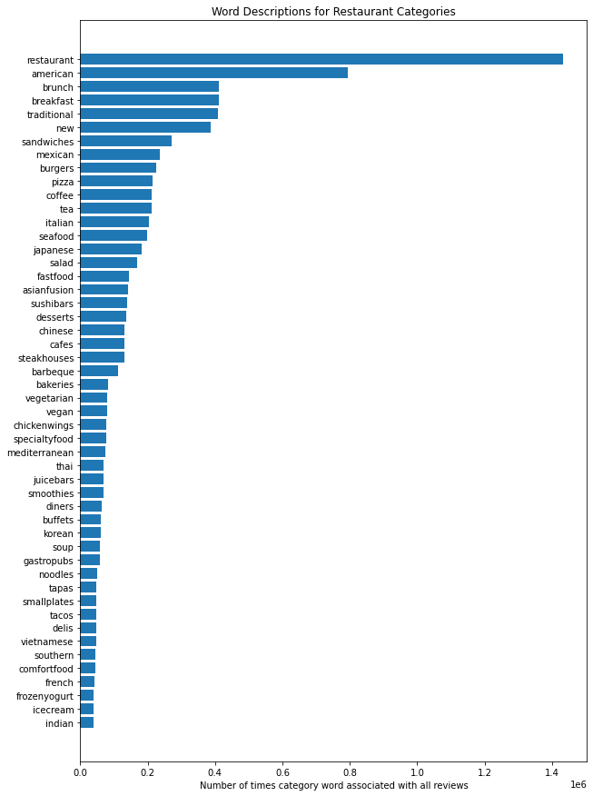
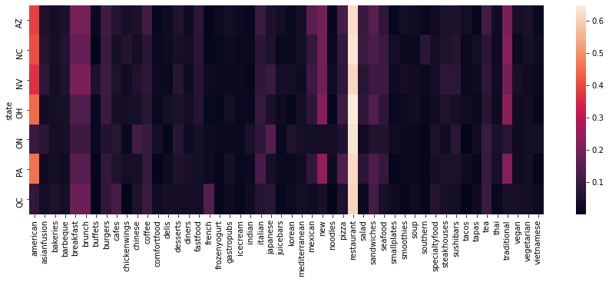
Vectorization of Restaurant Category Words
Restaurant Category Word
Counts In Across Reviews
Restaurant Category
Word Counts Per City

Slide 13
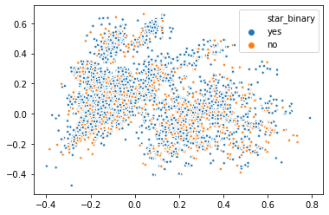
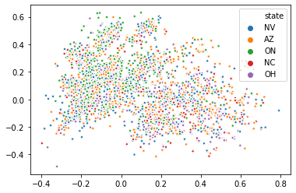
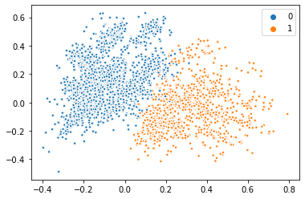
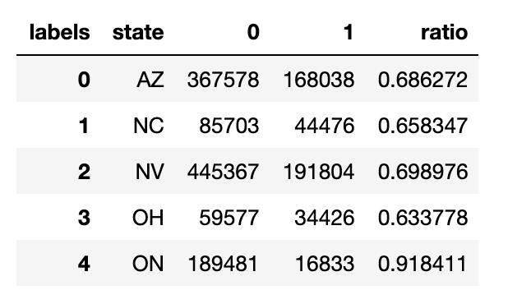
PCA of reviews by score and city
Review Score Labels
City Labels
K means Labels
Cluster grouping
By Cities

Slide 14
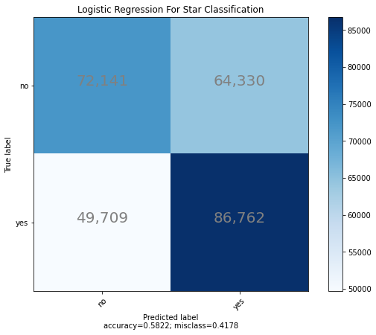
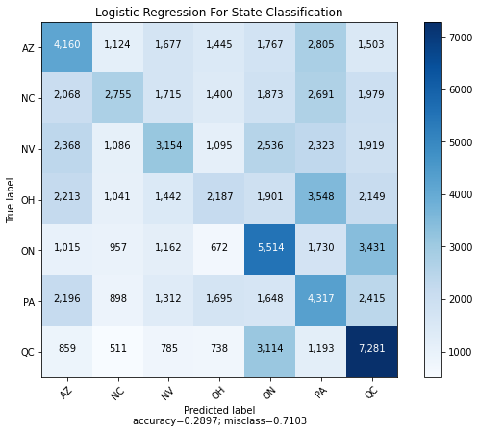
Logistic Regression
Review Classification
City Classification
Bad
Good
Good
Bad Good
Test macro average recall score is 0.582
Train macro average recall score is 0.58
Test macro average recall score is 0.29
Train macro average recall score is 0.29
1.1643719178433514
2.028036737794352

Slide 15
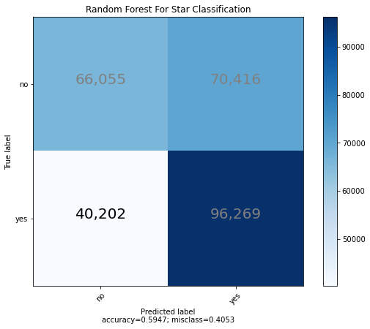
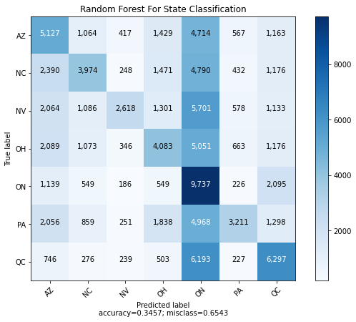
Random Forest
Review Classification
City Classification
Bad
Good
Bad Good
Test macro average recall score is 0.58
Train macro average recall score is 0.58
Test macro average recall score is 0.59
Train macro average recall score is 0.59
1.1894395146221541
2.4202057868931703

Slide 16
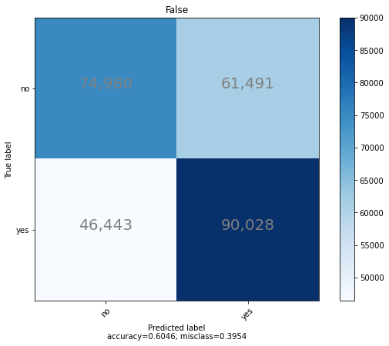
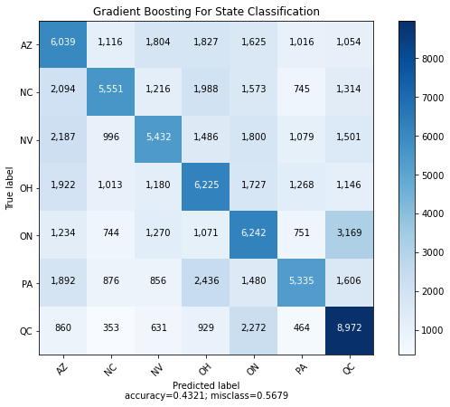
Gradient Boost
Review Classification
City Classification
Bad
Good
Bad Good
Test macro average recall score is 0.60
Train macro average recall score is 0.60
Test macro average recall score is 0.43
Train macro average recall score is 0.43
1.209106696660829
3.024376769560113

Slide 17
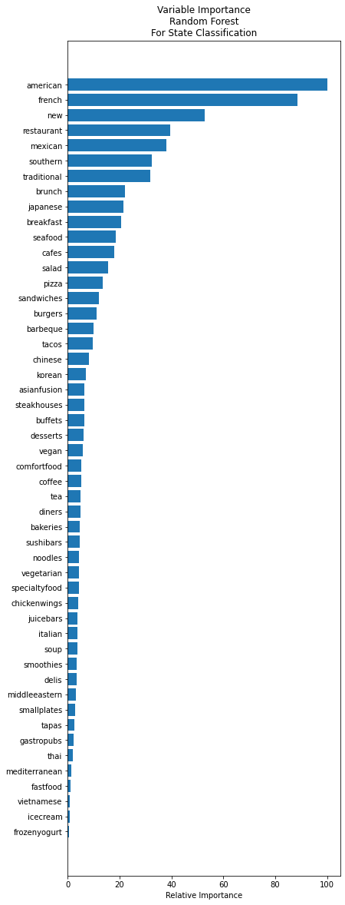
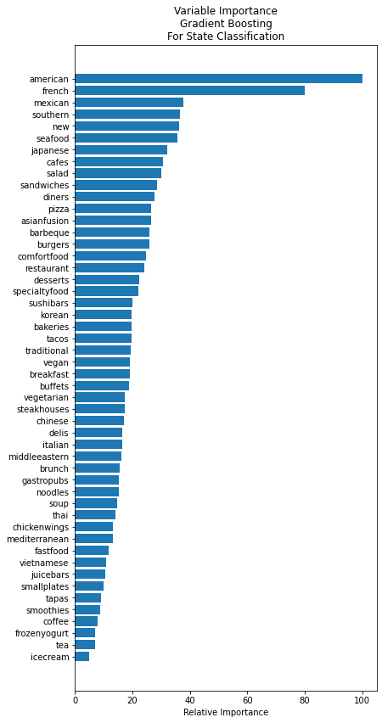
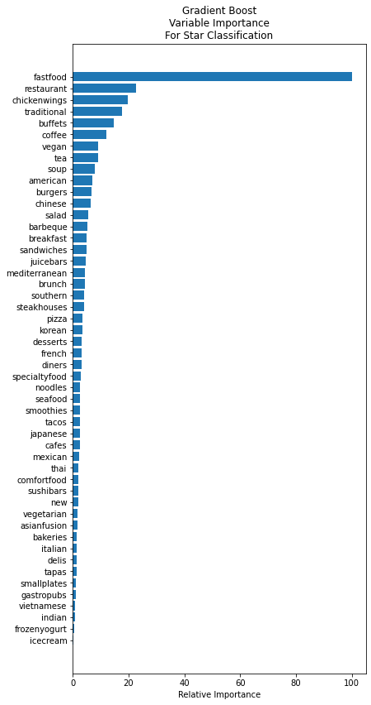
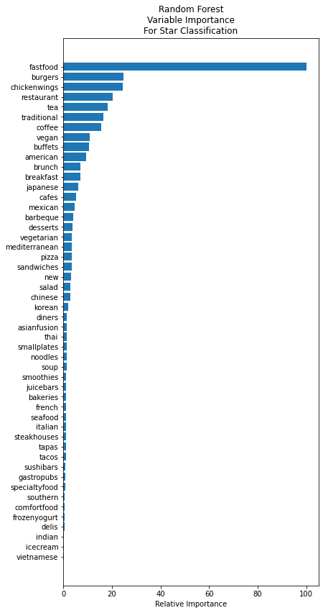

Slide 18
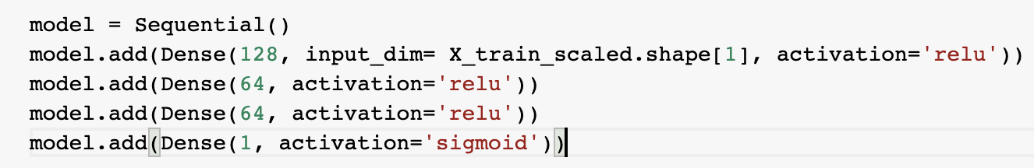
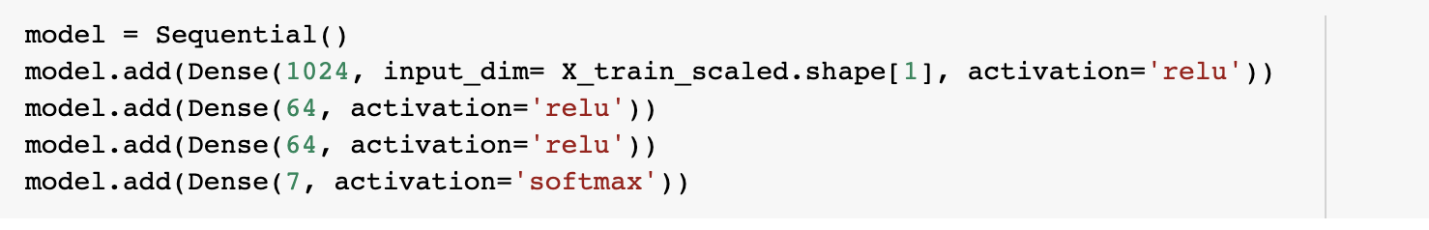
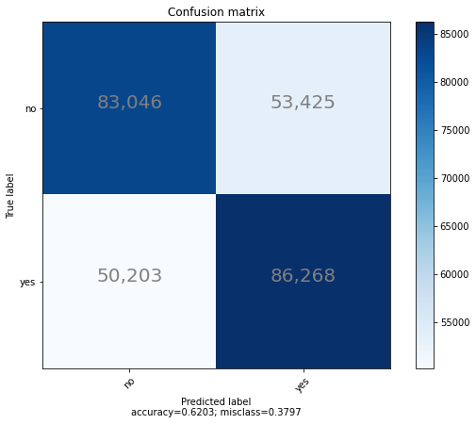
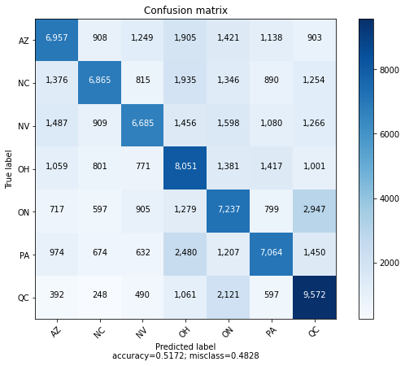
Neural Network
Review Classification
City Classification
Bad
Good
Bad Good
Test macro recall 0.61
Test macro recall 0.52
1.2406591876662443
3.620675367723224

Slide 19
Conclusions
Fold better than chance
Percent better than chance
Also, category words definitely associate regions (or cities, especially US vs Canada)

Slide 20
Future Directions
Short-term
Hyper-tuning
Improve category words for vectorization
Long-term
Prediction of best zip code
Improve category words for vectorization
Add demographic features (ethnicity distribution of population, aver age group, marital status)
Add restaurant density information by city or even by zipcode
Overlay traffic pattern info from latch data from US bureau of transportation (street level decisions)
Flip model to predict restaurant words best associated with positive review by region

