Slide 1
Data Science for Business: Project
Rodrigues Alves Danny
Robin Genolet

Slide 2
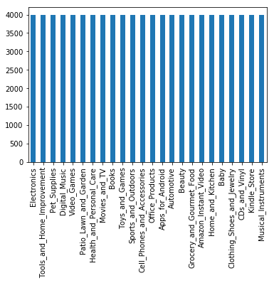
Step 1, preprocessing
Data is uniformly distributed
Features that we dropped:
asin
reviewTime
unixReviewTime
reviewerName
For this step, we use only 2 features
reviewText tf-idf
summary tf-idf
Why?
Models yield better results without the features that we create in steps 2 & 3

Slide 3
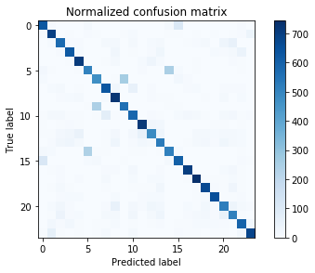

Step 1, best model
Final ranking:
Linear Support Vector Classification
Linear SVM (with SDG)
Random Forest Classifier
KNN Classifier
Dummy classifier
And the winner is: Linear Support Vector Classification
Precision (%)
76.1
73.5
60
47.75
4.5
$$\frac{1}{24} :4.16$$

Slide 4
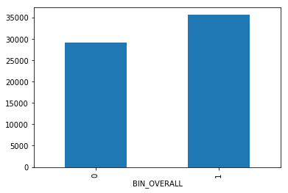
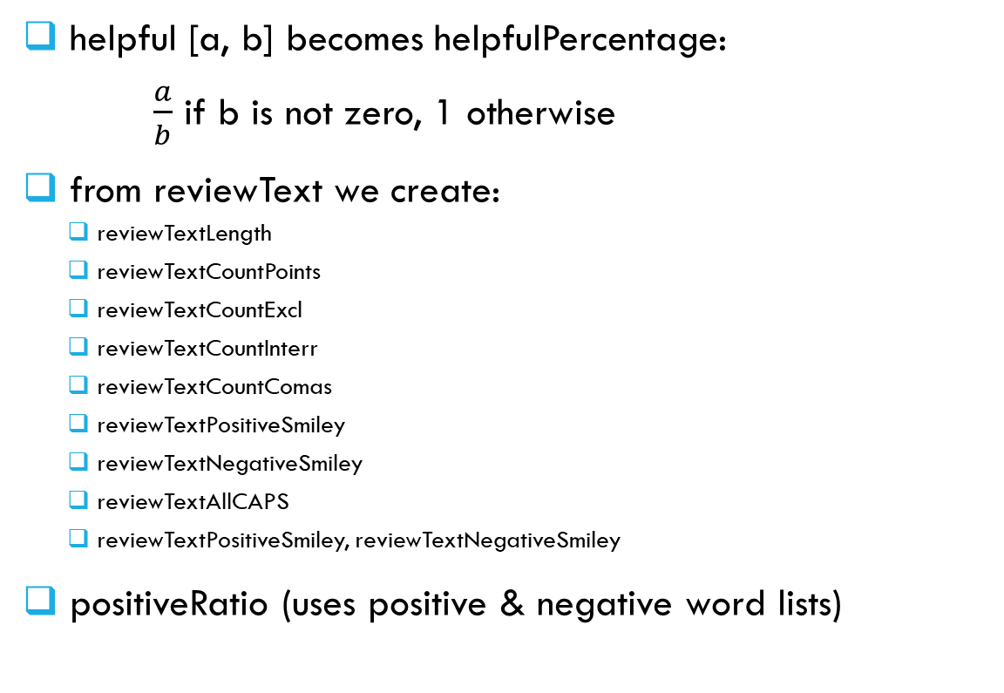
Step 2, preprocessing
Skewed data
helpful [a, b] becomes helpfulPercentage:
$\frac{a}{b}$ if b is not zero, 1 otherwise
from reviewText we create:
reviewTextLength
reviewTextCountPoints
reviewTextCountExcl
reviewTextCountInterr
reviewTextCountComas
reviewTextPositiveSmiley
reviewTextNegativeSmiley
reviewTextAllCAPS
reviewTextPositiveSmiley, reviewTextNegativeSmiley
positiveRatio (uses positive & negative word lists)
We don’t merge features reviewText and Summary
Avoid loss of information (e.g. summary has specific keywords
We could have added features that guess if user is good/random/bad worker
Avoids trolls

Slide 5
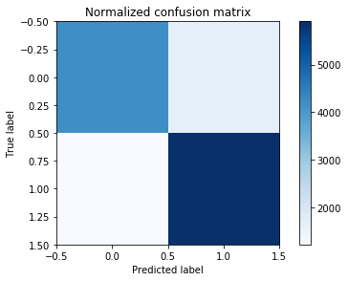

Step 2, best model
Final ranking:
Linear Support Vector Classification
Linear SVM (with SDG)
Random Forest Classifier
KNN Classifier
Dummy classifier
And the winner is (again): Linear Support Vector Classification
Precision (%)
77.9
77.3
76.1
63.3
4.5
$$\frac{1}{2}:50$$

Slide 6
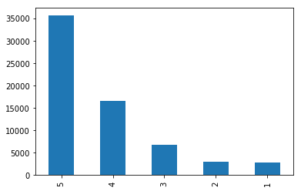

Step 3
Final ranking:
Linear Support Vector Classification
Linear SVM (with SDG)
Random Forest Classifier
KNN Classifier
Dummy classifier
Same order in each step!
Precision (%)
57
50.93
57.1
44
20.2
Skewed data:
Use all created features
$$\frac{1}{5}:20$$

