Slide 1
Location based event notification
A Mobile application to remind you place about anything

Slide 2
OUTLINE
Objective
Scope of project
Business requirement
Architecture
Modular Design
Component table
Script Details
Implementation plan
Test Plans
References

Slide 3
OBJECTIVE
The Location based event notifier is a mobile application developed to provide the end users with the various types of notification’s according to the location he is in. According to the need of user.
Now the users are having issue with tracking multiple tasks for the day like buying groceries while returning from office or to meet someone, while he is on some specific location.
The proposed solution for this is provided by the mobile device of the users by this application. The user will be sharing his location service in his mobile. Then the user can schedule an event notification by the place he is in. Which will remind the user when he is available at the location. The users can share the event with their friends. And plan/schedule events according to the location. The wider scope this project is to provide the user with custom advertisement and offers available at his location.

Slide 4
Scope of project
Provides ease of access to the end user
Quick and easy to handle application
Providing better reliability
Faster access to the location and easily customizable
Providing efficient output to the user in terms of reminder of tasks by notifying them on correct location

Slide 5
Project requirement
The application should be able to get the accurate location of the user.
The user should be able to add event to his current location.
The system should be capable of understanding the time gap between scheduling and reminding.
The users should be able to schedule event at any available location.
To provide users promotional offers and advertisement by location based.

Slide 6
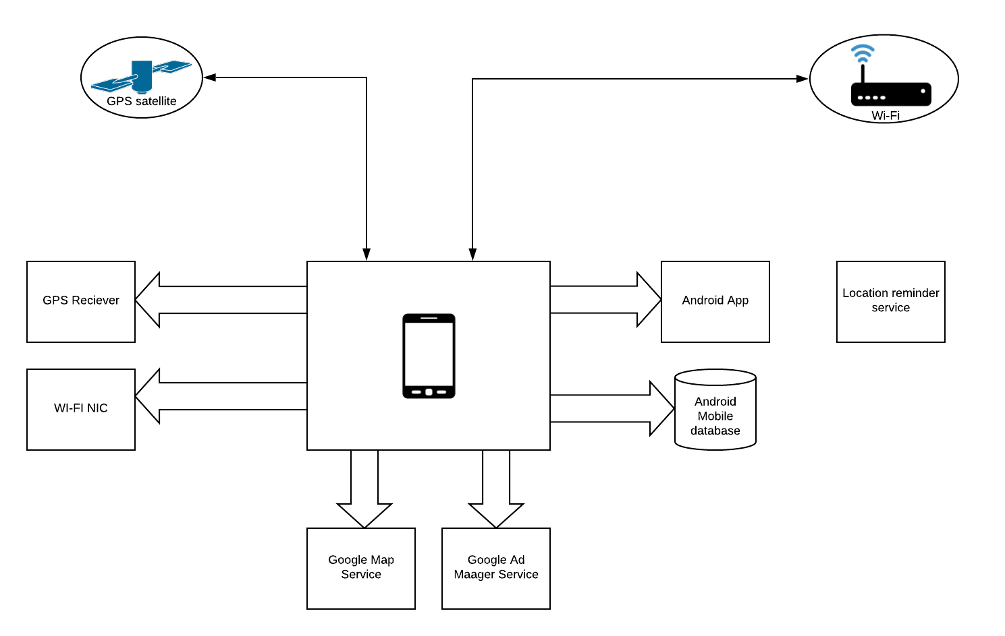
ARCHITECTURAL DESIGN

Slide 7
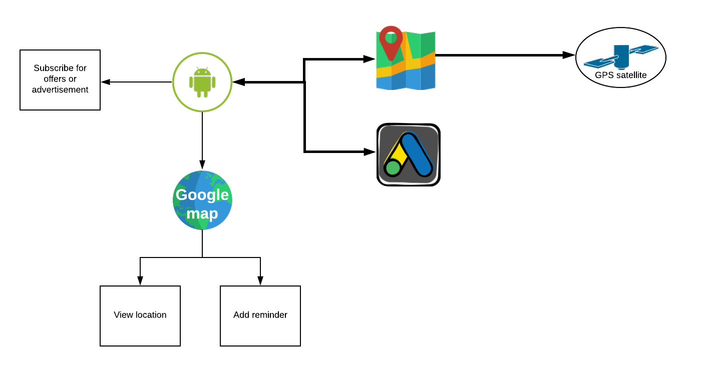
DATAFLOW DESIGN

Slide 8
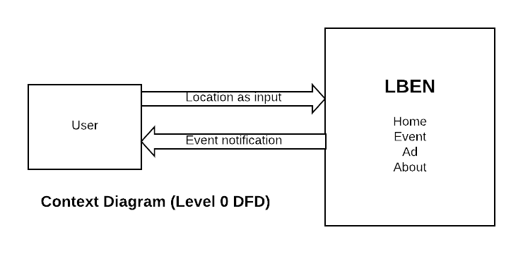
CONTEXT DIAGRAM – Level 0

Slide 9

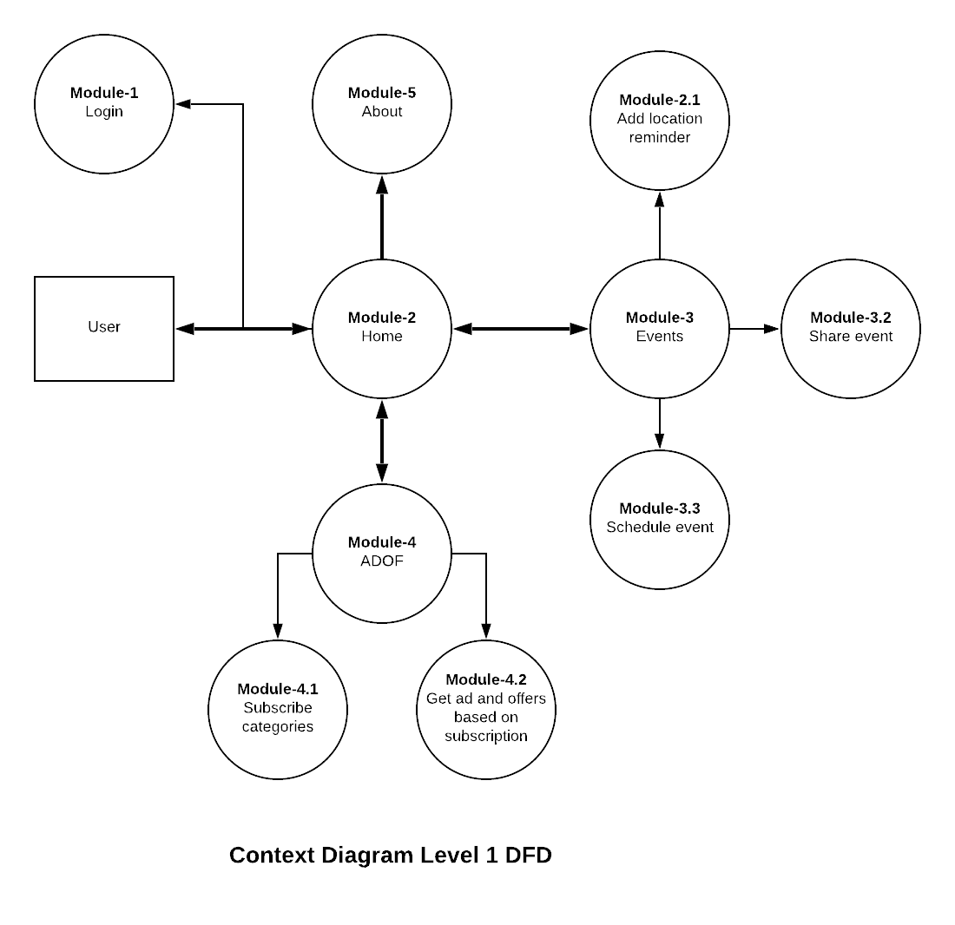
CONTEXT DIAGRAM- Level 1

Slide 10
Model object details
USER_DETAILS
OAUTH_ACCESS_TOKEN
OAUTH_REFRESH_TOKEN
OAUTH_CLIENT_DETAILS
OAUTH_CLIENT_TOKEN
OAUTH_CODE
EVENT_DETAILS
SUBSCRIBED_TOPICS
GOOGLE_ADS_CATEGORIES
API_END_POINTS

Slide 11
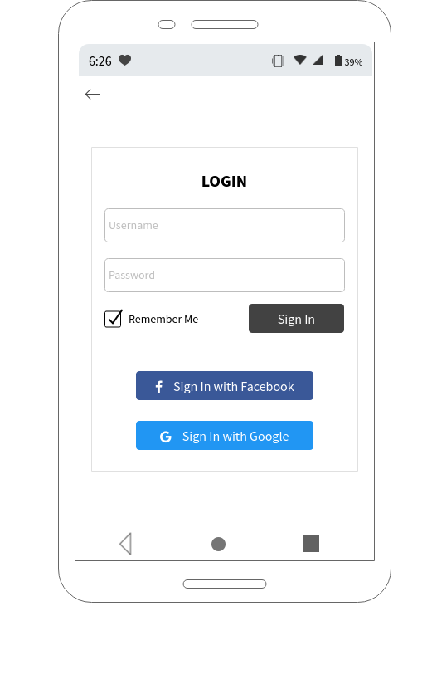
Implementation - LOGIN

Slide 12
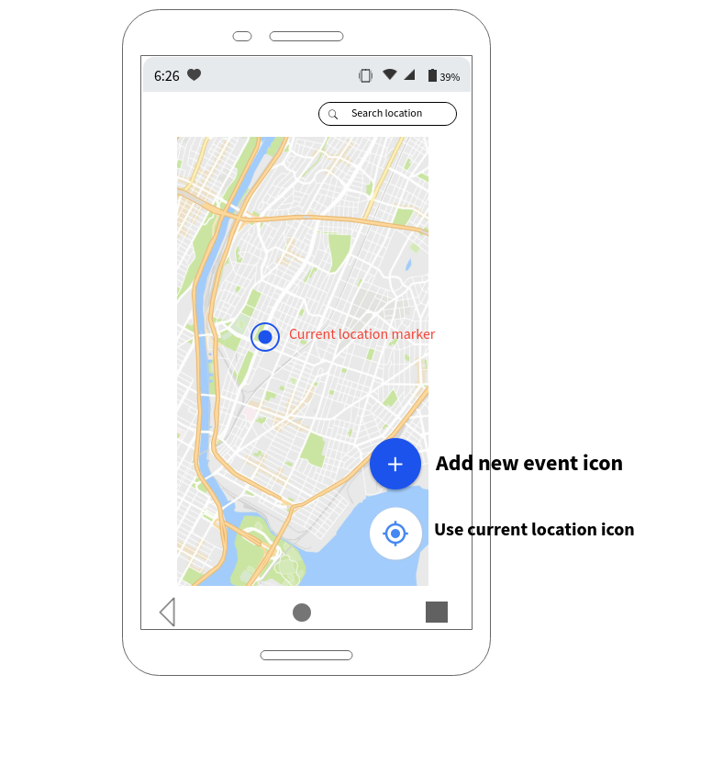
Implementation-HOME SCREEN

Slide 13
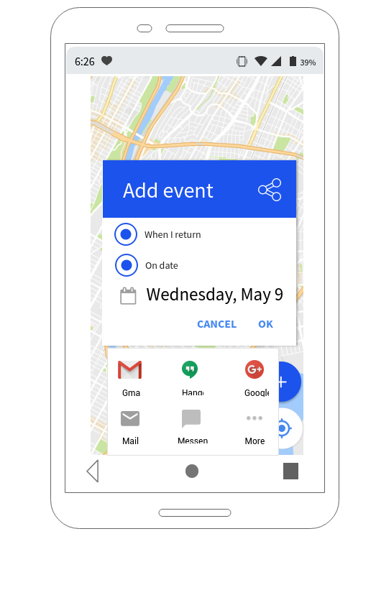
Implementation- ADD EVENT

Slide 14
Test plan -UTC PLAN
Test Case ID | Description | Result | Status
LBEN_UTC_01 | To validate the application is opening on android device | With a click application is opening in android device | PASS
LBEN_UTC_02 | To validate the login | Login is working fine post entering ID and Password | PASS
LBEN_UTC_03 | To validate the location navigator is working | Location navigator is showing the locations as per google map | PASS
LBEN_UTC_04 | To validate the navigation to different features is working fine | Once any feature is clicked the navigation is moving to another page/screen | PASS
LBEN_UTC_05 | To validate post event insertion notification is triggered | Notification is getting triggered | PASS

Slide 15
Test Plan- APT Plan
Test Case ID | Description | Result | Status
LBEN_APT_01 | To validate while writing in password box values are encrypted, to make sure the security of the application | Password is visible in encrypted format making sure about the security | PASS
LBEN_APT_02 | To validate if user entering wrong password error message is showed. | Post entering wrong password, error message is visible as 'Incorrect Password!' | PASS
LBEN_APT_03 | To validate once remember me option is checked, while logging second time user's ID is coming automatically | User is recognized by the system and asked for only password | PASS
LBEN_APT_04 | To validate post entering in the application location navigation is working with all the below features: --> Connection with google maps --> Current location identification --> Search option to check for any location in the map | Location navigation is working fine as per google maps to search location and identify current location | PASS

Slide 16
Test Plan- APT Plan (continued)
Test Case ID | Description | Result | Status
LBEN_APT_05 | To validate if any mid-way store location is added for scheduling the reminder, offers available in that store is fetched and sent to the user | Available offers are showed before reaching to the place | PASS
LBEN_APT_06 | To validate if the place for a particular event is about to come, notification is getting triggered with correct reminder mentioned | Correct notification is triggered while nearing the place of event | PASS
LBEN_APT_07 | To validate if an event involves multiple people the reminder will get sent to them through social media (like Facebook, Instagram, WhatsApp) | Reminder sent to multiple people through social media included in the event | PASS

Slide 17
Test Plan- UAT Plan
Test Case ID | Description | Result | Status
LBEN_UAT_01 | User should be able to login to the application | Login worked | PASS
LBEN_UAT_02 | User should be able to schedule the below details: Location Event Participants | Event scheduled | PASS
LBEN_UAT_03 | User should get notification and related advertisements of his event | Notification triggered | PASS
LBEN_UAT_04 | Multiple users involved in the event should get notified for the event with relevant information | Notification triggered to multiple users | PASS

Slide 18
References
Mohammad Salah Uddin, S. M. Allayear, N. C. Das, and F. A. Talukder “A Location Based Time and Attendance System”.
T. Sohn, et al., "Place-Its: A Study of Location- Based Reminders," in UbiComp, 2005, p. 19.
U. Government. (1999), Global Positioning System. [Online]. www.gps.gov.
Reto Mier, “Professional Android Application Development”.
Ruchika Gupta and BVR Reddy GPS and GPRS Based Cost Effective Human Tracking System Using Mobile Phones.
Location Based Services by Valerie Bennett
Amit Kushwaha, Vineet Kushwaha “Location Based Services using Android Mobile Operating System” International Journal of Advances in Engineering & Technology, Mar 2011. ISSN: 2231-1963.
Mark Dexter version 1.1 (2008),‟Eclipse and Java : Using the Debugger version Companion Tutorial Guide‟ Licensed under the Educational Community License.
http://developers.android.com/index.html

