Slide 1
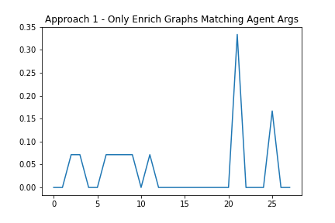
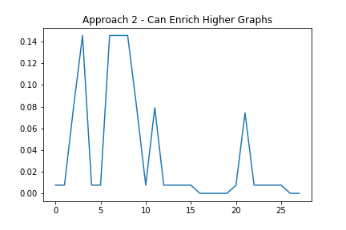
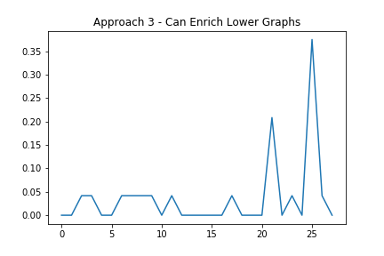
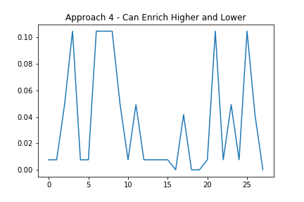
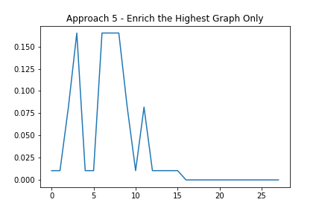
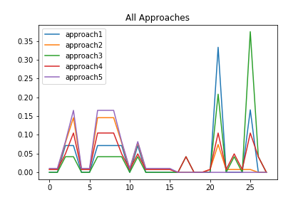
Agent Args | Polarity | Quantity
A,B,C | + | 3
A,B | + | 2
A | + | 1
Known Agent – [C]
 | Apprch1 | Apprch2 | Apprch3 | Apprch4 | Apprch5
Pos Chance | 0.5 | 0.834848 | 0.416667 | 0.707071 | 0.916667
Neg Chance | 0.0 | 0.000000 | 0.000000 | 0.000000 | 0.000000
Ntl lChance | 0.0 | 0.000000 | 0.000000 | 0.000000 | 0.000000
nothingChance | 0.0 | 0.015152 | 0.000000 | 0.015152 | 0.020833
High Agent – [A,B,C,D(+)]
 | Apprch1 | Apprch2 | Apprch3 | Apprch4 | Apprch5
Pos Chance | 0.5 | 0.834848 | 0.416667 | 0.707071 | 0.916667
Neg Chance | 0.0 | 0.000000 | 0.000000 | 0.000000 | 0.000000
Ntl lChance | 0.0 | 0.000000 | 0.000000 | 0.000000 | 0.000000
nothingChance | 0.0 | 0.015152 | 0.000000 | 0.015152 | 0.020833

Slide 2
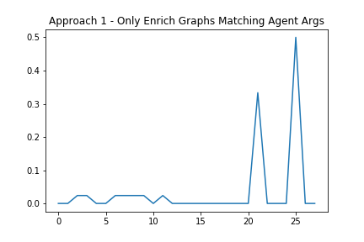
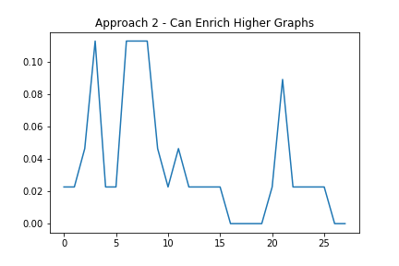
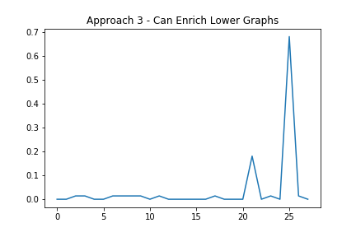
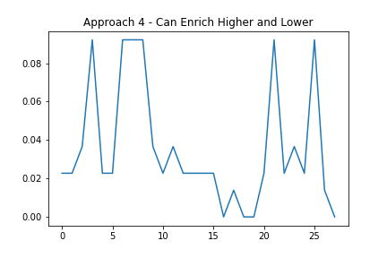
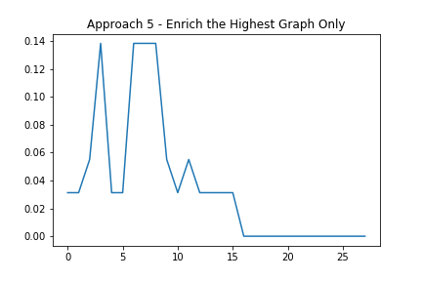
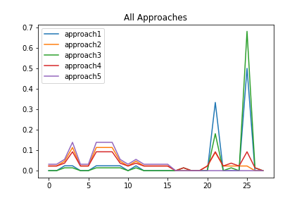
Agent Args | Polarity | Quantity
A,B,C | + | 1
A,B | + | 2
A | + | 3
Known Agent – [C]
 | Apprch1 | Apprch2 | Apprch3 | Apprch4 | Apprch5
Pos Chance | 0.166667 | 0.637879 | 0.138889 | 0.565657 | 0.7500
Neg Chance | 0.0 | 0.000000 | 0.000000 | 0.000000 | 0.000000
Ntl lChance | 0.0 | 0.000000 | 0.000000 | 0.000000 | 0.000000
nothingChance | 0.000000 | 0.045455 | 0.000000 | 0.045455 | 0.0625
High Agent – [A,B,C,D(+)]
 | Apprch1 | Apprch2 | Apprch3 | Apprch4 | Apprch5
Pos Chance | 1.0 | 0.382559 | 1.0 | 0.388287 | 0.355190
Neg Chance | 0.0 | 0.000000 | 0.000000 | 0.000000 | 0.000000
Ntl lChance | 0.0 | 0.000000 | 0.000000 | 0.000000 | 0.000000
nothingChance | 0.0 | 0.015152 | 0.000000 | 0.015152 | 0.020833

Slide 3
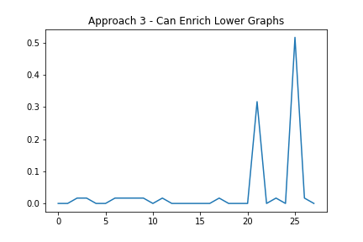
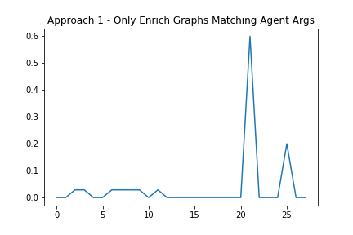
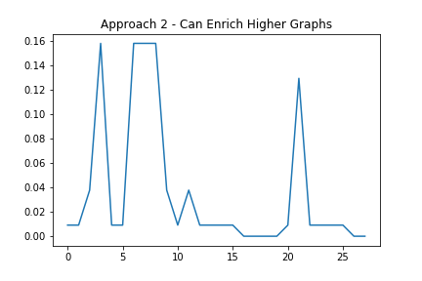
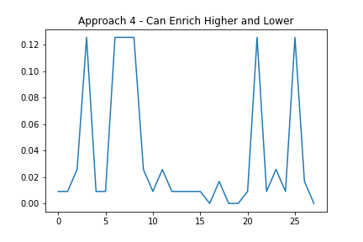
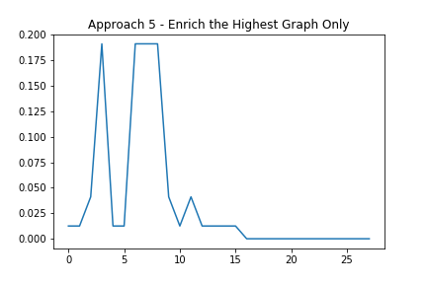
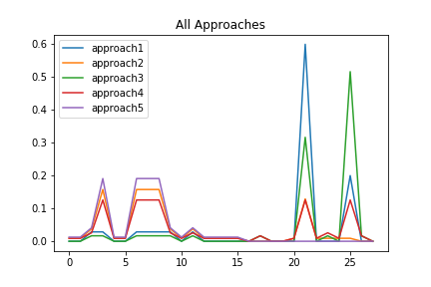
Agent Args | Polarity | Quantity
A,B,C | + | 1
A,B | + | 2
A | + | 1

Slide 4
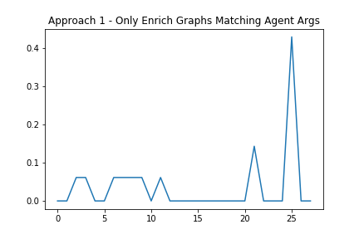
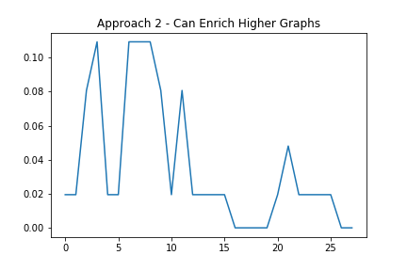
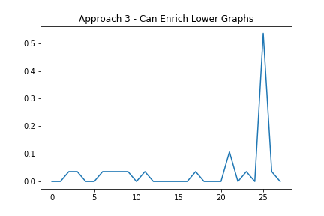
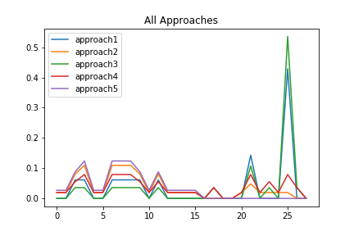
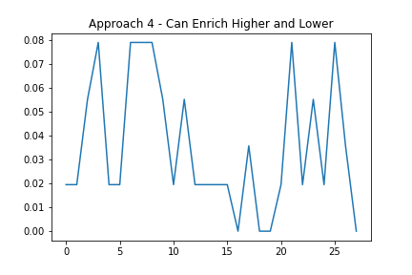
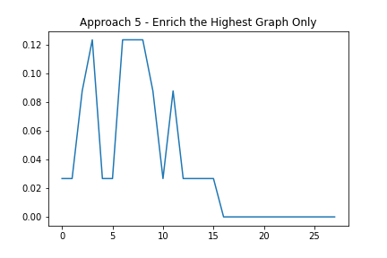
Agent Args | Polarity | Quantity
A,B,C | + | 3
A,B | + | 1
A | + | 3

Slide 5
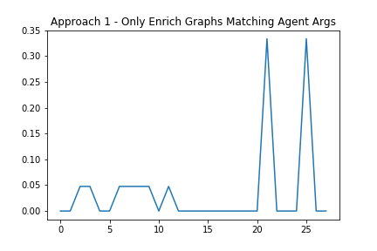
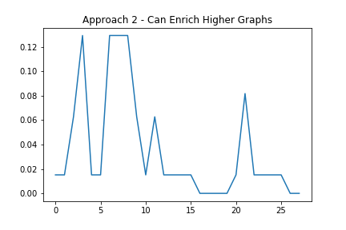
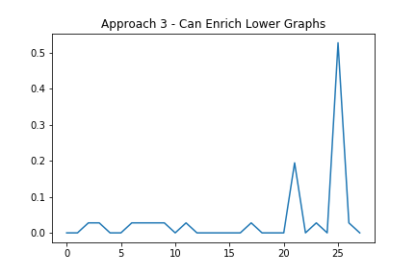
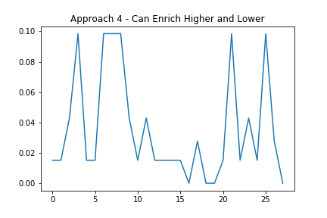
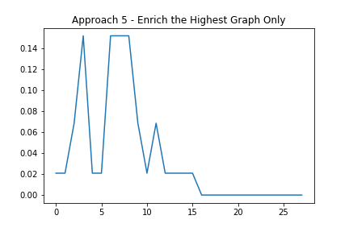
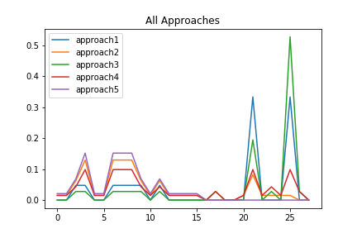
Agent Args | Polarity | Quantity
A,B,C | + | 2
A,B | + | 2
A | + | 2

Slide 6
Agent Args | Polarity | Quantity
A,B,C | + | 3
A,B | + | 3
A | + | 3

Slide 7
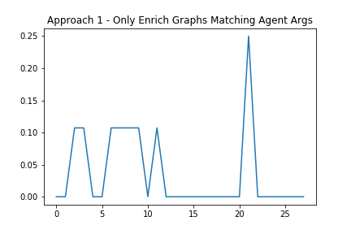
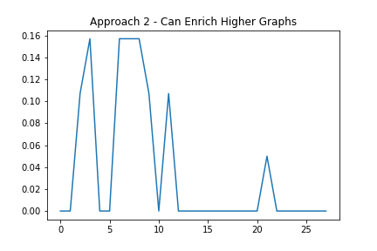
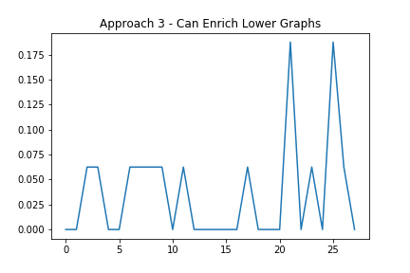
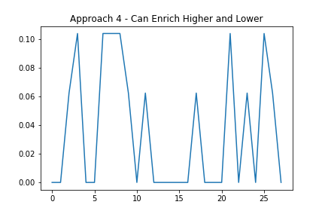
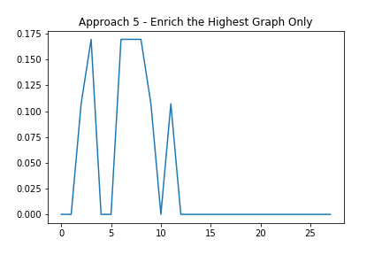
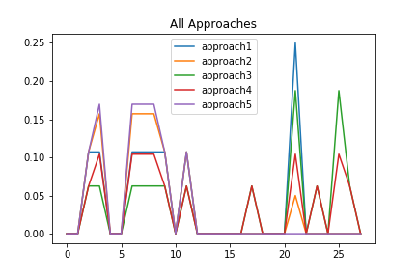
Agent Args | Polarity | Quantity
A,B,C | + | 3
A,B | + | 1
A | + | 0
High, Low, Zero

Slide 8
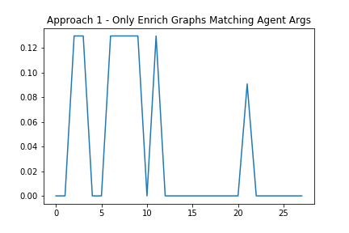
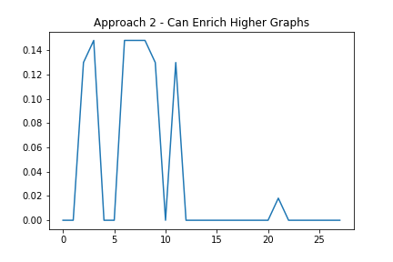
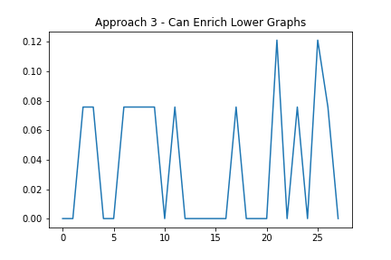
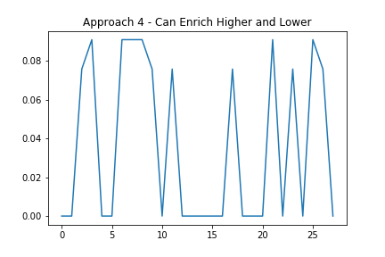
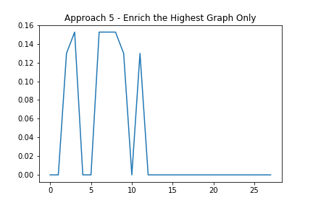
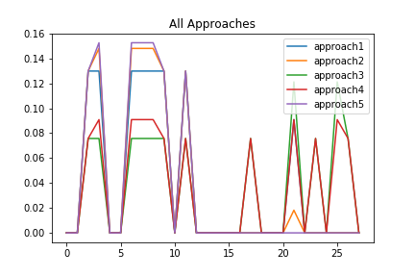
Agent Args | Polarity | Quantity
A,B,C | + | 10
A,B | + | 3
A | + | 0

Slide 9
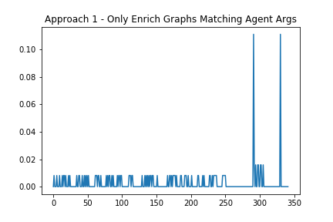
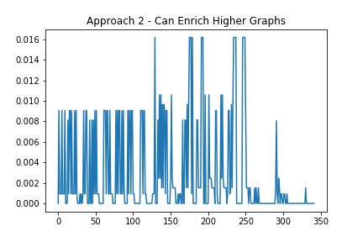
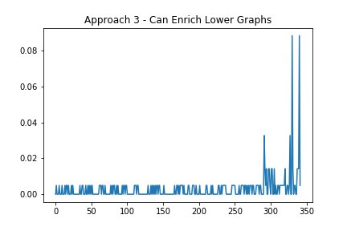
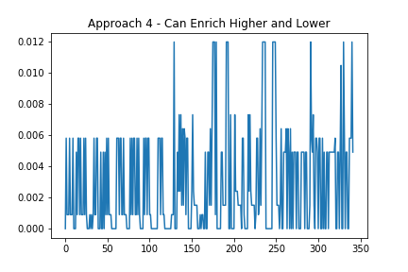
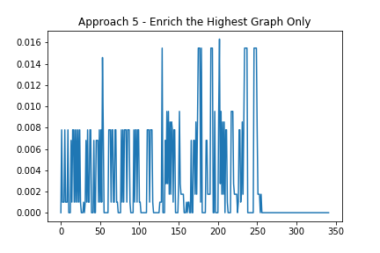
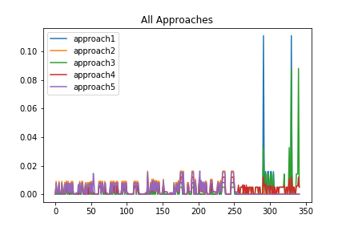
Agent Args | Polarity | Quantity
A,B,C,D | + | 3
A,B,C,D | - | 2
A,B,C | + | 1
A,B,C | - | 1
A,B | + | 1
Known Agent – [C]
 | Apprch1 | Apprch2 | Apprch3 | Apprch4 | Apprch5
Pos Chance | 0.5 | 0.482042 | 0.446078 | 0.449039 | 0.415896
Neg Chance | 0.0 | 0.000000 | 0.000000 | 0.000000 | 0.000000
Ntl lChance | 0.0 | 0.000000 | 0.000000 | 0.000000 | 0.000000
nothingChance | 0.0 | 0.022879 | 0.000000 | 0.022232 | 0.025112

