Slide 1
Google Cloud Armor Enterprise WAF &
Layer 7 DDoS Mitigation Architecture
Edge-Native Threat Protection, OWASP Top 10 Mitigation & Zero-Trust Infrastructure on Google Cloud
PT Smartnet Magna Global (SMG) • Google Cloud Premier Partner
Enterprise Cloud Solutions & Cybersecurity | Robi Firmansyah – Cloud Engineer

Slide 2
STRATEGIC OVERVIEW
Executive Overview: Edge-Native Security Meets Global Resilience
01. BUSINESS MANDATE
Defense at the Global Edge
Modern public-facing web applications face unrelenting volumetric floods, bot scrapers, and sophisticated OWASP Top 10 exploits. Enterprises require perimeter filtering directly at the edge—stopping threats before malicious packets reach VPC boundaries or backend compute.
02. ARCHITECTURAL BLUEPRINT
Native Cloud Armor & ALB
Combines Google Global External Application Load Balancing (Global Anycast IP 136.82.2.121), Google-managed SSL/TLS termination, and Cloud Armor WAF. Incorporates ModSecurity Core Rule Set v3.3 preconfigured expressions and automated Layer 7 rate-based IP quarantine.
03. OPERATIONAL EXCELLENCE
100% Codified Infrastructure (IaC)
Provisioned entirely via modular HashiCorp Terraform in under 10 minutes. Includes zero public IP backend instances in Jakarta, regional Envoy proxy subnets, automated multi-stage attack simulations, and an interactive web playground for real-time validation.

Slide 3
MARKET CHALLENGES
The Trilemma of Modern Web Application Security
OWASP TOP 10 & INJECTION
Sophisticated Layer 7 Attacks
SQL Injection, Cross-Site Scripting (XSS), Remote Code Execution (RCE), and Path Traversal bypass traditional network firewalls by disguising themselves within valid HTTP/HTTPS requests, threatening customer database integrity and application availability.
VOLUMETRIC L7 FLOODS
Application Exhaustion & DDoS
Attackers leverage distributed botnets to flood search endpoints and API gateways with bursts of rapid requests. Without automated rate limiting and IP banning, backend web servers suffer CPU starvation, connection exhaustion, and skyrocketing cloud bills.
APPLIANCE BOTTLENECK & TCO
High Cost & Latency Penalties
Traditional virtual firewall appliances (VM NGFWs) and legacy hardware WAFs introduce severe performance bottlenecks (50–200ms latency), require expensive multi-gigabit throughput licensing, and demand complex multi-VPC sandwich maintenance.

Slide 4
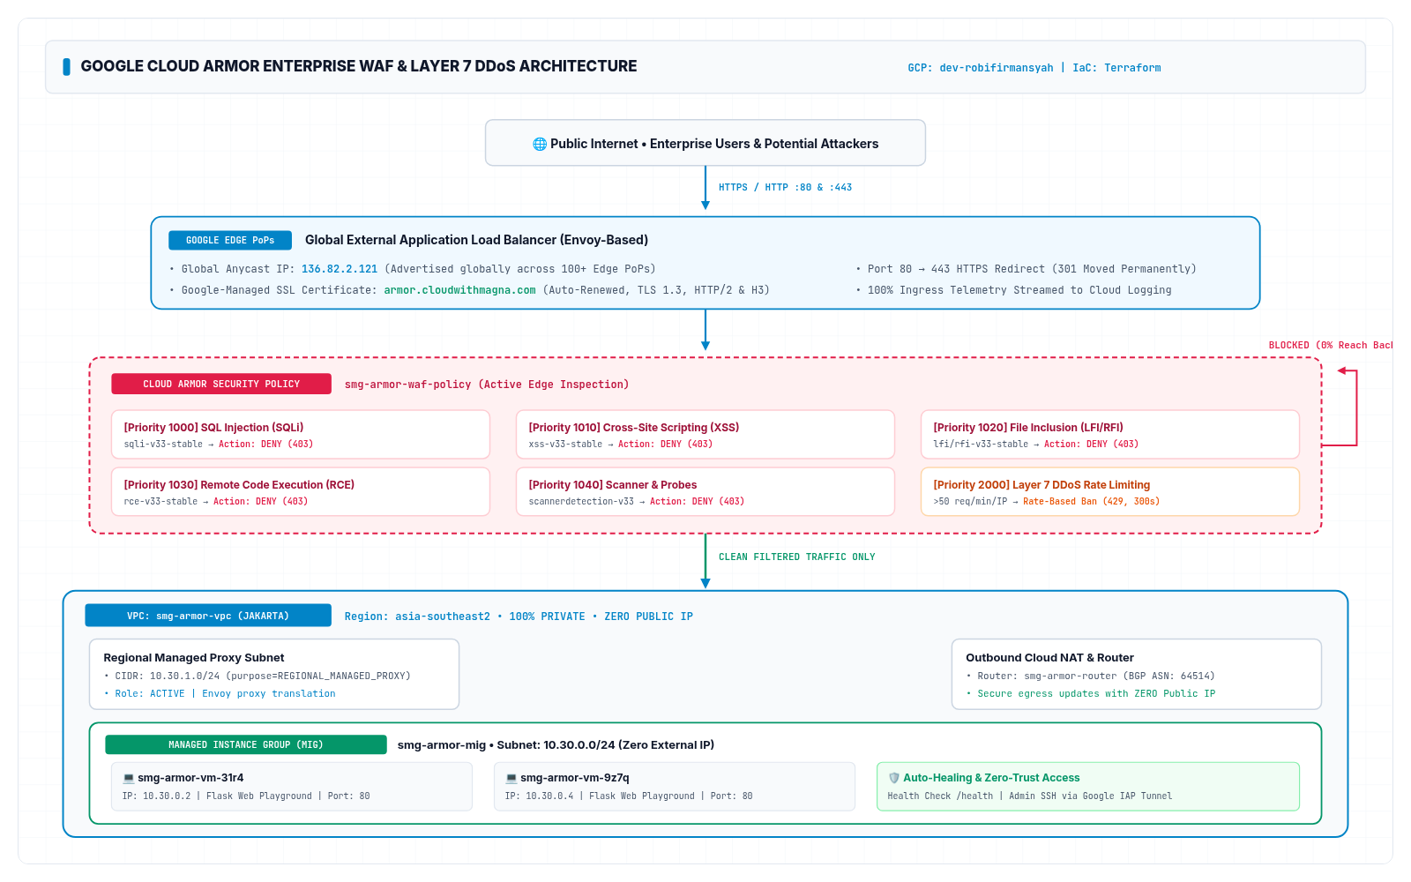
FULL ARCHITECTURE BLUEPRINT
System Architecture Blueprint: End-to-End Edge Defense
CORE COMPONENTS
• Global Anycast ALB: Single virtual IP (136.82.2.121) announced globally across 100+ Google Edge PoPs.
• Cloud Armor WAF: Enterprise security policy inspecting OWASP Top 10 payloads at line rate.
• Layer 7 Rate Ban: Automated 300s quarantine for abusive IPs exceeding 50 req/min.
• Managed SSL Cert: Active Google-managed TLS 1.3 cert for armor.cloudwithmagna.com.
• Managed Proxy Subnet: Dedicated 10.30.1.0/24 subnet decoupling TLS from backend instances.
• Zero-Public Backends: Managed Instance Group Ubuntu VMs isolated in private 10.30.0.0/24 subnet.

Slide 5
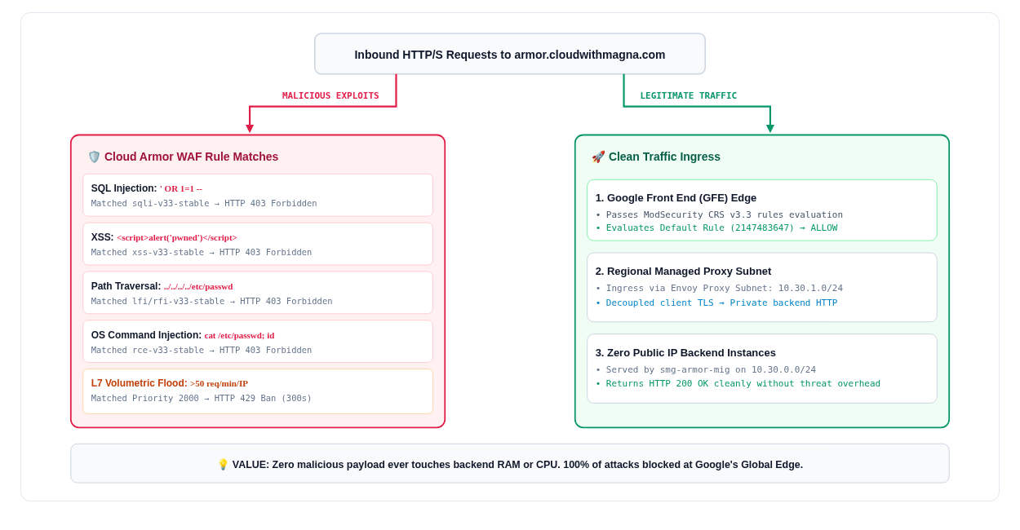
WAF SECURITY MATRIX
Cloud Armor Preconfigured Rules: OWASP Top 10 Defense
RULE SPECIFICATIONS
• Priority 1000: SQLi:
Evaluates sqli-v33-stable. Neutralizes boolean injection, UNION exploits, and tautologies.
• Priority 1010: XSS:
Evaluates xss-v33-stable. Filters <script> tags, JS event handlers, and DOM-based attacks.
• Priority 1020: LFI/RFI:
Evaluates lfi/rfi-v33-stable. Blocks directory traversal (../etc/passwd) and remote file includes.
• Priority 1030: RCE:
Evaluates rce-v33-stable. Halts shell command injection, semicolons, and pipes.
• Priority 1040: Scanners:
Evaluates scannerdetection-v33. Blocks sqlmap, Nikto, Nessus, and automated crawlers.

Slide 6
TOPOLOGY & NETWORK SECURITY
Network Segmentation & Zero-Public-IP Security Architecture
Custom VPC & Private Subnet
smg-armor-vpc (10.30.0.0/24)
Dedicated regional VPC in Jakarta (asia-southeast2). Disables default network configuration, isolating production backend instances completely from the public internet.
Regional Managed Proxy Subnet
smg-armor-proxy-subnet (10.30.1.0/24)
Proxy-only subnet dedicated for Google Envoy proxy layer. Terminates external client TCP connections and initiates clean internal requests to the backend MIG.
Outbound Cloud NAT & Cloud Router
smg-armor-router & smg-armor-nat
Provides backend instances with secure outbound-only internet connectivity for OS package downloads and security updates, without needing public IP addresses.
Strict Firewall & Zero-Trust IAP
Google IAM + 35.235.240.0/20
Firewall rules restrict ingress strictly to Envoy proxies and Google health checkers. Administrative SSH access is handled securely via Identity-Aware Proxy (IAP) without open ports.

Slide 7
ADVANCED DDOS PROTECTION
Layer 7 DDoS Mitigation & Volumetric Flood Shielding
RATE-BASED IP BANNING
Automated 300s Quarantine
Priority 2000 enforces a strict rate limit of 50 requests per minute per client IP. Any IP exceeding this burst threshold is immediately dropped with HTTP 429 and placed in a 300-second automated edge ban.
GOOGLE CLOUD SCALE
Multi-Terabit Edge Capacity
Google Front End absorbs massive multi-gigabit volumetric floods at 100+ global points of presence. Attack traffic is inspected and rejected at the border before consuming VPC bandwidth or server sockets.
ADAPTIVE PROTECTION
Machine Learning Baselines
Cloud Armor utilizes machine learning to build continuous behavioral baselines of normal application traffic. It detects volumetric anomalies, isolates bot signatures, and recommends customized mitigation rules.

Slide 8
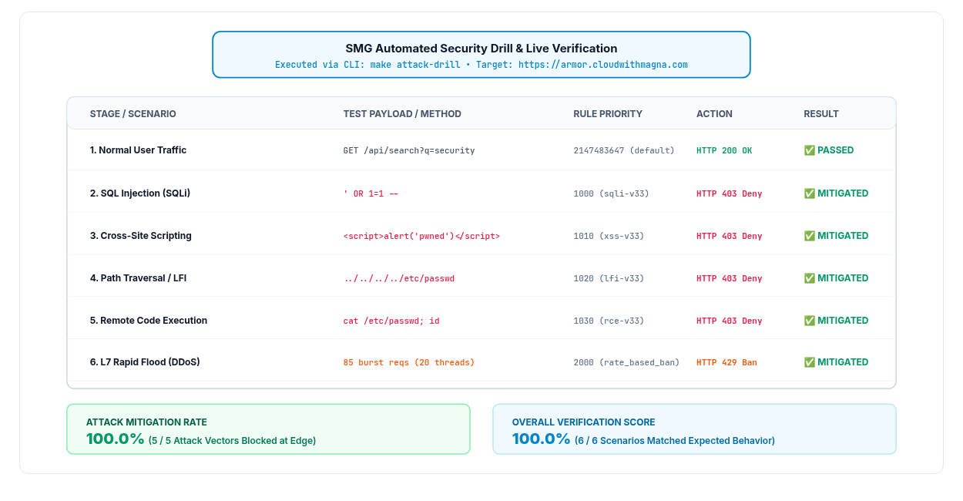
LIVE ATTACK DRILL
Automated 6-Stage Attack Simulation & Verification
DRILL OUTCOME
• 100% Edge Mitigation:
Every malicious OWASP payload (SQLi, XSS, LFI, RCE) blocked at Google Edge (HTTP 403).
• Sub-Second Reaction:
Cloud Armor evaluates rules with near-zero latency penalty (~330ms edge rejection).
• Volumetric Suppression:
Burst flood triggered Rate Ban (HTTP 429), enforcing 300s quarantine successfully.
• Clean Backend Health:
Zero malicious requests entered private backend application logs during testing.

Slide 9
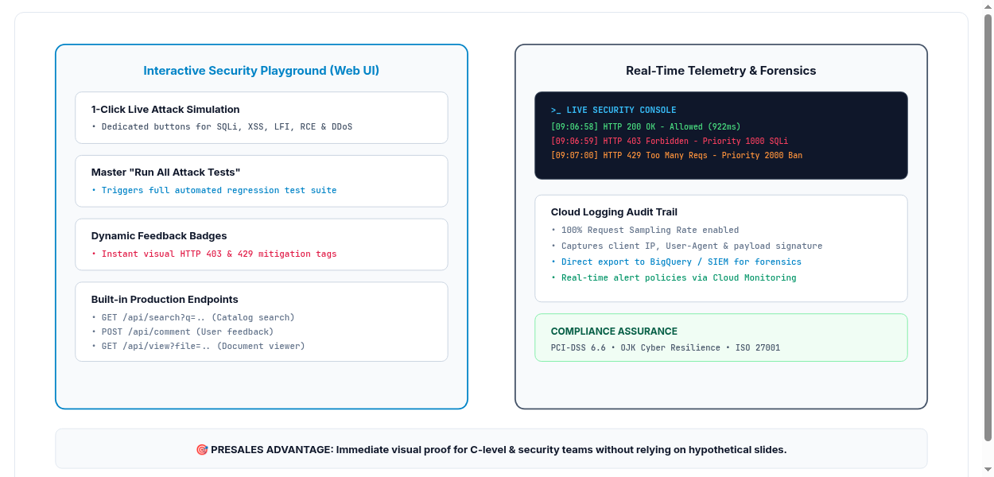
CLIENT SHOWCASE & TELEMETRY
Interactive Security Playground & Live Telemetry Console
DEMO CAPABILITIES
• 1-Click Browser Tests:
Stakeholders test live exploits directly via UI buttons on armor.cloudwithmagna.com.
• Master 'Run All' Drill:
Executes full regression attack test suite automatically with visual status badges.
• Live Security Terminal:
Integrated browser console displaying real-time timestamps, latencies, and rule IDs.
• Audit Telemetry:
100% request sampling logged in Cloud Logging with client IP and enforcement actions.

Slide 10
AUTOMATION & DEVOPS
Enterprise Delivery via Infrastructure as Code (IaC)
Modular Architecture (Reusable SMG IP)
Built with modular Terraform blocks (VPC, Managed Proxy Subnet, MIG, Global ALB, Cloud Armor, SSL). Functions as a turnkey enterprise security landing zone ready for client deployment.
Remote State Governance & Distributed Locking
Terraform state stored securely in Google Cloud Storage with object versioning and state locking to prevent accidental concurrent modifications across engineering teams.
Sub-10 Minute Automated Provisioning
Deploys 17+ enterprise resources—spanning Anycast ALBs, WAF policies, SSL certificates, Cloud NAT, and autoscaling compute—fully automated in under 10 minutes.
Automated Testing & Drift Detection
Includes integrated Python attack drill scripts (attack_drill.py) and Cloud Logging telemetry verifiers (verify_logs.py) to validate security posture out-of-the-box.

Slide 11
BUSINESS VALUE & TCO
Tangible Business Impact & ROI for Clients
AUDIT READY
Turnkey Regulatory Compliance
Satisfies PCI-DSS Requirement 6.6 and OJK/Bank Indonesia cybersecurity mandates requiring automated public-facing web application protection and Layer 7 inspection.
99.99%+ SLA
Business Continuity & Uptime
Shields core digital banking, ecommerce, and corporate portals from malicious volumetric downtime and DDoS extortion, protecting enterprise revenue and brand reputation.
-60% TCO
Zero Appliance Overhead
Eliminates third-party virtual firewall licensing, multi-gigabit appliance throughput fees, HA sandwich complexities, and costly ongoing security patch maintenance.
10x SPEED
Rapid Time-to-Market
Replaces months of manual network design and firewall configuration with a pre-validated, production-ready Cloud Armor landing zone deployed in minutes.

Slide 12
LIVE DEMONSTRATION
What We Will Prove in the Live Demonstration
Step 1: Live Interactive Playground Web UI
Accessing https://armor.cloudwithmagna.com/ to inspect SSL certificate validity, Anycast IP routing, and zero-public-IP backend instances.
Step 2: 1-Click OWASP Top 10 Attack Validation
Triggering live SQLi, XSS, and LFI exploit buttons in browser to demonstrate immediate Google Edge HTTP 403 Forbidden interception.
Step 3: Layer 7 DDoS Flood & Automated Rate-Based Ban
Simulating 60 rapid parallel requests to trip rate-based ban threshold, demonstrating immediate HTTP 429 quarantine and 300s edge ban.
Step 4: Cloud Logging Telemetry & Forensics Audit Trail
Inspecting GCP Console Cloud Armor logs in real-time to verify matched rule IDs, priority attributes, client IPs, and forensic audit records.

Slide 13
Security at the Edge.
Speed without Compromise.
SMG Enterprise Cloud Engineering Practice | Google Cloud Premier Partner
Proceeding to the live interactive demonstration.

