Slide 1

WELCOME TO PRESENTATION SESSION
19 JAN, 2019

Slide 2

PRESENTATION
ON
OFFICE NETWORK DESIGN
Course Title : System Analysis and Design Lab
Course Code : CSE 326

Slide 3
Senior Lecturer Department of CSE City university
Directed by :
Supta Richard Philip

Slide 4
Presented by :
Md. Robin
(171442640)
Sharful Islam
(171442641)
Nitu Akter
(171442639)
CSE Department, 44th Batch (Eve)
City University, Dhaka.

Slide 5
WELCOME
TO
THE HONOURABLE TEACHER
&
OUR CLASMATES

Slide 6
What is school management?
Educational management is concerned with the planning and formulation of efucational policies of programmes with a view t achieving educational goals.

Slide 7
Some problems of old school management system
Old admission system
Teacher student communication problem
Time based classes
Time based classes
Problem to do group based jobs/assignments
Manual attendance system
Student suffer for old payment system
TC system is time consuming

Slide 8






Slide 9
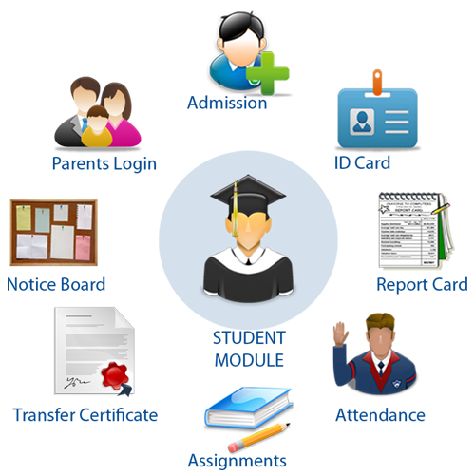
Solution of this problem
Online/Digital School Management System

Slide 10
What is School Management System?
School Management System is a is a complete school management software designed to automate a school's diverse operations from classes, exams to school events calendar.
This school software has a powerful online community to bring parents, teachers and students on a common interactive platform. It is a paperless office automation solution for today's modern schools. The School Management System provides the facility to carry out all day to day activities of the school, making them fast, easy, efficient and accurate.

Slide 11


Slide 12
Requirement gathering
Functional Requirements
Functional Requirements
Admin shall login
Usability
Admin shall add new student, teacher, and class and modify them
Efficiency
Admin shall update school data
Performance
Admin shall access all the data about student &Teacher related
Space
Student shall login by his/her id. Requirements
Reliability
Portability
Teacher shall login by his/her id
Parents shall login through his child id
Declare result online

Slide 13
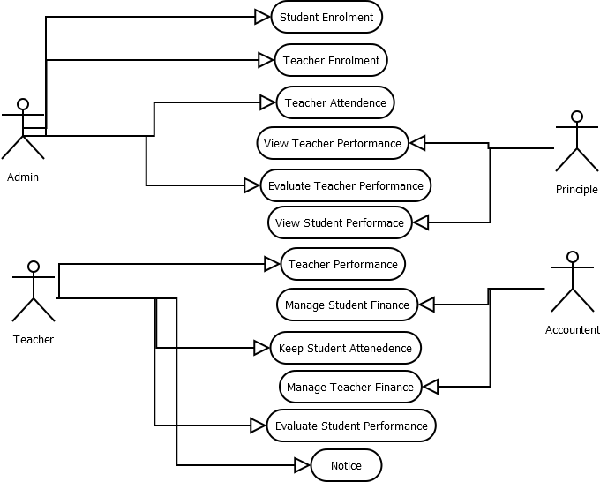
Use Case Diagram for
School Management System

Slide 14
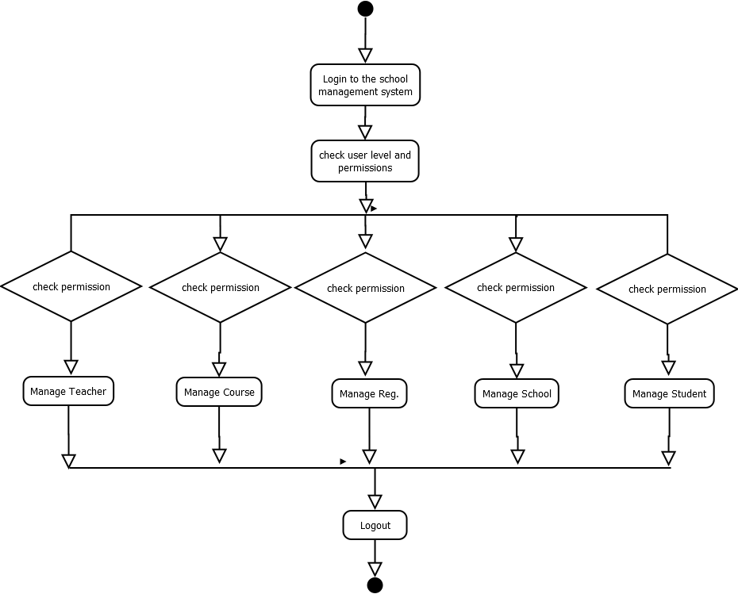
Activity Diagram for
School Management System

Slide 15

After complete this project I think teacher, parents, student, administrator all will not suffer from those various problems. And we will make a beautiful education system

Slide 16
Conclusion
At the end of this project not only will you have more inside knowledge about our career but also know how complex project we have to handle. We are thankful to our teacher SUPTA RICHARD PHILIP. We find so much fun as well as interesting with this project.

Slide 17


Thank You

