Slide 1
CS430 DEMO
Group 10
Qiuping Zhang, Bin Zou, Xiaonan Peng.

Slide 2
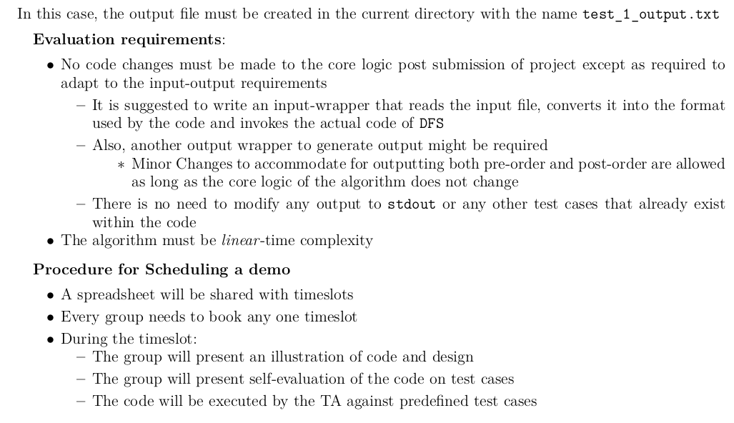

Slide 3
illustration of code design
define the structure used to represent the graph , stack, visited list
initailize stack with start node
use an dummy stack action to simulate the recursive call
explore adjacent nodes
backtrack to the previous node after all adjacent nodes of the current node have been visited.
When the entire graph is completely traversed and no node is unvisited, DFS terminates.
return the pre-order and post order nodes list

Slide 4
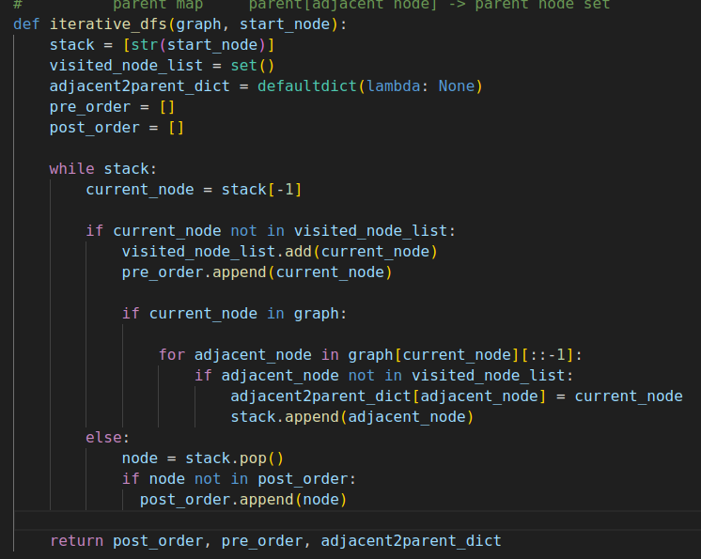
illustration of code design
dummy pop and implement a dummy recursive call
node
left child, right child
backtrack node for post order

Slide 5
Test case example: 5 4 1 2 1 3 2 4 2 5 1 convert to graph: graph: {'1': ['2', '3'], '2': ['4', '5'], '3': ['6', '7']} start_node: 1
and initialize the stack[] with start node 1
1
2
3
4
5

Slide 6
1
1
2
3
4
5
Current node 1 popped from stack ['1']
1 is NOT visited, push it to pre-order ['1']
explore the adjacent nodes
3 is not visited,push it to stack ['1', '3']
2 is not visited,push it to stack ['1', '3', '2'] from bottom to top

Slide 7
2
1
2
3
4
5
Current node 2 popped from stack ['1', '3', '2']
2 is NOT visited, push it to pre-order ['1', '2']
explore the adjacent nodes
5 is not visited,push it to stack ['1', '3', '2', '5']
4 is not visited,push it to stack ['1', '3', '2', '5', '4']

Slide 8
3
1
2
3
4
5
Current node 4 popped from stack ['1', '3', '2', '5', '4']
4 is NOT visited, push it to pre-order ['1', '2', '4']

Slide 9
4
1
2
3
4
5
Current node 4 popped from stack ['1', '3', '2', '5', '4']
4 is visited, pop node 4 from stack ['1', '3', '2', '5']
push node 4 to post order ['4']
4 is leaf node, no adjacent nodes
backtrack

Slide 10
5
1
2
3
4
5
Current node 5 popped from stack ['1', '3', '2', '5']
5 is NOT visited, push it to pre-order ['1', '2', '4', '5']

Slide 11
6
1
2
3
4
5
Current node 5 popped from stack ['1', '3', '2', '5']
5 is visited, pop node 5 from stack ['1', '3', '2']
push node 5 to post order ['4', '5']
5 is leaf node, no adjacent nodes
backtrack

Slide 12
7
1
2
3
4
5
Current node 2 popped from stack ['1', '3', '2']
2 is visited, pop node 2 from stack ['1', '3']
push node 2 to post order ['4', '5', '2']
backtrack

Slide 13
8
1
2
3
4
5
Current node 3 popped from stack ['1', '3']
3 is NOT visited, push it to pre-order ['1', '2', '4', '5', '3']

Slide 14
9
1
2
3
4
5
Current node 3 popped from stack ['1', '3']
3 is visited, pop node 3 from stack ['1']
push node 3 to post order ['4', '5', '2', '3']
backtrack

Slide 15
10
1
2
3
4
5
Current node 1 popped from stack ['1']
1 is visited, pop node 1 from stack []
push node 1 to post order ['4', '5', '2', '3', '1']
backtrack

