Slide 1

Notes:
Who should give it – almost anyone who wants to start working with k8s (beginners to pros)
Why – I will ask why not.
Company pays for it
You get two attempts
It is only 66% to pass
And you literally have the most accurate training materials (which we talk about)
WHAT IS CKAD (CKA / CKS)
CNCF has as of now 3 certificates
As per common norm the easiest one is the developer one
19 questions for 2hr
Valid for 3 yrs
BUT BEFORE WE START …. LET US JUST LOOK AT SOME BASICS
https://acdc-tools-feedback.cfapps.sap.hana.ondemand.com/survey/?eventId=gyk7zfi

Slide 2

TUTOR
Notes:
But before we jump into k8s, let us revisit the simple things out of the way
VIM… even though there is NANO, I prefer it – you can make up your mind.
If you like VIM, why not but if you want to learn, just go VIMTUTOR.
& do not forget working with YAML – it is such a crucial part of the course that we always forget to mention it (like my blog and this presentation)

Slide 3

Notes:
TUX is here to remind you not forget it…
Few bash shell commands are not bad to know revise (not everyone uses them regularly)
Grep
Wget
Netcat / nc (probably only for one single question)

Slide 4

Notes:
If you want to prepare and have absolutely no idea, do these two training (otherwise only one)
- Dan Wahil’s Kubernetes Core Concepts (pluralsight) : https://www.pluralsight.com/courses/kubernetes-developers-core-concepts
- Mumshad Mannambeth : https://www.udemy.com/course/certified-kubernetes-application-developer

Slide 5

Notes:
There is no substitution to practice
Locally you cannot do always because of the docker limit, but because you have the MM course or spin up cluster on Katakloud – you can always practice
Tones of git repo with practice questions - https://github.com/dgkanatsios/CKAD-exercises/ - I used one specific one.

Slide 6

Notes:
Kubernetes allows you to have a tab open and you can reference Kubernetes documents and you can always copy the YAML file
But imperative commands gives you the necessary speed you need / make sure you have some alias.
I do not want to be too opiniated, so during your practice try to create few which you can add in the bashrc in under 1-3 mins
I didn’t use the command completion, but lot of people do use it.

Slide 7

Notes:
Read all the exam guide which are few steps before you register for the exam. You will find about ssh in there,
Setup the laptop: Some people found problem with company laptop. I had another mac at hand so I used that one.
Do not forget your bookmarks, it is good to have them handy
Sample: Book 2 weeks from the day you done, practice one week later once more and then go for it.

Slide 8
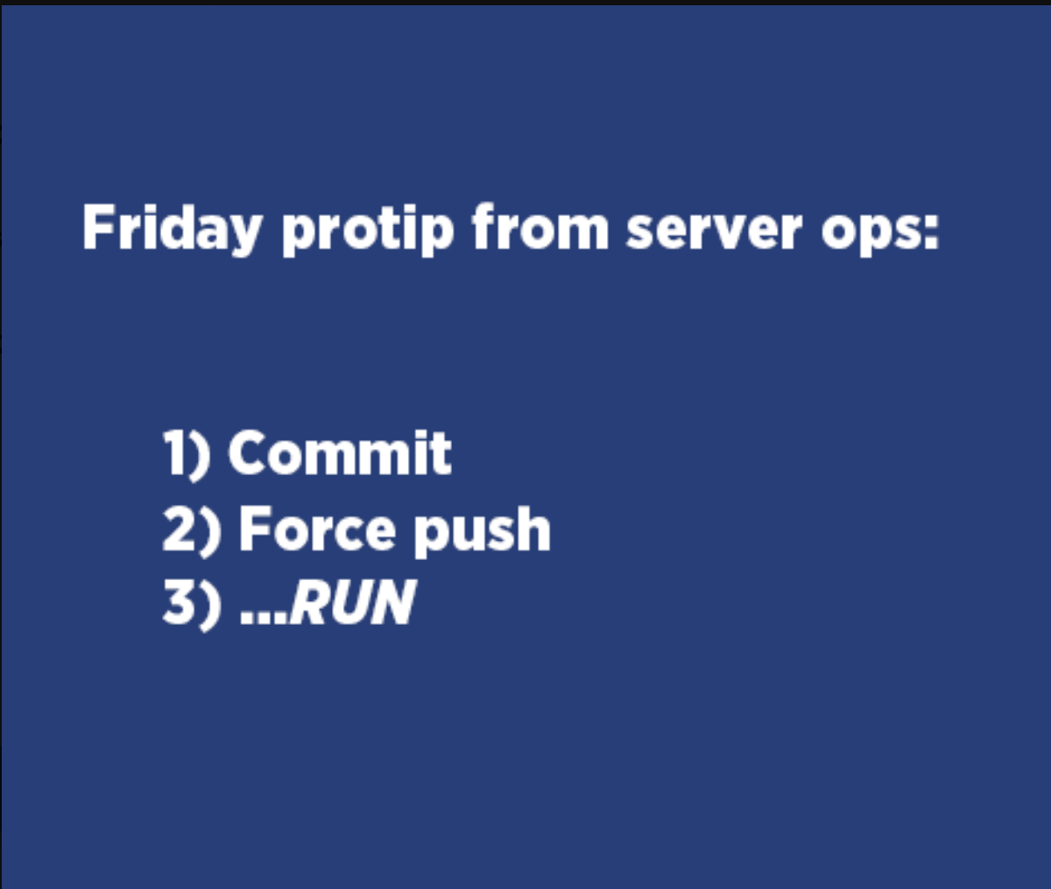
Notes:
Finally some protips
If you can pay the additional $29, do it – because killer.sh gets you in the mode of using similar (not same) kind of environment. The questions are touch harder, so it gives you added benefit to judge yourself – I score 88% in killer first attempt.
Use the NOTEPAD / Write all your aliases and vimrc commands before hand in the notepad. In case there is any system restart, that is somehow the only thing which will survive.
Read absolutely the FULL FULL FULL FULL question – can’t emphases it more – you will get into problem if you don’t.
Watch out for the namespace snafu.
Look at the percentage and the length of the question – if it is 2% and the whole of left section is filled, mark it and move on.
Time management – MM will share it too in his training.

Slide 9

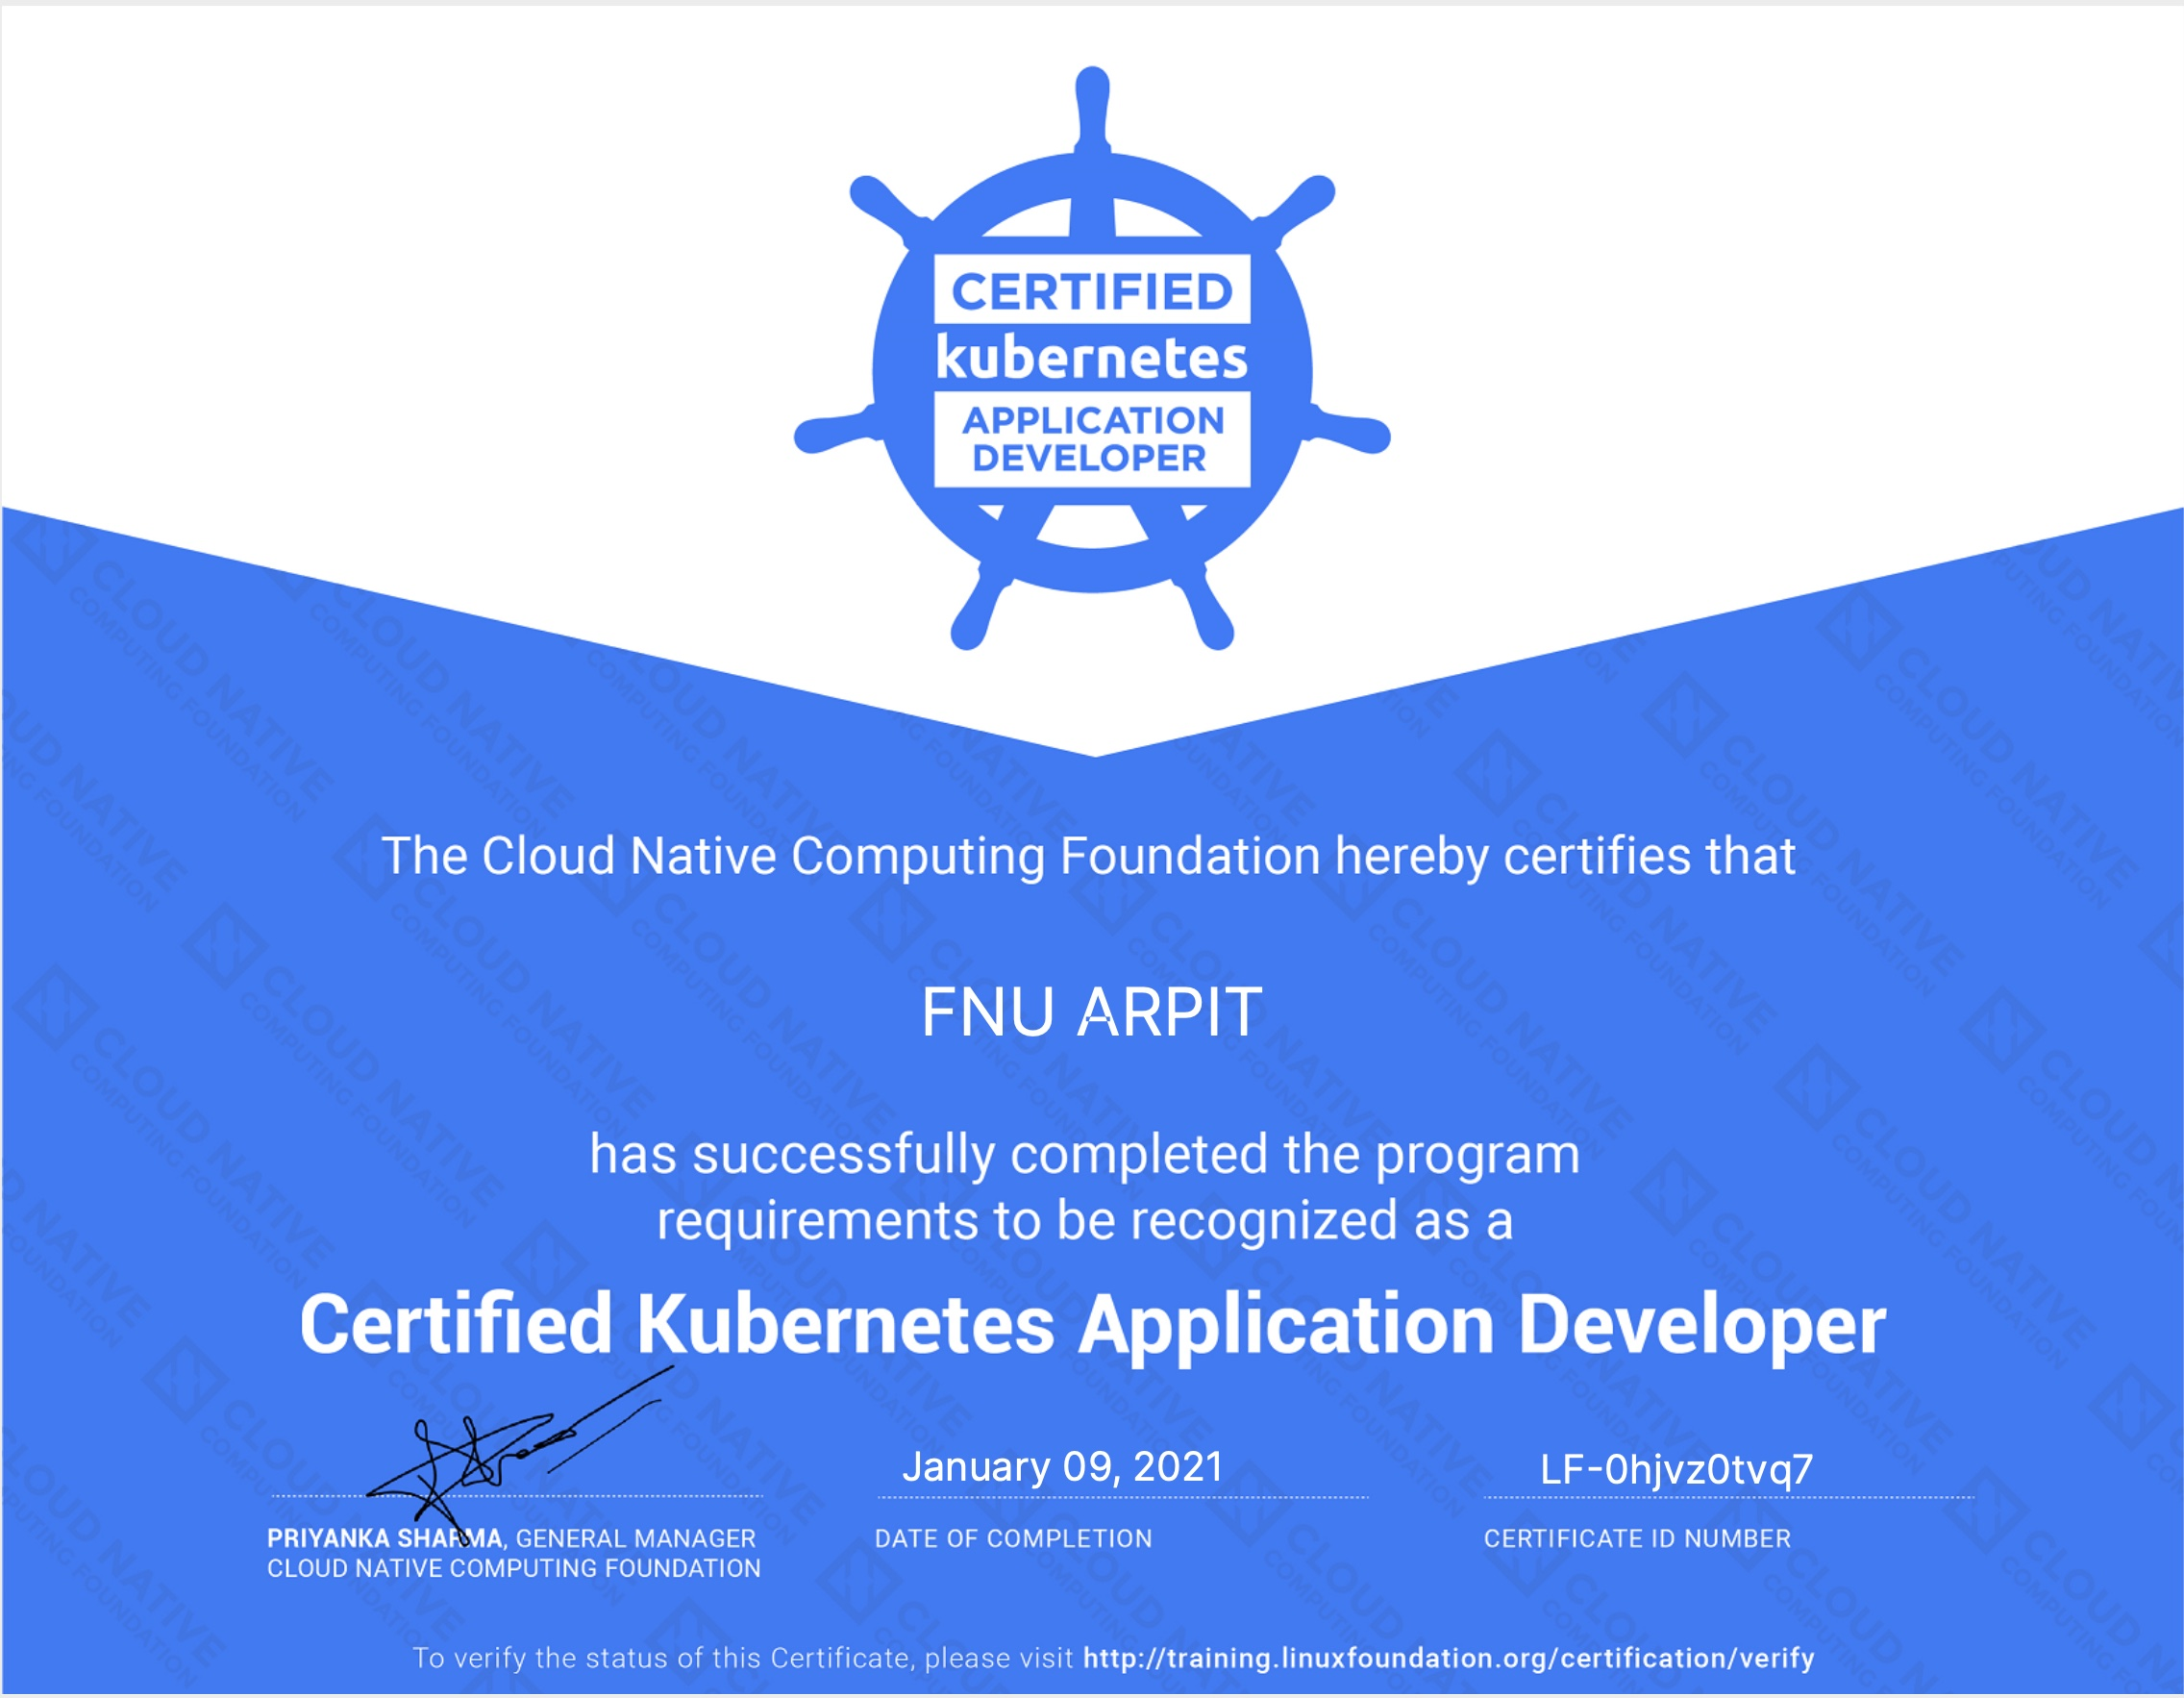
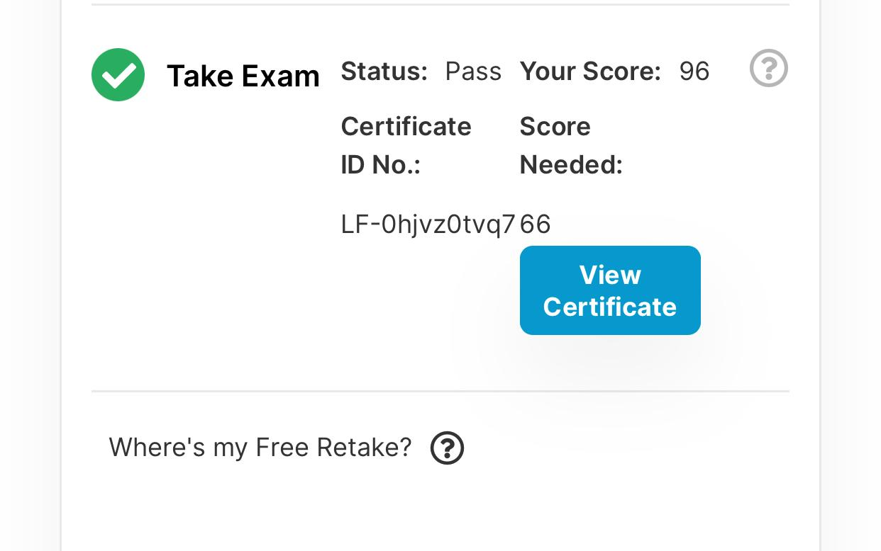

ARPIT GOYAL
ASSOCIATE ARCHITECT
Notes:
PLEASE GIVE FEEDBACK NOW - https://acdc-tools-feedback.cfapps.sap.hana.ondemand.com/survey/?eventId=gyk7zfi
And yeah my name has lot of challenges and now when anyone asks me I charge them money – because soon I will be spending around about $1000 to fix my name both in India and United States.

