Slide 1
Moonshot project
Robin DEBRY 2023-2024

Slide 2
Summary
What is a moonshot project
Subject choosen
Story of the screen readers
How screen readers works
Technologies used
Comparison between technologies
Future improvements
Demonstration
Conclusion

Slide 3

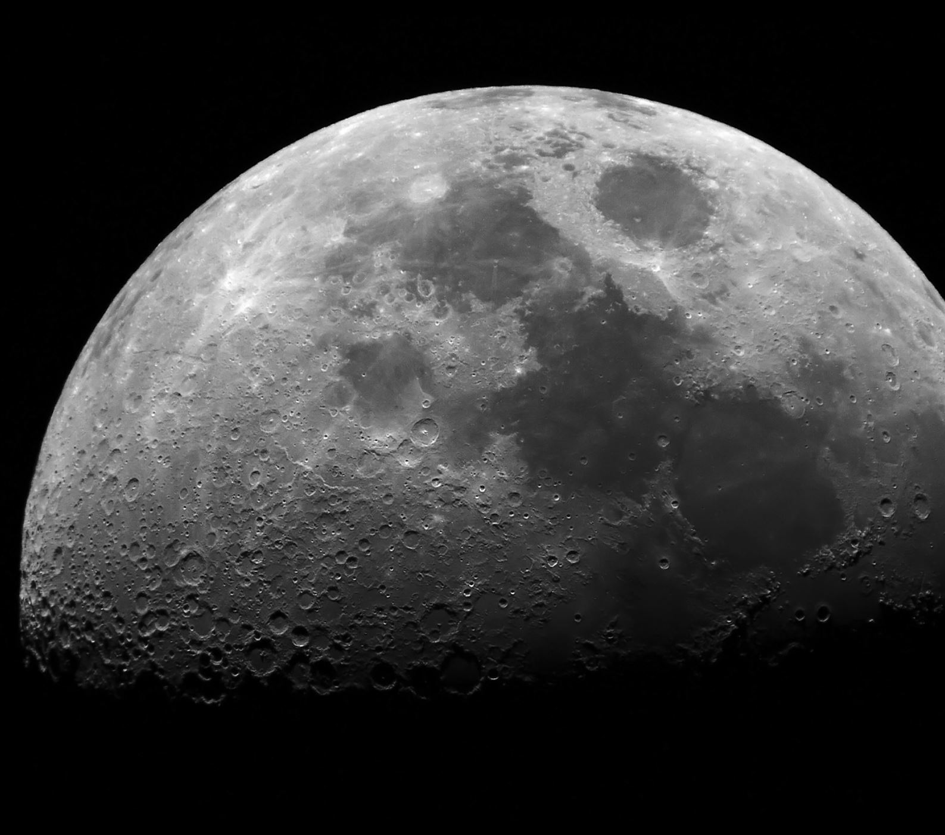




What is a moonshot project

Slide 4

My first idea

Slide 5

The subject I chose

Slide 6

Story of the screen readers

Slide 7

How screen readers works

Slide 8

Laws and regulations

Slide 9

Management part

Slide 10

EYES LIMIT

Slide 11
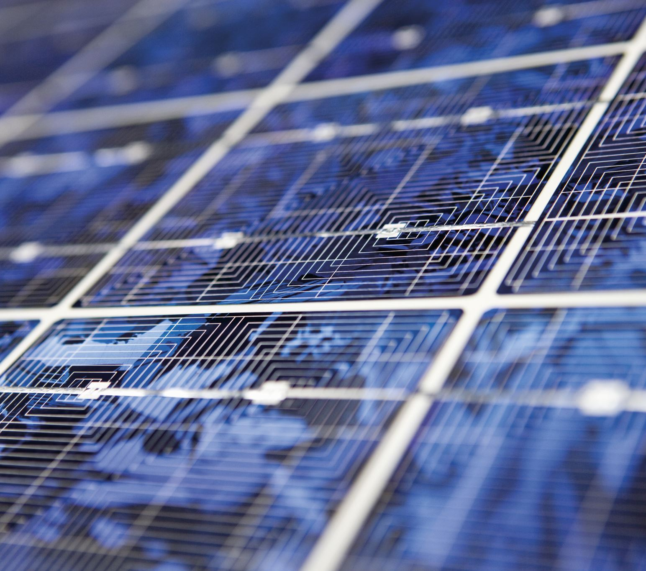
Technologies used

Slide 12
Comparison between technologies

Slide 13

Future improvements

Slide 14
Demonstration

Slide 15

What I learned from this project

Slide 16

Conclusion

