Slide 1
2 Factor Authentication
3조 보안연대
Team David Belasco

Slide 2
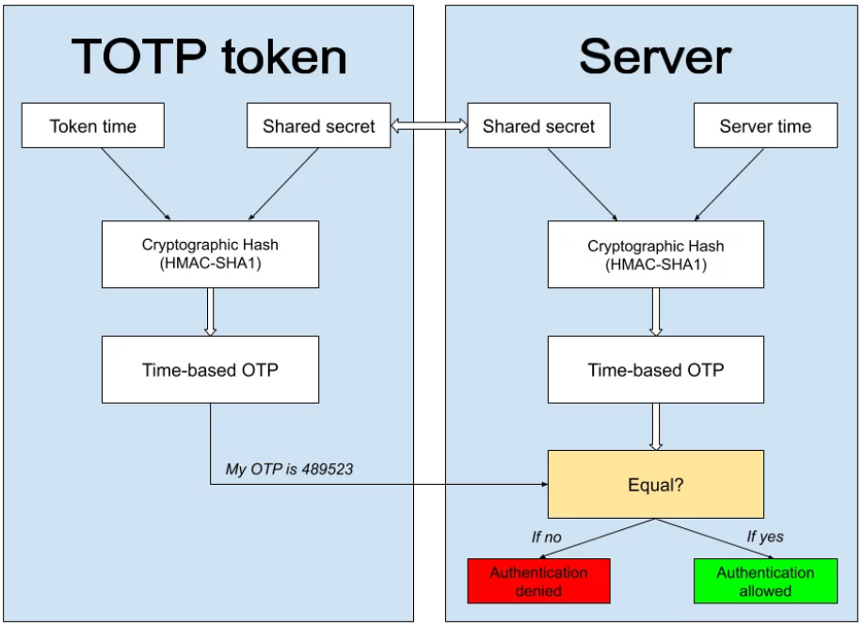
TOTP

Slide 3
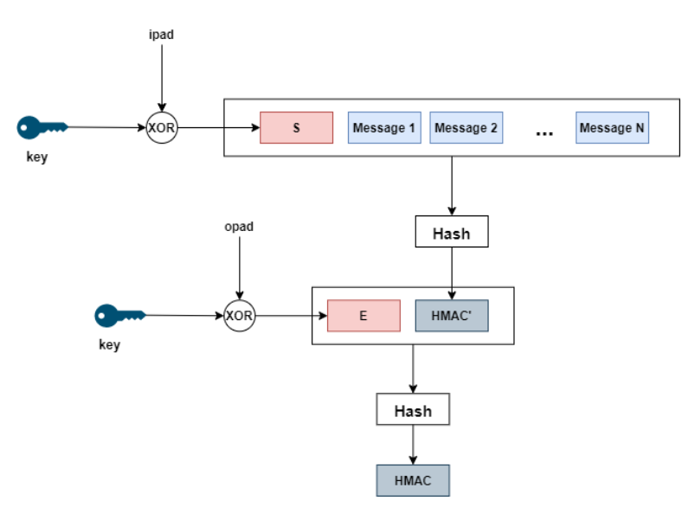
HMAC-SHA1
Key : Secret Key
SHA1 : 20 Byte
Opad : Key XOR 0x5C (length of K)
Ipad : Key XOR 0x36 (length of K)

Slide 4


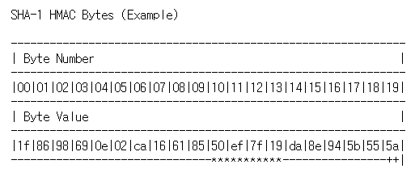
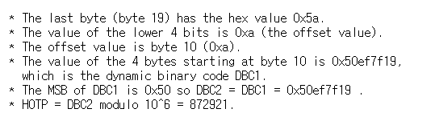

TOTP
UT : elapsed time from 1970-01-01, T0 : current time

