Slide 1

How to install / use VideoChat
3조 보안연대
Team David Belasco

Slide 2
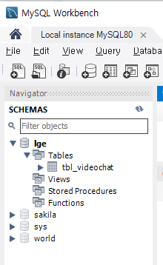
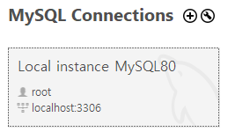
How to install MySQL Database
MySQL 8.0 install guide
1. Install MySQL 8.0 https://dev.mysql.com/downloads/windows/installer/8.0.html
2. Make account : root / lge1234 port : 3306 3. Make SCHEMAS : lge
Add PATH : C:\Program Files\MySQL\MySQL Server 8.0\bin

Slide 3
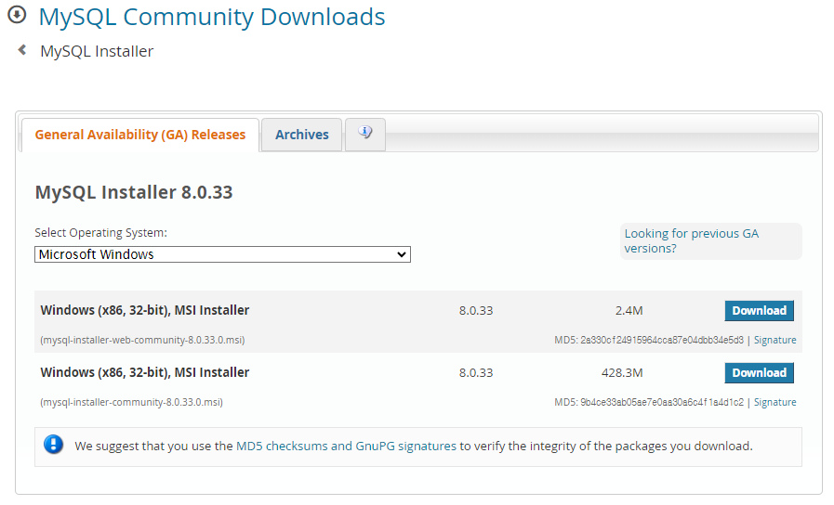
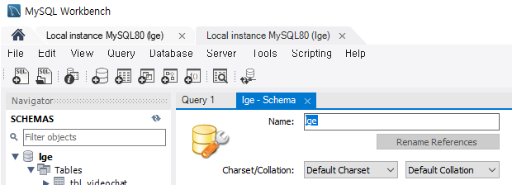
MySQL download & make Schema

Slide 4
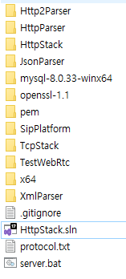
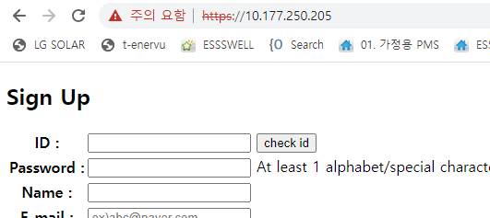
How to use VideoChat
1. Run server.bat (This is server for signaling / user registration)
@echo on
echo "Run Server"
start cmd.exe /c ".\x64\Debug\TestWebRtc.exe" .\TestWebRtc\html .\pem\cert.pem
2. Run tool/db_init_bat
3. Connect to server with Chrome browser (platform independent)
Ex) https://192.168.0.10
4. Registration and Log in
5. Retrieve the Logged in user list 5. Call the user
This is why self-signed certification is used

Slide 5
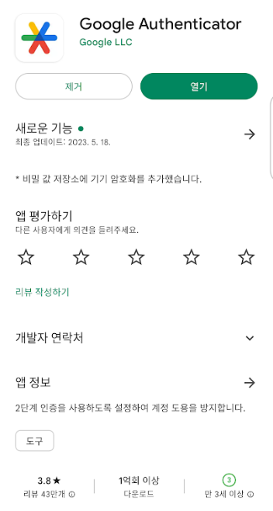
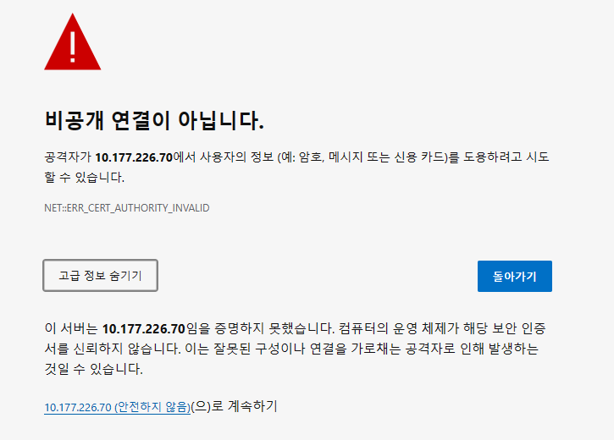
How to use
https://10.177.226.70

