Slide 1

VideoChat
3조 보안연대
Team David Belasco

Slide 2
Project Members and Role
Architect, Signaling, Database, Registration, Login
Robin Kim(김성준), SeKi Park(박세기)
2 Factor authentication, Peer connection
SungMin Kim(김성민), DongHoon Shin(신동훈)
Test case and Validation
JiYoung Yoon(윤지영)
Mentor / Support
David Belasco

Slide 3
Schedule
Meeting with David
W1 (Brainstorm) |  |  | W2 (Feature Complete) |  |  | W3 (Security Enhancement)
Requirement meeting
Progress meeting
Demo with David
Security Audit with David
Requirement
brainstorm
DongHoon/
TEAM 3
Signaling (wss authentication)
Signaling (Call, Invite, Accept, Reject)
SeongJun
TEAM 3
Registration (database)
Seki
Log in
2 factor authentication
SeongJun
SungMin
Peer Connection (webRTC)
SeongJun / DongHoon
openssl latest patch
Validation
JiYoung
JiYoung
Security Review
TEAM 3

Slide 4
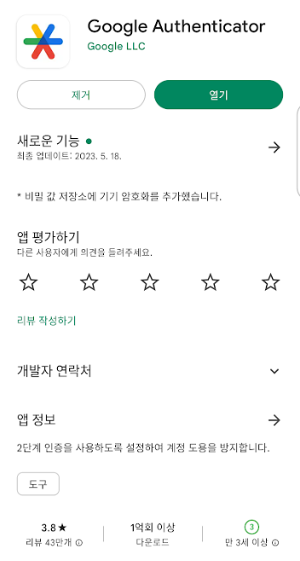
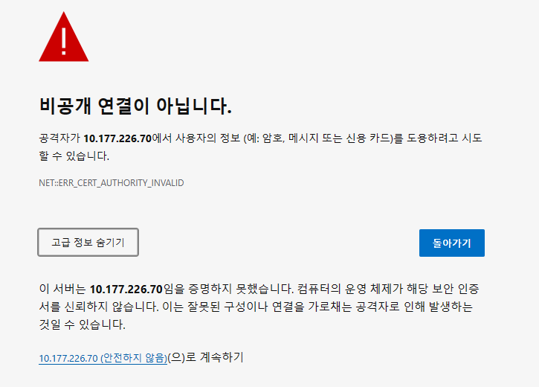
Demo
https://10.177.226.70

Slide 5
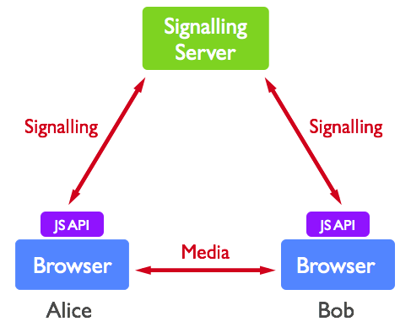
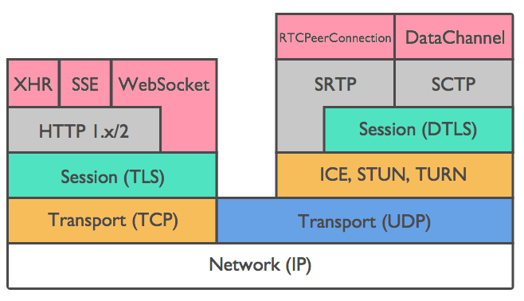
Brainstorm / Background
Harnessing collective intelligence to find best solution of the requirement
WebRTC is perfectly matched for the requirement
Signaling (TLS)
Media (DTLS)

Slide 6

Overall Architect
PeerToPeer (webRTC/Datagram TLS) Resilience over the network
Chrome
Chrome
Alice
7. createOffer with RTCPeerConnection
Bob
8. createAnswer with RTCPeerConnection/RTCSessionDescription
User login (https) WebSocket(“wss://IP:443”) req|login|user_id
3. User login (https) WebSocket(“wss://IP:443”) req|login|user_id
2. res|login
4. res|login
Signaling (https/TLS)
Register account
Login with 2 factor authentication
Database interface
Signaling with WebSocket secure & SDP
Peer2Peer connection with webRTC
Fault detect & recovery
5. Invite user_id
6. res|user info
Server
Password - SHA256 with salt
Google OTP key - AES
SQL query binding
Minimum privilege access
Certification(pem)
Local TCP
Application
Database
UPDATE tbl_videochat SET gotp = ? WHERE unique_id = ?

Slide 7
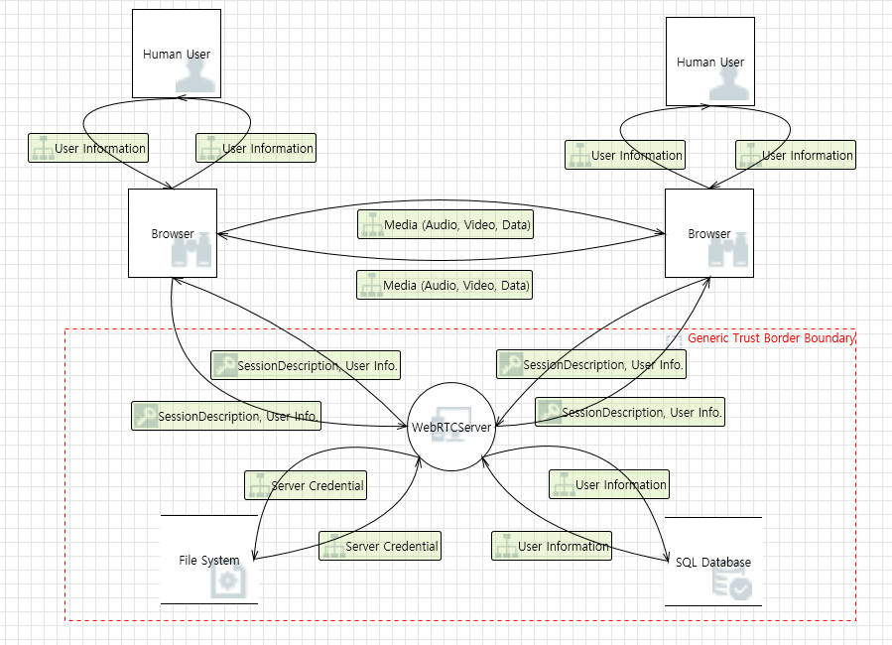
Threat Modeling

Slide 8
Threat Lists (1/2)
Priority | Category | When/Where | Threat/Requirement Description | Mitigation | Requirement #
1 | Tampering | Brower → WebRTCServer | The web server 'WebRTCServer' could be a subject to a cross-site scripting attack because it does not sanitize untrusted input. | 1. Input validation 2. Input sanitization(Use Regular Expression): Special characters can be blocked or removed | R1.1.2
2 | Elevation Of Privilege | Brower → WebRTCServer | WebRTCServer may be able to impersonate the context of Browser in order to gain additional privilege. | 1. Use 2FA 2. Use Least Privilege principle | R1.2
3 | Repudiation | Brower → WebRTCServer | WebRTCServer claims that it did not receive data from a source outside the trust boundary. Consider using logging or auditing to record the source, time, and summary of the received data. | 1. Logging 2. TLS (Server Authentication) | R15
4 | Elevation Of Privilege | Brower → WebRTCServer | An attacker may pass data into WebRTCServer in order to change the flow of program execution within WebRTCServer to the attacker's choosing. | 1. Input validation 2. Input sanitization 3. Use Least Privilege principle | R1.1.2

Slide 9
Threat Lists (2/2)
Priority | Category | When/Where | Threat/Requirement Description | Mitigation | Requirement #
5 | Spoofing | SQL DB → WebRTCServer | SQL Database may be spoofed by an attacker and this may lead to incorrect data delivered to WebRTCServer. Consider using a standard authentication mechanism to identify the source data store. | 1. Block remote access to DB 2. Use strong password 3. TLS: meets both authentication and encryption | R16
6 | Information Disclosure | SQL DB | Improper data protection of SQL Database can allow an attacker to read information not intended for disclosure. Review authorization settings. | 1. Use SQL bind variabe 2. Block remote access to DB 3. Use strong password 4. DB Encryption | R16
7 | Spoofing | WebRTCServer → FileSystem | File System may be spoofed by an attacker and this may lead to data being written to the attacker's target instead of File System. Consider using a standard authentication mechanism to identify the destination data store. | 1. Keep server credential in secure storage | R16

Slide 10
Static View
Alice
Bob
RTCPeerConnection DTLS/UDP
wss://192.168.0.10:443
WSS/TLS/TCP
wss://192.168.0.10:443 WSS/TLS/TCP
WebSocketSecure
http stack
http2 stack
Tcp stack
TCP (127.0.0.1:3306)
Database

Slide 11
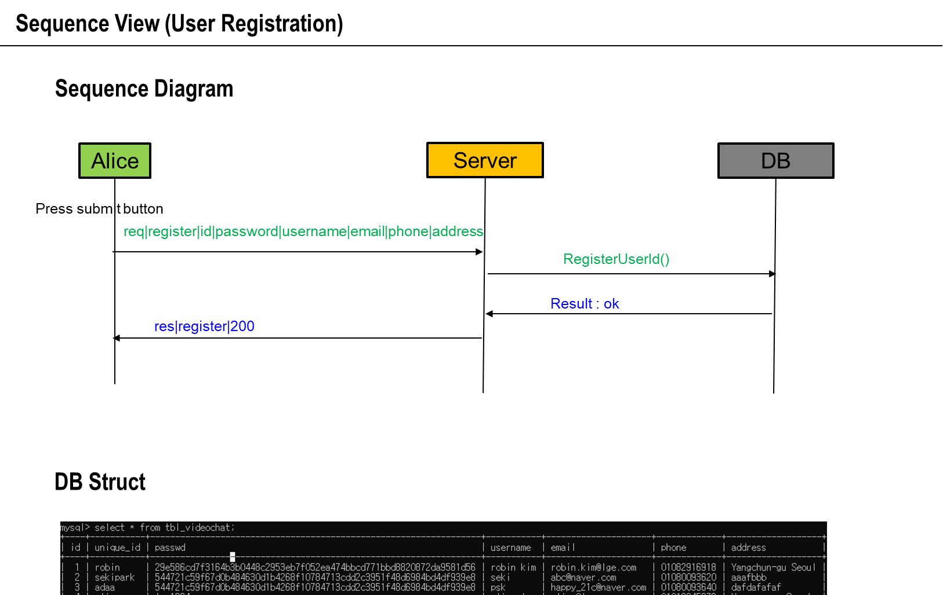
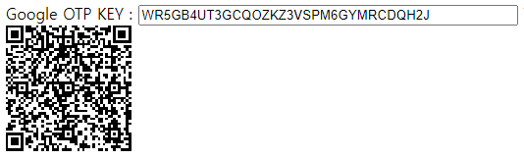
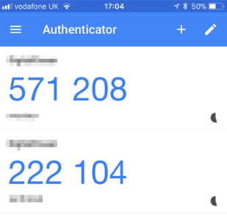
|otp_key
OTP key AES encription
2 factor authentication with Google OTP
#define SQL_CREATE_TBL \
" CREATE TABLE IF NOT EXISTS tbl_videochat( \n \
id INTEGER PRIMARY KEY AUTO_INCREMENT, \n \
unique_id TEXT NOT NULL, \n \
passwd TEXT NOT NULL, \n \
username TEXT NOT NULL, \n \
email TEXT NOT NULL, \n \
phone TEXT NOT NULL, \n \
address TEXT NOT NULL, \n \
passwd_update_utc INTEGER, \n \
passwd_wrong_cnt INTEGER DEFAULT 0, \n \
passwd_lock_utc INTEGER DEFAULT 0, \n \
gotp TEXT \n \
);"

Slide 12
Sequence View (Signaling Call Accept)
Alice
Server
Bob
req|login|alice
|password|otp_key
res|login|200
req|login|bob
|password|otp_key
User log-in
res|login|200
Press Invite button
req|invite|bob|sdp_alice
res|invite|180
Calling
req|invite|alice|sdp_alice
Press Accept button
res|invite|200|sdp_bob
res|invite|200|sdp_bob
Accept

Slide 13
Sequence View (Peer to Peer)
Alice
Server
Bob
Press Invite button
pc = new RTCPeerConnection(pc_config, pc_constraints);
pc.createOffer( setLocalOffer, onSignalingError, sdpConstraints );
createOffer
setIceCandidateOffer
Invite(local SDP)
SDP(Alice)
SDP(Alice)
Press Accept button
pc = new RTCPeerConnection(pc_config, pc_constraints); var sd = new RTCSessionDescription( { sdp: strSdp, type:"offer" } );
pc.setRemoteDescription(sd);
pc.createAnswer(setLocalAnswer, onSignalingError, sdpConstraints);
createAnswer
setIceCandidateAnswer
Accept(local SDP)
SDP(Bob)
SDP(Bob)
var sd = new RTCSessionDescription( { sdp: strSdp, type:"answer" } ); pc.setRemoteDescription(sd);
setAnswer
setRemoteDescription(remote SDP)
RTCPeerConnection

Slide 14
Sequence View (Signaling Call Decline)
Alice
Server
Bob
req|login|alice
|password|otp_key
res|login|200
req|login|bob
|password|otp_key
User log-in
res|login|200
req|invite|bob|sdp_alice
res|invite|180
Calling
req|invite|alice|sdp_alice
res|invite|603
res|invite|603
Decline

Slide 15
Security View
RTCPeerConnection DTLS/UDP
Alice
Bob
Confidentiality - TLS encrypt the data and attacker can only see the encrypted data - client/server uses SSL/TLS for authentication - peer to peer uses DTLS for date secure - password sha256 hash with salt - Google OTP key is encrypted with AES
Integrity - TLS and DTLS can guarantee the integrity as well.
Availability - connection failed physically, it resume the connection again automatically (QUIC)
wss://192.168.0.10:443
WSS/TLS/TCP
wss://192.168.0.10:443
WSS/TLS/TCP
Server
Database
Password - SHA256 with salt
Google OTP key - AES
SQL bind variable
Minimum privilege access

Slide 16
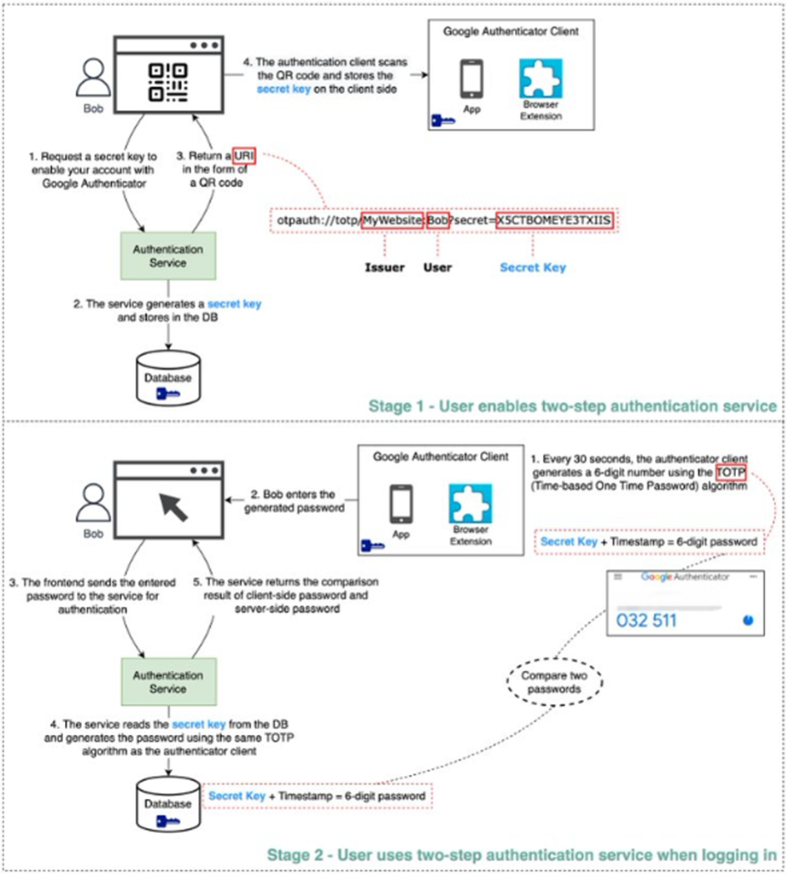
2 Factor Authentication (sequence)

Slide 17
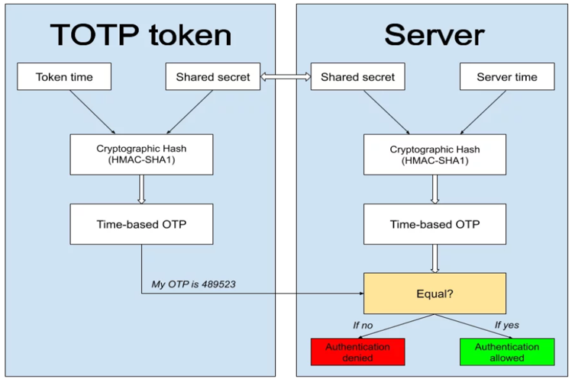
2 Factor Authentication (internal)

Slide 18
Functional Requirements
No | Requirements | Satisfactory | Security
R1 | 1. The ability for the user to register with the system | YES | TLS based wss used with port 443
R1.1 | 1.1 The user shall provide the system their email address and password. | YES
R1.1.1 | 1.1.1 The system shall ensure that the user’s password is secure. | YES | Password is saved SHA-256 with salt
R1.1.2 | 1.1.2 Passwords must be a minimum of 10 characters long and include one number and one symbol. | YES | LG Password rule is applied 1. at least 1 alphabet 2. at least 1 special character 3. at least 1 number 4. length should be 10 ~ 15
R1.2 | 1.2 The system shall use two-factor authentication. | YES | Google OTP is applied as well as user password Google OTP can be used with “QR code” or “Setup Key”
R1.3 | 1.3 The system should force a user to periodically reset their password (at least once a month). | YES | Detect 1 month past after setting password Password setting UTC time is saved in Database
R1.4 | 1.4 If the user enters the incorrect password more than three times, then their account will be locked for one hour. | YES | Password wrong count and UTC time tried is saved in Database / User blocked
R1.5 | 1.5 The system shall allow users to change their email address in a secure way. | YES | Email address can be changed securely using TLS
R1.6 | 1.6 The system shall provide the ability for the user to recover or change their password in the event it is lost. | YES | Password can be changed securely using TLS. Password can be sent to user’s email by SMTP with TLS.

Slide 19
Functional Requirements
No | Requirements | Satisfactory | Security
R2 | 2. After successful registration the system shall assign the user a unique contact identification name (contact identifier). | YES | system has a functionality checking unique_id is unique Unique id is used for the system
R2.1 | 2.1 this can be the user’s email address or some other name chosen by the user if it does not conflict with other user’s contact identifiers already in the system. | YES | system has a functionality checking unique_id is unique
R3 | 3. The system shall provide a contact list that associates a person with their contact identifier (last name, first name, address, e-mail, contact identifier). | YES | System provide the contact list login-ed through TLS connection “Retrieved Logined ID” button support this requirement
R3.1 | 3.1 . When a contact is associated with a contact identifier the VoIP application shall display the contact’s name instead of the contact identifier. | YES | All login user information is displayed
R4 | 4. The system shall provide the ability to initiate a call using a contact identifier or the contacts list. | YES | unique_id is used for peer connection
R4.1 | 4.1 During the call initiation, the user shall be presented with call status and outcome (answered, busy or rejected). | YES | system presents BUSY, REJECT, ANSWER
R4.2 | 4.2 During call initiation the user shall have the ability to end the call at any time. | YES | system has the ability to Call END

Slide 20
Functional Requirements
No | Requirements | Satisfactory | Security
R5 | 5. The system shall provide the ability to accept or reject calls while not in a call. | YES | System has the ability to Accept or Reject
R5.1 | 5.1 Application shall show the caller’s contact identifier or contact name during an incoming call. | YES | During incoming call, user can see the contact name
R6 | 6. The system shall notify the user of missed calls, either because the call was not accepted or because the called entity was in another call. | YES | system notify missed call
R7 | 7. Provide the ability to terminate a call at any time while in a call. | YES | system can terminate call
R7.1 | 7.1 If a call is terminated by one user, the other caller shall be notified. | YES | system can notify it
R8 | 8. Application shall be brought to the foreground during an incoming call. | YES | We are using web browser(e.g. Google Chrome) as a client, so bringing the browser to the foreground might be challenging. However, we notify users through pop-up alerts.
R9 | 9. This application is a point-to-point communication system. That is, each end point of the call should function as both a server and a client. | YES | WebRTC peer connection is used

Slide 21
Quality Attribute (Non Functional)
No | Requirements | Details | Satisfactory
R10 | Performance | The system must deliver call video/audio as close to real time as possible. | YES
R11 | Authentication | The system must use two factor authentication for sign on and user credentials must be protected. Lost or compromised credentials must be handled in a reasonable way. | YES
R12 | Communication privacy | The system must ensure that calls remain private. No intermediary should be able to snoop or spy on an ongoing call. | YES
R13 | Proof of identity (nonrepudiation) | Users should be confident that the entity they are on a call with is the one that they believe it is. | YES
R14 | Reliability | The system must ensure that calls are reliable. The system should recover from networking errors and dropped calls as soon as possible. The goal is to maintain a secure, performant connection at all costs. | YES If disconnected network, it recover again with QUIC protocol

Slide 22
Security Requirements
No | Requirements | Details | Satisfactory
R15 | Reliability | All transaction should be logged | YES
R16 | SQL query safe | SQL query should be binded | YES

Slide 23
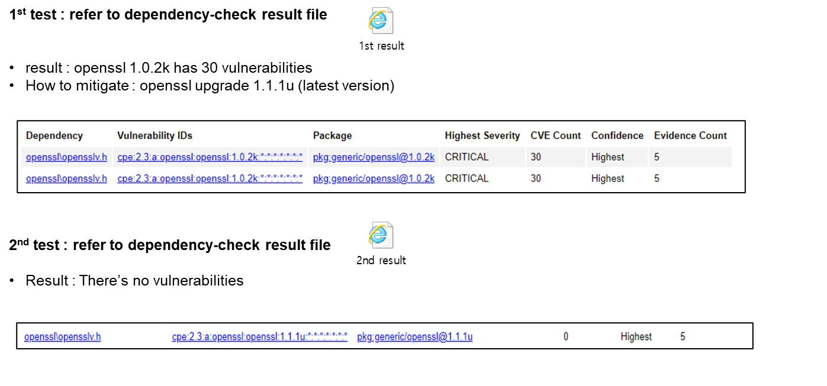
Threat & Security - dependency-check
OpenSSL migration (1.0.2k -> 1.1.1u)

Slide 24
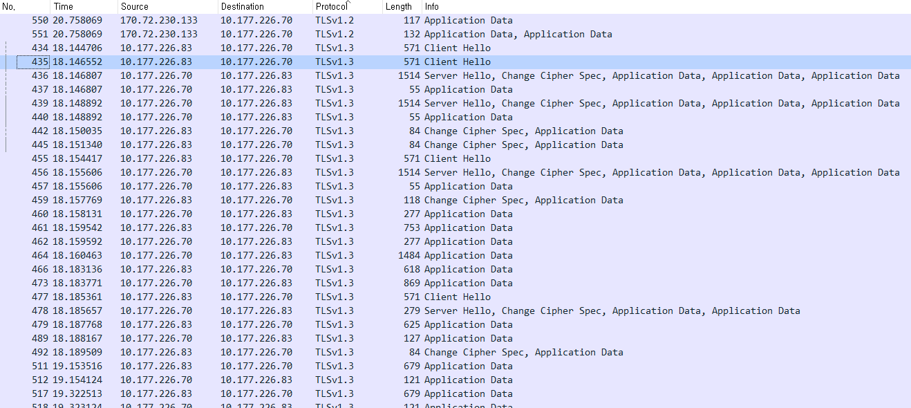
TLS Validation Test (wireshark)

Slide 25
Work to do / Limitation
Server Certification Key self-signed is not saved in secure storage of Windows

Slide 26
Test Case -1
Req_No. | Requirement | Test Case | Result
R1 R1.1 | 1. The ability for the user to register with the system 1.1 The user shall provide the system their email address and password. | TC000) A registration screen should be provided where you can enter your ID, password, name, email, phone, and address. | OK
 |  | TC001) The ID, password, name, and email information are mandatory, and if they are missing, a separate warning popup will be displayed when the submit button is pressed. | OK
 |  | TC002) After entering the information and clicking the submit button, you should see a success popup. | OK
R1.1.1 R1.1.2 | 1.1.1 The system shall ensure that the user’s password is secure. 1.1.2 Passwords must be a minimum of 10 characters long and include one number and one symbol. | TC003) Provide a guide on the password entry screen (at least 1 alphabet/special character/number and length 10 to 15). | OK
 |  | TC004) Provide the ability to retype passwords, giving users the ability to double-check their passwords. | OK
R1.2 | 1.2 The system shall use two-factor authentication. | TC005) After entering the user information and clicking the Submit button, the screen should provide a QR code for Google OTP and a setup key value. | OK
 |  | TC006) Using the Google OTP app, you can scan the QR code or enter the setup key to receive the authentication key value. | OK

Slide 27
Test Case -2
Req_No. | Requirement | Test Case | Result
R1.4 | 1.4 If the user enters the incorrect password more than three times, then their account will be locked for one hour. | TC007) To log in to the system, you will need to enter the saved user ID, password, and OTP values and click the login button. | OK
 |  | TC008) If you enter an incorrect password and press the login button, a pop-up will be displayed error popup. | OK
 |  | TC009) If you enter the password incorrectly 3 times, a pop-up will be displayed saying 'Too many password is wrong, wait for 60 seconds'.(The requirement says that it should be locked for 1 hour, but we changed it to 1 minute lock for testing convenience) | OK
 |  | TC010) If an incorrect otp value is entered, a 'OTP is WRONG' warning popup should be displayed. | OK
 |  | TC011) If the user id, password, and otp value are entered correctly, the user should be logged in normally by pressing the login button. | OK

Slide 28
Test Case -3
Req_No. | Requirement | Test Case | Result
R1.5 | 1.5 The system shall allow users to change their email address in a secure way. | TC012) Once you've logged in, the Change Email button should be active. | OK
 |  | TC013) Click it, enter the email address you want to change and click submit, and your email address should be changed. | OK
 |  | TC014) If you press submit button without entering an email address, it displays error popup. | OK
R2 | 2. After successful registration the system shall assign the user a unique contact identification name (contact identifier). | TC015) During user registration, a button UI should be provided to enter a unique id. | OK
 |  | TC016) If the user presses the submit button without entering an ID, a warning popup should be displayed stating "userid has not been entered". | OK
 |  | TC017) If the user enters a username and presses the submit button, it should proceed to the next step unless it is a duplicate of a value already in the database. | OK?

Slide 29
Test Case -4
Req_No. | Requirement | Test Case | Result
R2.1 | 2.1 this can be the user’s email address or some other name chosen by the user if it does not conflict with other user’s contact identifiers already in the system. | TC018) Provide a button called Check id to allow the user to check for duplicates when registering an ID. | OK
 |  | TC019) If there are no duplicates, when the user clicks the check id button, a popup will display 'user ID is available{userid]'. | OK
 |  | TC020) If a duplicate ID is entered, a warning will be displayed saying 'user ID ALREADY registered. Please use another user ID' warning popup’. | OK
R3 R3.1 | 3. The system shall provide a contact list that associates a person with their contact identifier (last name, first name, address, e-mail, contact identifier). 3.1 . When a contact is associated with a contact identifier the VoIP application shall display the contact’s name instead of the contact identifier. | TC021) The Retrieve login ID button is disabled when the user is not logged in. | OK
 |  | TC022) If you click the Retrieve login ID button after logging in, the contact list will be displayed at the bottom of the screen. | OK
 |  | TC023) At the bottom, the value (contact identifier, name, e-mail, phone, address) entered by the user during registration should be displayed. | OK

Slide 30
Test Case -5
Req_No. | Requirement | Test Case | Result
R4 | 4. The system shall provide the ability to initiate a call using a contact identifier or the contacts list. | TC024) View the Contact list, enter the id of the contact list in the peer ID and click the CALL button to make a call. | OK
 |  | TC025) If you enter a user who is not logged in to the peer ID and make a call, you will see a popup saying 'peer ID is not log-in now' and 'please press 'retrieved login ID' button'. | OK
R4.1 R5 R5.1 | 4.1 During the call initiation, the user shall be presented with call status and outcome (answered, busy or rejected). 5. The system shall provide the ability to accept or reject calls while not in a call. 5.1 Application shall show the caller’s contact identifier or contact name during an incoming call. | TC026) When a call is received, it should display the following information ’You have a call from userid’ | OK
 |  | TC027) When a call is received, a popup should be displayed with the option to 'accept' or 'decline'. | OK
 |  | TC028) Clicking the Accept button should start the call with the other party. | OK
 |  | TC029) Clicking the Decline button should end the call. | OK
 |  | TC030) If a third party calls you during a call, a pop-up will appear to let them know you are busy. | OK

Slide 31
Test Case -6
Req_No. | Requirement | Test Case | Result
R4.1 R5 R5.1 | 4.1 During the call initiation, the user shall be presented with call status and outcome (answered, busy or rejected). 5. The system shall provide the ability to accept or reject calls while not in a call. 5.1 Application shall show the caller’s contact identifier or contact name during an incoming call. | TC031) When the call is connected, the caller information screen should be shared. | OK
 |  | TC032) When you make a call, the BYE button should be enabled. | OK
 |  | TC033) If you press BYE to end the call, the other party should see a missed call noti pop-up. | OK
R4.2 R6 R7 R7.1 | 4.2 During call initiation the user shall have the ability to end the call at any time. 6. The system shall notify the user of missed calls, either because the call was not accepted or because the called entity was in another call. 7. Provide the ability to terminate a call at any time while in a call. 7.1 If a call is terminated by one user, the other caller shall be notified. | TC034) When you make a call, the BYE button should be enabled. | OK
 |  | TC035) If you press BYE to end the call, the other party should see a missed call noti pop-up. | OK
 |  | TC036) When the BYE button is pressed during a call, the other party should receive a noti that the call has ended. | OK
 |  | TC037) When a call is received, you should be able to press the decline button to end the call. | OK

Slide 32
Test Case -7
Req_No. | Requirement | Test Case | Result
R4.2 R6 R7 R7.1 | 4.2 During call initiation the user shall have the ability to end the call at any time. 6. The system shall notify the user of missed calls, either because the call was not accepted or because the called entity was in another call. 7. Provide the ability to terminate a call at any time while in a call. 7.1 If a call is terminated by one user, the other caller shall be notified. | TC038) The decline button must also be active during the call. | OK
 |  | TC039) In either case, the call should end when the bye or decline button is pressed. | OK
R8 | 8. Application shall be brought to the foreground during an incoming call. | TC040) When a call is received, it should display the following information ’You have a call from userid’ | OK

