Slide 1

VideoChat
3조 보안연대
Team David Belasco

Slide 2
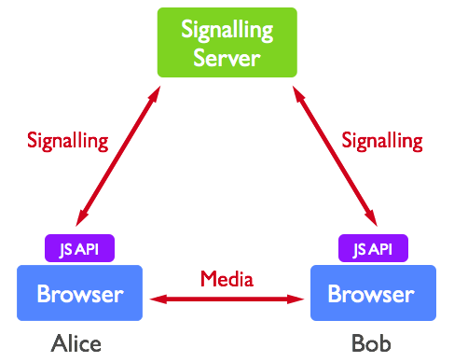
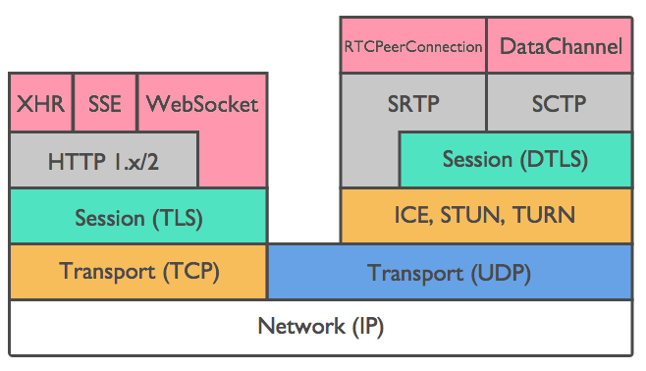
Brainstorm / Background
Harnessing collective intelligence to find best solution of the requirement
WebRTC is perfectly matched for the requirement
Signaling (TLS)
Media (DTLS)

Slide 3

Overall Architect
PeerToPeer (webRTC/Datagram TLS) Resilience over the network
Chrome
Chrome
Alice
7. createOffer with RTCPeerConnection
Bob
8. createAnswer with RTCPeerConnection/RTCSessionDescription
User login (https) WebSocket(“wss://IP:443”) req|login|user_id
3. User login (https) WebSocket(“wss://IP:443”) req|login|user_id
2. res|login
4. res|login
Signaling (https/TLS)
Register account
Login with 2 factor authentication
Database interface
Signaling with WebSocket secure & SDP
Peer2Peer connection with webRTC
Fault detect & recovery
5. Invite user_id
6. res|user info
Server
Password - SHA256 with salt
Google OTP key - AES
SQL query binding
Minimum privilege access
Certification(pem)
Local TCP
Application
Database
UPDATE tbl_videochat SET gotp = ? WHERE unique_id = ?

Slide 4
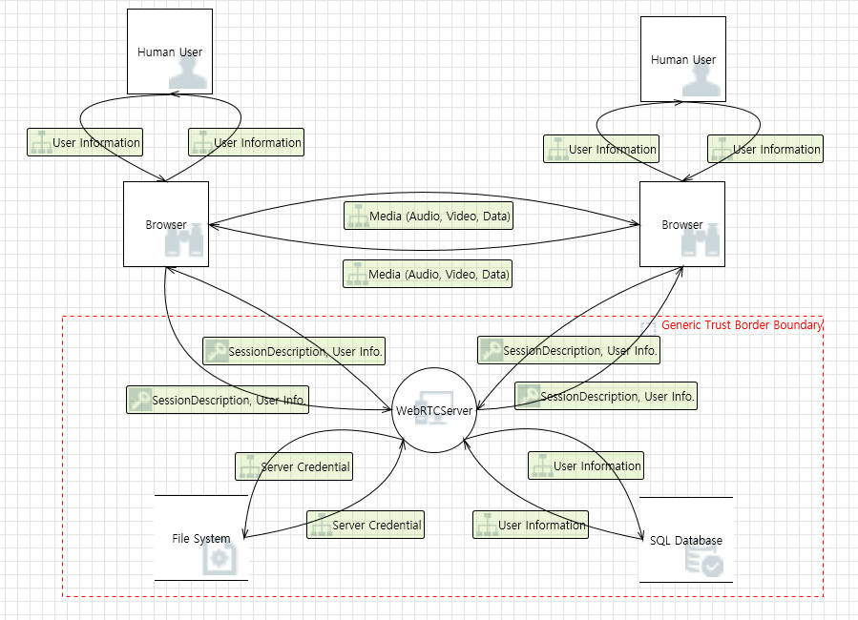
Threat Modeling

Slide 5
Threat Lists
Priority | Category | When/Where | Threat/Requirement Description | Mitigation | Requirement #
1 | Tampering | Brower → WebRTCServer | The web server 'WebRTCServer' could be a subject to a cross-site scripting attack because it does not sanitize untrusted input. | 1. Input validation 2. Input sanitization(Use Regular Expression): Special characters can be blocked or removed | R1.1.2
2 | Elevation Of Privilege | Brower → WebRTCServer | WebRTCServer may be able to impersonate the context of Browser in order to gain additional privilege. | 1. Use 2FA 2. Use Least Privilege principle | R1.2
3 | Repudiation | Brower → WebRTCServer | WebRTCServer claims that it did not receive data from a source outside the trust boundary. Consider using logging or auditing to record the source, time, and summary of the received data. | 1. Logging 2. TLS (Server Authentication) | R15
4 | Elevation Of Privilege | Brower → WebRTCServer | An attacker may pass data into WebRTCServer in order to change the flow of program execution within WebRTCServer to the attacker's choosing. | 1. Input validation 2. Input sanitization 3. Use Least Privilege principle | R1.1.2

Slide 6
Security View
RTCPeerConnection DTLS/UDP
Alice
Bob
Confidentiality - TLS encrypt the data and attacker can only see the encrypted data - client/server uses SSL/TLS for authentication - peer to peer uses DTLS for date secure - password sha256 hash with salt - Google OTP key is encrypted with AES
Integrity - TLS and DTLS can guarantee the integrity as well.
Availability - connection failed physically, it resume the connection again automatically (QUIC)
wss://192.168.0.10:443
WSS/TLS/TCP
wss://192.168.0.10:443
WSS/TLS/TCP
Server
Database
Password - SHA256 with salt
Google OTP key - AES
SQL bind variable
Minimum privilege access

