Slide 1
LLM Prediction Of Treatment Effects: Elicitation, Augmentation, And Model Dependence
Validation and learning-wave results, benchmarked against elastic net and a control-equals-treatment null.
Baseline GPT-4.1 is stronger than many augmentation variants on validation.
Reasoning helps more reliably than most augmentation tweaks.
Augmentation changes implied CONFIG-level beliefs, not just error metrics.
GPT-4.1-nano does not preserve the main pattern cleanly.
Baseline:
GPT-4.1
no augmentation (only information about the 14 design parameters + efficiency value in the control game)
eliciting one prediction at a time
directly outputting an integer prediction without “reasoning” process

Slide 2
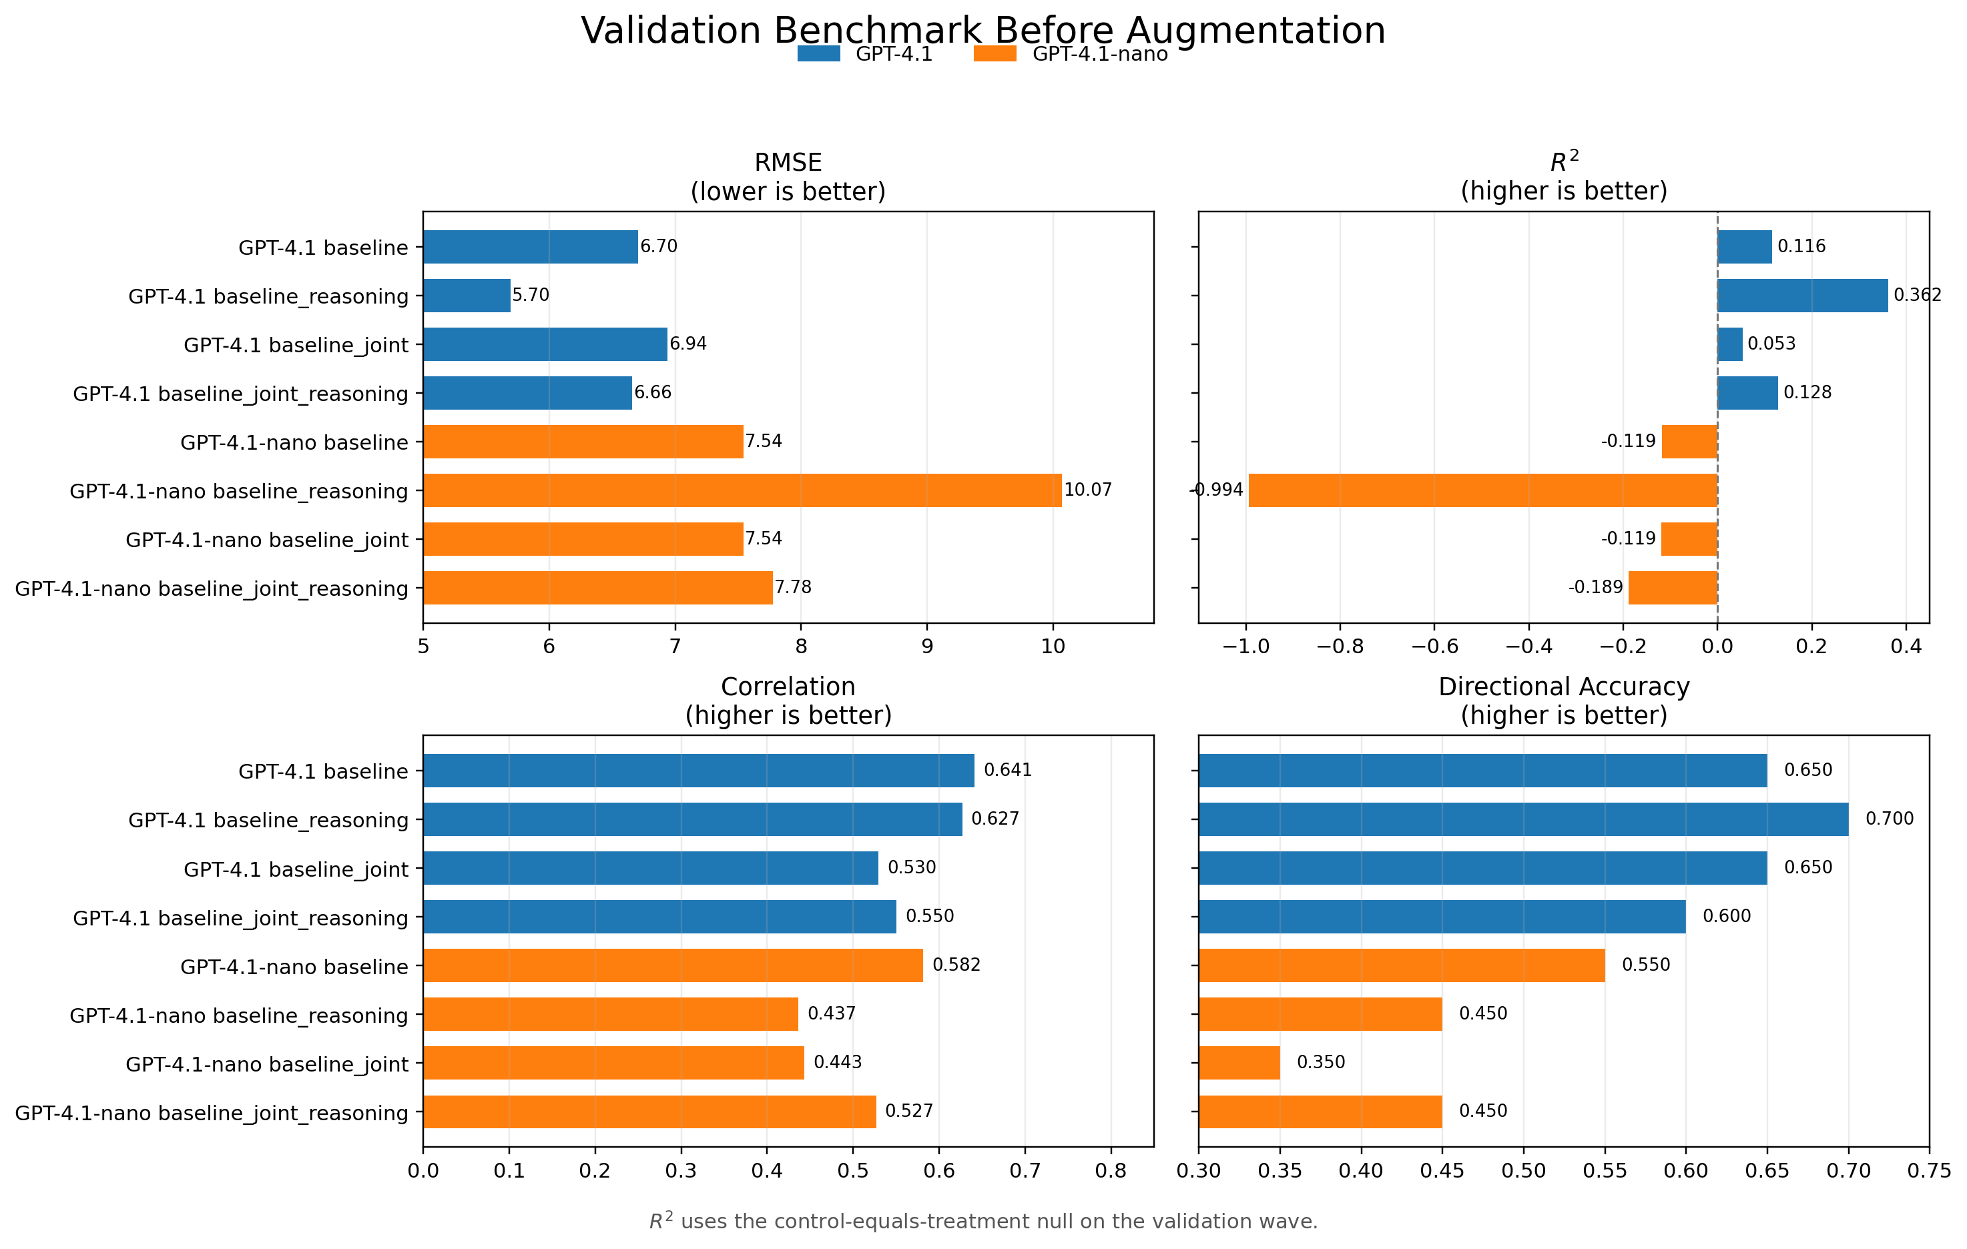
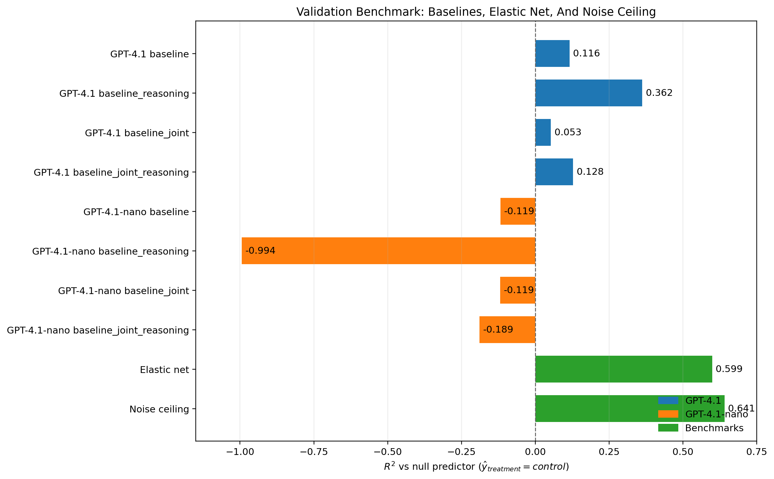
Benchmark Before Augmentation (Validation Wave)
Baseline-only comparison across elicitation modes; elastic net and the noise ceiling are kept in the slide text.
GPT-4.1 baseline_reasoning is the strongest GPT-4.1 baseline on validation: RMSE 5.70, correlation 0.627, directional accuracy 0.70, R² 0.362.
GPT-4.1-nano is weaker across all four metrics on validation; nano baseline_reasoning drops to R² -0.994.
External benchmark: elastic net reaches RMSE 4.52, correlation 0.773, directional accuracy 0.75, R² 0.599; the validation noise ceiling is R² 0.641.
External benchmarks: E-net RMSE 4.52, corr 0.773, DA 0.75, R² 0.599; noise ceiling R² 0.641.
Validation is the cleanest place to show that elastic net still outperforms the non-augmented LLM baselines.

Slide 3
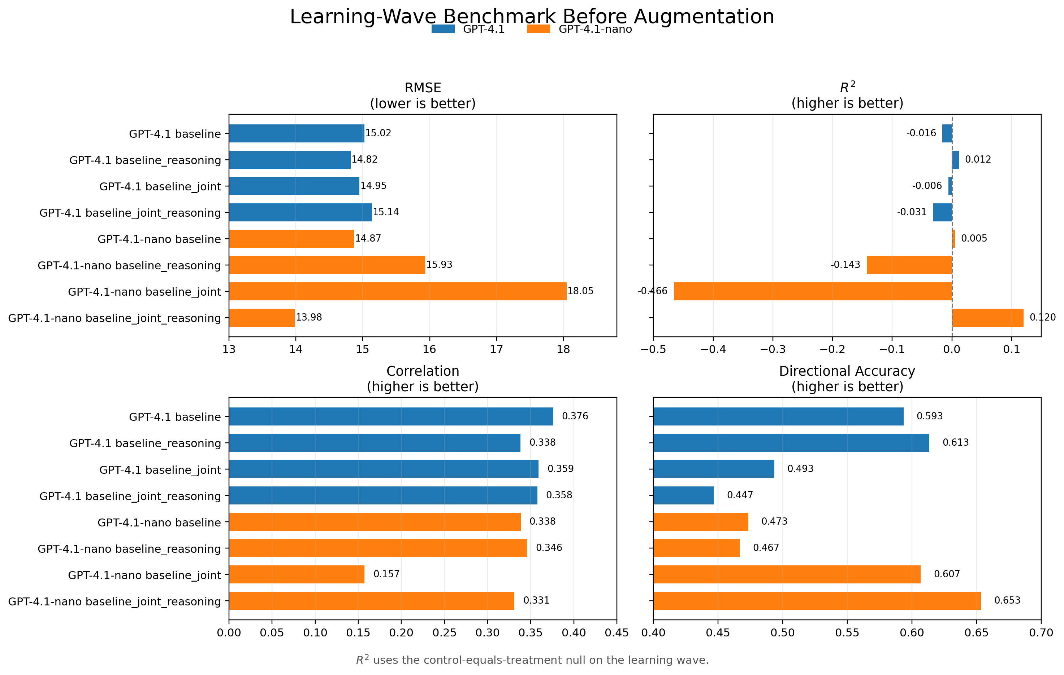
Benchmark Before Augmentation (Learning Wave)
Baseline-only comparison on the learning wave, using the same four metrics and the same layout as validation.
GPT-4.1 is fairly flat across elicitation modes on learning; baseline_reasoning is best on RMSE and R².
GPT-4.1-nano behaves differently: joint_reasoning is the strongest nano baseline on RMSE, R², and directional accuracy.
Unlike validation, the learning-wave ordering is not dominated by a single clear baseline family across both models.
The learning wave changes the baseline ordering, especially for GPT-4.1-nano.

Slide 4
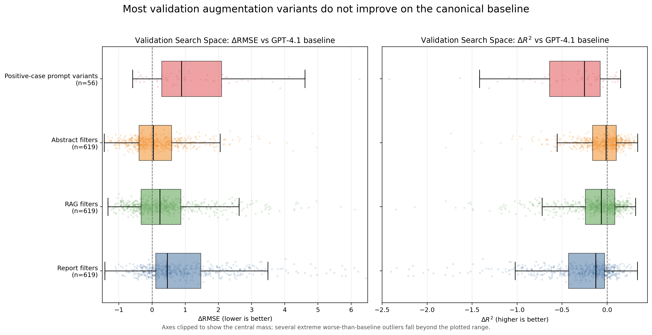
Main Validation Result
This summary includes the larger report/RAG/abstract search space plus the newer positive-case prompt variants.
Report filters: median ΔRMSE +0.46, only 20% of variants beat baseline on point estimate.
RAG filters: median ΔRMSE +0.24; Abstract filters: median +0.04.
Positive-case prompt variants are worse on average: median ΔRMSE +0.89 and median ΔR² -0.25.
Typical validation augmentation variants do not improve on the canonical GPT-4.1 baseline.

Slide 5
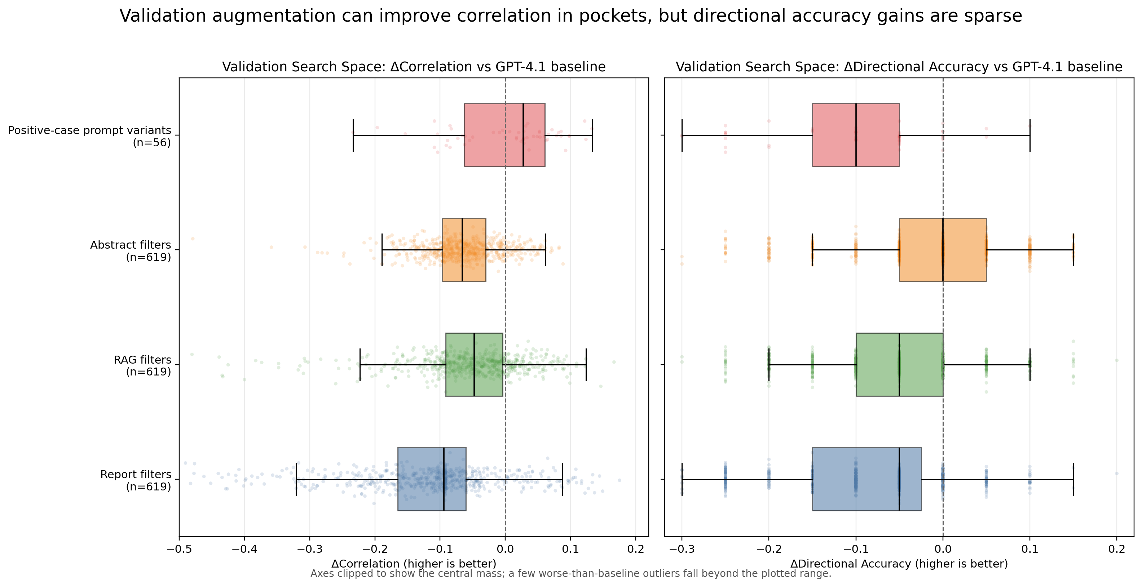
Validation: Correlation And Directional Accuracy
A few augmentation pockets improve correlation, but directional-accuracy gains are rare.
Report, RAG, and abstract filter families all have negative median Δcorrelation on validation.
Positive-case prompt variants are the one family with positive median Δcorrelation (+0.027), but their median Δdirectional accuracy is -0.10.
Directional-accuracy gains are sparse across the whole validation search space.
On validation, any upside is much easier to find in correlation than in directional accuracy.

Slide 6
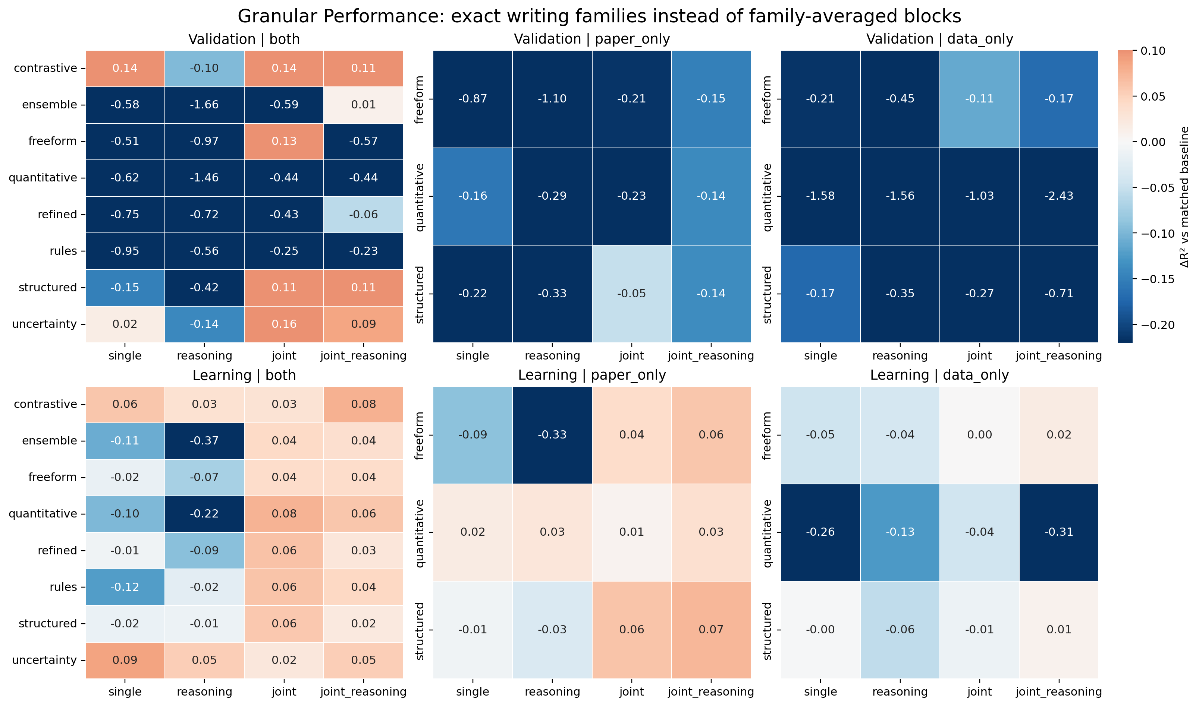
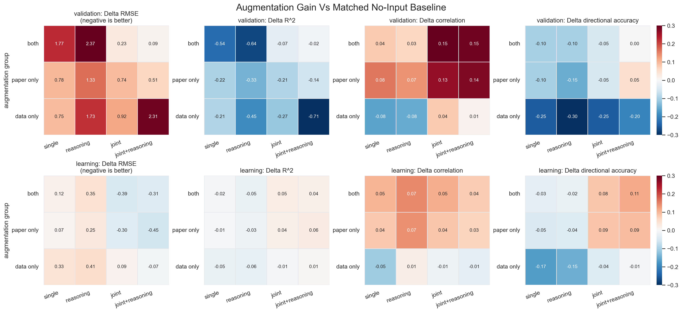
Where Augmentation Helps, With Writing-Level Granularity
Each cell is one exact positive-case writing family, not an average over multiple writing versions.
Validation winners are concentrated in a few exact families, especially both/contrastive, both/structured, and both/uncertainty under joint-like modes.
Learning is much cleaner: both and paper_only families become positive mainly under joint or joint_reasoning, while data_only stays weak.
Granularity shows that 'augmentation helps' is too coarse; the exact writing family matters.
The writing family is part of the treatment: averaging across them hides real heterogeneity.

Slide 7
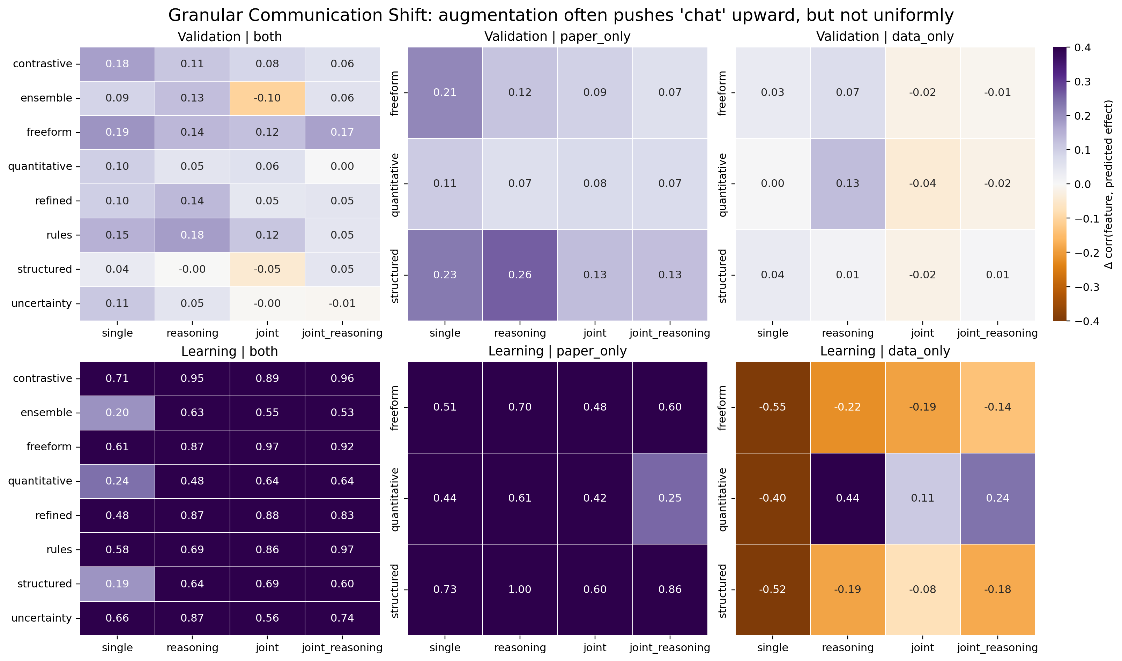
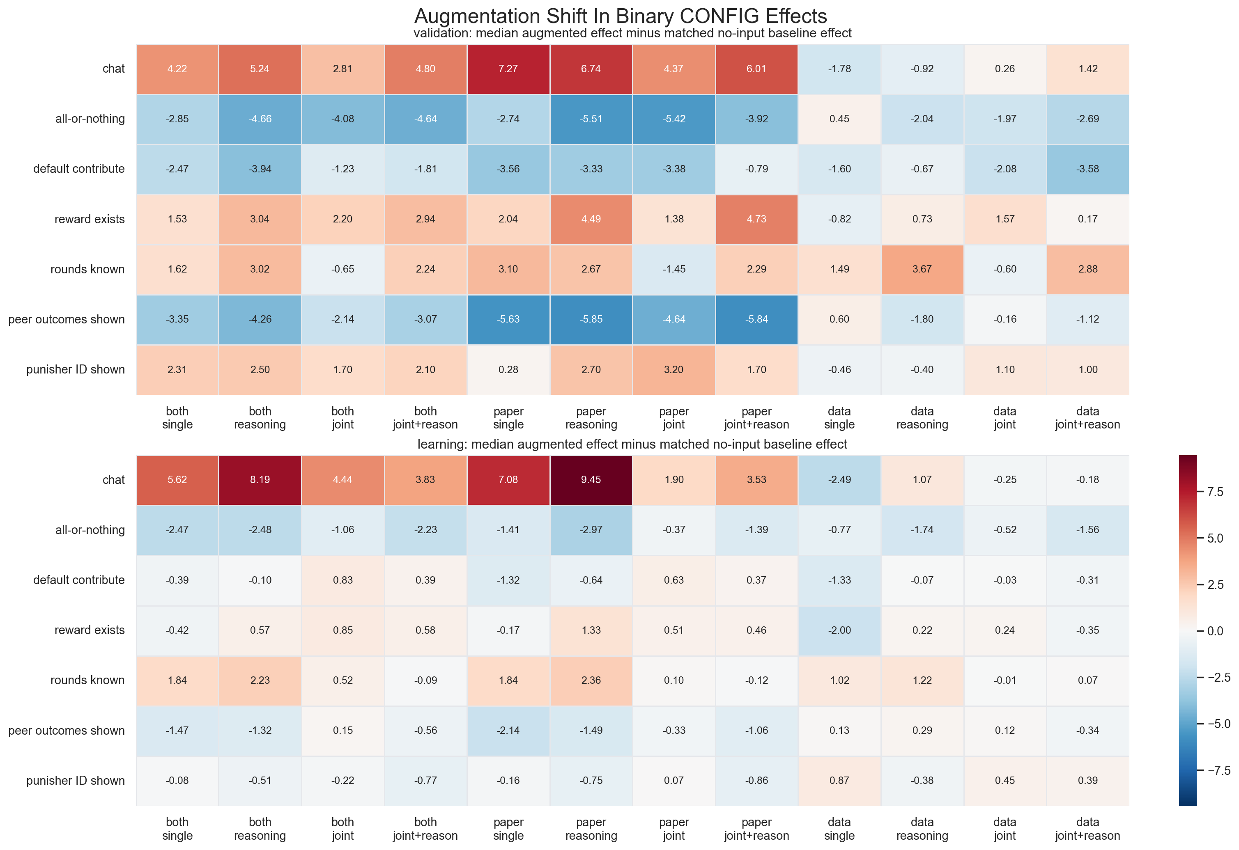
Communication Shift Is Real, But It Does Not Buy Performance By Itself
Here the feature shift is shown at exact writing-family granularity relative to the matched no-input baseline.
On learning, most both and paper_only families push communication sharply upward; validation shifts are much smaller.
Data_only is unstable and can even reverse direction, especially on learning.
This shift is not enough on its own: corr(chat shift, ΔR²) is -0.01 on validation and only 0.26 on learning.
A meaningful belief shift is not the same as a predictive gain.

Slide 8
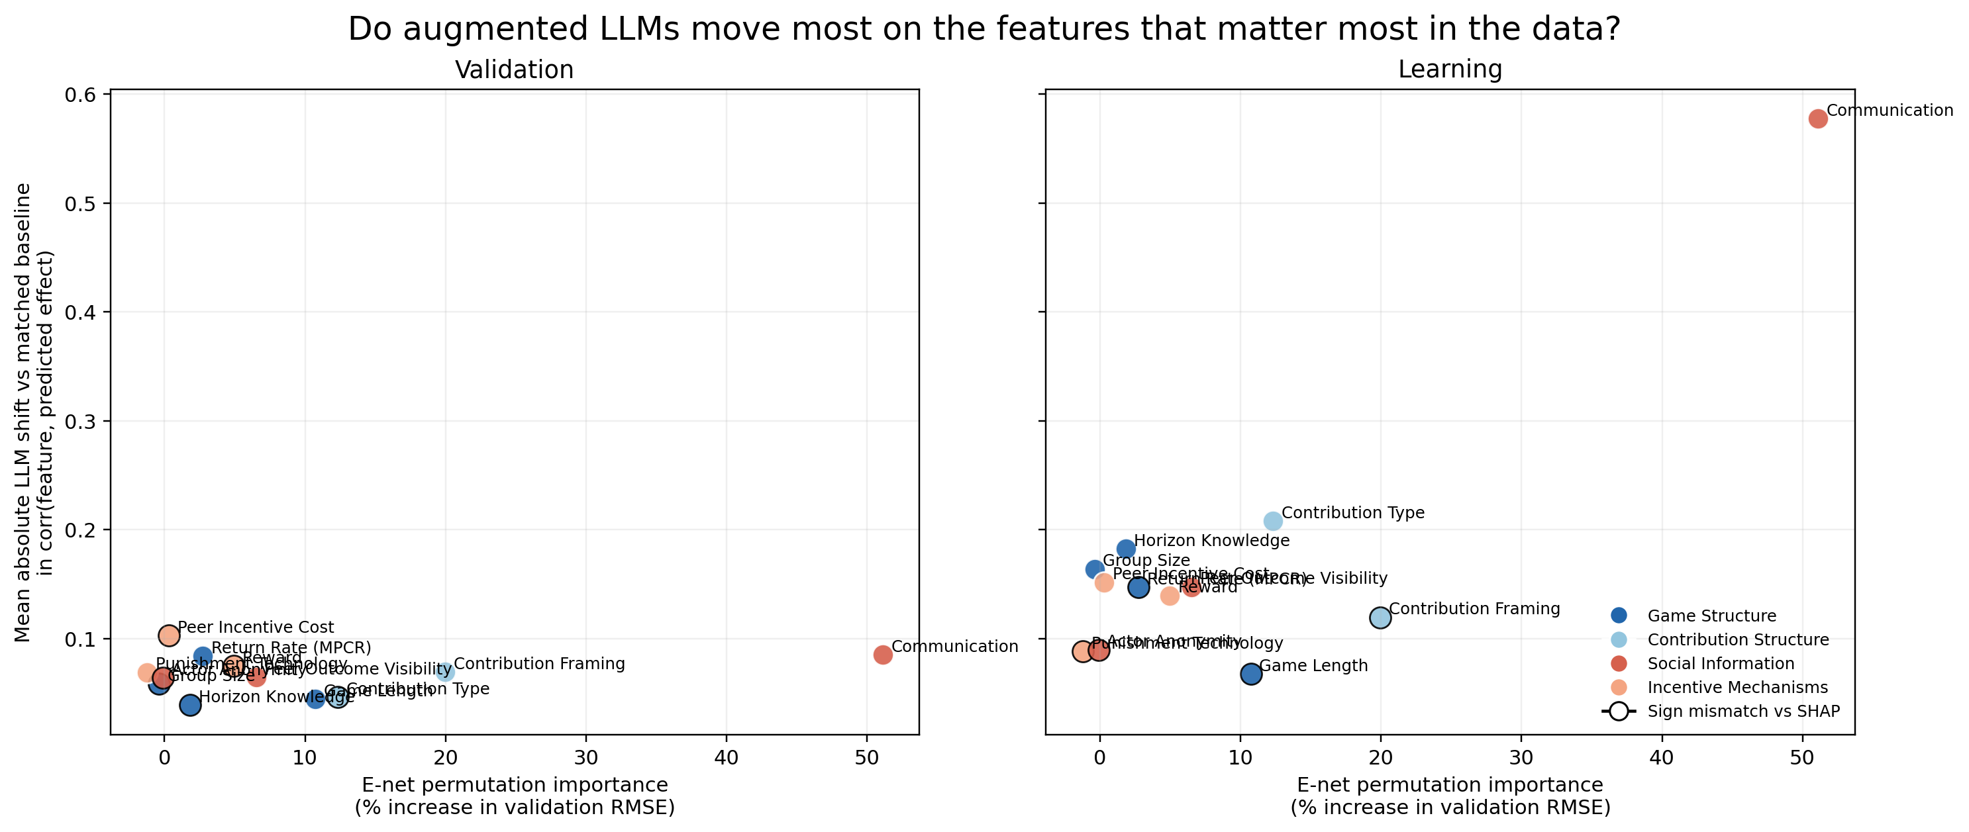
Do The LLM Shifts Match What Matters In The Data?
Comparison against the manuscript's E-net feature-importance and SHAP analysis; this is a feature-level, not interaction-level, audit.
Yes for communication: it is the highest-importance E-net feature and also the largest aligned LLM shift.
But several features look miscalibrated: peer incentive cost and group size are overindexed, while game length and contribution framing look underweighted.
This first pass compares feature-level main effects; checking interaction mismatch would require a second pass against manuscript Figure 5.
The augmented LLM is not random, but some of its biggest shifts still look misaligned with the data-driven model.

Slide 9
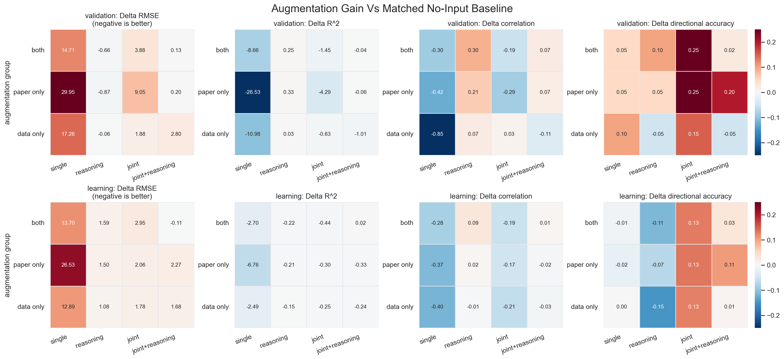
Nano Is Not A Drop-In Substitute
The same analysis pipeline on GPT-4.1-nano produces a materially different pattern.
GPT-4.1 cross-wave search has 0 missing outputs; GPT-4.1-nano has 71 missing outputs, including 50 missing learning cases for both_refined_joint_reasoning.
Some coarse trends survive, especially data_only being weak.
But the winning regions change and several learning-wave gains disappear under nano.
Model coice changes the story; nano should be treated as a separate regime, not a cheaper replica.

Slide 10
Takeaways
On validation, the canonical GPT-4.1 baseline remains hard to beat even after a large augmentation search over report, RAG, abstract, and prompt variants.
Within unaugmented prompting, GPT-4.1 baseline_reasoning is the strongest simple setup; elastic net still outperforms the LLM baselines on R^2.
Augmentation is only useful in selective regimes, mainly with both/paper_only inputs; data_only is consistently weak.
Prompting and augmentation change the model's implied causal beliefs about CONFIGs, especially chat, rewardExists, and showOtherSummaries.
GPT-4.1-nano should be treated as a separate regime: weaker validation baselines, 71 missing outputs, and materially different augmentation patterns.
Family-level patterns are more trustworthy than exact winner rankings.

Slide 11
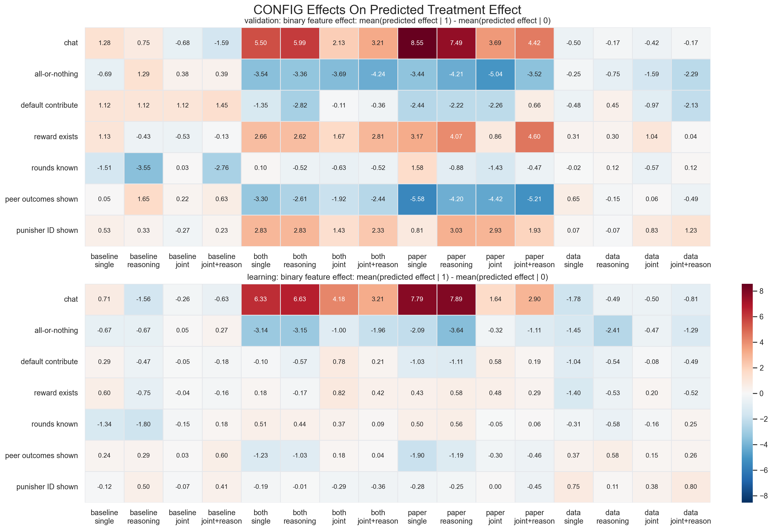
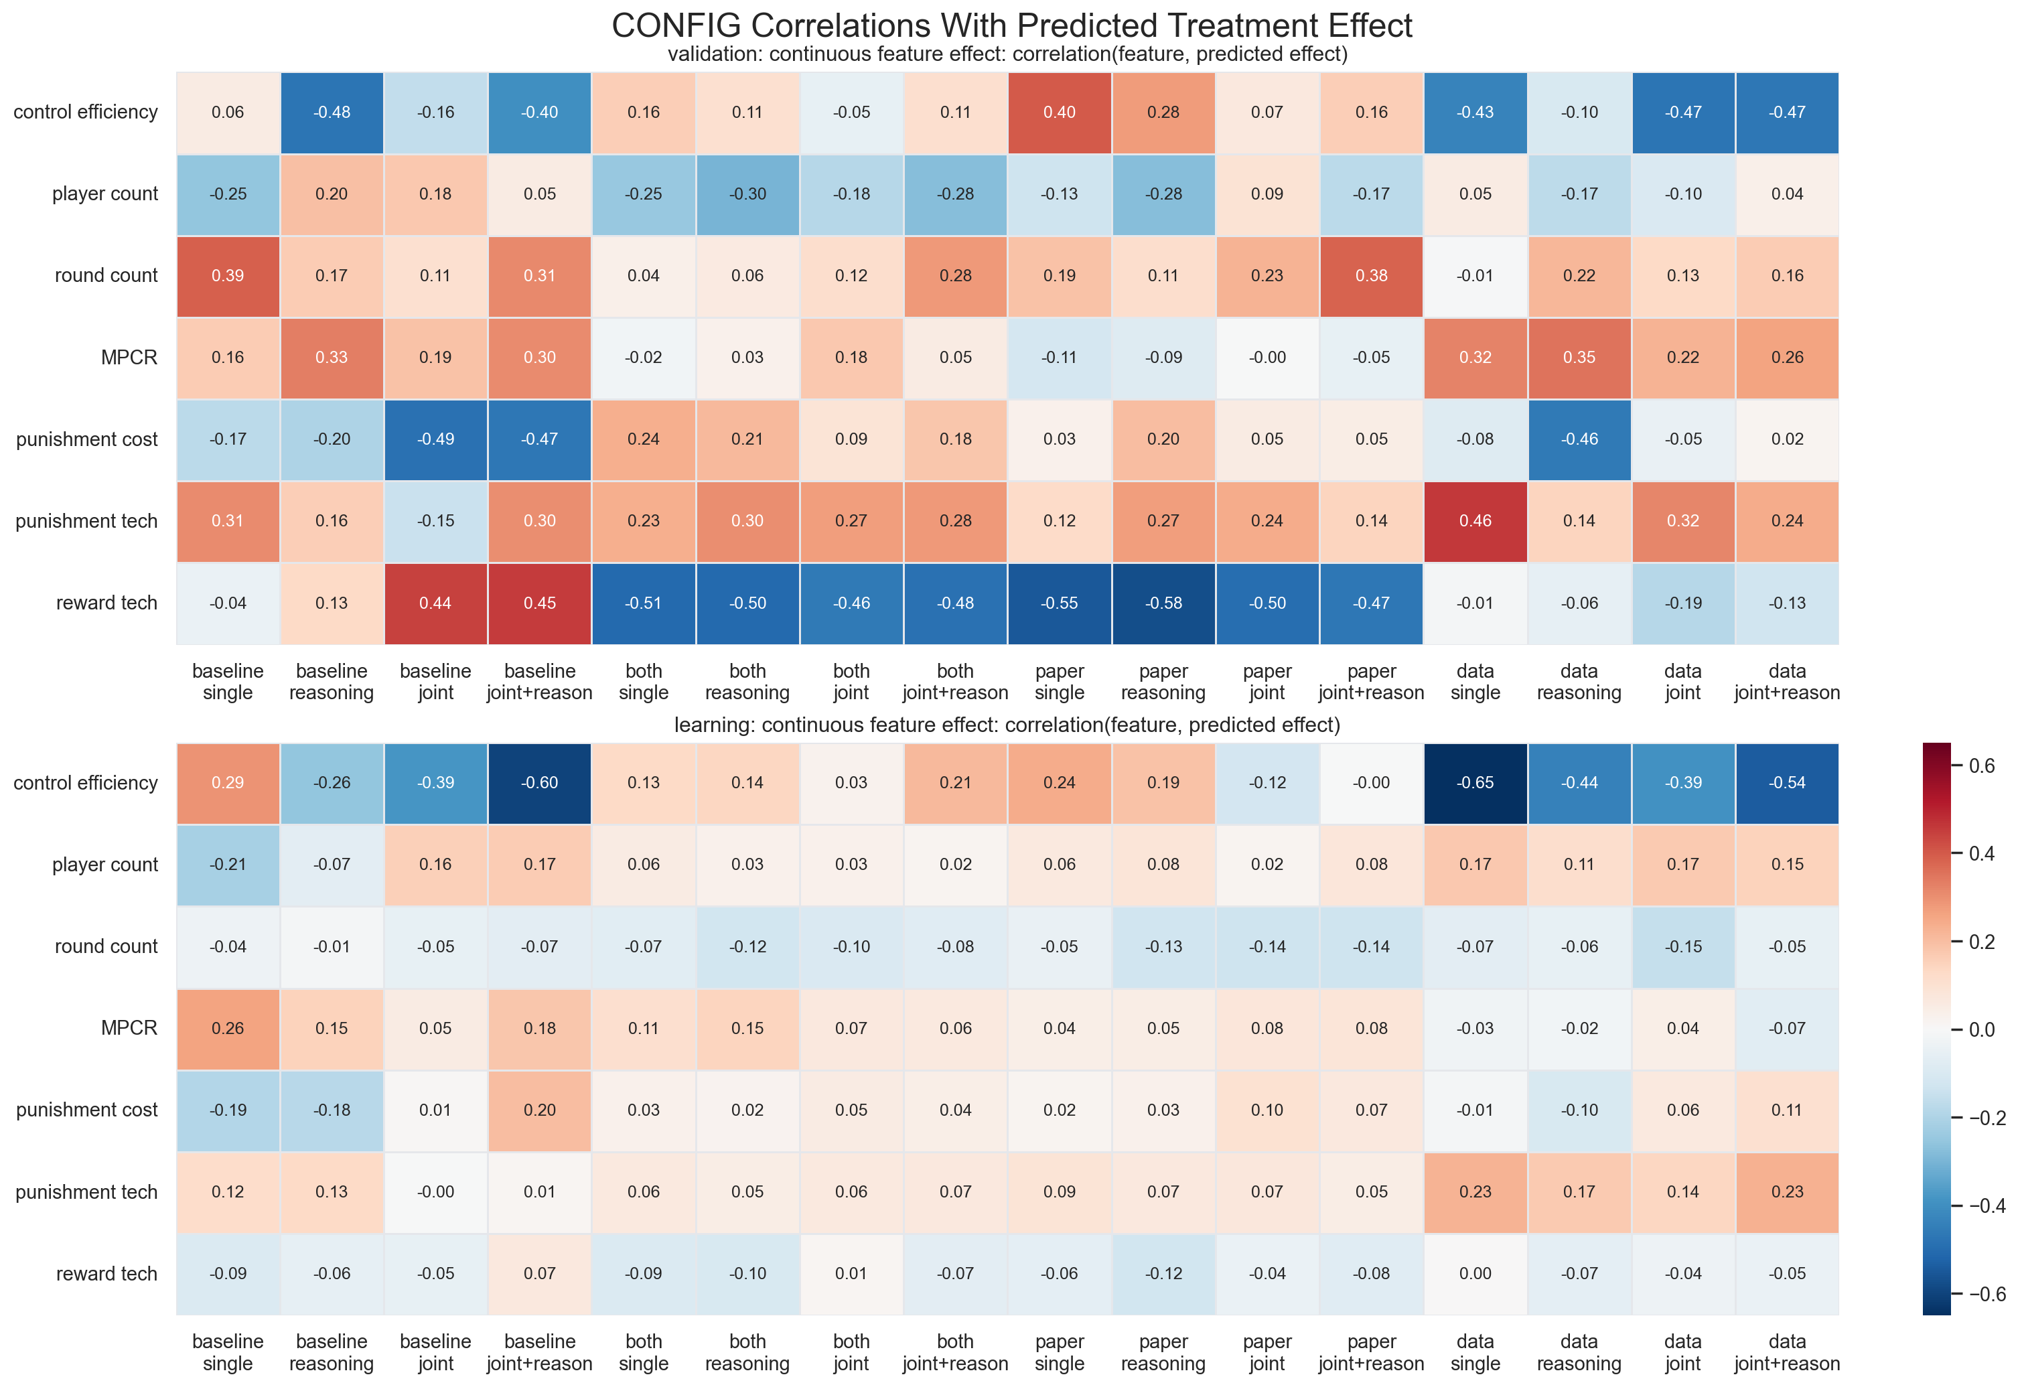
Appendix: Raw CONFIG Tendency Maps
These show the model's implied treatment-effect tendencies before differencing against the matched no-input baseline.
Binary features summarize sign and magnitude shifts for yes/no CONFIGs.
Continuous features summarize correlations between predicted treatment effect and CONFIG intensity.
The augmentation-delta slide in the main deck is the cleaner causal comparison; these are the raw tendency maps behind it.

