Slide 1
Big Data QA
and
Robot Framework
Robin Li
Wechat: robin3795
robinli@live.ca

Slide 2
Agenda
1. Big Data Brief Introduction
3. Robot Framework
4. Python Language
5. Case Study – 3 Big Data QA Projects
* Data Migration
* Data Ingestion
* Data Quality Check
6. Q &A

Slide 3
Big Data
Data < ---> Inforamtion
Volume: data amount: GB,TB,PB
Variety: data types -- structure / no-structure
Velocity: data generating rate
DB --> DW --> DL Big Data: Hadoop
Analystic Application: BI, AI, Cloud, IoT
Cloud: AWS, Azure, GCP,...
Data Quality --- Automation Testing
Notes:
Business Intelligence
Artifical Intelligence
- Machine Learning
- Deep Learning
KB(kilo), MB(Mega), GB(Giga), TB(Tera),PB(Peta),EB(Exa),ZB(Zetta),YB(Yotta)
Banking, Telecomm, RFID, e-commerce, Manufacturing, ....

Slide 4
Hadoop
Scalable, Fault tolerant, Open source
Framework for distributed storing and processing of large set data on commodity hardware.
Storge: HDFS(Hadoop Distributed File System)
+ Computing: MapReduce(MR v2--YARN: Yet Another Resource Negotiator)
Nodes: Name Node, Data Node
Platforms: Cloudera, Horonworks, MapR,......

Slide 5
HDFS
* WORM(Write Once, Read Many times)
* Divide into blocks, distribute
* Multiple replication
Commands:
$ hdfs dfs -command [args]
For example:
$ hdfs dfs -put mylocalfile /some/hfds/path
Web Interface: HUE, WebHDFS

Slide 6
Some popular Hadoop Tools
Spark: Fast processing engine to build and run SQL, streaming, ML or graphic applications.
Hive: DW infrastructure support ad hoc SQL.
Pig: HL platform for extracting, transforming or analyzing large dataset.
Hbase: Scalable distributed NoSQL DB.
Kafka: Fast, scable, durable, adm fault-tolerant publish-subscribe messaging system.
Oozie,Zookeeper, Sqoop, Kylin,......
Commerical tools: Vertica, Data Torrent,......

Slide 7
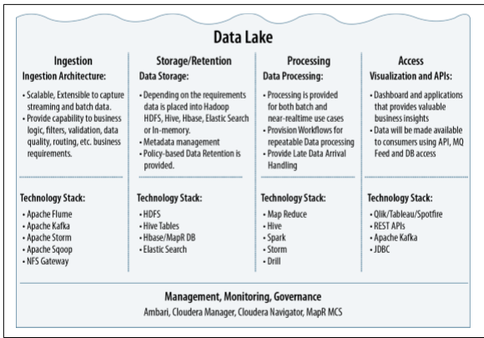
From ”Architecting Data Lakes
Data Management Architectures for
Advanced Business Use Cases”

Slide 8
Robot Framework
* Easy, flexible test automation framework
* ATDD: acceptance test-driven development
* Keyword-driven testing framework that uses tabular test data syntax
Interface: 1. GUI: RIDE -->TC development
2. CLI: pybot testSuite.txt ["Test Case"]
* Devops: Build tools(Jenkins) / Deploy tools(UCD)
* Management tools: HP ALM (QC)

Slide 9
RIDE (Robot framwork IDE)
Installation:
1. Python 2.6 above --- Python 2.7.13
2. wxPython 2.8.12.1 with Unicode support
3. Robot framework
4. RIDEhttps://github.com/robotframework/RIDE/wiki/How-To#starting-ride
5. Libraries

Slide 10
Install Robot Framework Libraries
For example: Database
Download robotframework-databaselibrary 1.0.1 from pypi.python.org/pypi https://pypi.python.org/pypi/robotframework-databaselibrary
Unzip, find setup.py file
cmd> python setup.py install
egg info --- dependency
List all installed libraries:
cmd> pip freeze

Slide 11
Robot Framework Libraries
http://robotframework.org
Libraries
Standard: Builtin, Collections, Strings,…
External: Selenium, Database,…
In-house libraries / functions
Example1: query count(*) [(n, )] ;
rowCount() HIVE
2: ExcelLibrary.py

Slide 12
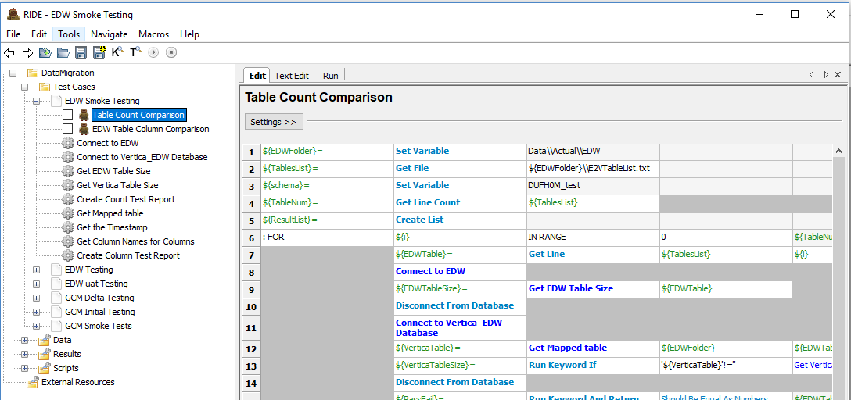

Slide 13
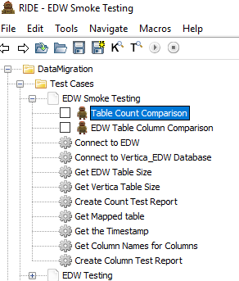
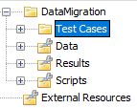

Slide 14
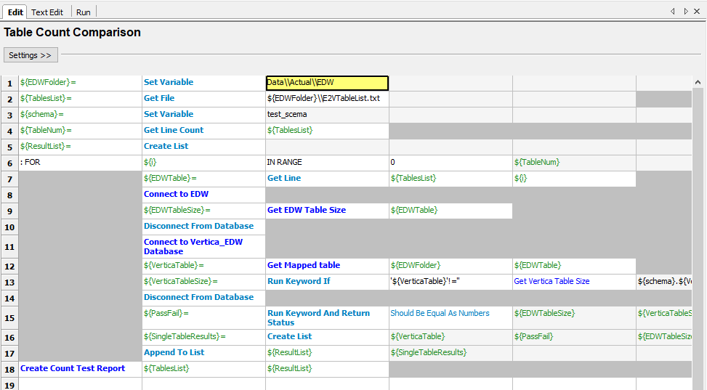

Slide 15
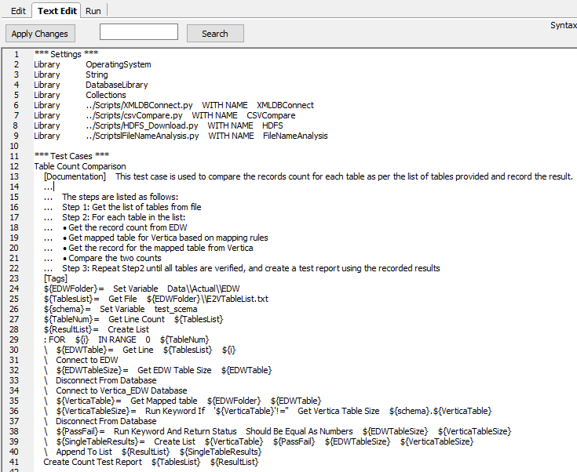

Slide 16
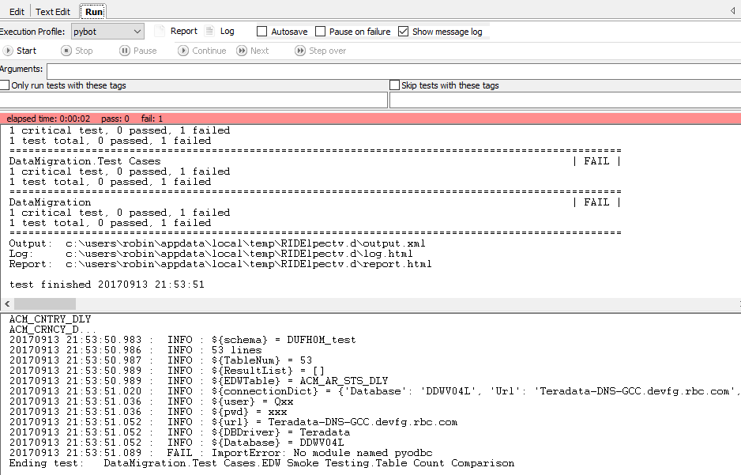

Slide 17
Why Python?
* New user friendly
* Healthy Community Support
* Help from Enterprises
* Big data, cloudy applications
* Execellent libraries: numPy, SciPy, Django, scikit-learn, nltk, .......
*Effective and Reliable

Slide 18
Python Language
General-purpose interpreted, interactive, object-oriented, and high-level programming language. -- >Easy, Flexible, Scripting
* Block: Same (4) spaces indent (no braces)
* Line, Statement: \, ;
* Case sensitive
* Quotation:'...', “...”, “““...”””
* Comment: #
===> Pythonic

Slide 19
Basic Syntax
* Assignment
-- No explicit declaration
- Multiple assignment:
a = b = c = 1 or a,b,c = 1,2,"abc" or a,b = b,a
* Condition
if expression:
statement(s)
else:
statement(s)
* Assignment
-- No explicit declaration
- Multiple assignment:
a = b = c = 1 or a,b,c = 1,2,"abc" or a,b = b,a
* Condition
if expression:
statement(s)
else:
statement(s)
* Loop
-- While
-- For
break, continue, pass (null)

Slide 20
Data Types and Objects
* Number: int, long, float, complex
* String: No char, substring [0:-1]
* List: sequence [,]
* Tuple: sequence of immutable objects (,)
* Dictionary: {key:value,}
** Function: def function( arguments)
** Module : runnable Python code file
** Package: modules and subpackages

Slide 21
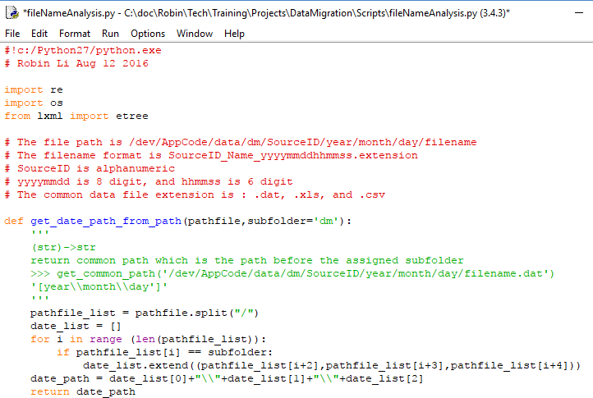

Slide 22
Project 1: Data Migration
Source:
1. Delta data --- DB
Fully verification, Timestamp
2. History data --- DW
Sampling, By order
Staging:
HDFS
Destination:
DB on Hadoop

Slide 23
Sampling Query
1. Vertica, MySQL, HIVE:
SELECT * FROM table LIMIT n;
2. SQL Server, Teradata
SELECT TOP n * FROM table;
3. Oracle
SELECT * FROM table WHERE ROWNUM<=n;
4. DB2
SELECT * FROM table FETCH FIRST n ROWS ONLY;

Slide 24
Project 2: Data Ingestion
E T L (Extract, Transform, Load)
1. Extracr from data sources (SQL, GFF, CSV, PSV....) HDFS (raw data) --> Ingestion
2. Transformation Parser/Mapper:
Ex: Standardization, data Format,...
Configuration files – Mapping rules
Parquet file -- column-oriented
(Apache HIVE, Cloudera Impala, Pig)
3. Stream out for applications

Slide 25
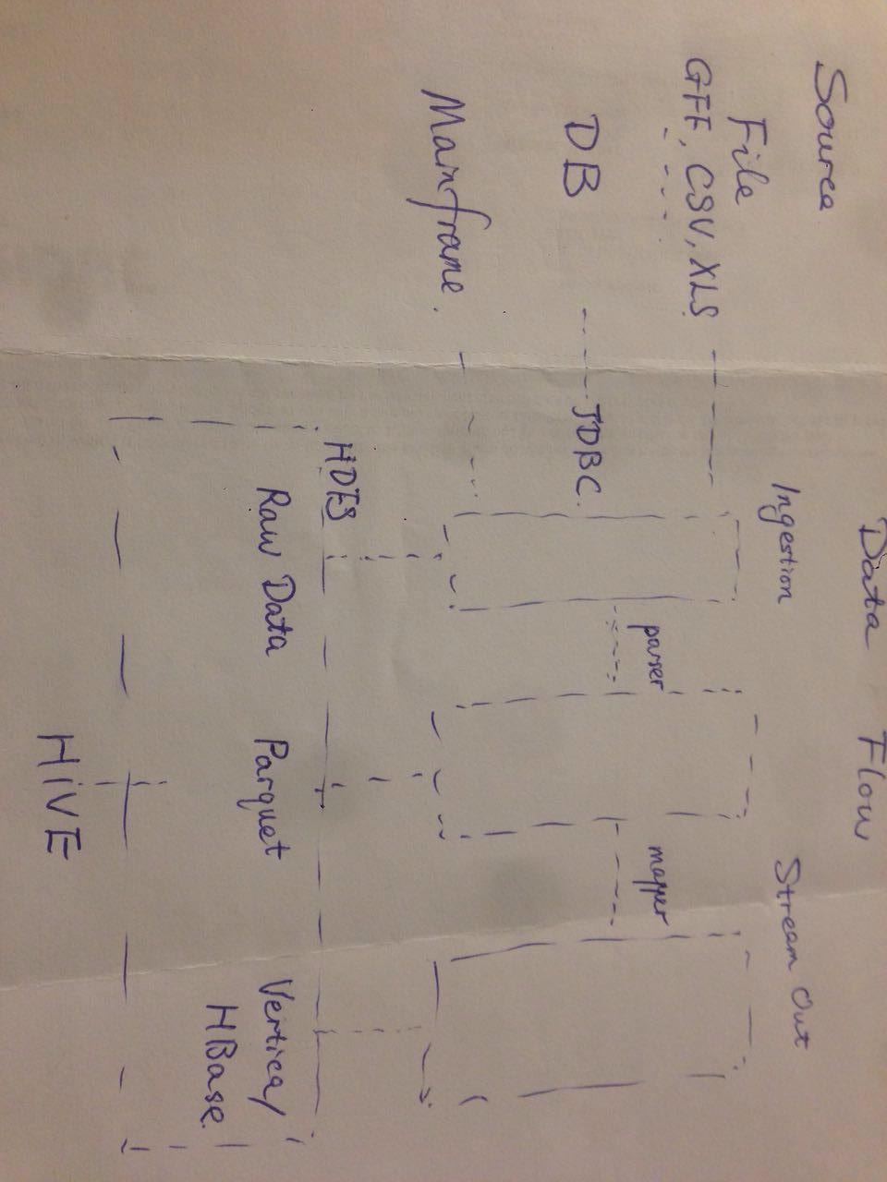
Data Flow
Data Flow

Slide 26
Data Flow

Slide 27
Project 3: Data Quality
Data Quality (data governance)
Accuracy, Correctness, Integrity, Completeness, Consistency, Currency, ......
(Row Counts, Null rate, MD5,Orphan records, ......)
Log check

Slide 28
Q & A
THANK YOU !

