Slide 1
Robot Framework
and Python
for Big Data QA
E-Bridge Career
Robin

Slide 2
Agenda
1. Big Data QA
2. Robot Framework
3. Python Language
4. Case Study – 3 Big Data QA Projects
* Data Migration
* Data Ingestion
* Data Quality Check

Slide 3
Data --> Big Data
Why: BI / AI
Data is resource, .......
Challenges : Volume, Variety, and Velocity
Quantity: KB(kilo), MB(Mega), GB(Giga), TB(Tera), PB(Peta),EB(Exa),ZB(Zetta),YB(Yotta)
Data Types: structure / no-structure
Quality: QA / Testing, Automation
DB -> DW -> Data Mart -> Data Lake

Slide 4
Big Data QA
Why Big Data?
-- History
-- Current Trend, BI & AI
What is Big Data?
-- Hadoop
Big data QA
-- ETL SQL
-- Automation tools
-- Python
Notes:
Business Intelligence
Artifical Intelligence
- Machine Learning
- Deep Learning
KB(kilo), MB(Mega), GB(Giga), TB(Tera),PB(Peta),EB(Exa),ZB(Zetta),YB(Yotta)
Banking, Telecomm, RFID, e-commerce, Manufacturing, ....

Slide 5
Big Data Technology
Apache Hadoop：
Storage: HDFS + Computing: MapReduce
Main Platforms: Cloudera, Horonworks, ......
Tech: MPP(Massive Parallel Processing)
Some popular tools:
Data Management: HDFS, YARN
Operations: Zookeeper, Cloudbreak, Oozie
Data Access: Pig, Hive, Storm, Hbase, Spark,
Integration: Falcon, WebHDFS, Sqoop,Kafka

Slide 6
Robot Framework
What?
-- Keyword-driven testing framework
Why ?
-- Easy, flexible
-- Python
How?
-- Open source environment
-- Libraries: built-in, extenal, and in-house

Slide 7
Robot Framework User
Basic:
Environment setup, simple TC design, TC running, create Keyword
Intermediate:
Built-in libraries, external libraries, DatabaseLibrary &ETL TC, Selenium2Library & Web TC, CI
Advance:
Build customized libraries

Slide 8
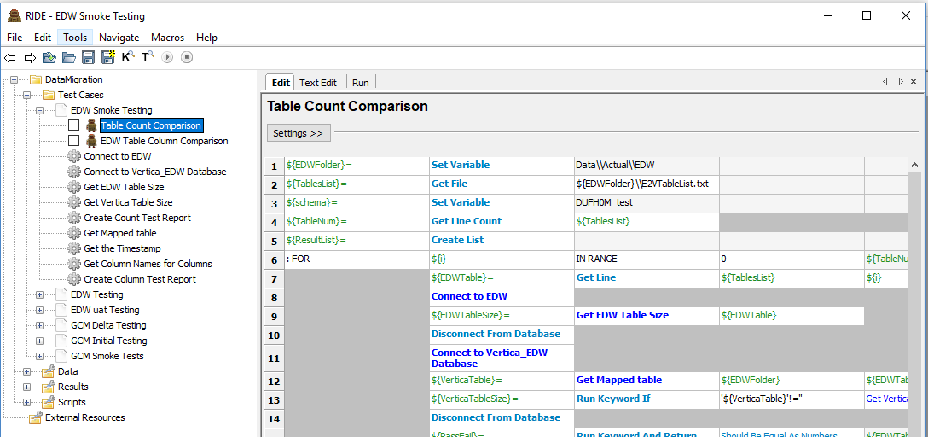

Slide 9
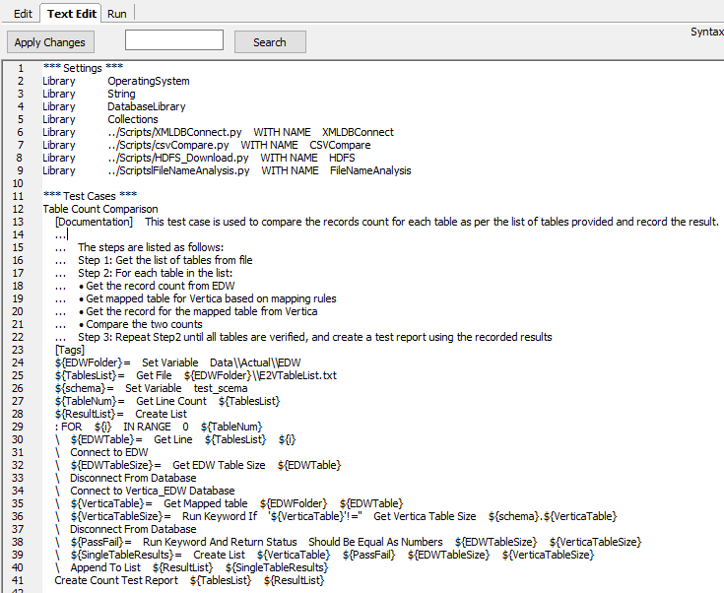

Slide 10
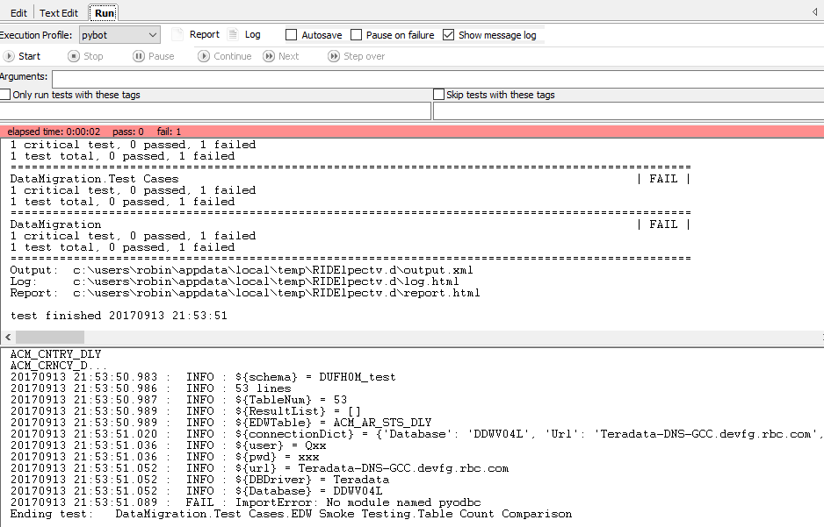

Slide 11
Python
Why?
-- Easy, flexible and powerful
How?
Practice, practice and practice !

Slide 12
Python Language
1. Overview and Setup
2. Basic Syntax
3. Data Types
4. Functions / Modules
5. Files Input/Output
6. Exceptions
7. Network and Muti-Thread

Slide 13
Project 1: Data Migration
Source:
1. Delta data --- DB
Fully verification, Timestamp
2. History data --- DW
Sampling, By order
Staging:
HDFS
Destination:
DB on Hadoop

Slide 14
Sampling Query
1. Vertica, MySQL, HIVE:
SELECT * FROM table LIMIT n;
2. SQL Server, Teradata
SELECT TOP n * FROM table;
3. Oracle
SELECT * FROM table WHERE ROWNUM<=n;
4. DB2
SELECT * FROM table FETCH FIRST n ROWS ONLY;

Slide 15
Project 2: Data Ingestion
E T L (Extract, Transform, Load)
1. Extracr from data sources (SQL, GFF, CSV, PSV....) HDFS (raw data) --> Ingestion
2. Transformation Parser/Mapper:
Ex: Standardization, data Format,...
Configuration files – Mapping rules
Parquet file -- column-oriented
(Apache HIVE, Cloudera Impala, Pig)
3. Stream out for applications

Slide 16
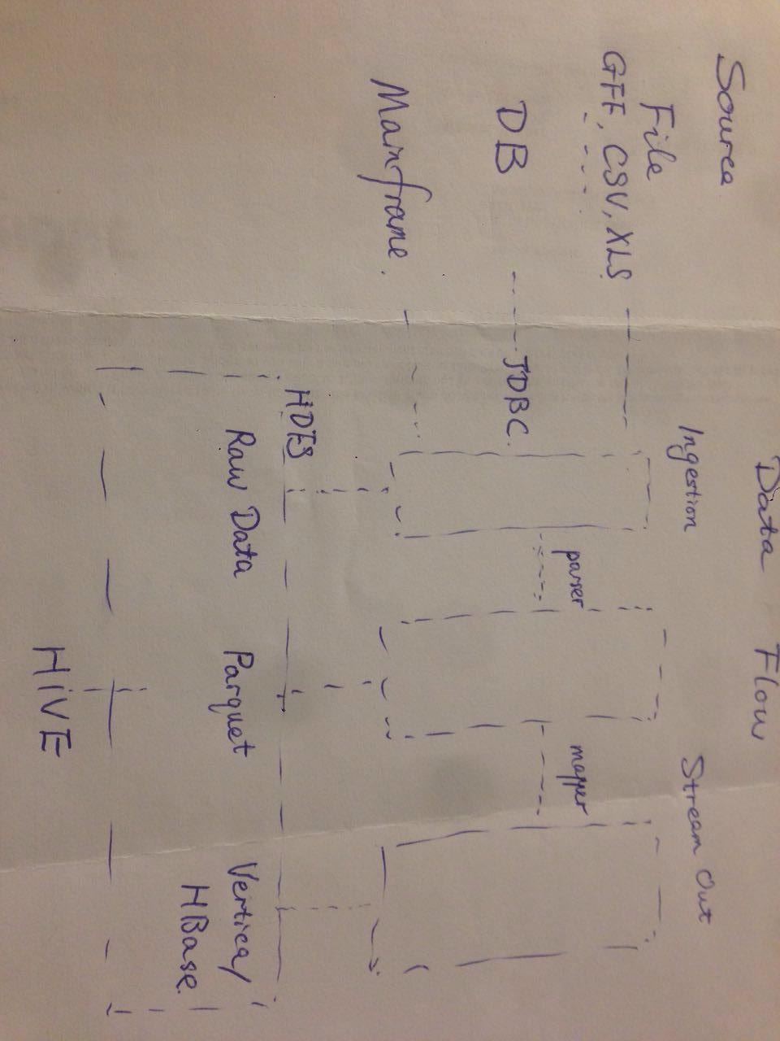
Data Flow
Data Flow

Slide 17
Project 3: Data Quality
Data Quality (data governance)
Accuracy, Correctness, Integrity, Completeness, Consistency, Currency, ......
(Row Counts, Null rate, MD5,Orphan records, ......)
Log check

Slide 18
Q & A
THANK YOU !

Slide 19
Test Script Sample
def first_TC():
I_get_a_key()
open_the_door()
then_I_see_you()
and_say(Hello World!)

