Slide 1
Big Data
Automation Testing
with
Robot Framework
Robin Li
robinli@live.ca

Slide 2
Agenda
1. Big data brief introduction
3. Robot Framework
4. Python Language
5. Cases Analysis – 3 Projects
6. Q &A

Slide 3
Why Big Data now?
Business Intelligence
Artifical Intelligence
  - Machine Learning
  - Deep Learning
  - ....
Industries:
- Telecommunication
- Banking

Slide 4
Data --> Big Data
Data is resource, .......
Challenges : Volume, Variety, and Velocity
Quantity: KB(kilo), MB(Mega), GB(Giga), TB(Tera), PB(Peta),EB(Exa),ZB(Zetta),YB(Yotta)
Data Types: structure / no-structure
Quality: QA / Testing, Automation
DB -> DW -> Data Mart -> Data Lake

Slide 5
Big Data Technology
Apache Hadoop：
Storage: HDFS
Computing: MapReduce (YARN)
Main Platforms:
Cloudera,
Horonworks,
......
Tech: MPP(Massive Parallel Processing)

Slide 6
Big Data Tools
Some popular tools:
Data Management
HDFS, YARN
Operations
Zookeeper, Cloudbreak, Oozie
Data Access
Pig, Hive, Storm, Hbase, Spark,
Integration
Falcon, WebHDFS, Sqoop,Kafka

Slide 7
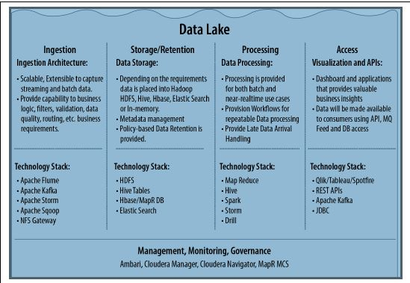
From ”Architecting Data Lakes
Data Management Architectures for
Advanced Business Use Cases”

Slide 8
Robot Framework
* Generic test automation framework
* ATDD: acceptance test-driven development
* Keyword-driven testing framework that uses tabular test data syntax
GUI: RIDE / CLI: pybot testSuite.txt ["Test Case"]
Connect to Test Case Management tools, pass test results to ALM /Jira
Devops: Build tools(Jenkins) + Deploy tools(UCD)
https://github.com/robotframework/QuickStartGuide/blob/master/QuickStart.rst

Slide 9
RIDE
(Robot framwork IDE)
1. Python 2.6 above --- Python 2.7.13
2. wxPython 2.8.12.1 with Unicode support
3. Robot framework
4. RIDE
https://github.com/robotframework/RIDE/wiki/How-To#starting-ride
Example: No nested loop

Slide 10
Robot Framework Libraries
http://robotframework.org
Libraries
Standard: Builtin, Collections, Strings,…
External: Selenium, Database,…
In-house libraries / functions
Example1: query count(*) [(n, )] ;
rowCount() HIVE
2: “,” in csv file

Slide 11
Python Language
Easy, flexible Scripting Languages
Indent: 4 spaces to define block
Convention:
Constant --UPPER
camel case: welcomeBigdataEvent
__function__, _function_, self.
official vs irregular
print-out vs hand-writing
Example :github.com sudoku game

Slide 12
Project 1: Data Migration
Source:
1. Delta data --- DB
Fully verification, Timestamp
2. History data --- DW
Sampling, By order
Staging:
HDFS
Destination:
DB on Hadoop

Slide 13
Project 2: Data Ingestion
E T L (Extract, Transform, Load)
1. Extracr from data sources (SQL, GFF, CSV, PSV....) HDFS (raw data) --> Ingestion
2. Transformation Parser/Mapper:
Ex: Standardization, data Format,...
Configuration files – Mapping rules
Parquet file -- column-oriented
(Apache HIVE, Cloudera Impala, Pig)
3. Stream out for applications

Slide 14
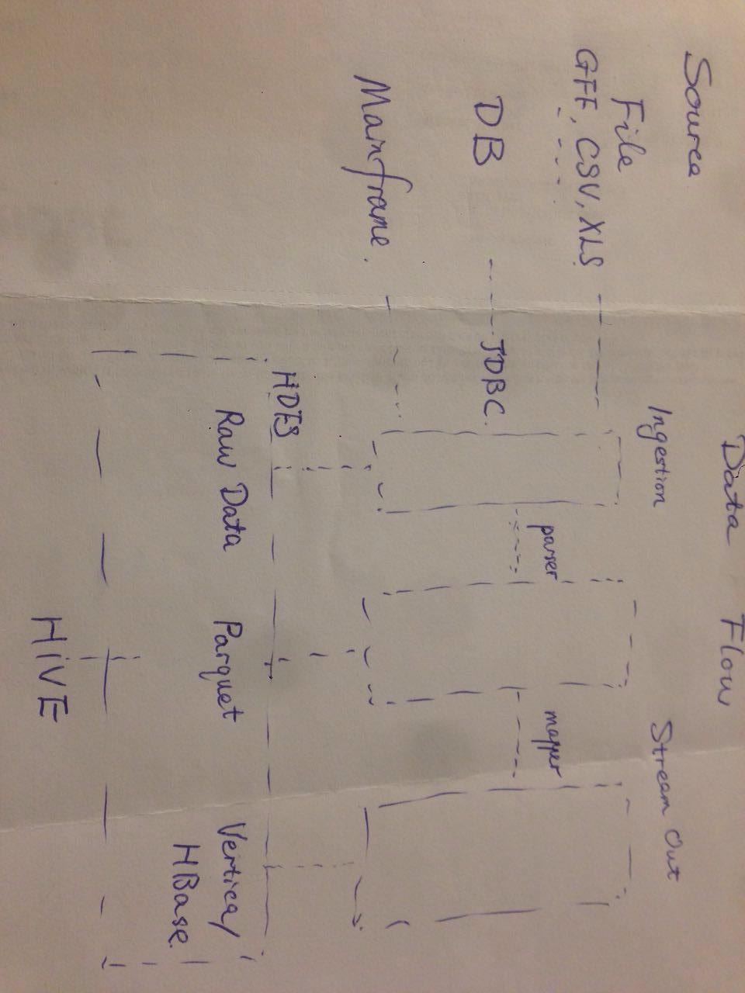
Data Flow

Slide 15
Project 3: Data Quality
Data Quality (data governance)
Accuracy, Correctness, Integrity, Completeness, Consistency, Currency, ......
(Row Counts, Null rate, MD5,Orphan records, ......)
Log check

Slide 16
Agenda
1. Big data brief introduction (10%)
3. Robot Framework (20%)
4. Python Language (10%)
5. Cases Analysis – 3 Projects(60%)
6. Q &A

Slide 17
Q & A
THANK YOU !

