Slide 1
Section II: Robot Framework
2.1 RF introduction and Setup
2.2 Basic Level: 2.2.1 First Test case
2.2.2 RIDE tools 2.2.3 Resource
2.3 Intermediate Level
2.3.1 Builtin library 2.3.2 Other Libraries
2.4 Database library
2.4.1 Introduction 2.4.2 Keywords
2.5 Integrated with tools
2.5.1 CI 2.5.2 QA 2.5.3 VCS
2.6 Advanced level
2.6.1 Customize RF 2.6.2 Build own libraries

Slide 2
2.1 RF Introduction and Setup
What?
-- Keyword-driven testing framework
Why ?
-- Easy, flexible
-- Python
How?
-- Open source environment
-- Libraries: built-in, external, and in-house

Slide 3
Robot Framework Setup
Python 2.6 above --- Python 2.7.13
www.python.org/downloads double click .msi
PATH
2. Setup tools
pypi.python.org/pypi/setuptools
Python setup.py install
easy_install egg
**Pip:https://pypi.python.org/pypi/pip
Python setup.py install -- install pip tools
pip install LibraryName

Slide 4
Robot Framework Setup(2)
3. Robot framework
github.com/robotframework/robotframework/release
4.wxPython 2.8.12.1 with Unicode support
www.wxpython.org/download.php
5. RIDE
https://github.com/robotframework/RIDE/release
https://code.google.com/p/robotframwork-ride/downloads/list
Unzip tar.gz
C:> python setup.py install

Slide 5
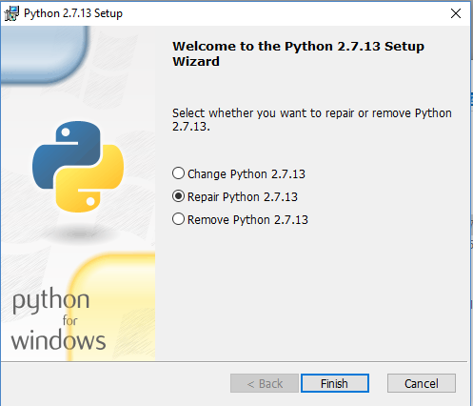
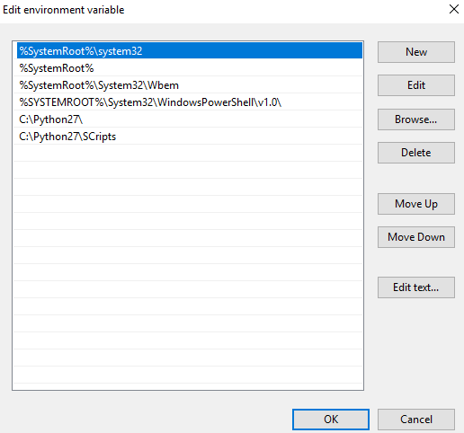
Python 2.7.13 Installation
PATH Setup:
Edit the system
environment variables==>
Environment Variables ==>
PATH:
C:\Python2.7;
C:\Python2.7\Scripts

Slide 6
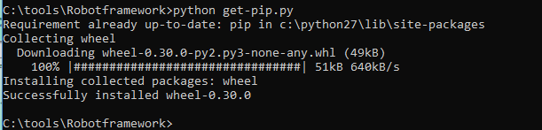
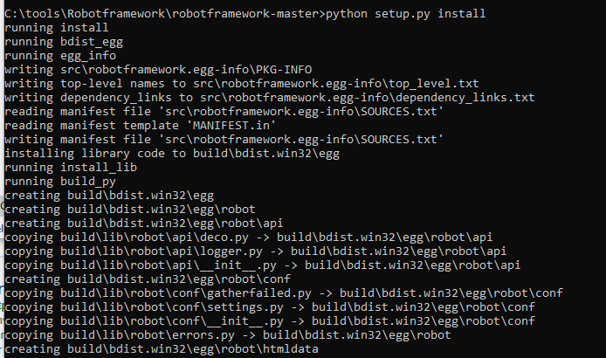

Slide 7
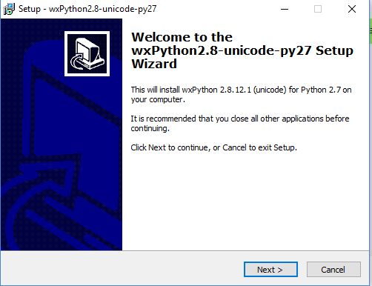

Slide 8
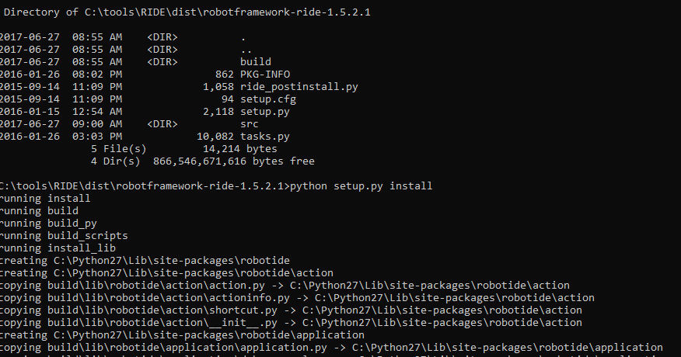
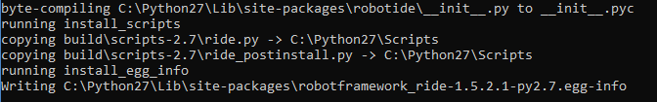

Slide 9
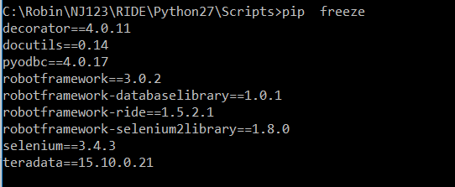
Check Libraries
Wheel and Egg are both packaging formats that aim to support the use case of needing an install artifact that doesn’t require building or compilation, which can be costly in testing and production workflows.
The Egg format was introduced by setuptools in 2004, whereas the Wheel format was introduced by PEP 427 in 2012.

Slide 10

Starting RIDE
1.CLI:
cd C:\Python2.7\Scripts
Python ride.py
2. Double click on C:\Python2.7\Scripts\ride.py
3. Right click ride.py, and Sent to ==> Desktop (Create shortcut)

Slide 11
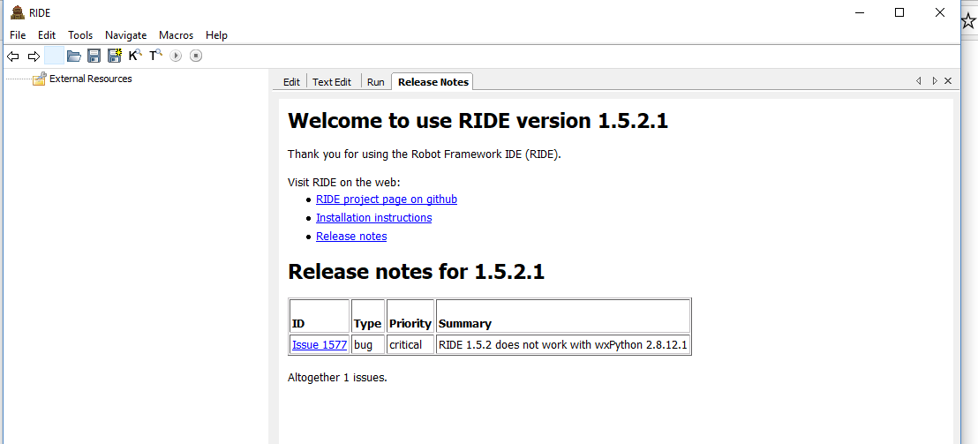

Slide 12
2.2 RF Basic Level
* A generic test automation framework
* Acceptance test-driven development (ATDD).
* Easy-to-use tabular test data syntax and keyword-driven testing approach
* Extended by test libraries with Python or Java, and new higher-level keywords
* OS and application independent.
* Open source software initially developed at Nokia Networks, and by Robot Framework Foundation.

Slide 13
2.2.1 First Test case
1: Run in CLI
** For test case: robot -t "Test Cases" Test_Suite.robot
** For test suite : robot Test_Suite.robot
Or pybot|jybot|ipybot [options] data_sources
or: python|jython|ipy -m robot.run [options] data_sources
or: python|jython|ipy run.py [options] data_sources
or: java -jar robotframework.jar run [options] data_sources
Options: -h -? --help Print usage instructions
--version Print version information
-v --variable name:value * Set variables in the test data
-d --outputdir dir Where to create output files
Source code for robot.run Link to full options

Slide 14
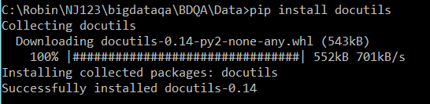
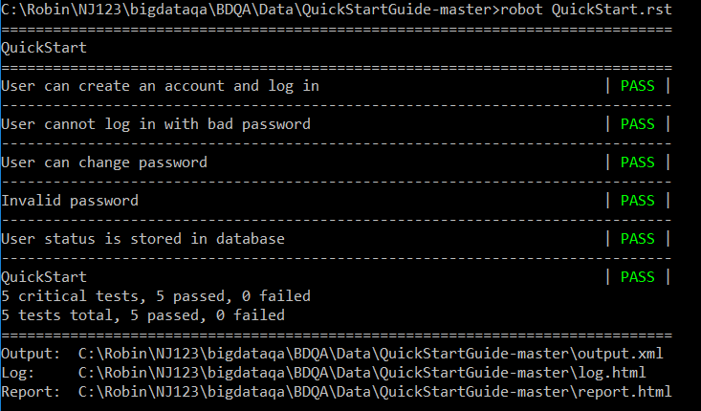
11:13:17

Slide 15
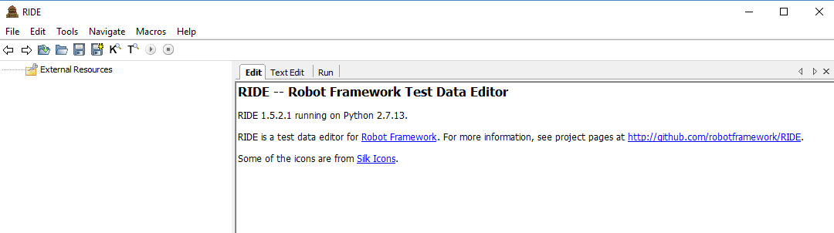
2: Run GUI --- RIDE
11:13:17

Slide 16
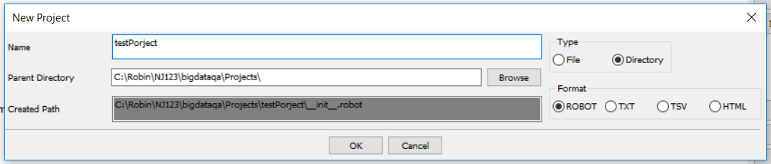
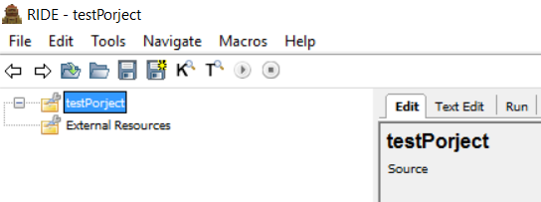
Creates Test Case Steps
Start RIDE
Create Project: Choose “ File->New Project”, enter testProject, in Name textbox in “New Project” window, Type click Directory,
then click OK button.

Slide 17
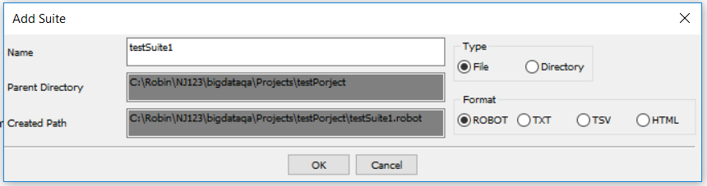
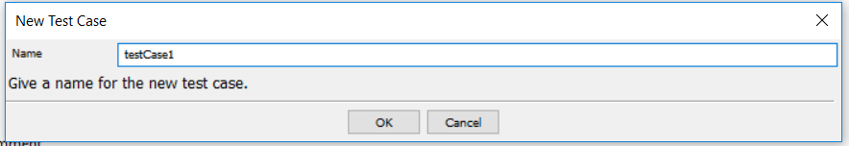
3. Create Test Suite: Right click on testProject, choose “New Suite”, enter testSuite1 in Name textbox, then OK
4. Create Test Case: Right click on testSuite, choose “New Test Case”, enter testCase1 in Name textbox
then OK

Slide 18
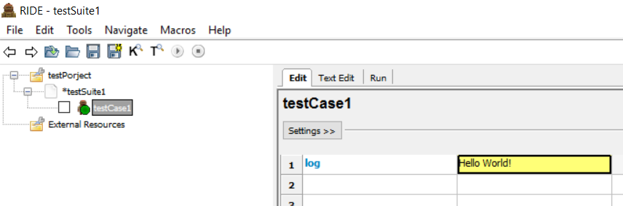
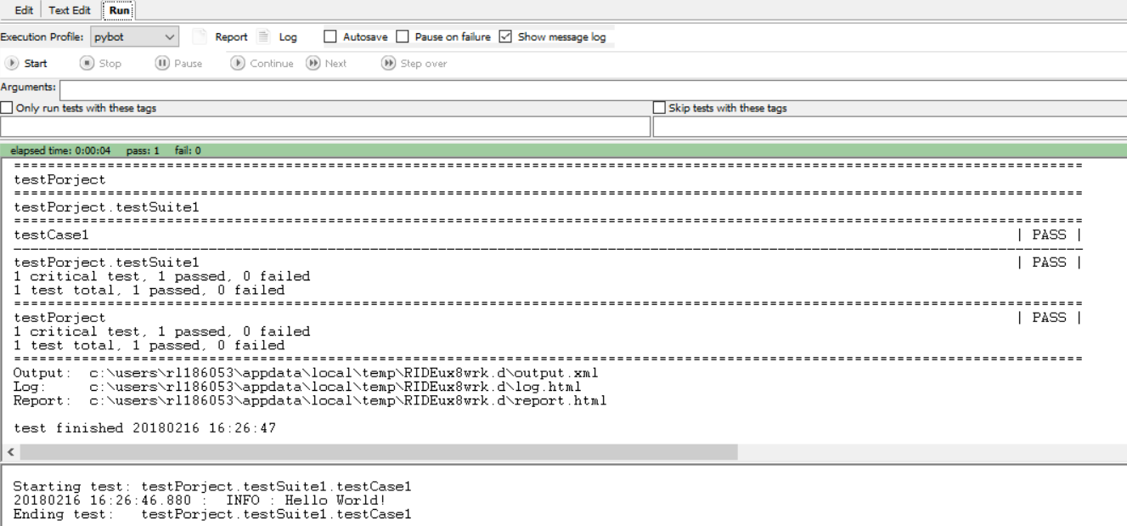
5. Write first script:log Hello world!
6. Run first script: In Run section, click Start

Slide 19
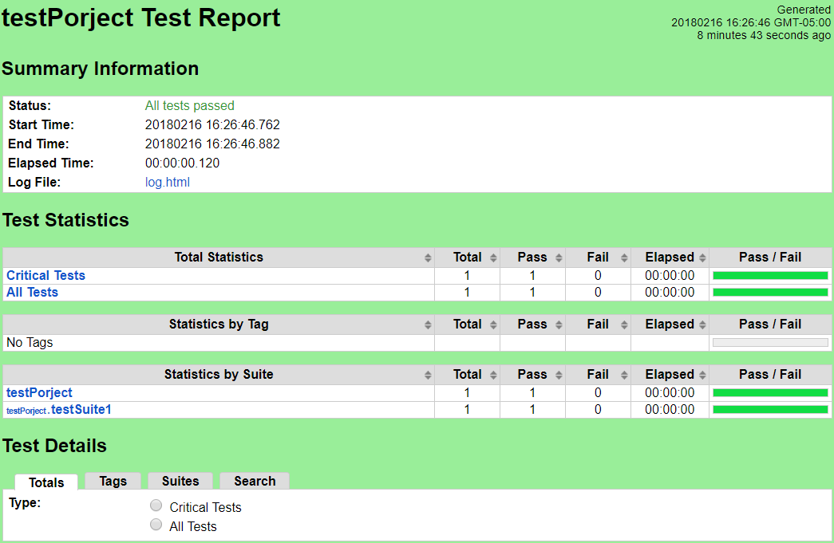
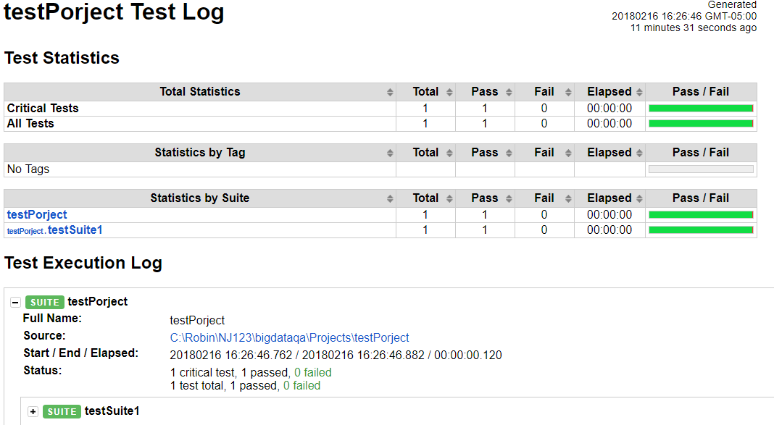
7. Review test results:
Click Report to open report.html -- general summary
Click Log to open log.html -- detailed step by step

Slide 20
2.2.2 RIDE tools
Menu Area:
*File ==>New project(^N), Open Test Suite(^O), Open Directory, Save(^S), Save all ,recent files (max 4), Exit
* Edit==>Add Tag to selected, Clear Selected, Undo, Redo, Cut, Copy, Paste, Insert, Delete, Comment(^3), Uncomment(^4), Insert Cells, Delete Cells, Insert Rows, Delete Rows
*Tools ==>Run Tests(F8), Stop Test Runs(^F8), Search Tests(F3), Search Keywords(F5), Search Unused Keywords, Content Assistance, Preview, Manage Plugins, View All Tags(F7),Import Library Spec XMLm View RIDE Log, Perference
*Navigate ==>Go Back, Go Forward
*Macro ==>Manage Run Configurations
*Help ==>Shortcut keys, User Guide, Report problem, Release Note, About

Slide 21

2.2.2 RIDE tools (2)
Tools Area:
* Go Back (Alt-Left)
* Go Forward (Alt-Right)
* Open Test Suite (Ctrl-O)
* Open Directory (Ctrl-Shift-O)
* Save (Ctrl-S)
* Save All (Ctrl-Shift-S)
* Search Keywords (F5)
* Search Test (F3)
* Run Tests (F8)
* Stop Test Run (Ctrl-F8)

Slide 22
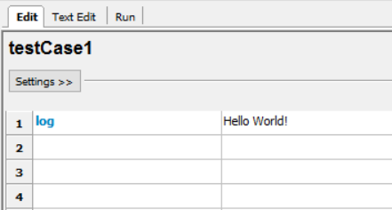
2.2.2 RIDE tools (3)
3. Projects Area:
Project
  Test Suites:
  Directory Test Suite ---- folder
  File Test Suite ---- *.robot, *.txt, *.tsv, *.html
    Test Case
      Keyword
External Resources
4. Working Area:
Setting: Documentation
Setup, Teardown, Tags,
Timeout, Template

Slide 23
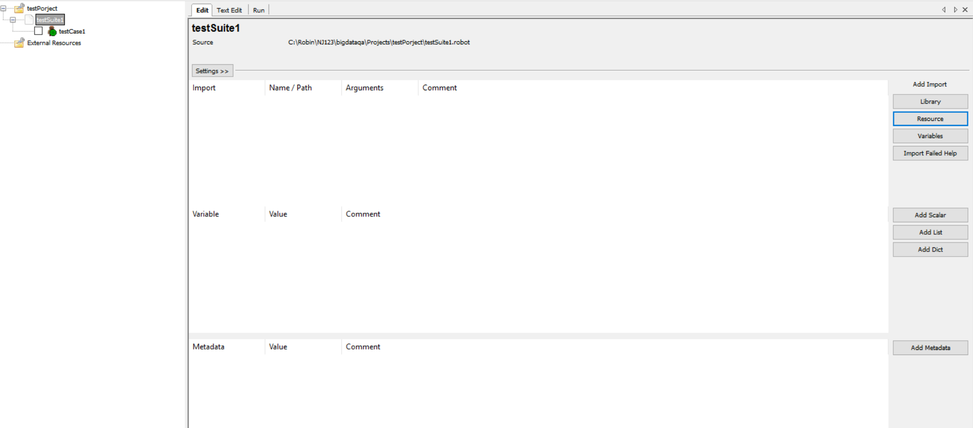
2.2.3 Resource
Test Suite file --> test cases
Resource file --> user defined keywords

Slide 24
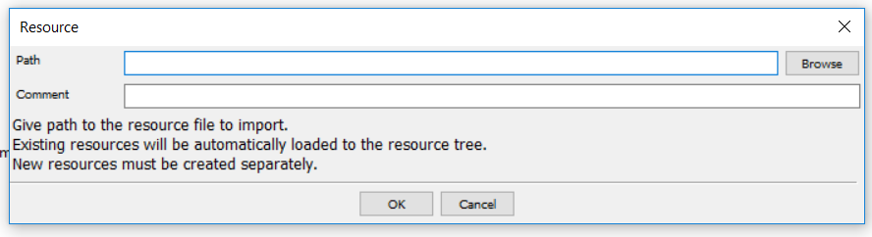
Internal resource
External resource:
Right click External Resources in Project Area, choose “Add Resource” to add external resource
Path: absolute path: \\a\\b\\c
relative path: ..\\..\c\\d
It is said that / is ok instead of \\

Slide 25
Constants / Variables
Constants:
Environment variables: %{Python_Home}
Constant values: ${PI}
Specific Strings: ${/},${False},${null}
System reserved words
Variables: Similar as Python, no explicit declaration
Scalar: ${var}: set variable, get length, -v val:…
List: @{Lvar}: set variable, create List, *args
Dict: &{Dvar}
Object:${return.status}
Note: Error if no value for a variable.

Slide 26
Variables Usages
In If condition:
As String
Operation
Element in list:@{list1}={1,2,3}
@{list1}[0], ${list1[1]}
@{list2}={${list1},123}
@{list2[0]}[1]
Scalar <---> List
If no initialized or assigned, scalar can be used as list

Slide 27
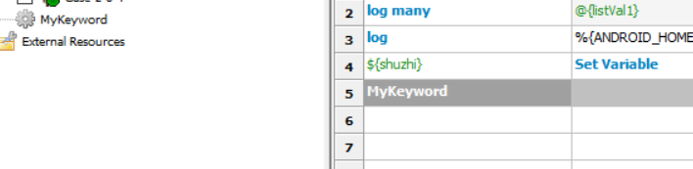
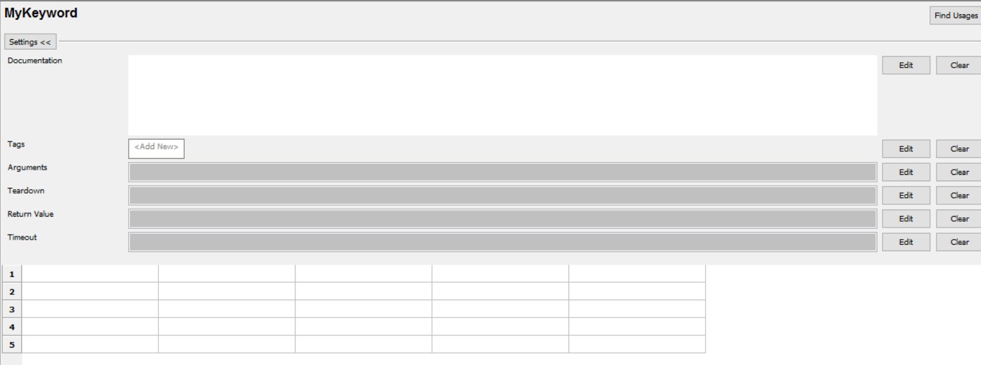
Keywords
Keywords = functions Arguments / Return Values

Slide 28
2.3 RF Intermediate Level
1. repeat
2. Loop
:FOR IN RANGE
Nested loop: use keyword
3. Branch
Run Keyword If
4. Combination
:FOR ${i} IN RANGE 10
Log i=${i}
Run Keyword If ${i}>7 Exit For Loop

Slide 29
2.3.1 Built-in Library
Built-in Library Document
Keywords:
Convert: Set Variable, Convert To Binary, Convert To Boolean, Convert To Bytes, Convert To Hex, Convert To Integer, Convert To Number, Convert To Octal, Convert To String
Variables: Set Global Variable, Set Suite Variable, Set Test Variable, Set Variable If, Replace Variables, Get Variables, Get Variable Value, Import Variables
Create: Create List, Create Dictionary

Slide 30
2.3.1 Built-in Library
Built-in Library Document
Keywords:
Convert: Set Variable, Convert To Binary, Convert To Boolean, Convert To Bytes, Convert To Hex, Convert To Integer, Convert To Number, Convert To Octal, Convert To String
Variables: Set Global Variable, Set Suite Variable, Set Test Variable, Set Variable If, Replace Variables, Get Variables, Get Variable Value, Import Variables
Create: Create List, Create Dictionary

Slide 31
4. Verify: Fail; Fatal Error; Should Contain, Keyword Should Exist, Length Should Be, Should Be Empty, Should Be Equal, Should Be Equal As Integers, Should Be Equal As Numbers, Should Be Equal As Strings, Should Be True, Should Contain Any, Should Contain X Times, Should End With, Should Match, Should Match Regexp, Should Not Be Empty, Should Not Be Equal, Should Not Be Equal As Integers, Should Not Be Equal As Numbers, Should Not Be Equal As Strings, Should Not Be True, Should Not Contain, Should Not Contain Any, Should Not End With, Should Not Match, Should Not Match Regexp, Should Not Start With, Should Start With, Variable Should Exist, Variable Should Not Exist
5. Run Keywords: Run Keyword If, Run Keyword And Ignore Error, Run Keyword And Return, Run Keyword And Return If, Run Keyword And Return Status, Run Keyword If All Critical Tests Passed, Run Keyword If All Tests Passed, Run Keyword If Any Critical Tests Failed, Run Keyword If Any Tests Failed, Run Keyword If Test Failed, Run Keyword If Test Passed, Run Keyword If Timeout Occurred, Run Keyword Unless, Run Keywords, Run Keyword And Continue On Failure, Run Keyword And Expect Error
6. Set: Set Tags, Set Test Documentation, Set Test Message, Set Library Search Order, Set Log Level, Set Suite Documentation, Set Suite Metadata, Set Tags, Set Test Documentation, Set Test Message

Slide 32
4. Verify: Fail; Fatal Error; Should Contain, Keyword Should Exist, Length Should Be, Should Be Empty, Should Be Equal, Should Be Equal As Integers, Should Be Equal As Numbers, Should Be Equal As Strings, Should Be True, Should Contain Any, Should Contain X Times, Should End With, Should Match, Should Match Regexp, Should Not Be Empty, Should Not Be Equal, Should Not Be Equal As Integers, Should Not Be Equal As Numbers, Should Not Be Equal As Strings, Should Not Be True, Should Not Contain, Should Not Contain Any, Should Not End With, Should Not Match, Should Not Match Regexp, Should Not Start With, Should Start With, Variable Should Exist, Variable Should Not Exist
5. Run Keywords: Run Keyword If, Run Keyword And Ignore Error, Run Keyword And Return, Run Keyword And Return If, Run Keyword And Return Status, Run Keyword If All Critical Tests Passed, Run Keyword If All Tests Passed, Run Keyword If Any Critical Tests Failed, Run Keyword If Any Tests Failed, Run Keyword If Test Failed, Run Keyword If Test Passed, Run Keyword If Timeout Occurred, Run Keyword Unless, Run Keywords, Run Keyword And Continue On Failure, Run Keyword And Expect Error
6. Set: Set Tags, Set Test Documentation, Set Test Message, Set Library Search Order, Set Log Level, Set Suite Documentation, Set Suite Metadata, Set Tags, Set Test Documentation, Set Test Message

Slide 33
7. Get: Get Count, Get Length, Get Library Instance, Get Time
8. Controls: Pass Execution, Pass Execution If, Sleep ,Wait Until Keyword Succeeds, Repeat Keyword, Exit For Loop If, Continue For Loop, Continue For Loop If, Exit For Loop, Return From Keyword, Return From Keyword If
9. Misc: Catenate, Comment, No Operation, Log, Log Many , Log To Console, Log Variables
10. Evaluate: Evaluate (random number, random string, string processing, character set, regular expression, date, execution)
11:13:17

Slide 34
2.3.2 Other Libraries
http://robotframework.org/robotframework/
Common Libraries:
String
Convert
Line
String
Collections
List
Dictionary

Slide 35
OperatingSystem
Environment
File
Directory
Path
Process
XML
DateTime
Dialogs
Screenshot

Slide 36
2.4 Database Library
Download Robot Framework Database Library
Unzip if necessary, then Install the library:
python setup.py install
Or pip install Robotframework-Database-Library
For Oracle DB, need install cx_oracle (Python Interface for Oracle Database)
Note: Be careful for correct package: oracle version, windows version and Python version

Slide 37
2.4.1 Introduction
Database Library contains utilities meant for Robot Framework's usage. This can allow you to query your database after an action has been made to verify the results.
This is compatible with any Database API Specification 2.0 module.
References:
+ Database API Specification 2.0
+ Lists of DB API 2.0
+ Python Database Programming

Slide 38
2.4.2 Keywords
Call Stored Procedure
Check If Exists In Database, Check If Not Exists In Database
Connect To Database, Connect To Database Using Custom Params
Disconnect From Database
Delete All Rows From Table
Description
Query, Execute Sql Script, Execute Sql String, ·Execute Sql String Sanstran
Row Count, Row Count Is 0, Row Count Is Equal To X, Row Count Is Greater Than X, Row Count Is Less Than X, Table Must Exist
*** Query SELECT COUNT(*) FROM table; --> return list { n,}
Row Count --> return an integer

Slide 39
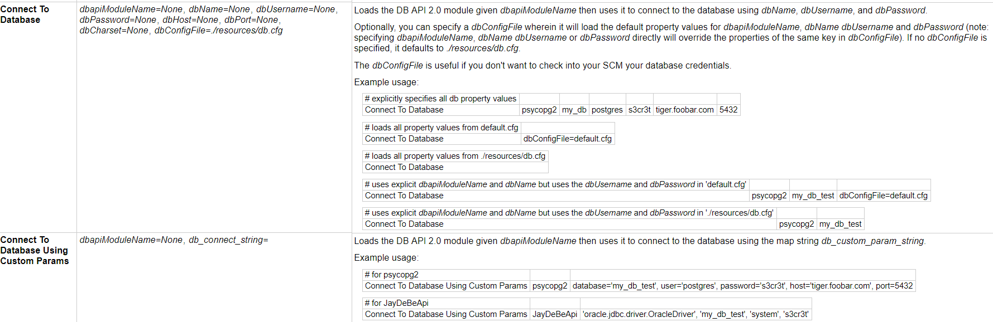
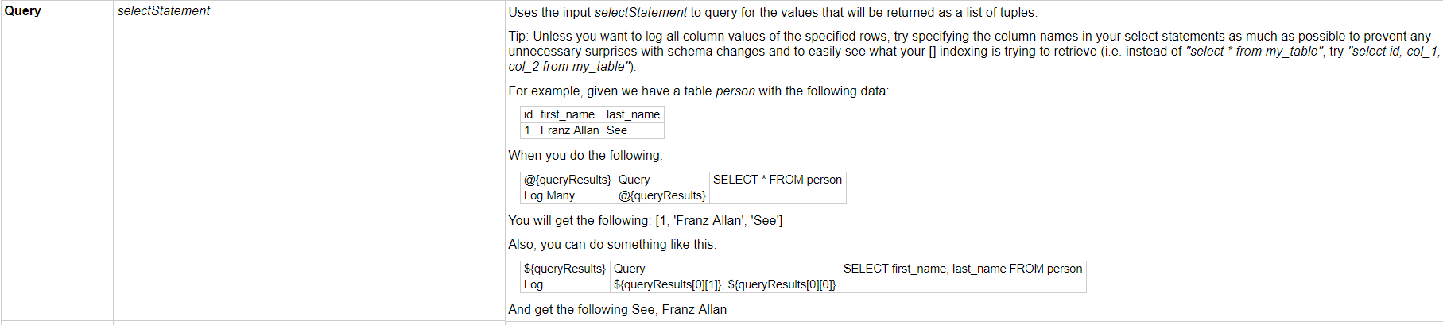
11:13:17

Slide 40
2.5 Integrated with other tools
Other Tools:
CI (Continuous Integration) / CD (Continuous Delivery): Jenkis/ UCD, teamcity
Devops
QA management tools: HP ALM (QC) or Jira
VCS (Version Control System): github / git, SVN

Slide 41
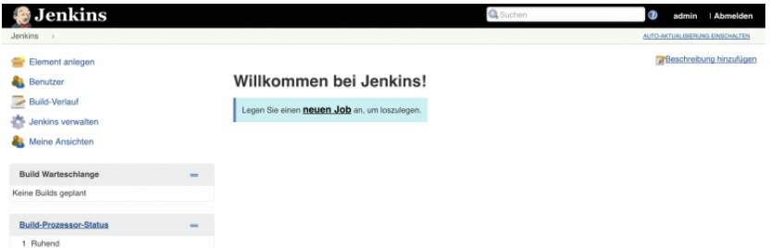
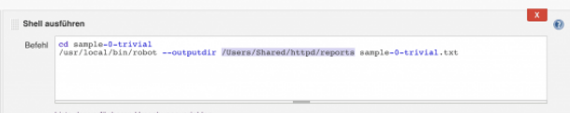
2.5.1 Integrated with CI tools
Jenkins is a self-contained, open source automation server which can be used to automate all sorts of tasks related to building, testing, and delivering or deploying software. Configure Jobs to run Robot framework test suites:
robot -t testSuites

Slide 42
2.5.2 Integrated with QA tools
Use Python functions (in-house libraries) to connect QA management tools, such as HP ALM (QC) or Jira, and pass test results to QA management tools, attach results files (report and log html) and results (text file) to QA tools.
In RF test cases Tag section, add QA tools test case ID as the tag to connect RF and QA tools.

Slide 43
2.5.3 Integrated with VCS tools
Use Python functions to connect Version Control System tools, such as Github /git or SVN (TortoiseSVN, …...), and pass test scripts to VCS tools to track all committed changes.
Common commands:
git add (first time)
git commit
git push or git merge

Slide 44
2.6 Advanced Level
2.6.1 Customize libraries
1. Locate the library file: Usually in Python27\Lib\site-packages\
2. Comment out inappropriate part in current function
3. Add updated or new functions with comment or document
4. Verify the updated library

Slide 45
2.6.2 Build Own Libraries
Libraries Type: Static, Dynamic and Hybrid
MyLibrary.py: Name, Structure
HEAD: Document, import modules
BODY: Code, class and methods
Configuration
Keyword Name
Keyword parameters and Return Values
Log
Testing own libraries

