Slide 1
Section IV: Case Study
4.1 Data Migration project
4.1.1 History data testing 4.1.2 Delta data testing
4.2 Data Ingestion project
4.2.1 Silver layer data
4.2.2 Source by source data validation
4.2.3 Fixed length configuration
4.2.4 Fixed delimiter issues
4.3 Data Quality project
4.3.1 NFR testing 4.3.2 Log checking

Slide 3
Project 1: Data Migration
Source:
1. Delta data --- DB
Fully verification, Timestamp
2. History data --- DW
Sampling, By order
Staging:
HDFS
Destination:
DB on Hadoop

Slide 4
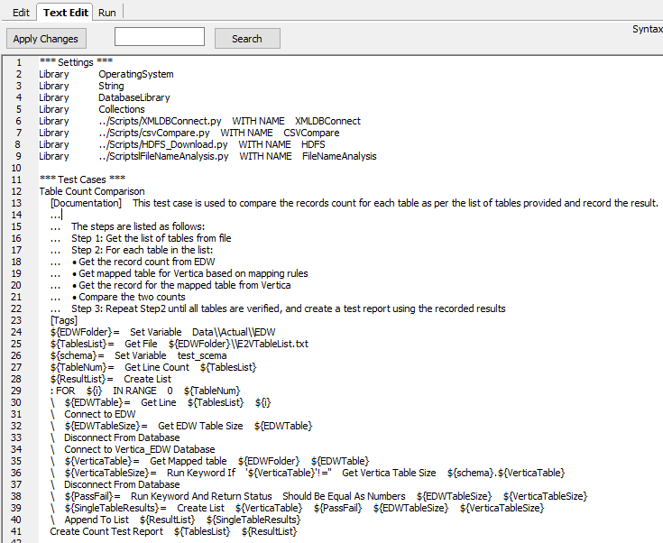

Slide 5
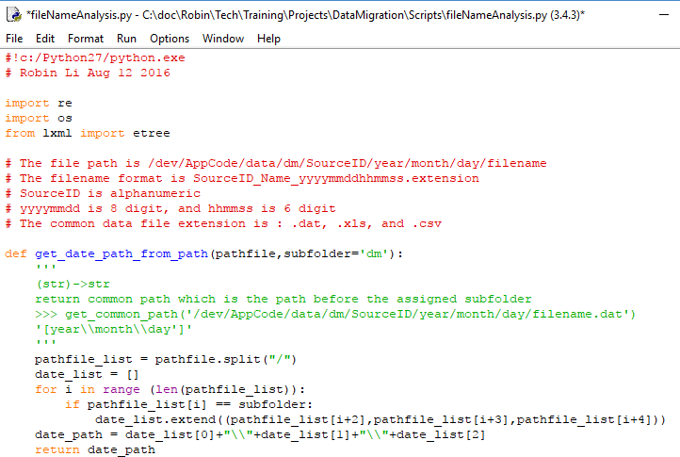

Slide 6
Sampling Query
1. Vertica, MySQL, HIVE:
SELECT * FROM table LIMIT n;
2. SQL Server, Teradata
SELECT TOP n * FROM table;
3. Oracle
SELECT * FROM table WHERE ROWNUM<=n;
4. DB2
SELECT * FROM table FETCH FIRST n ROWS ONLY;

Slide 7
Project 2: Data Ingestion
E T L (Extract, Transform, Load)
1. Extracr from data sources (SQL, GFF, CSV, PSV....) HDFS (raw data) --> Ingestion
2. Transformation Parser/Mapper:
Ex: Standardization, data Format,...
Configuration files – Mapping rules
Parquet file -- column-oriented
(Apache HIVE, Cloudera Impala, Pig)
3. Stream out for applications

Slide 8
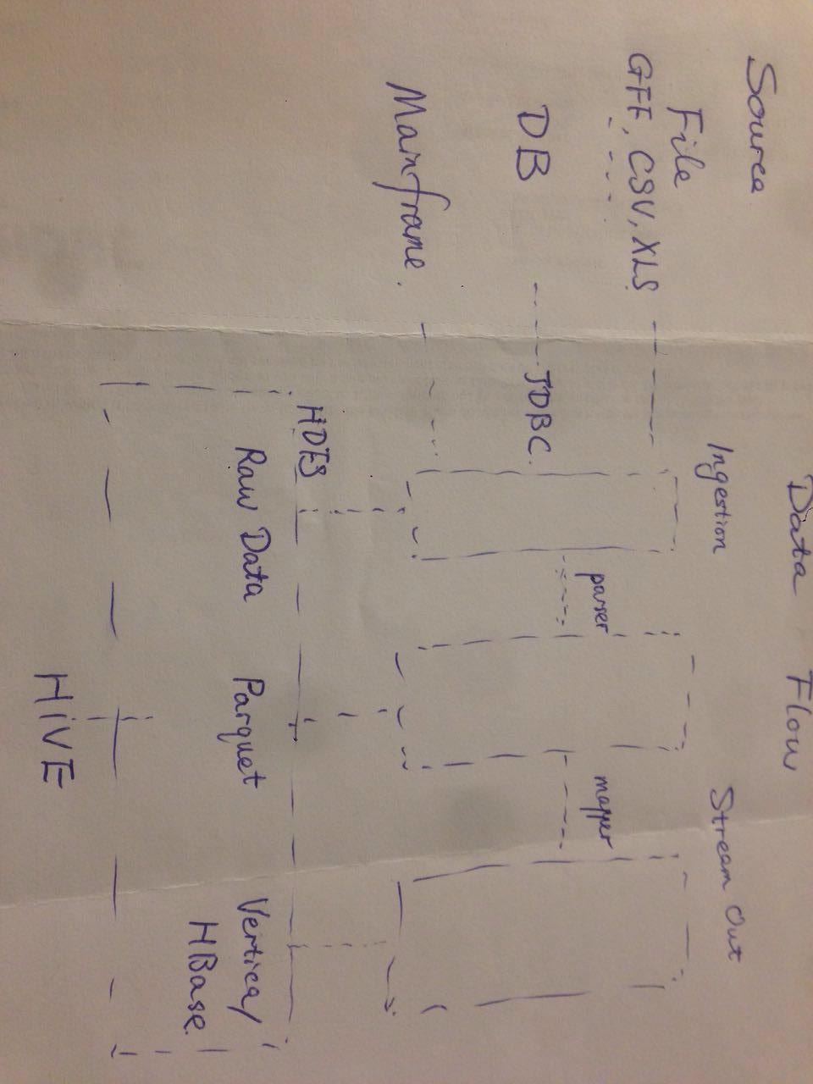
Data Flow
Data Flow

Slide 9
Project 3: Data Quality
Data Quality (data governance)
Accuracy, Correctness, Integrity, Completeness, Consistency, Currency, ......
(Row Counts, Null rate, MD5,Orphan records, ......)
Log check

Slide 10
Q & A
THANK YOU !

Slide 11
Test Script Sample
def first_TC():
I_get_a_key()
open_the_door()
then_I_see_you()
and_say(Hello World!)

