Slide 1
Section III: Python
3.1 Basic Python
3.1.1 Basic Features 3.1.2 Collections
3.1.3 Python Code Samples
3.2 Intermediate Python
3.2.1 Modules 3.2.2 File I/O
3.2.3 Exceptions 3.2.4 DB access

Slide 2
3.1 Python Basic
Why? -- Easy, flexible and powerful
* New user friendly
* Healthy Community Support
* Help from Enterprises
* Execellent libraries: numPy, SciPy, Django, scikit-learn, nltk, .......
* Effective and Reliable
How?
Practice, practice and practice !

Slide 3
3.1.1 Basic Features
* Interpreted: readable source code, easy to read, easy to maintain
* Interactive --- easy learning: few keywords, simple structure, and a clearly defined syntax
* Portable: cross-platform compatible on UNIX, Windows, and Macintosh
* Object-Oriented – extendable – libraries:
low-level modules, database, GUI, easily integrated with others, and automatic garbage collection

Slide 4
Python Language
General-purpose interpreted, interactive, object-oriented, and high-level programming language. -- >Easy, Flexible, Scripting
* Block: Same (4) spaces indent (no braces)
* Line, Statement: \, ;
* Case sensitive
* Quotation:'...', “...”, “““...”””
* Comment: #
===> Pythonic

Slide 5
Identifiers
* A name used to identify a variable, function, class, module or other object.
* Starts with a letter A to Z or a to z or an underscore (_) followed by zero or more letters, underscores and digits (0 to 9)
* Not allow punctuation characters such as @, $, and % within identifiers
* Case sensitive
variable_a, variable_A

Slide 6
Name Conventions
* Class names start with an uppercase letter. All other identifiers start with a lowercase letter
* Starting an identifier with a single leading underscore indicates that the identifier is private
* Starting an identifier with two leading underscores indicates a strongly private identifier
*If the identifier also ends with two trailing underscores, the identifier is a language-defined special name, for example: __main__

Slide 7
Basic Syntax
* Assignment
-- No explicit declaration
- Multiple assignment:
a = b = c = 1 or a,b,c = 1,2,"abc" or a,b = b,a
* Condition
if expression:
statement(s)
else:
statement(s)
* Loop
-- While
-- For
break, continue, pass (null)

Slide 8
Variable Types
* Variables are nothing but reserved memory locations to store values --- data type
* Not need explicit declaration, automatically when assign (=)
* 5 standard data types: Numbers, String, List, Tuple, Dictionary
* Multiple Assignment
a=b=c=1
c,b,c = 1,2,”abc

Slide 9
Data Types and Objects
* Number: int, long, float, complex
* String: No char, substring [0:-1]
* List: sequence [,]
* Tuple: sequence of immutable objects (,)
* Dictionary: {key:value,}
** Function: def function(arguments)
** Module : runnable Python code file
** Package: modules and subpackages

Slide 10
Numbers
* int (signed integers)
Ex: 10, -100, 0x260
* long (long integers, they can also be represented in octal and hexadecimal)
Ex:123456789L,142857142857l,0xABCDEFABL
* float (floating point real values)
Ex: 3.14, 1.8+e18, 30.1E12
* complex (complex numbers)
Ex: 3.14j,-0.65+J

Slide 11
Strings
* a contiguous set of characters represented in the quotation marks
Ex: str = 'Hello World!'
print str # Prints complete string
print str[0] # Prints first character of the string
print str[2:5] # Prints characters starting from 3rd to 5th
print str[2:] # Prints string starting from 3rd character
print str * 2 # Prints string two times
print str + "TEST" # Prints concatenated string
Hello World!
H
llo
llo World!
Hello World! Hello World!
Hello World!TEST

Slide 12
3.1.2 Collections
1. List: sequence [,]
Similar as arrays in C, with different data types
Ex:list1 = [ 'abcd', 786 , 2.23, 'john', 70.2 ]
Accessing, Updating, and Deleting
Basic List Operations:
Length: len(list1), Concatenation: list1+list2,
Repetition: list1*2, Membership: 786 in list1
Iteration: for x in [1, 2, 3]: print x
Indexing: list1[-1]

Slide 13
List functions:
cmp(list1, list2), len(list), max(list)
min(list) list(seq)
List methods:
list.append(obj) list.count(obj)
list.extend(seq) list.index(obj)
list.insert(index, obj) list.pop(obj=list[-1])
list.remove(obj) list.reverse()
list.sort([func])

Slide 14
2. Tuple: sequence of immutable objects (,)
Cannot be updates, read-only lists
Ex: tuple1=('abcd', 786 , 2.23, 'john', 70.2)
tup1 = () tup2 = (50,)
Basic List Operations:
Length: len((1,2,3)), Concatenation: (1,2)+(3,4),
Repetition: (1,2)*2, Membership: 2 in (1,2,3)
Iteration: for x in (1, 2, 3): print x
Indexing: tup[-1], functions as list
No Enclosing Delimiters: print 'abc', 123, 12.3

Slide 15
3. Dictionary: {key:value,}
Kind of hash table type, unordered.
Ex: dict1 = {'name': 'john','code':6734, 'dept': 'sales’}
Accessing dictionary: dict1[‘name']
Keys are unique within a dictionary while values may not be, and keys must be of an immutable data type such as strings, numbers, or tuples.
When duplicate keys encountered during assignment, the last assignment wins.

Slide 16
Dictionary Functions:
cmp(dict1, dict2) len(dict)
str(dict) type(dict)
Dictionary Methods:
dict.clear() dict.copy()
dict.fromkeys(seq[, value]) dict.items()
dict.get(key, default=None) dict.keys()
dict.has_key(key) dict.values()
dict.setdefault(key, default=None)
dict.update(dict2)

Slide 17
Data Type Conversion
* int(x [,base]):Convert x to an integer. base specifies the base if x is a string.
long(x [,base] ), float(x),complex(real [,imag])
*str(x):Convert object x to a string representation.
repr(x), eval(str)
*tuple(s):Converts s to a tuple.
list(s), set(s),dict(d),frozenset(s)
*chr(x):Converts an integer to a character.
unichr(x), ord(x), hex(x),oct(x)

Slide 18
Basic Operators (1)
* Arithmetic Operators
+,-,*,/,%,**,//(Floor Division)
* Comparison (Relational) Operators
==,!=,<>,>,<,>=,<=
* Assignment Operators
=,+=,-=,*=,/=,%=,**=,//=
* Logical Operators
not, or, and

Slide 19
Basic Operators (2)
* *Bitwise Operators
&(AND), |(OR), ^(XOR), ~(NOT),<<(Left Shift),>>(Right Shift)
* Membership Operators: in, not in
* Identity Operators: is, is not
* Operators Precedence:
1.** 2.~ + -(unary) 3.* / % // 4.+ -
5.>> << 6.& 7.^ | 8.<= < > >=
9.<> == != 10.= %= /= //= -= += *= **=
11.is is not 12.in not in 13.not or and

Slide 20
3.1.3 Python Code Samples
* Interactive Mode
C:>python
>>> print (“Hello World!”)
* Script Mode, with IDLE or any editor
Save the script into Hello_world.py
C:>python Hello_world.py
Or associate with Python interpreter, and double click, or create shortcut
In Linux: chmod +x, then ./Hello_world.py

Slide 21
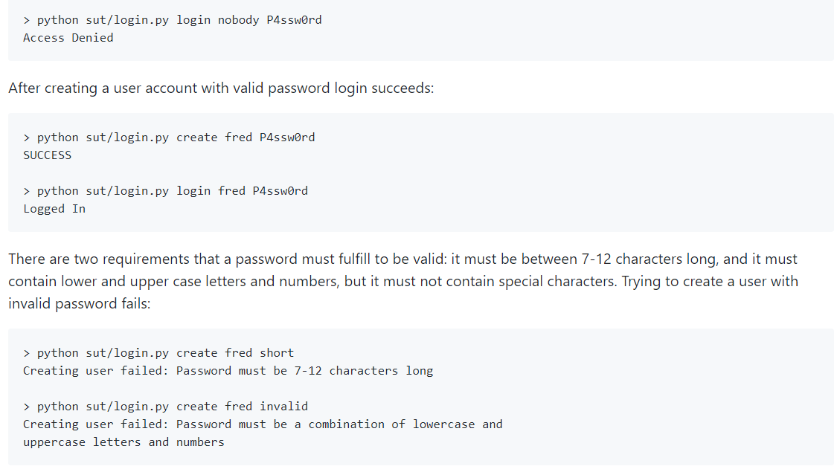
A classic login example: login.py
* Create an account with a valid password.
* Log in with a valid user name and password.
* Change the password of an existing account.

Slide 22
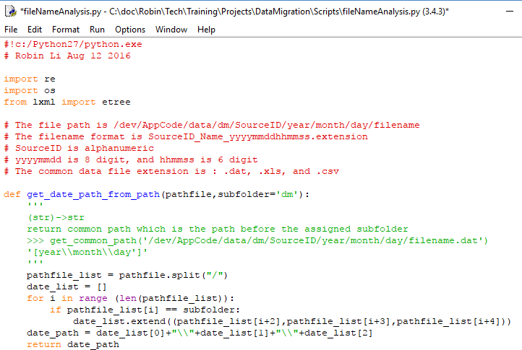

Slide 23
3.2 Intermediate Python
3.2.1 Modules:
Functions, Modules, Packages
3.2.2 File I/O
File read and write
3.2.3 Exceptions
Exception Handling, Assertions
3.2.4 DB Access
Generic Database Interfaces and APIs

Slide 24
3.2.1 Modules
Function: def function(arguments)
A block of organized, reusable code that is used to perform a single, related action.
Module : runnable Python code file
A module is a file consisting of Python code, including define functions, classes and variables
Package: modules and subpackages
A hierarchical file directory structure of modules and subpackages, and so on.

Slide 25
Modules Usages:
import module1[, module2[,... moduleN]
from module1 import function1
Locating Modules:
1. current directory
2. directory defined in PYTHONPATH
3. installation-dependent default path
Modules Functions:
dir():a sorted list of strings
reload() globals() locals()

Slide 26
3.2.2 File I/O
open Function :
file object = open(file_name [, access_mode][, buffering])
access_mode:
r, rb, r+, rb+, w, wb, w+, wb+, a, ab, a+, ab+
Attributes related to file object:
file.closed, file.mode, file.name, file.softspace
Methods:
close(), write(string), read([count]), tell()
os.rename(current, new), os.remove(file_name)

Slide 27
3.2.3 Exceptions
An exception: A Python object that represents an error.
When a Python script raises an exception, it must either handle the exception immediately otherwise it terminates and quits.
Syntax:
try:
......................
except ExceptionI:
If there is ExceptionI, then execute this block.
except ExceptionII:
If there is ExceptionII, then execute this block.
......................
else:
If there is no exception then execute this block.

Slide 28
3.2.4 DB Access
Generic Database Interfaces and APIs, including:
* Importing the API module
* Acquiring a connection with the database
* Issuing SQL statements and stored procedures
* Closing the connection
import MySQLdb
db = MySQLdb.connect("localhost","user",“pass","TESTDB" )
cursor = db.cursor()
cursor.execute(sql)
db.close()

Slide 29
#!/usr/bin/python
import MySQLdb
db = MySQLdb.connect("localhost","user",“pass",“db" )
cursor = db.cursor()
sql = "SELECT * FROM table WHERE condition "
try:
cursor.execute(sql) # Execute the SQL command
results = cursor.fetchall() # Fetch all the rows
for row in results:
field1= row[0]……
fieldn= row[n-1]
print "field1=%s, …., fieldn=%s" % (field1, …, fieldn)
except:
print "Error: unable to fecth data"
db.close()

Slide 30
DELETE/UPDATE/INSERT operations
……
cursor = db.cursor()
# Prepare SQL query to DELETE required records
sql = "DELETE FROM table WHERE condition"
try:
# Execute the SQL command
cursor.execute(sql)
# Commit your changes in the database
db.commit()
except:
# Rollback in case there is any error
db.rollback()
db.close()

Slide 31
Handling Errors
1.Warning: Used for non-fatal issues
2.Error: Base class for errors
3.InterfaceError: Used for errors in the database module
4.DatabaseError: Used for errors in the database
5.DataError: Refers to errors in the data.
6.OperationalError: Refers to operational errors
7.IntegrityError: Damage the relational integrity
8.InternalError: Refers to errors internal to the database module, such as a cursor no longer being active.
9.ProgrammingError: Refers to programming errors such as a bad table name
10.NotSupportedError: Refers to trying to call unsupported functionality

