Slide 1
Robot Framework
and Python
for Big Data QA
E-Bridge Career
Robin

Slide 2
Agenda Week 1 (Feb 10)
Section I: Big data QA Basic
1.1 Big data introduction
1.2 Hadoop Basic
1.3 ETL QA
Section II: Robot Framework
2.1 RF introduction and Setup
Exercises

Slide 3
Agenda Week 2 (Feb 17)
2.2 Basic Level： 2.2.1 First Test case
2.2.2 RIDE tools 2.2.3 Resource
2.3 Intermediate Level
2.3.1 Builtin library 2.3.2 Other Libraries
2.4 Database library
2.4.1 Introduction 2.4.2 keywords
2.5 Integrated with tools
2.5.1 CI tools 2.5.2 QA tools 2.5.3 VCS tools
Exercises
//(Feb 19 TBD) Extra for Basic Programming

Slide 4
Agenda Week 2 (Feb 17)
2.2 Basic Level： 2.2.1 First Test case
2.2.2 RIDE tools 2.2.3 Resource
2.3 Intermediate Level
2.3.1 Builtin library 2.3.2 Other Libraries
2.4 Database library
2.4.1 Introduction 2.4.2 keywords
2.5 Integrated with tools
2.5.1 CI tools 2.5.2 QA tools 2.5.3 VCS tools
Exercises
//(Feb 19 TBD) Extra for Basic Programming

Slide 5
Agenda Week 3 (Feb 24)
2.6 Advanced level
2.6.1 Customize RF 2.6.2 Build own libraries
Section III: Python
3.1 Basic Python： 3.1.1 Basic Concepts
3.1.2 Collections 3.1.3 First Python Code
3.2 Intermediate Python： 3.2.1 Modules
3.2.2 File I/O 3.2.3 Exceptions 3.2.4 DB access
Section IV: Case Study
4.1 Data Migration project
4.1.1 History data testing 4.1.2 Delta data testing
Exercises

Slide 6
Agenda Week 4 (Mar 03)
4.2 Data Ingestion project
4.2.1 Silver layer data
4.2.2 Source by source data validation
4.2.3 Fixed length configuration
4.2.4 Fixed delimiter issues
Exercises

Slide 7
Agenda Week 5 (Mar 10)
4.3 Data Quality project
4.3.1 NFR testing
4.3.2 Log checking
Section V: Job Hunting and Q&A
5.1 Resume & Interview
5.2 Job offer and assisting
THANK YOU!

Slide 8
Section I: Big data QA Basic
1.1 Big data introduction
1.1.1 From Data to Big Data
1.1.2 Challenges
1.2 Hadoop Basic
1.3 ETL QA
Notes:
Life Quality --- Decisions --- Information – Data

Slide 9
1.1.1 From Data to Big Data
"The quantities, characters, or symbols on which operations are performed by a computer, which may be stored and transmitted in the form of electrical signals and recorded on magnetic, optical, or mechanical recording media. "-- Oxford dictionary
Data is resource, information, knowledge
Value -- data type -- information
Storage -- CDROM, FD/HD, Flash(SSD)
( bit , Byte, WORD/DWORD/QWORD)
file --> DB --> DW --> Data Mart --> Data Lake
Notes:
Life Quality --- Decisions --- Information – Data

Slide 10
1.1.2 Big Data Challenges
Volume: KB(kilo) 10**3, MB(Mega) 10**6, GB(Giga) 10**9, TB(Tera) 10**12, PB(Peta) 10**15,EB(Exa) 10**18,ZB(Zetta) 10**21,YB(Yotta) 10**24
Variety: Structured-- fixed format -- SQL
Unstructured(schema on read) -- unknown form – Web, text,multimedia
Semi-structured -- known but not fixed -XML
Velocity: Ex: NYSE -- 1T/day
Facebook: 500T+/day

Slide 11
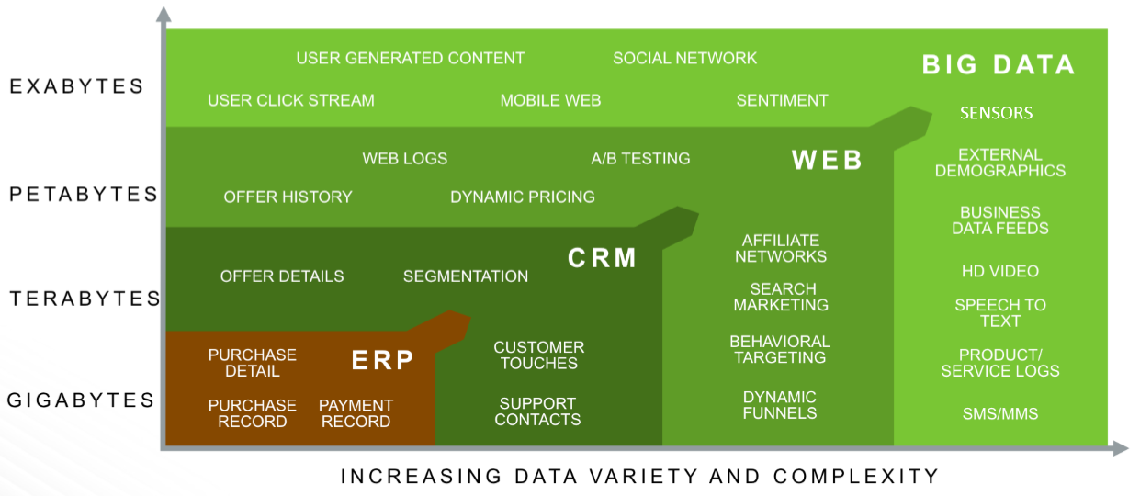

Slide 12
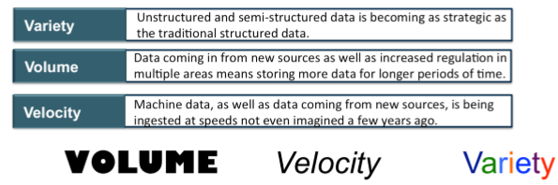

Slide 13
Related Technologies & Applications
BI (Business Intelligence)
IoT (Internet of Thing) -- RFID, senor
Cloud (AWS, GCP, MS Azure)
AI (Artificial intelligence)
-- Machine Learning,Neural Network
Block Chain -- decentralized
Industries:
Banking, Telecommunication, Healthcare, Manufacturing, Environment, and ....

Slide 14
1.2 Hadoop Basic
A scalable, fault tolerant, open source framework for the distributed storing and processing of large sets of data on commodity hardware.
Scalability -- Extendable
Fault Tolerance -- High Availability via redundancy (RAID)
Open Source -- Apache Foundation
Distributed Storage and Processing -- MPP
Commodity Hardware -- Low costs

Slide 15
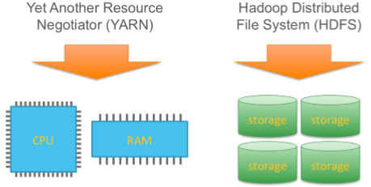
Hadoop Core = Storage + Compute
Storage: HDFS + Computing: MapReduce

Slide 16
Big Data Technology
Main Platforms:
Cloudera (CDH)
Horonworks (HDP:Hortonworks Data Platform), ......
Tech: MPP(Massive Parallel Processing)

Slide 17
HDFS
NameNode (Metadata) + DataNodes (actual data)
Read/write operations: a block level. Data files in HDFS are broken into block-sized (Default is 64 MB) chunks(independent units).
Access HDFS using JAVA API: Object java.net.URL reading contents of a file
Access HDFS Using CLI:
$HADOOP_HOME/bin/hdfs dfs -help
$HADOOP_HOME/bin/hdfs dfs -mkdir /mydirectory
$HADOOP_HOME/bin/hdfs dfs -copyFromLocal temp.txt /
$HADOOP_HOME/bin/hdfs dfs -copyToLocal /temp.txt

Slide 18
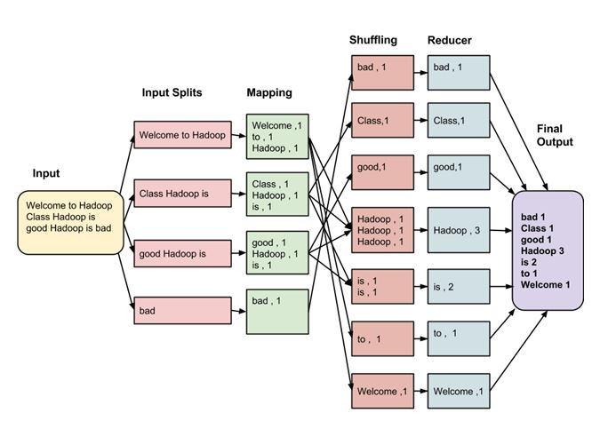
MapReduce

Slide 19
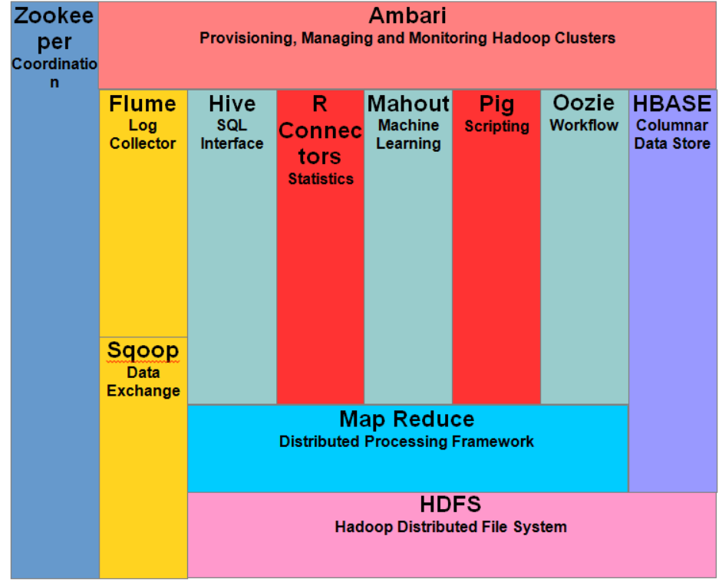
Hadoop Common Tools

Slide 20
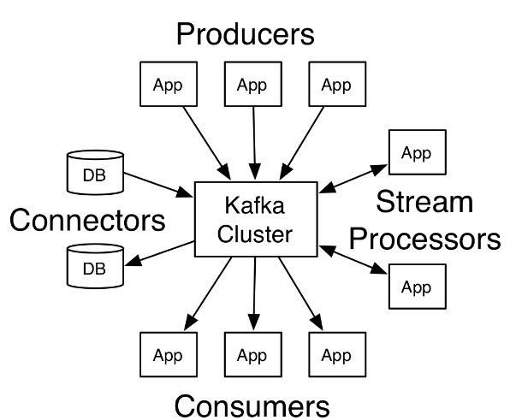
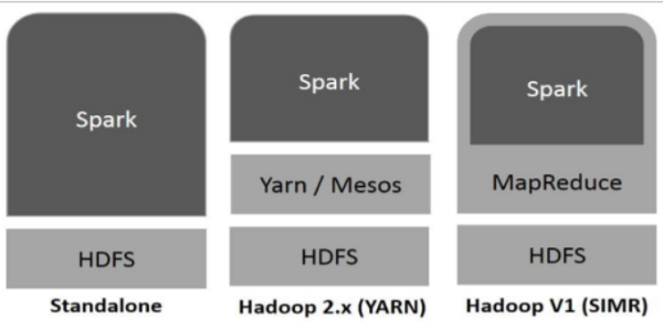
Some popular tools
Data Management: HDFS, YARN
Operations: Zookeeper, Cloudbreak, Oozie
Data Access: Pig, Hive, Storm, Hbase, Spark,
Integration: Falcon, WebHDFS, Sqoop,Kafka
Spark: in-memory cluster computing
Notes:
HDFS is a Java-based distributed file system that provides scalable, reliable, high-throughput access to application data stored across commodity servers. HDFS is similar to many conventional file systems. For example, it shares many similarities to the Linux file system. HDFS supports operations to read, write, and delete files. It supports operations to create, list, and delete directories. YARN is a framework for cluster resource management and job scheduling. YARN is the architectural center of Hadoop and enables multiple data processing engines such as interactive SQL, real-time streaming, data science, and batch processing to co-exist on a single cluster

Slide 21
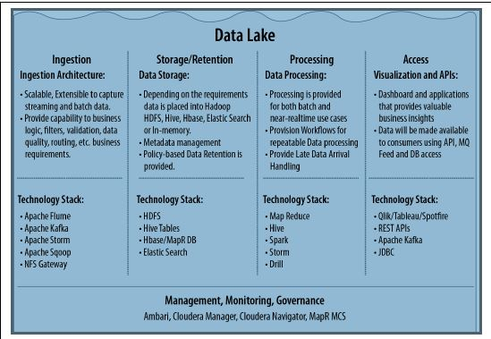
From ”Architecting Data Lakes
Data Management Architectures for
Advanced Business Use Cases”

Slide 22
Applications
• Analytics in the cloud: Unlimited scalability, ease of use
• Schema on read: Data is applied to a plan (schema) as it is pulled out of a stored location, rather than as it goes in
• More predictive analytics: Traditional analysis depended on samples; now process very large amounts of data
• Faster, better SQL on Hadoop: Speed supports iterative analytics
• Deep learning: Enables computers to recognize interesting content in huge amounts of unstructured data and deduce relationhips within that data without needing models on which to build instruction
• In-memory analytics: In-memory databases can speed up analytic processessing for some applications

Slide 23
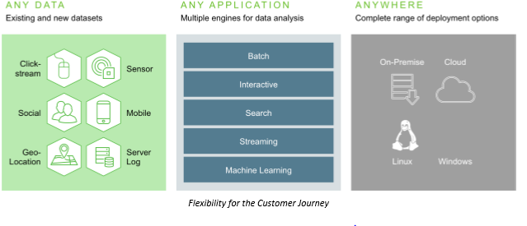

Slide 24
1.3 Big Data / ETL QA
ETL(Extract, Transform, Load) /Data Flow:
1. Data sources (SQL, GFF, CSV, PSV....)
Ingestion Parser/Mapper
2. Hadoop HDFS
Parquet file -- column-oriented
(Apache HIVE, Cloudera Impala, Pig)
Configuration files
3. Stream out for applications
DB on Hadoop

Slide 25
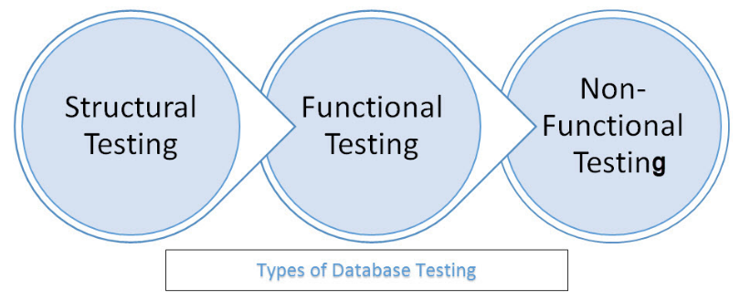
Testing objects: schema, table, column , keys and indexes, stored procedures, trigger…
Checking data integrity and consistency, Login and user security…
Load testing, Stress Testing, Security Testing, Usability Testing, and Compatibility Testing…

Slide 26
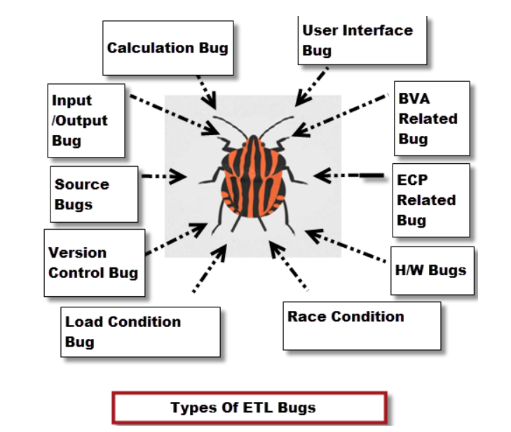
Notes:
Type of Bugs
Description
User interface bugs/cosmetic bugs
Related to GUI of application
Font style, font size, colors, alignment, spelling mistakes, navigation and so on
Boundary Value Analysis (BVA) related bug
Minimum and maximum values
Equivalence Class Partitioning (ECP) related bug
Valid and invalid type
Input/Output bugs
Valid values not accepted
Invalid values accepted
Calculation bugs ---**Mathematical errors**Final output is wrong
Load Condition bugs--**Does not allows multiple users**Does not allows customer expected load
Race Condition bugs--**System crash & hang**System cannot run client platforms
Version control bugs--**No logo matching** No version information available
--This occurs usually in Regression Testing
H/W bugs--**Device is not responding to the application
Help Source bugs
Mistakes in help documents

Slide 27
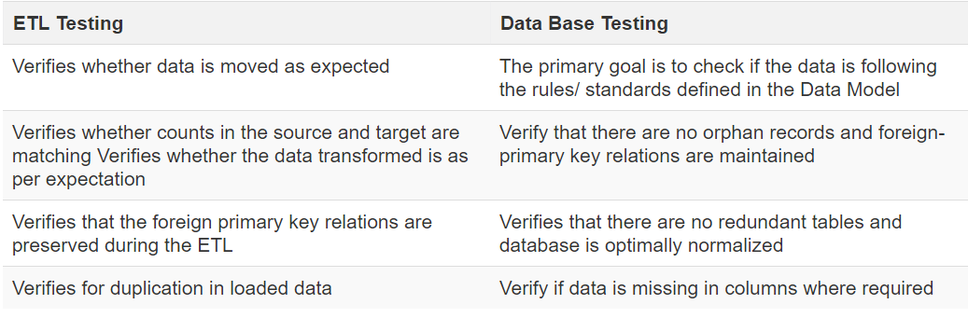

Slide 28
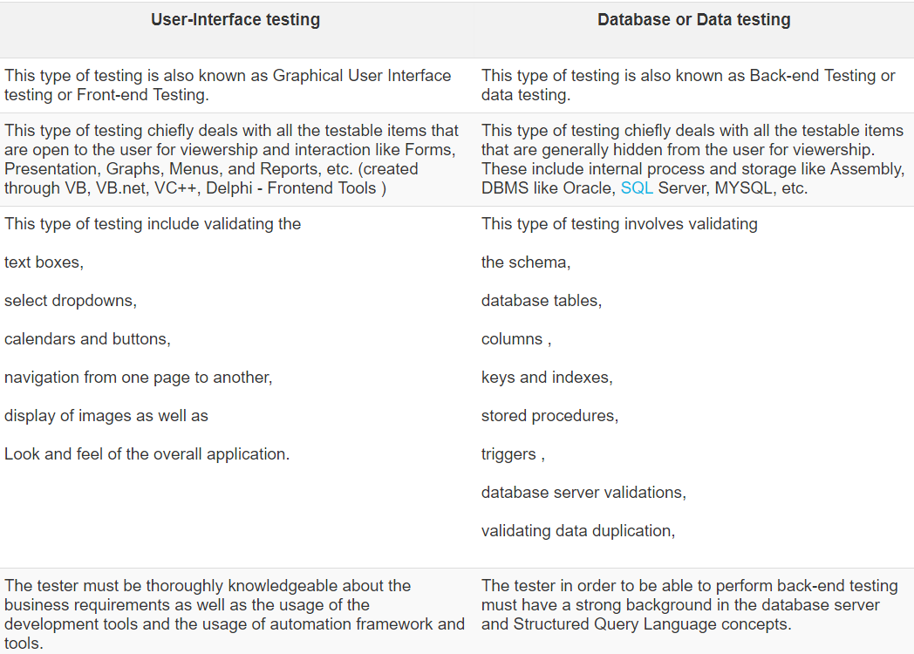
11:13:17

Slide 29
Section II: Robot Framework
2.1 RF introduction and Setup
2.2 Basic Level: 2.2.1 First Test case
2.2.2 RIDE tools 2.2.3 Resource
2.3 Intermediate Level
2.3.1 Builtin library 2.3.2 Other Libraries
2.4 Database library
2.4.1 Introduction 2.4.2 Keywords
2.5 Integrated with tools
2.5.1 CI 2.5.2 QA 2.5.3 VCS
2.6 Advanced level
2.6.1 Customize RF 2.6.2 Build own libraries

Slide 30
2.1 RF introduction and Setup
What?
-- Keyword-driven testing framework
Why ?
-- Easy, flexible
-- Python
How?
-- Open source environment
-- Libraries: built-in, extenal, and in-house

Slide 31
Robot Framework Setup(1)
Python 2.6 above --- Python 2.7.13
www.python.org/downloads .msi
PATH
2. Setup tools
pypi.python.org/pypi/setuptools
Python setup.py install
easy_install egg
**Pip:https://pypi.python.org/pypi/pip
Python setup.py install -- install pip tools
pip install LibraryName

Slide 32
Robot Framework Setup(2)
3. Robot framework
github.com/robotframework/robotframework/release
4.wxPython 2.8.12.1 with Unicode support
www.wxpython.org/download.php
5. RIDE
https://github.com/robotframework/RIDE/release
https://code.google.com/p/robotframwork-ride/downloads/list
Unzip tar.gz
Python setup.py install

Slide 33
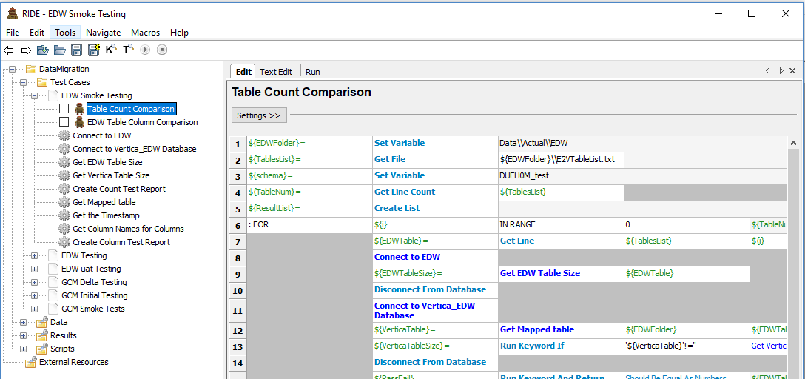

Slide 34
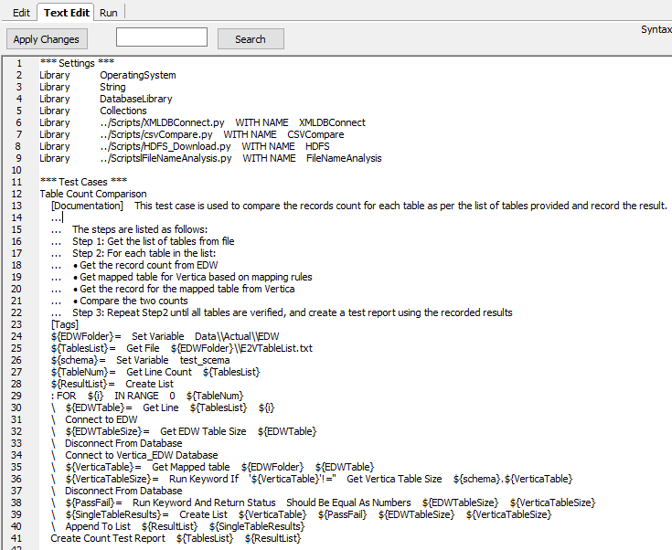

Slide 35
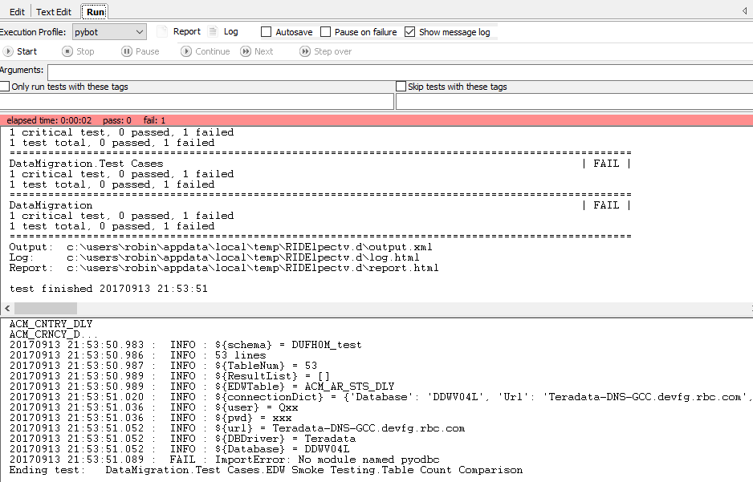

Slide 36
Python
Why?
-- Easy, flexible and powerful
How?
Practice, practice and practice !

Slide 37
Python Language
1. Overview and Setup
2. Basic Syntax
3. Data Types
4. Functions / Modules
5. Files Input/Output
6. Exceptions
7. Network and Muti-Thread

Slide 38
Project 1: Data Migration
Source:
1. Delta data --- DB
Fully verification, Timestamp
2. History data --- DW
Sampling, By order
Staging:
HDFS
Destination:
DB on Hadoop

Slide 39
Sampling Query
1. Vertica, MySQL, HIVE:
SELECT * FROM table LIMIT n;
2. SQL Server, Teradata
SELECT TOP n * FROM table;
3. Oracle
SELECT * FROM table WHERE ROWNUM<=n;
4. DB2
SELECT * FROM table FETCH FIRST n ROWS ONLY;

Slide 40
Project 2: Data Ingestion
E T L (Extract, Transform, Load)
1. Extracr from data sources (SQL, GFF, CSV, PSV....) HDFS (raw data) --> Ingestion
2. Transformation Parser/Mapper:
Ex: Standardization, data Format,...
Configuration files – Mapping rules
Parquet file -- column-oriented
(Apache HIVE, Cloudera Impala, Pig)
3. Stream out for applications

Slide 41
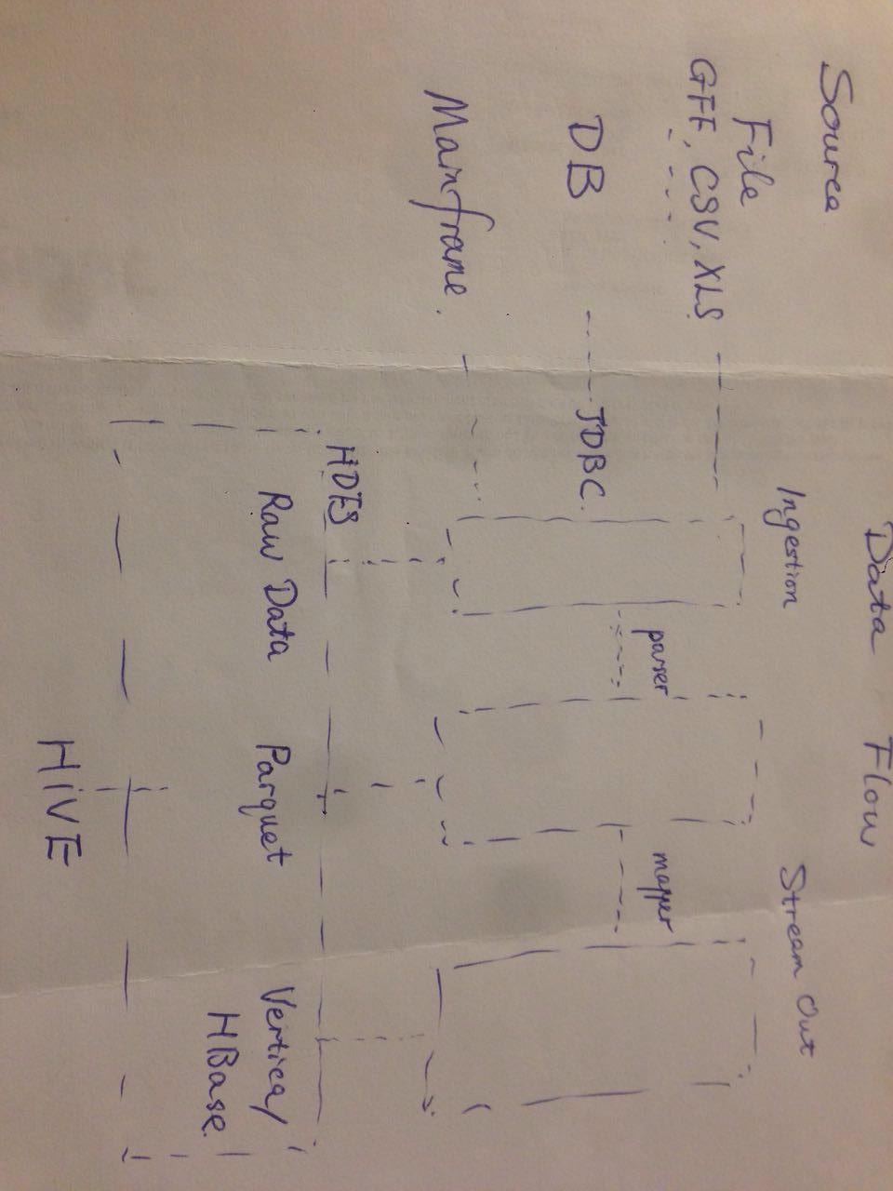
Data Flow
Data Flow

Slide 42
Project 3: Data Quality
Data Quality (data governance)
Accuracy, Correctness, Integrity, Completeness, Consistency, Currency, ......
(Row Counts, Null rate, MD5,Orphan records, ......)
Log check

Slide 43
Q & A
THANK YOU !

Slide 44
Test Script Sample
def first_TC():
I_get_a_key()
open_the_door()
then_I_see_you()
and_say(Hello World!)

