Slide 1
Big Data / ETL Automation Testing
& Robot Framework
Robin Li
robinli@live.ca

Slide 2
Agenda
1. Big data brief introduction
2. ETL Automation Test
3. Robot Framework
4. Python Language
5. Q &A

Slide 3
Data --> Big Data
Why: BI / AI
Data is resource, .......
Challenges : Volume, Variety, and Velocity
Quantity: KB(kilo), MB(Mega), GB(Giga), TB(Tera), PB(Peta),EB(Exa),ZB(Zetta),YB(Yotta)
Data Base -> Data Warehouse -> Data Mart -> Data Lake
Quality: QA / Testing, Automation

Slide 4
Big Data Technology
Apache Hadoop：
Storage: HDFS + Computing: MapReduce
Main Platforms: Cloudera, Horonworks, ......
Tech: MPP Massive Parallel Processing
Some popular tools:
Data Management: HDFS, YARN
Operations: Zookeeper, Cloudbreak, Oozie
Data Access: Pig, Hive, Storm, Hbase, Spark,
Integration: Falcon, WebHDFS, Sqoop,Kafka

Slide 5
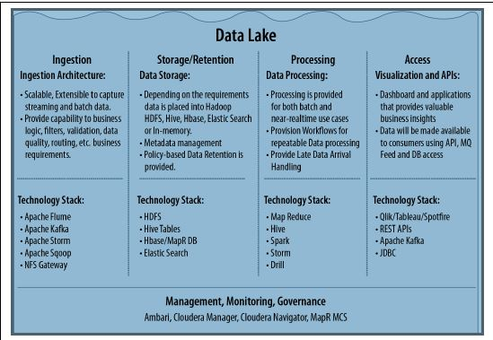
From ”Architecting Data Lakes
Data Management Architectures for
Advanced Business Use Cases”

Slide 6
E T L / Data Flow
(Extract, Transform, Load)
1. Data sources (SQL, GFF, CSV, PSV....)
Ingestion Parser/Mapper
2. Hadoop HDFS
Parquet file -- column-oriented
(Apache HIVE, Cloudera Impala, Pig)
Configuration files
3. Stream out for applications

Slide 7
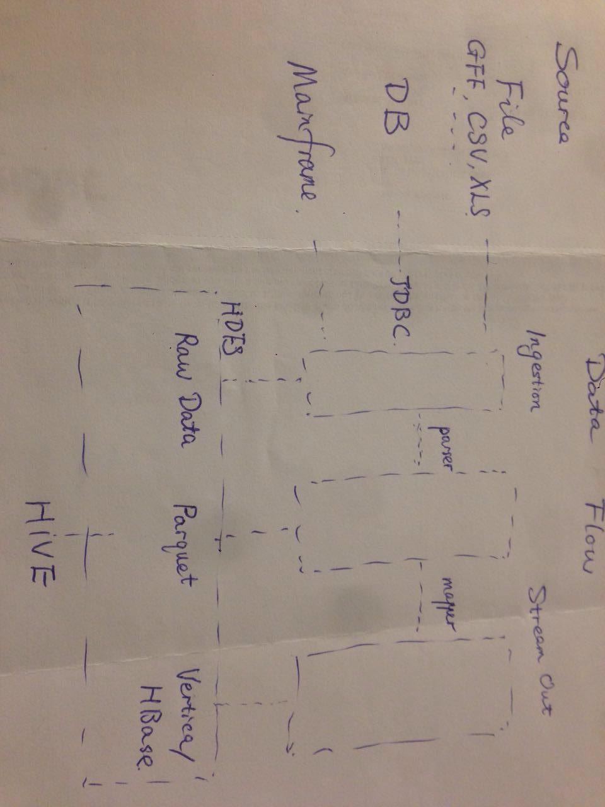
Data Flow

Slide 8
Data Quality
1. Source quality – Extract Transform Load
Bulk history: Sampling by order
Delta data: Fully verification, Timestamp
2. Data Quality (data governance)
Accuracy, Correctness, Integrity, Completeness, Consistency, Currency, ......
(Row Counts, Null rate, MD5,Orphan records, log check......)

Slide 9
Robot Framework
* Generic test automation framework
* ATDD: acceptance test-driven development
* Keyword-driven testing framework that uses tabular test data syntax
GUI: RIDE / CLI: pybot testSuite.txt ["Test Case"]
Connect to Test Case Management tools, pass test results to ALM /Jira
Devops: Build tools(Jenkins) + Deploy tools(UCD)
https://github.com/robotframework/QuickStartGuide/blob/master/QuickStart.rst

Slide 10
RIDE
(Robot framwork IDE)
1. Python 2.6 above --- Python 2.7.13
2. wxPython 2.8.12.1 with Unicode support
3. Robot framework
4. RIDE
https://github.com/robotframework/RIDE/wiki/How-To#starting-ride
Example: No nested loop

Slide 11
Robot Framework Libraries
http://robotframework.org
Libraries
Standard: Builtin, Collections, Strings,…
External: Selenium, Database,…
In-house library/function
Example1: query count(*) [(12, )] rowCount()
2: “,” in csv file

Slide 12
Python Language
Easy, flexible Scripting Languages
Indent: 4 spaces to define block
Convention:
Constant --UPPER
camel case: welcomeBigdataEvent
__function__, _function_, self.
official vs irregular
print-out vs hand-writing
Example :github.com/robin3795 sudoku game

Slide 13
Python common mistakes
Silly things: Forgetting to return a value; Misspelling; Mixing up Def and class
Styles: Bad naming; PEP-8 violations; Inscrutable lambdas;…
Structures: Pathological If/elif blocks; overusing private attributes;…
Surprises: Importing everything; Reinventing the wheel;….
From “How to Make Mistakes in Python”

Slide 14
Q & A
THANK YOU !

