Slide 1
Pythonic
* Pythonic means code that doesn't just get the syntax right but that follows the conventions of the Python community and uses the language in the way it is intended to be used
* Beautiful, clear, concise and maintainable
* PEP8 is a good standard to follow

Slide 2
List Objects
* Size: len([list])
* String: No char, substring [0:-1]
* List: sequence [,]
* Tuple: sequence of immutable objects (,)
* Dictionary: {key:value,}
** Function: def function( arguments)
** Module : runnable Python code file
** Package: modules and subpackages

Slide 3
Demo Login.py
* Login fail without user:
>python login.py login nobody P4ssw0rd
Access Denied
* Create user/password:
> python login.py create fred P4ssw0rd
SUCCESS
* Login success with valid user/password
> python sut/login.py login fred P4ssw0rd
Logged In

Slide 4
Robot framework
User Guide
Python 2 and Python 3: mostly the same,
not fully compatible with each others.
The main difference is that in Python 3 all strings are Unicode while in Python 2 strings are bytes by default.
Quick Start Tutorial
Notes:
Business Intelligence
Artifical Intelligence
- Machine Learning
- Deep Learning
KB(kilo), MB(Mega), GB(Giga), TB(Tera),PB(Peta),EB(Exa),ZB(Zetta),YB(Yotta)
Banking, Telecomm, RFID, e-commerce, Manufacturing, ....

Slide 5
Robot Framework Libraries
Robot Framework Libraries
STANDARD LIBRARIES:
1. Built-in 2. Operating System
3. String 4. Collections -- List /Dictionary
5. DateTime 6. XML
......
EXTERNAL LIBRARIES:
Database Library
Notes:
Business Intelligence
Artifical Intelligence
- Machine Learning
- Deep Learning
KB(kilo), MB(Mega), GB(Giga), TB(Tera),PB(Peta),EB(Exa),ZB(Zetta),YB(Yotta)
Banking, Telecomm, RFID, e-commerce, Manufacturing, ....

Slide 6
Database Library
Robot Framework Database Library
Common keywords:
1. Connect To Database/Connect To Database Using Custom Params
2. Query
3. Row Count
4. Table Must Exist
5. Disconnect From Database
Notes:
Business Intelligence
Artifical Intelligence
- Machine Learning
- Deep Learning
KB(kilo), MB(Mega), GB(Giga), TB(Tera),PB(Peta),EB(Exa),ZB(Zetta),YB(Yotta)
Banking, Telecomm, RFID, e-commerce, Manufacturing, ....

Slide 7
Some popular Hadoop Tools
Spark: Fast processing engine to build and run SQL, streaming, ML or graphic applications.
Hive: DW infrastructure support ad hoc SQL.
Pig: HL platform for extracting, transforming or analyzing large dataset.
Hbase: Scalable distributed NoSQL DB.
Kafka: Fast, scable, durable, adm fault-tolerant publish-subscribe messaging system.
Oozie,Zookeeper, Sqoop, Kylin,......
Commerical tools: Vertica, Data Torrent,......

Slide 8
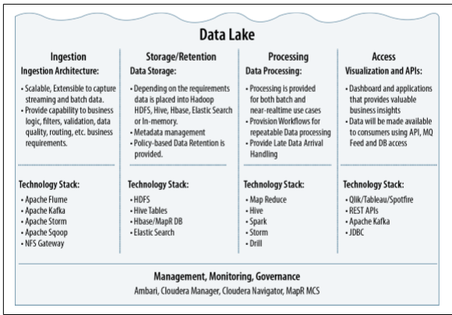
From ”Architecting Data Lakes
Data Management Architectures for
Advanced Business Use Cases”

Slide 9
Robot Framework
* Easy, flexible test automation framework
* ATDD: acceptance test-driven development
* Keyword-driven testing framework that uses tabular test data syntax
Interface: 1. GUI: RIDE -->TC development
2. CLI: pybot testSuite.txt ["Test Case"]
* Devops: Build tools(Jenkins) / Deploy tools(UCD)
* Management tools: HP ALM (QC)

Slide 10
RIDE (Robot framwork IDE)
Installation:
1. Python 2.6 above --- Python 2.7.13
2. wxPython 2.8.12.1 with Unicode support
3. Robot framework
4. RIDEhttps://github.com/robotframework/RIDE/wiki/How-To#starting-ride
5. Libraries

Slide 11
Install Robot Framework Libraries
For example: Database
Download robotframework-databaselibrary 1.0.1 from pypi.python.org/pypi https://pypi.python.org/pypi/robotframework-databaselibrary
Unzip, find setup.py file
cmd> python setup.py install
egg info --- dependency
List all installed libraries:
cmd> pip freeze

Slide 12
Robot Framework Libraries
http://robotframework.org
Libraries
Standard: Builtin, Collections, Strings,…
External: Selenium, Database,…
In-house libraries / functions
Example1: query count(*) [(n, )] ;
rowCount() HIVE
2: ExcelLibrary.py

Slide 13
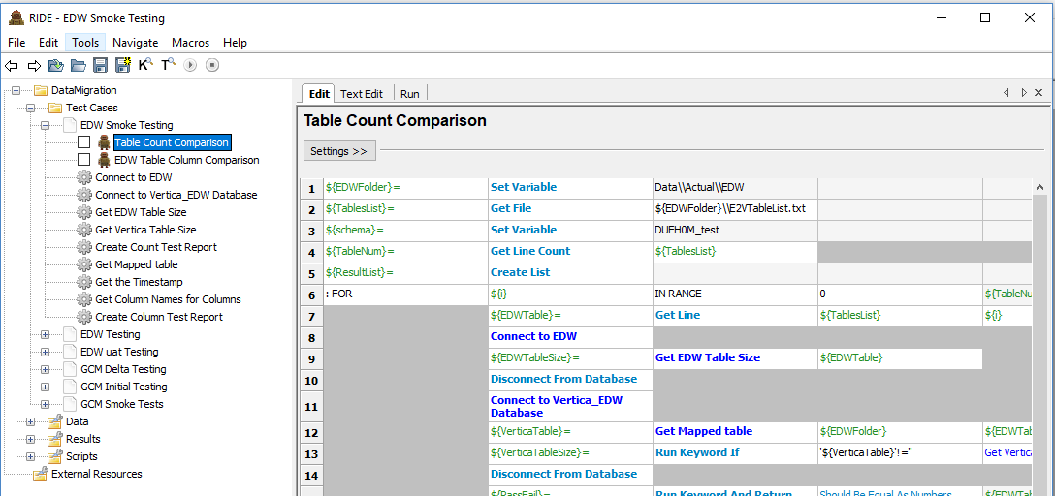

Slide 14
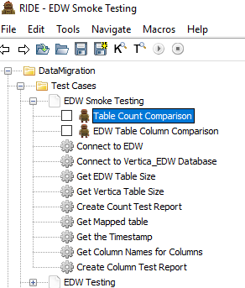
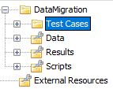

Slide 15
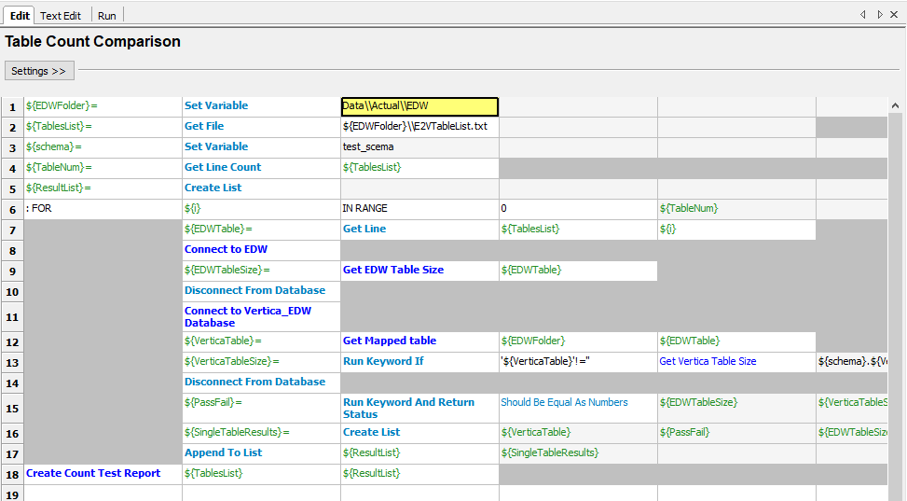

Slide 16
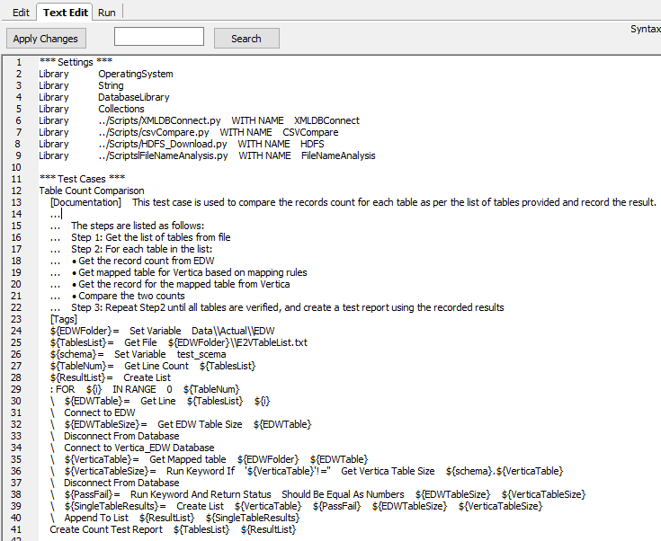

Slide 17
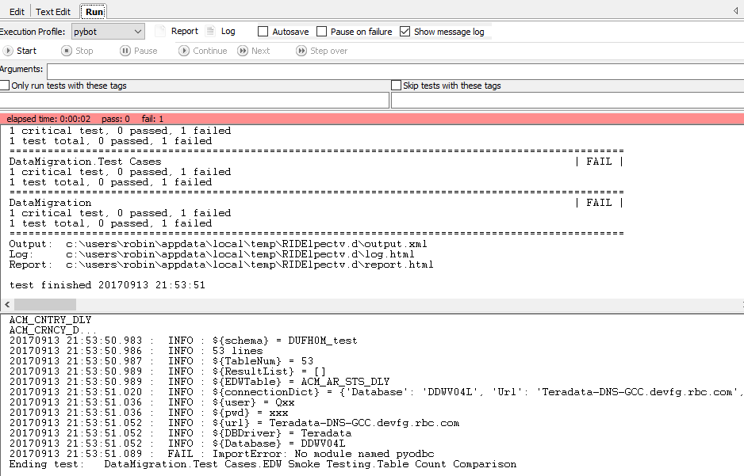

Slide 18
Why Python?
* New user friendly
* Healthy Community Support
* Help from Enterprises
* Big data, cloudy applications
* Execellent libraries: numPy, SciPy, Django, scikit-learn, nltk, .......
*Effective and Reliable

Slide 19
Python Language
General-purpose interpreted, interactive, object-oriented, and high-level programming language. -- >Easy, Flexible, Scripting
* Block: Same (4) spaces indent (no braces)
* Line, Statement: \, ;
* Case sensitive
* Quotation:'...', “...”, “““...”””
* Comment: #
===> Pythonic

Slide 20
Basic Syntax
* Assignment
-- No explicit declaration
- Multiple assignment:
a = b = c = 1 or a,b,c = 1,2,"abc" or a,b = b,a
* Condition
if expression:
statement(s)
else:
statement(s)
* Assignment
-- No explicit declaration
- Multiple assignment:
a = b = c = 1 or a,b,c = 1,2,"abc" or a,b = b,a
* Condition
if expression:
statement(s)
else:
statement(s)
* Loop
-- While
-- For
break, continue, pass (null)

Slide 21
Data Types and Objects
* Number: int, long, float, complex
* String: No char, substring [0:-1]
* List: sequence [,]
* Tuple: sequence of immutable objects (,)
* Dictionary: {key:value,}
** Function: def function( arguments)
** Module : runnable Python code file
** Package: modules and subpackages

Slide 22
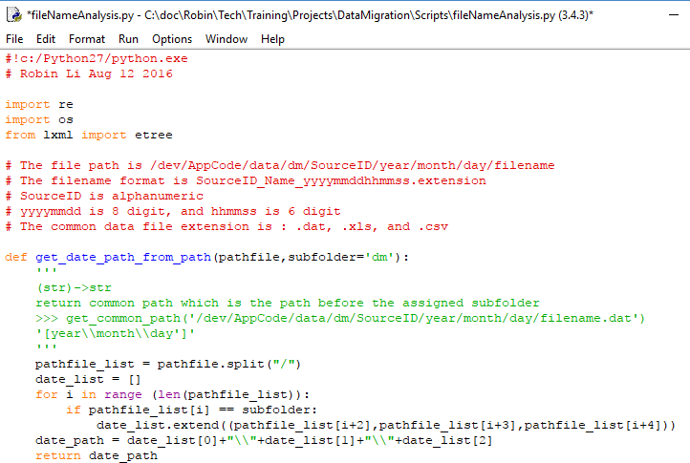

Slide 23
Project 1: Data Migration
Source:
1. Delta data --- DB
Fully verification, Timestamp
2. History data --- DW
Sampling, By order
Staging:
HDFS
Destination:
DB on Hadoop

Slide 24
Sampling Query
1. Vertica, MySQL, HIVE:
SELECT * FROM table LIMIT n;
2. SQL Server, Teradata
SELECT TOP n * FROM table;
3. Oracle
SELECT * FROM table WHERE ROWNUM<=n;
4. DB2
SELECT * FROM table FETCH FIRST n ROWS ONLY;

Slide 25
Project 2: Data Ingestion
E T L (Extract, Transform, Load)
1. Extracr from data sources (SQL, GFF, CSV, PSV....) HDFS (raw data) --> Ingestion
2. Transformation Parser/Mapper:
Ex: Standardization, data Format,...
Configuration files – Mapping rules
Parquet file -- column-oriented
(Apache HIVE, Cloudera Impala, Pig)
3. Stream out for applications

Slide 26
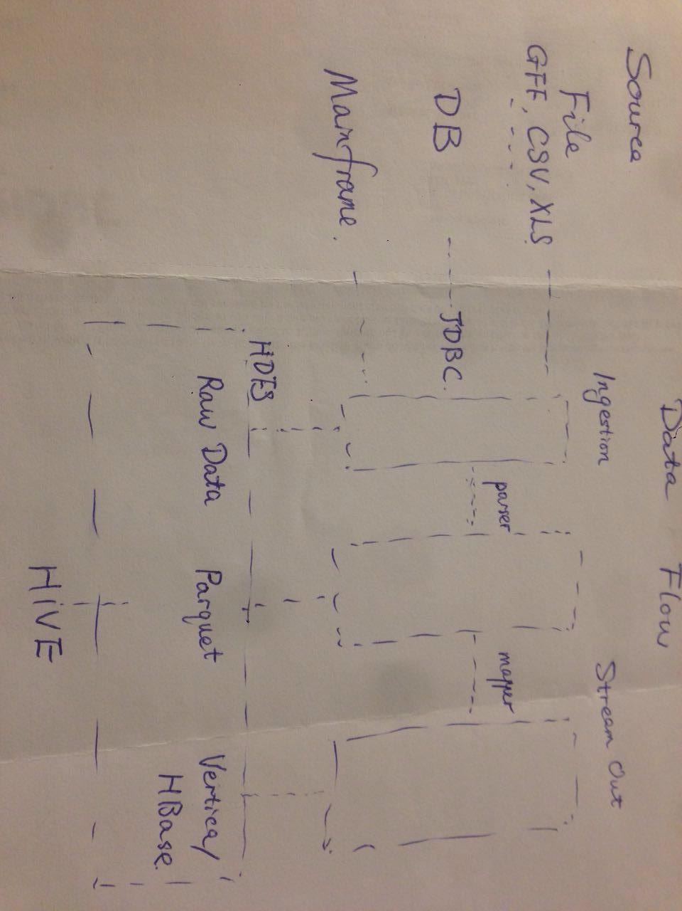
Data Flow

Slide 27
Project 3: Data Quality
Data Quality (data governance)
Accuracy, Correctness, Integrity, Completeness, Consistency, Currency, ......
(Row Counts, Null rate, MD5,Orphan records, ......)
Log check

Slide 28
Q & A
THANK YOU !

