Slide 1
Big Data / ETL Automation Testing
& Robot Framework
Robin Li
robinli@live.ca

Slide 2
Agenda
1. Big data Brief Introduction
2. ETL Automation Test
3. Robot Framework
4. Python Language
5. Q &A

Slide 3
Data --> Big Data
Why: BI / AI
Data is resource, .......
Quantity: KB(kilo), MB(Mega), GB(Giga), TB(Tera), PB(Peta),EB(Exa),ZB(Zetta),YB(Yotta)
Quality: QA / Testing
Data Base -> Data Warehouse -> Data Mart -> Data Lake
Challenges : Volume, Variety, and Velocity

Slide 4
Big Data
Apache Hadoop：
Storage: HDFS + Computing: MapReduce
Main Platforms: Cloudera, Horonworks, ......
Tech: MPP Massive Parallel Processing
Some popular tools:
Data Management: HDFS, YARN
Operations: Zookeeper, Cloudbreak, Oozie
Data Access: Pig, Hive, Storm, Hbase, Spark,
Integration: Falcon, WebHDFS, Sqoop,Kafka

Slide 5
E T L / Data Flow
1. Data sources (SQL, GFF, CSV,PSV....)
Ingestion Parser/Mapper
2. Hadoop HDFS
Parquet file -- column-oriented
(Apache HIVE, Cloudera Impala, Pig)
Configuration files
3. Stream out for applications

Slide 6
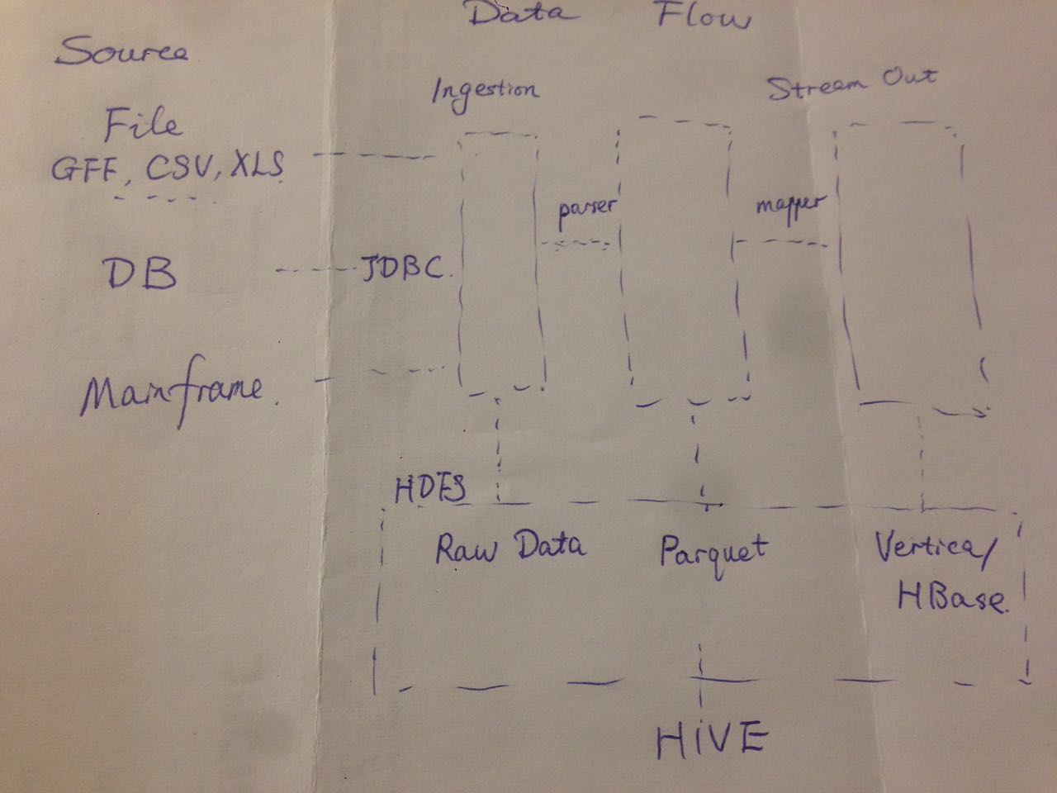
Data Flow

Slide 7
Data Quality
1. Source quality – Extract Transform Load
Bulk history: Sampling by order
Delta data: Fully verification,
Timestamp
2. Data Quality:
Integrity, Completeness, ......
(Counts, Null rate, MD5,Orphan records,log check......)

Slide 8
Robot Framework
Automation Testing Tool
GUI: RIDE
CLI: pybot Dir/Suite.txt "Test Case Name"
Connect to Test Case Management tools, pass test results to ALM /Jira
Devops: Build tools(Jenkins) + Deploy tools(UCD)
https://github.com/robotframework/QuickStartGuide/blob/master/QuickStart.rst
https://github.com/robotframework/RIDE/wiki/How-To#starting-ride

Slide 9
Libraries
http://robotframework.org
Libraries
Standard: Builtin, Collections, Strings
External: Selenium, Database
In-house library/function
Example1: sql count(*) [(12, )] HIVE
2: “,” in csv file

Slide 10
Python Language
Easy, flexible Scripting Languages
Convention:
Constant --UPPER
camel case
__function__,_function_, self.
official vs irregular/
print-out vs handwritting
Github.com/robin3795

Slide 11
Q & A
THANK YOU !

