Slide 1
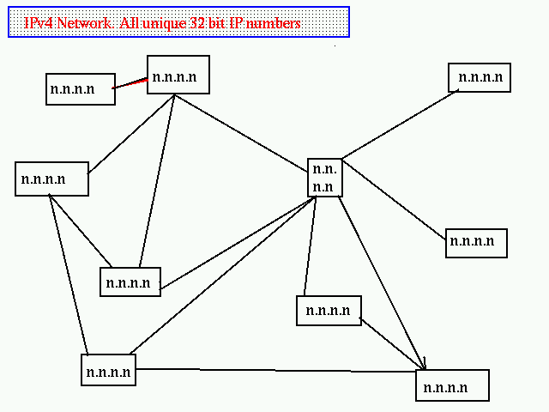
Internet Protocol Network
  The Internet Protocol is just that a simple coms protocol, using 32 bit addresses and port numbers.
  Quake III Arena sees the network like this

Slide 2
32 bit addresses, not user friendly...
Under Internet V4 all machines in the public network are defined by a 32 IP bit number
This is conventionally represented as four decimal values separated by dots (i.e. 192.12.189.250)
This is not user friendly, or easy to remember !
Something like www.yahoo.com - however is easy to remember !

Slide 3
Early Days of the Internet
In the early days of the internet (the called ARPANET), when it was still a U.S. Military resource, every computer on ARAPNET had a “HOSTS.TXT” file
For unix systems this became /etc/hosts (and can still be used today in fact).
This meant constant maintenance and updating of the 'file' across all severs on the net...
Obviously, with Billions of web servers out there now this would be impractical... even before this a solution was required....

Slide 4
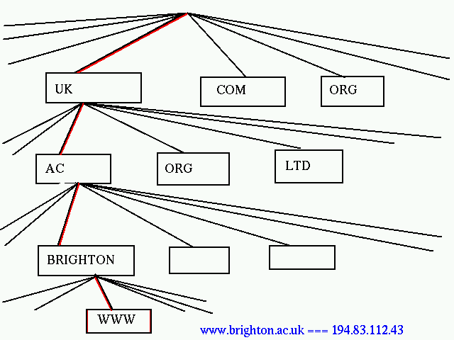
The Solution, a hierarchical network, with 'domains'

Slide 5
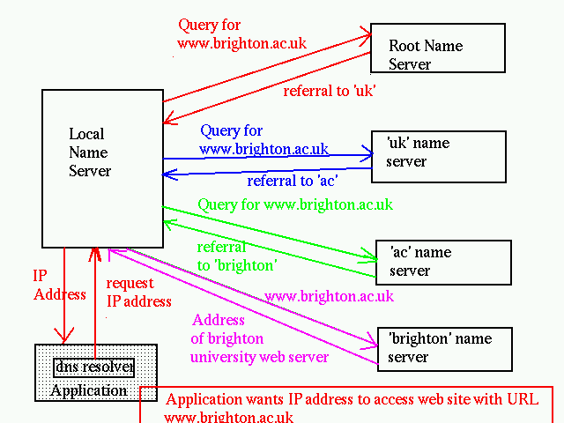
Mechanics of DNS Query
The DNS query first interrogates the root for the top domain.
In this case 'uk'
On finding the 'uk' domain server it queries this for 'ac'
And so on

Slide 6
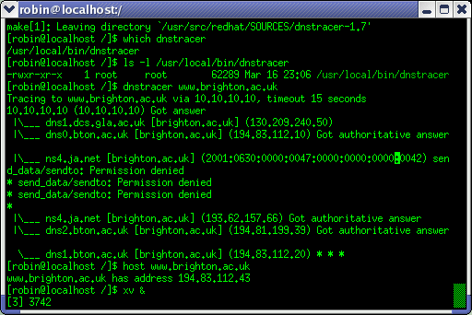
A DNS Trace

Slide 7
Why is this important to Web masters ?
Domains must be 'bought' to be listed in the hierarchy
Virtual hosting (where many domain names point at the same host) must be managed by an internal domain server (as in the www stage of the example before)

Slide 8
How do you buy a domain name ?
Well, lets Google....

