Slide 1

Event Detection & Retrieval from Twitter
Srinjay | Datta | Sanjeev | Robin | Sujan | Bodhi | Niten
Mentored by – Sankarshan Mridha

Slide 2
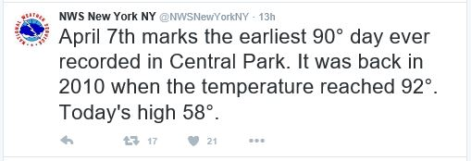
Motivation
Twitter emerged from social network to a news media for tracking real-world events, like-
What? Earliest 90* day
When? April 7
Where? Central Park
Today’s high 58*

Slide 3
Motivation
Some relevant twitter handles for extracting meaningful events-
Politics | NYC Politics (@PoliticsInNYC)
Sports | BBC Sport (@BBCSport) Star Sports (@StarSportsIndia)
Natural Disasters | Get Ready Get Thru (@NZGetThru)
Events Organized | New York Nightlife (@NYNightlife) Fashion and Style (@FashionAndStyle)
Taxi Availability & Planning | YellowCabNYC (@YellowCabNYC) taxiNYC (@taxiNYC)
Public Departments of US (Govt.) | NYC DOT (@NYC_DOT) NYC Finance (@NYCFinance)
Chosen

Slide 4
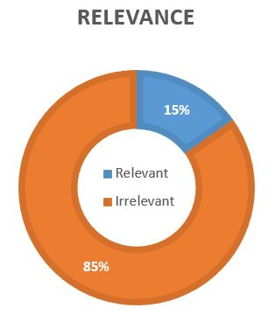
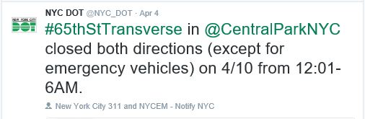
Motivation
NYC DOT (@NYC_DOT)
Twitter Handle:
Information related to Transportation at NYC
Primary objective:
Extracting Eventful Information.
Event:
NYC Road-Block/Closure
Information:
Event Tag
Date
Time
Location
254.5
tweets/month
10th April, 2016
12:01-6AM

Slide 5
Tweets
Data
TWITTER
API
JSON
Parser
CSV
Around 2000 tweets, with –
Time of tweet
Tweet Description
Hashtags
Manual labeling of all tweets are done (Relevant / Non-Relevant)
From NYC DOT Twitter Handle

Slide 6
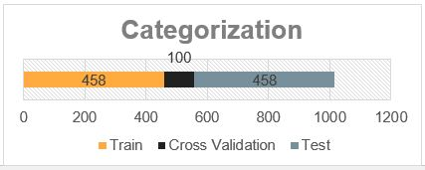
Data
TWITTER
API
JSON
Parser
CSV
Tweets
Problems faced –
Mostly Irrelevant Data (wrt Roads)
Out of Vocabulary Words used
High amount of noise and ambiguity of semantic

Slide 7
Process Flow Diagram

Slide 8
Input
Supervised classification
Information
Extraction
Output
Tweets from NYC Taxi Handle
Rules for Event Summary`
Bag of words and features
Ground Truth mapping
Bayesian Classification
Geocoder for location
Classified Tweets
Relevant/Non-Relevant
Rules for Event Date & Time
List of events
Event Name
Location
Time

Slide 9
Ground Truth Marking
Preliminary Marking
Relevant
Non-Relevant
Final Marking
Preliminary marking done by all the team members
The marking process gave insights into rules for extraction of date and time and location
Inter Annotator Agreement is measured among

Slide 10
Tweet Pre-Processing
To prepare data for classification, the following is done consecutively -
Normalization
Punctuation Removal
Squeezing of Whitespace
Encoding
Twitter API introduces some characters outside UTF-8
the others are generated from the csv
Date and Time Attribute Introduced
A new feature added, instead of treating all dates individually
Same applied for time.
Numeric Removal, since it unnecessarily increases the number of tokens
Tokenization (Tweets broken into words)
Stop Words Removal
Stemming (As bag of words are considered as feature, stemming is important)

Slide 11
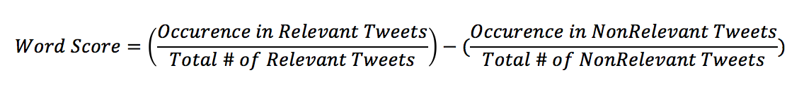
Feature Engineering
Step 1 :
Score indicative of Relevance prediction ; Appropriate Normalization
Step 2 :
Distribution of the word score for all the words plotted. [in the next slide]
Step 3 :
Extracting words with outlier scores [say, outside the 95% confidence interval]

Slide 12
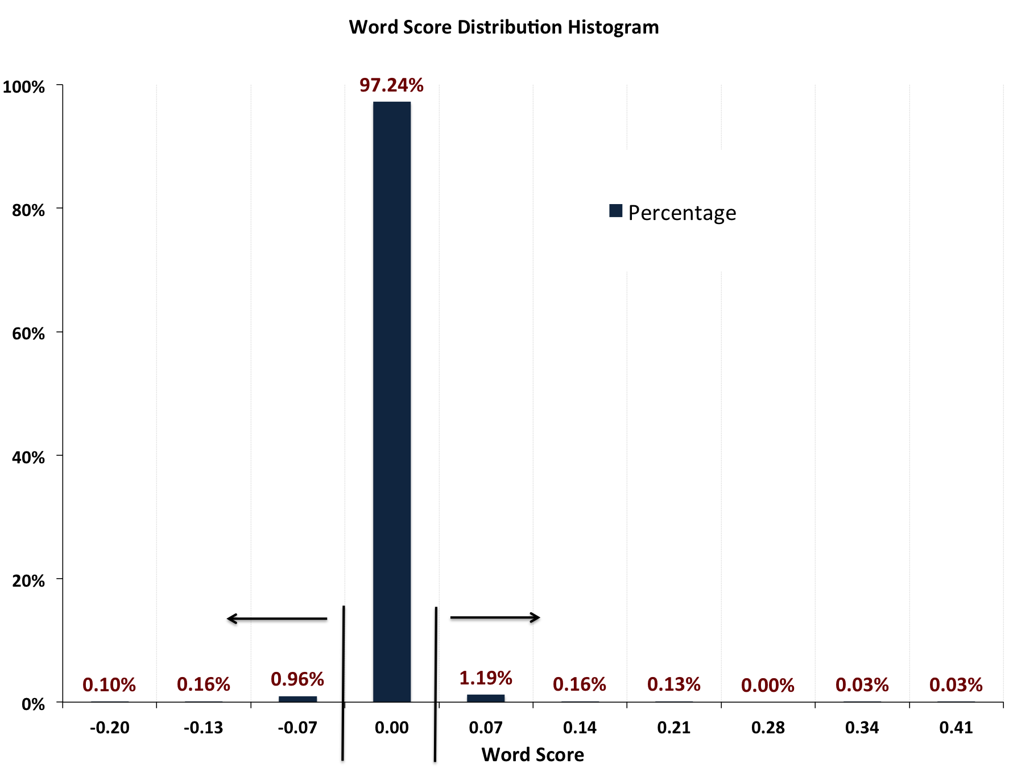

Slide 13
Feature Engineering
Positive Words:
['bridge', 'sun', 'fri', 'bound', 'thru'
'one', 'sat', 'closed', 'closure', 'closures',
'lanes', 'reminder', 'full', 'overnight', 'lane', 'from', 'will']
Negative Words
['here', 'office', 'free',
'report', 'contact', 'the',
'pls', 'commissioner', 'your', 'with', 'you',
'share', 'please', 'location', 'dot', 'our']

Slide 14

Bayesian Text Classification
Incomplete Slide
Naive Bayes is a simple technique for constructing classifiers: models that assign class labels to problem instances, represented as vectors of feature values, where the class labels are drawn from some finite set.
It is a conditional probability model: given a problem instance to be classified, represented by a vector x=(x1,...,xn) representing some n features (independent variables).

Slide 15
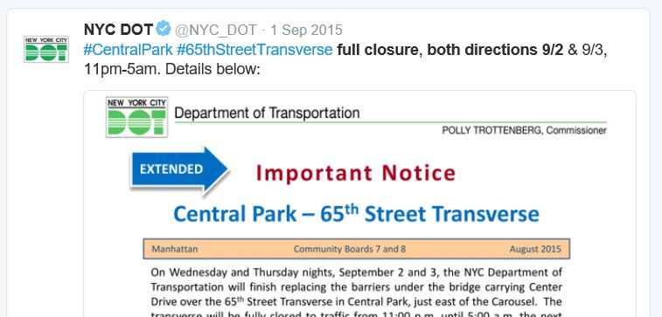
Event Tags
Objective:
Understand the type of event.
Example:
Full CLosure
Both Direction

Slide 16
Event Tags
Input:
full closure, both directions 9/2 &amp; 9/3, 11pm-5m. Details below:
Output:
Full closure both directions

Slide 17
Event Tags
Build Event Vocabulary
Take all the relevant tweets.
Take out the most frequent words (using a threshold frequency) Based on their stemmed counterparts
Inference from Data: close(5) , closed(114), closes(1), closing(2), closely(3) = close(125) Closures(106),closure(240) = closur(346).
Create a Vocabulary of frequent words.
Manually remove the non relevant words related to road closure or blockage event
*Number in brackets represents their occurrence frequency.
Stem | Words | Frequency
pleas | please pleased | 670
report | report reported reporting reports | 622
dot | dot | 360
closur | closures closure | 346
lane | lane lanes | 332
locat | location locations located | 305
contact | contact contacting contacted | 287
pl | pl pls | 277
free | free | 233

Slide 18
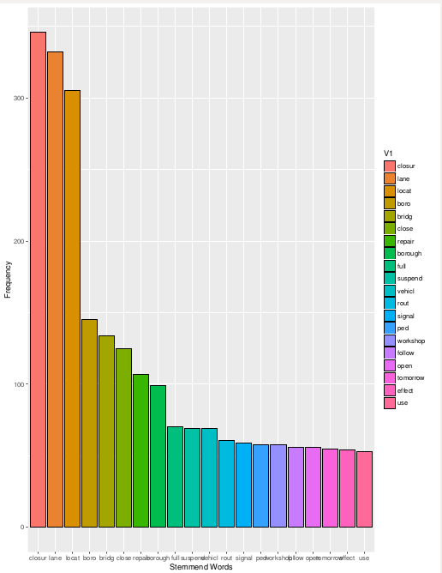
Event Tags
Frequency Distribution of Stemmed Words

Slide 19

Event Tags
Compare Incoming Tweet
Tokenize, Normalize Tweet
Check if each token is in Vocab
If yes, include in ‘name’
List tokens in the order of occurrence.
Stem | Words | Frequency
closur | closures closure | 346
lane | lane lanes | 332

Slide 20
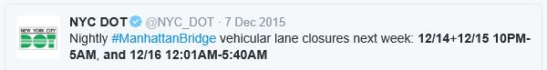

Event Date - Time Extraction
Example Tweets with Date/Time
12/5 thru 12/20, 7am-3pm.
Today lane closures begin from 10am-3pm
12/16-12/18 12:01-5AM & 12/19 1-6AM
Step 1 | Retrieve dates by REGEX + NER
Step 2 | Retrieve time by REGEX
Step 3 | Delete duplicate dates
Step 4 | Assign times to relevant dates

Slide 21


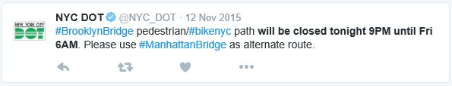
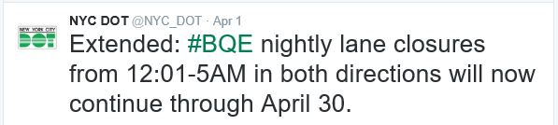
Event Date - Time Extraction
Pain points -
12am - Noon
Two location, two date/time
One date, two time
Time ranging from one day to another
1 date , 1 weekday mentioned
Time Mentioned before a Date

Slide 22
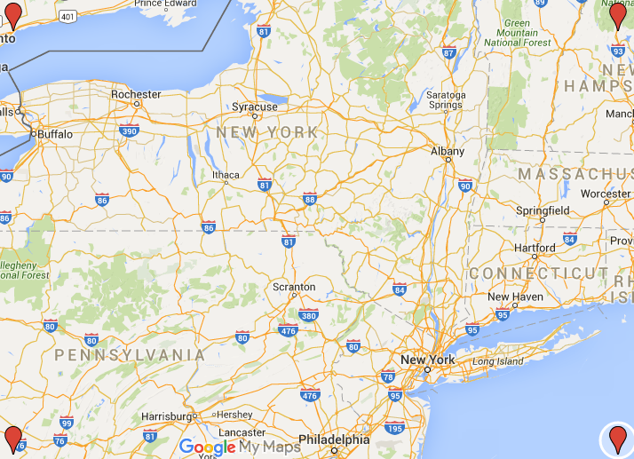
Event Location Extraction Algorithm
Step 1 | Relevant Tweets coming from classifier
Step 2 | Generate Candidate words from Hashtags Check text words in online Library
Step 3 | Generate possible Geographical Coordinates corresponding to all the candidate points
Step 4 | Check the Coordinates against the boundary coordinates of New York
Step 5 | Return the candidate words which fall within the coordinates of New York
Step 6 | Return the Actual Address corresponding to the coordinates if the subsequence matches.
[43.818746, -79.133970]
[43.818746, -71.653065]
[39.914668, -79.133970]
[39.914668, -71.653065]

Slide 23
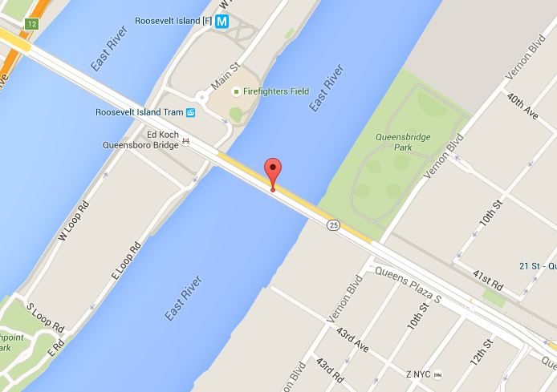
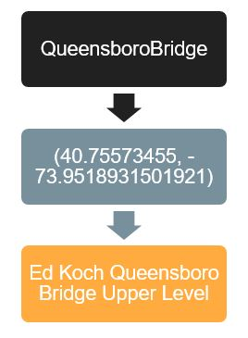
Event Location Extraction Algorithm

Slide 24
Evaluation

Slide 25
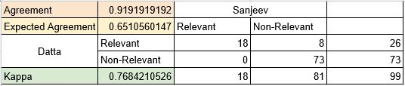
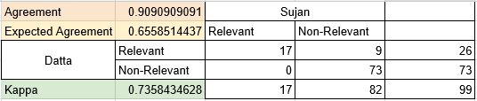
Inter-Annotator Agreement
Average Kappa
0.8231880667
Landis and Koch (1977)
0.0 – 0.2 : slight
0.2 – 0.4 : fair
0.4 – 0.6 : moderate
0.6 – 0.8 : substantial
0.8 – 1.0 : perfect
Result
Perfect

Slide 26
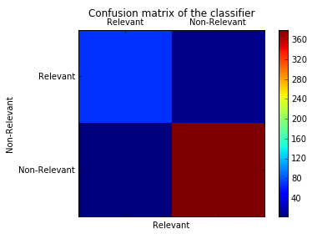
Classification
Performance
69 | 7
3 | 380
Confusion Matrix

Slide 27
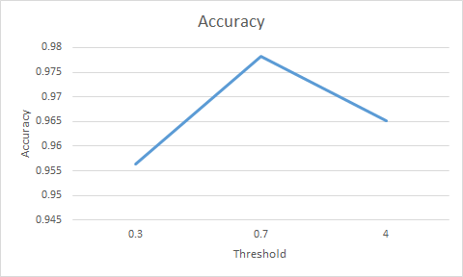
Accuracy Measure
Threshold Selected | 0.7
Cross Validation Accuracy | 0.975
Test Accuracy | 0.91

Slide 28
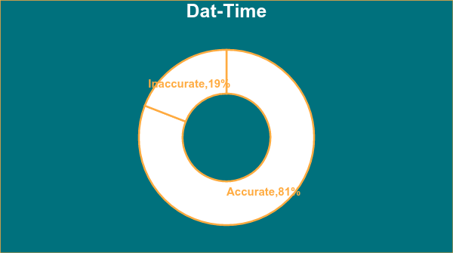
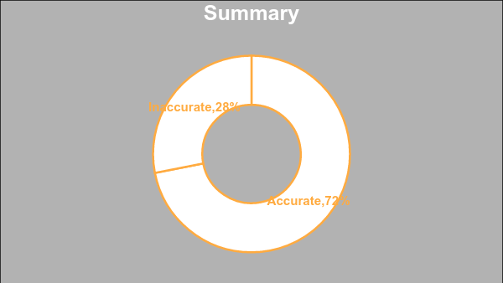
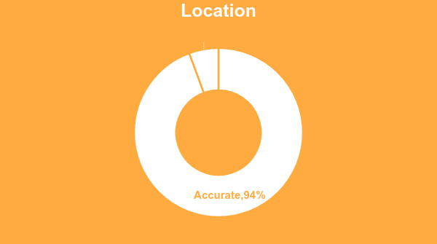
Extraction Measure

Slide 29
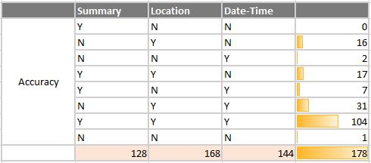
Extraction Measure

Slide 30
Demo

Slide 31
References and Modifications

Slide 32
Appendix : Past Researches
Paper | Event Detection | Information Extraction
TEDAS: Twitter Based Event Detection and Analysis System¹ | Twitter function based features Crime and disaster specific words | Rank information based on the user attributes, content
EvenTweet : Online Localized Event Detection from Twitter² | Burstiness of word Persistence of word for a significant time | Entropy based Spatial signature Cosine similarity for signature
1.TEDAS: a Twitter Based Event Detection and Analysis System , Rui LI, Kin Hou Lei, Ravi Khadiwala , Kevin Chen-Chuan Chang
2.EvenTweet: Online Localized Event Detection from Twitter,Hamed Abdelhaq, Christian Sengstock, and Michael Gertz

Slide 33
References
Python - Pandas, NLTK , Geopy
http://homes.cs.washington.edu/~mausam/papers/kdd12.pdf
http://www.telegraph.co.uk/technology/twitter/9945505/Twitter-in-numbers.html
TEDAS: a Twitter Based Event Detection and Analysis System , Rui LI, Kin Hou Lei, Ravi Khadiwala , Kevin Chen-Chuan Chan
EvenTweet: Online Localized Event Detection from Twitter,Hamed Abdelhaq, Christian Sengstock, and Michael Gertz

Slide 34
Thank You!!

Slide 35
Appendix : Past Researches - Incomplete Slide
Date Extraction: NER cannot be used because NUM format 12/12 (unstructured text)
TIme extraction: NER - 12:30 pm. Even then most of the times it recognises as JJ
Location of the tweet cannot be used. And OOV words used. BKLN Bridge, thus subsequence.
Classification - not only bag of words, date-time present, week present

Slide 36
Rough Slide : Not to be presented
Draw a tree diagram with 100% training data on the top
We are assuming, that the relevant tweets all have the Events, Location, Time information
Create a matrix which will have
The accuracy of information extraction, will determine which decisions can be taken based on the information
For example without time information we cannot take a time related decision
E.g. if we cannot get the location information, then we cannot take a judge on where to go
Examples of Extraction of Location from Tweets
At the end, reference of the papers which have been read. The papers were read we cannot use them
Data set not matching
Some greedy approach is not working
Idea borrowed from there
Not have enough stream of data for a particular method to be implemented

