Slide 1
Bond Liquidity Prediction Team DATAMAFIA Indian Statistical Institute Kolkata
Ayan Sengupta
Bodhisattwa Prasad Majumder
Robin Singh

Slide 2
Methodology
Buy/Sell Volume Forecast for a Bond
=
{
Latest Trend Value + Seasonality Correction (for bonds trading on more than 35 days)
Average of volume on Friday-Monday-Tuesday (for bonds trading less than 35 days)
0 (for bonds traded less than 2 times in 3 months)
}
+
{
Metadata based Correction
}

Slide 3
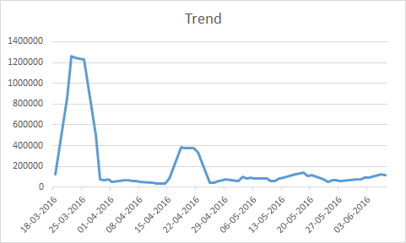
Trend and Seasonality Decomposition for individual time series
Decomposition of unevenly spaced time series into Trend and Seasonality with cycle time of 5 days

Slide 4
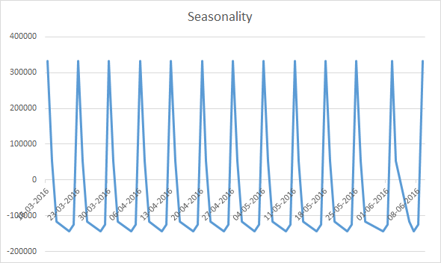
Forecast = last_value_of_trend_series + Seasonality_correction

Slide 5
Average of Fri-Mon-Tues as forecast
Variation in Buy Sell Volumes variation over 3 months are flat except few spikes. Hence we can use average as a reliable forecast for Bonds with medium number of transactions in 3 months

Slide 6
Metadata based Correction
Steps of analysis
Liquidity Def & Calculation for each day
Event Definition
Study of change in distribution of liquidity with events
Identify metaData variables indicating Bond response to Event
Correction to the Buy and Sell Volume for the Bonds full filling the criteria

Slide 7
Liquidity Definition on a day
(Buy Volume + Sell Volume)
absolute(Buy Volume - Sell Volume) + 100
100 has been added in the denominator as a smoothening factor to avoid infinite values during programming

Slide 8
Distribution of liquidity on all bonds and all days

Slide 9
Definition of Event
Event Type = 1 → Rating announcement by Rating Agency 1
Event Type = 2 → Rating announcement by Rating Agency 2
Event Type = 3 → Date of issuance

Slide 10
Liquidity Distribution Changes wrt Event 1

Slide 11
Liquidity Distribution Changes wrt Event 2

Slide 12
Liquidity Distribution Changes wrt Event 3

Slide 13
Huge Liquidity Values are dominant with Event 1 and Event 2

Slide 14
Liquidity Changes and Events mapping with MetaData
Market 0 is dominating in the cases when Event 1 and Event 2 lead to high Liquidity
Buy and Sell Volume Forecasts in such cases are
Multiplied with factor
Balanced to have Buy and Sell Volume equal

