Slide 1
easyMda
What is MDA
Why easyMda
Demo
Questions?

Slide 2
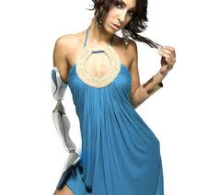
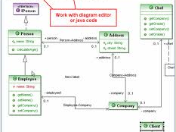
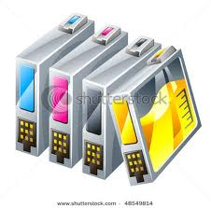
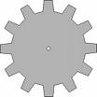

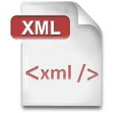
What is MDA
1. Design your model
2. Select cartridge, template or module
Generator
Scala, C##
....
3 Generate code ...

Slide 3
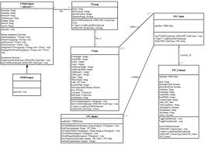







Three kinds of Mda
UML
DSL
mkdir hello
cd hello
roo
roo> hint
roo> project --topLevelPackage com.foo
roo> persistence setup --provider HIBERNATE
roo> entity --class ~.Timer --testAutomatically
roo> field string --fieldName message --notNull
roo> hint controllers
roo> controller all --package ~.web
roo> selenium test --controller ~.web.TimerController
roo> gwt setup
roo> perform tests
roo> quit
The rest
Xml, Special edtor etc

Slide 4
Why not used more often
UML
- Difficult to adapt
- Limited vocabulary (only stereotypes)
- Difficult to keep model and code in sync
DSL
- Very complex and time consuming to
Create new template.
- Steep learning curve

Slide 5
easyMda
Easy to use, Eclipse plugin
Easy to create model (just Java, intellisense)
Easy to adapt templates (jsp like Jet engine)
Easy to create new template (just Java)
Powerful: Interfaces + Annotations
Fast
- to create model (code completion)
- to generate code (msec's)

Slide 6
Demo
How to create a wizard in record time.

