Slide 1
NIR emission from hBN

Slide 2
Confocal Set-up
Sample on XYZ scanning stage
to Labview Interface
Filters to clean pump
OPO SHG fs pulsed laser (80MHz)
Camera
Timecard
Physical pinhole
LP Filter
0
1
APDs
1:1 relay lens
Imaging Spectrometer
50/50 Splitter
XY stage
Telescopic Z stage
Multimode Fibre
LP Filters
Microscope

Slide 3
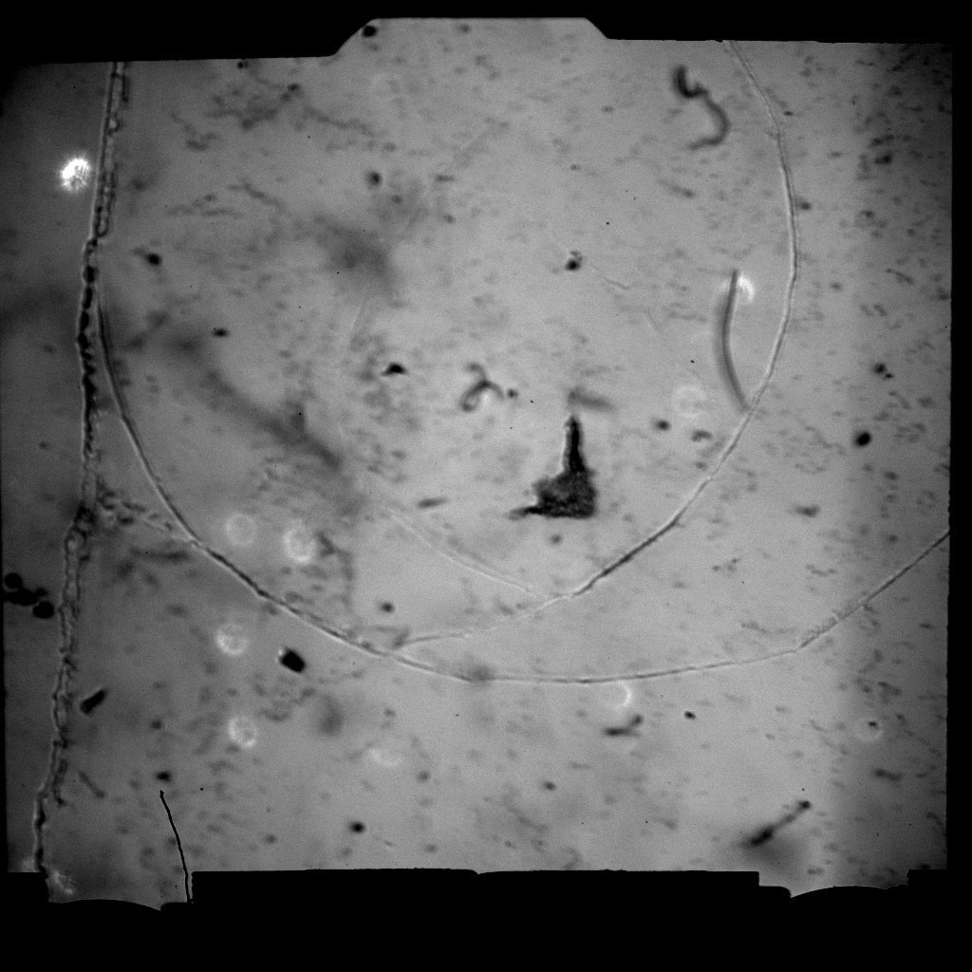
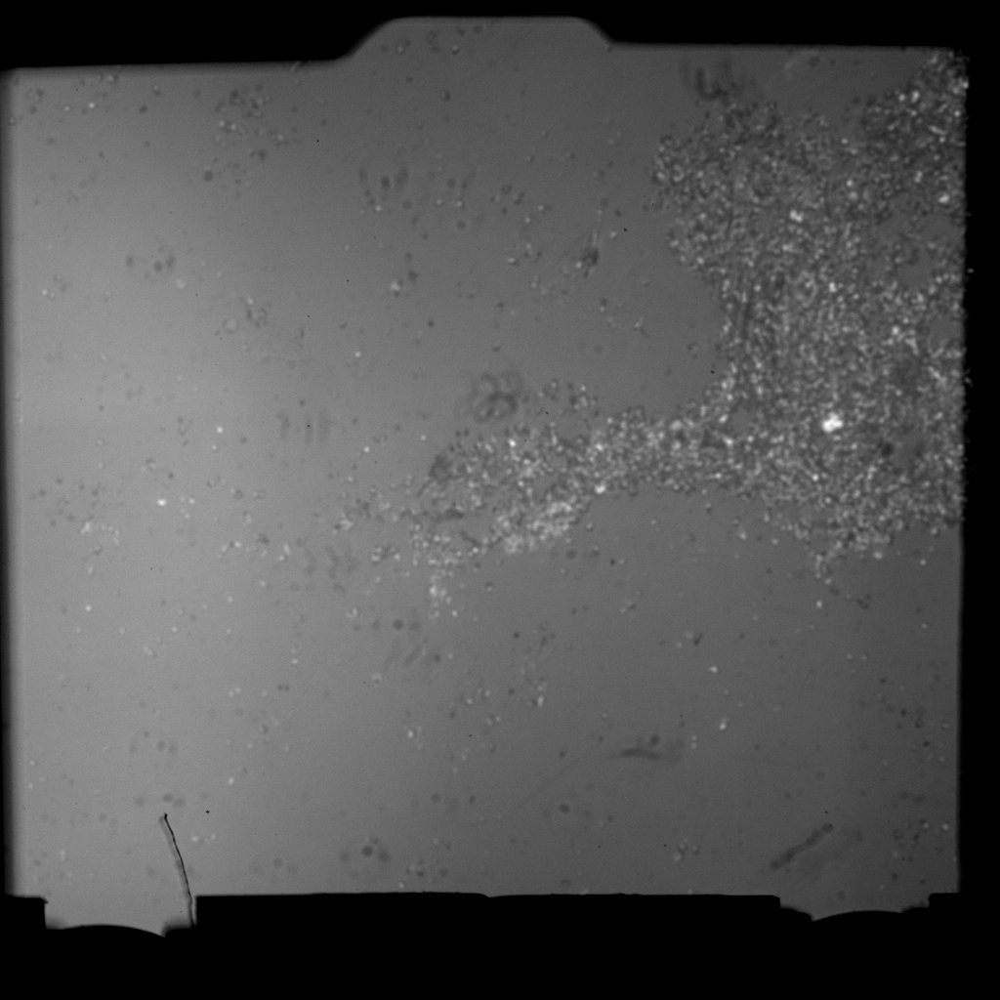
hBN on Quartz: Area scanned
M = 10X
M = 111X

Slide 4
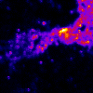
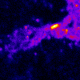
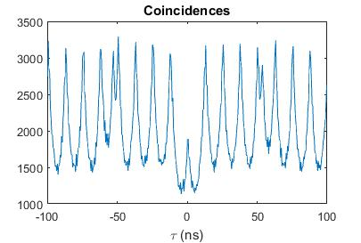
532nm pump (0.2mW before objective)
Nikon 60X 0.95NA
75 micron pinhole
Anti-bunched emission observed in VIS but not NIR
(same excitation conditions as above for coincidences, integration time 10 minutes, coincidence window 0.5ns)
10um
10um
VIS collection (650nm - ~850nm)
NIR collection (>900nm)

Slide 5
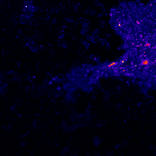
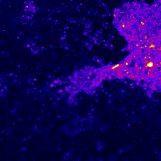
680nm pump (2mW before objective)
Olympus 100X (111X with Nikon tube lens) 0.85NA
200 micron pinhole
25um
VIS collection (650nm - ~850nm)
25um
NIR collection (>900nm)

Slide 6
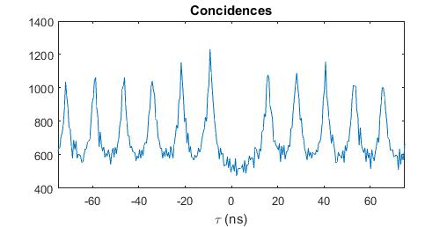
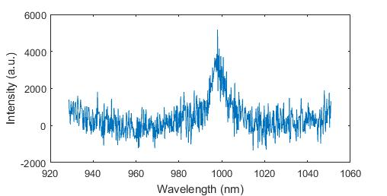
Anti-bunching in NIR emission:
Id320 detector efficiency 20% @ 1550nm, dead time 2us
680nm pump, 2mW before objective; collection>750nm
Integration time 4 hrs, coincidence window 0.5ns
(no background subtraction)
25um
NIR collection (>900nm)

Slide 7
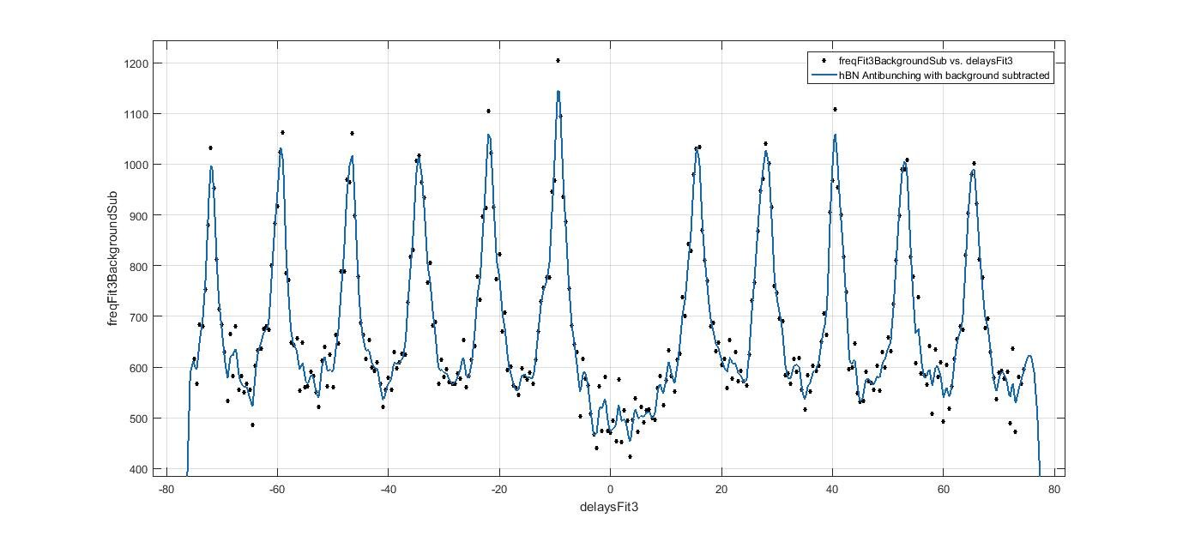
Further Work
Basic background subtraction & fit
Background should probably be retaken, for full 4hr length (above was coincidences over 10 minutes multiplied by 24)
What should be the analytic expression for the fit function?
Most efficient pump wavelength was found to be 635nm, re-take at this pump?

