Slide 1
The Governed Data Product for AI
How eight raw banking files became data an AI assistant can query correctly — and only for the clients each user may see
Berka (PKDD'99) take-home · technical walkthrough · 9 November 2026
Notes:
Good morning. In the next thirty minutes I will walk through what I built for the take-home, step by step,
and for each step the decision, why I made it, what it cost, and where it is weak. I will also tell you what
I found wrong after I submitted it, because I would rather you hear it from me.
Everything I show is from the delivered version, commit fc0c281. Where I mention later work I will say so.

Slide 2
The brief, and the one idea behind my answer
Task 1 · Data quality
Task 2 · AI-ready product
Task 3 · Entitlements
Rules for completeness, uniqueness, referential integrity, validity, consistency — each with a severity and a reason.
A model, a semantic layer, and an LLM answering ten questions — generated SQL and result per question.
Each user sees only their own clients. Where the filter sits, why the LLM cannot bypass it, onboarding without code.
Treat the AI assistant as a dumb and dangerous client
Dumb — it guesses at anything the data does not spell out. Every layer should remove a reason to guess.
Dangerous — whatever it writes runs against customer data. Every layer should remove a way to do harm.
Notes:
The brief has three tasks on the public Berka bank dataset and ten business questions. The expected effort was one
to two days and it warns that time spent on infrastructure means you misread it — I will come back to that.
The idea that organises everything: I treated the AI as a dumb and dangerous client. Dumb, because it will confidently
guess any meaning the data does not state — a column name, a date, a definition. Dangerous, because the code it writes
runs against customer data. So each layer you will see either removes a reason to guess, or removes a way to do harm.

Slide 3
Six schemas in one PostgreSQL database
raw
stg
dq
core
ai
sec
BRONZE
SILVER
CONTROL
GOLD
SURFACE
ACCESS
8 files verbatim as text, SHA-256 per file, line numbers
Typed, decoded, sign resolved — nothing filtered, originals kept
124 rules, quarantine, flags, reconciliation, run log
Star schema = stg − quarantine, verified each build
11 business-named views, all security_invoker
Principals, grants, TOTP — read by 7 RLS policies
Contract | Checked by | Delivered result
raw = stg on rows and money | DQ step (dq.reconciliation) | 11 of 11 balanced
core = stg − quarantine on rows and money | build_model.reconcile_core | 9 of 9 balanced, every delta 0
semantic layer = live schema | make semantic | 0 problems (11 entities, 105 columns, 19 joins)
Notes:
The whole thing is one PostgreSQL database with six schemas, each with a contract to the next.
raw keeps the files exactly as they arrived, hashed. stg types and decodes but filters nothing. dq is the control plane.
core is the star schema, which must equal staging minus the quarantine on rows and on money. ai is the only surface a
consumer can query. And sec, beside core rather than on top, holds who may see what, read by seven row level security policies.
Why PostgreSQL and not DuckDB or a warehouse: Task 3 is about enforcement, and the only honest proof that generated SQL
cannot bypass a filter is to put the filter in the engine and log in as a restricted user. DuckDB has no row level security.

Slide 4
How I worked: rules that explain most decisions
Executed, not asserted
Land verbatim, never repair
Grade, do not gate
Every number comes from a logged command; a step that did not run says NOT EXECUTED
Originals survive in _raw columns with a note (D013)
Staging filters nothing; rules decide afterwards (D020)
A severity has a consequence
One definition, one place
Distrust your own build
block quarantines · warn flags travel to the answer · info logs
Owner, problematic, incoming, month-end decided once (D006, D017)
Model verified every build; 20 seeded defects; security tested by logging in
Notes:
A few working rules explain most of the decisions before anyone asks. Every number is produced by a command whose run is
logged — nothing typed from memory, and a step that did not run is printed NOT EXECUTED. Bronze is verbatim and silver
never repairs: a repaired value looks exactly like an observed one a week later. Staging filters nothing, so the quality
report describes the source, not what survived the loader. A severity must have a mechanical consequence. Each business
term is decided once. And I distrust my own build: the model is verified after every build, the rules are proven by seeded
defects, and security is tested by logging in as the restricted user and counting rows.
I built it with an AI coding assistant under my direction; the disclosure names every model and role.

Slide 5
Ingest: land everything exactly as it arrived
1
8
1,079,680
SHA-256
8 / 8
original .asc files from a verified public mirror (D003)
rows landed as text, file + line on every row (C01, C02)
per file in raw.load_audit — proof of which bytes
row counts match the published reference
Why everything lands as text
Why defects are injected elsewhere (D004)
A cast at load time destroys the evidence of the defect it trips over: a bad date aborts the load or vanishes. Bronze is the one layer that cleans nothing, so when a number is disputed I can show what actually arrived.
The public copy is clean enough that most rules never fire — and a rule that never fired proves nothing. A seeded, corrupted copy in its own schema proves the rules while the ten answers stay on untouched data.
Notes:
Step one. Eight original files from a public mirror whose row counts match the published reference exactly — all eight.
Every field lands as text with its file and line number, and each file gets a SHA-256 in the load audit. The reason is
simple: a cast at load time hides the defect it trips over. Bronze is the layer you can't argue with.
Because the public copy is clean, I seed defects into a separate schema to prove the rules fire — never into the real data.

Slide 6
Profile, then clean without overwriting
2
21 cleaning steps — exactly one removes a row
Step | What it does | Measured
C03 | Seven spellings of 'missing' ('', ?, NA, N/A, NULL, -, unknown) become NULL; original kept | 1,380 rows
C05 | YYMMDD text becomes a date; two-digit years read as 19xx; a failed parse is NULL, not an error | 1,062,394 dates
C07–C08 | Birth date and gender decoded from birth_number (women: month + 50) — labelled derived | 5,369 clients
C09 | Czech codes decoded to English labels from one map; the code stays beside the label | 2,466,175 values
C10 | Sign resolved once: PRIJEM credit; VYDAJ and VYBER debit (VYBER is not in the data description) | 1,056,320 postings
C14 | The one row removed: a duplicate posting, quarantined with its reason | 1 row
Profiling ran first: every column measured and 17 candidate defects written down with counts before any rule existed.
Notes:
Before writing rules I profiled every column and wrote down candidate defects with counts — the rules came from the data,
not from a checklist. Then cleaning: twenty-one steps, and exactly one removes a row, the quarantine of one duplicate.
Everything else converts without overwriting. The step I would single out for AI-readiness is the sign: every question about
money in or out turns on Czech words, and the data has VYBER, a debit that the documentation does not even list.
A query that gets that wrong does not fail — it returns a plausible wrong number. So the sign is decided once, in staging.

Slide 7
Grade every defect — and give the grade a consequence
3
BLOCK
WARN
INFO
Quarantined, excluded from core and the ai views, reversible
Kept; the flag travels onto the row and into the semantic layer as a caveat
Standardised or logged; no answer changes
1 rule · 1 row
6 rules · 440 flags
12 rules
124 rules (89 hand written + 35 completeness sweep) · 19 fire on the public copy · 14 defect types
Same check, opposite decision
14 postings have amount zero. 'Amount must be positive' sounds right — but they are real interest runs that accrued nothing; blocking them would break 14 balance chains to fix nothing, so they are info. A negative amount would be block: the sign was applied twice and money moves the wrong way.
Notes:
Task one. 124 rules across six dimensions, and every one carries a severity with a reason written in terms of the questions
it affects — the loader refuses a rule without one. The point is that a severity does something: block quarantines,
warn flags the row and the flag reaches the answer, info logs.
My favourite example is the zero-amount postings: same kind of check as a negative amount, opposite decision, and I can say
why for each. Raise it yourself: the one blocked row is a 0.00 duplicate, because the rule needs an identical resulting
balance — so it can only catch duplicates that didn't move money. I would add a warn rule for repeated identical batches.

Slide 8
Prove the rules fire, and prove nothing was lost
4
20 of 20 seeded defects caught
Reconciled after every build
A deterministic injector corrupts a copy of staging in its own schema, one defect per rule family; a test asserts each is caught by the rule meant to catch it.
raw = stg on 8 row counts and 3 money sums. core = stg − quarantine on 7 row counts and 2 money sums (transactions 6,257,793,560.30; loans 103,261,740.00).
The bug that proved the point
The quarantine view was not scoped by schema, so running the rule tests made the injected defects exclude real rows: 76 districts instead of 77, 11,024 transactions orphaned. The model's grain and foreign-key checks failed before any deliverable was written (D008). A green build is not a correct build.
Notes:
Two kinds of proof. That the rules work: twenty seeded defects, each caught by the right rule. And that cleaning lost nothing:
raw equals staging, and core equals staging minus the quarantine, on rows and money, after every build.
And the best bug of the project: the self-test nearly deleted real data, because the quarantine view wasn't scoped to the real
schema. The model checks caught it before anything was written out. That is the argument for verifying the model instead of
trusting a green build.

Slide 9
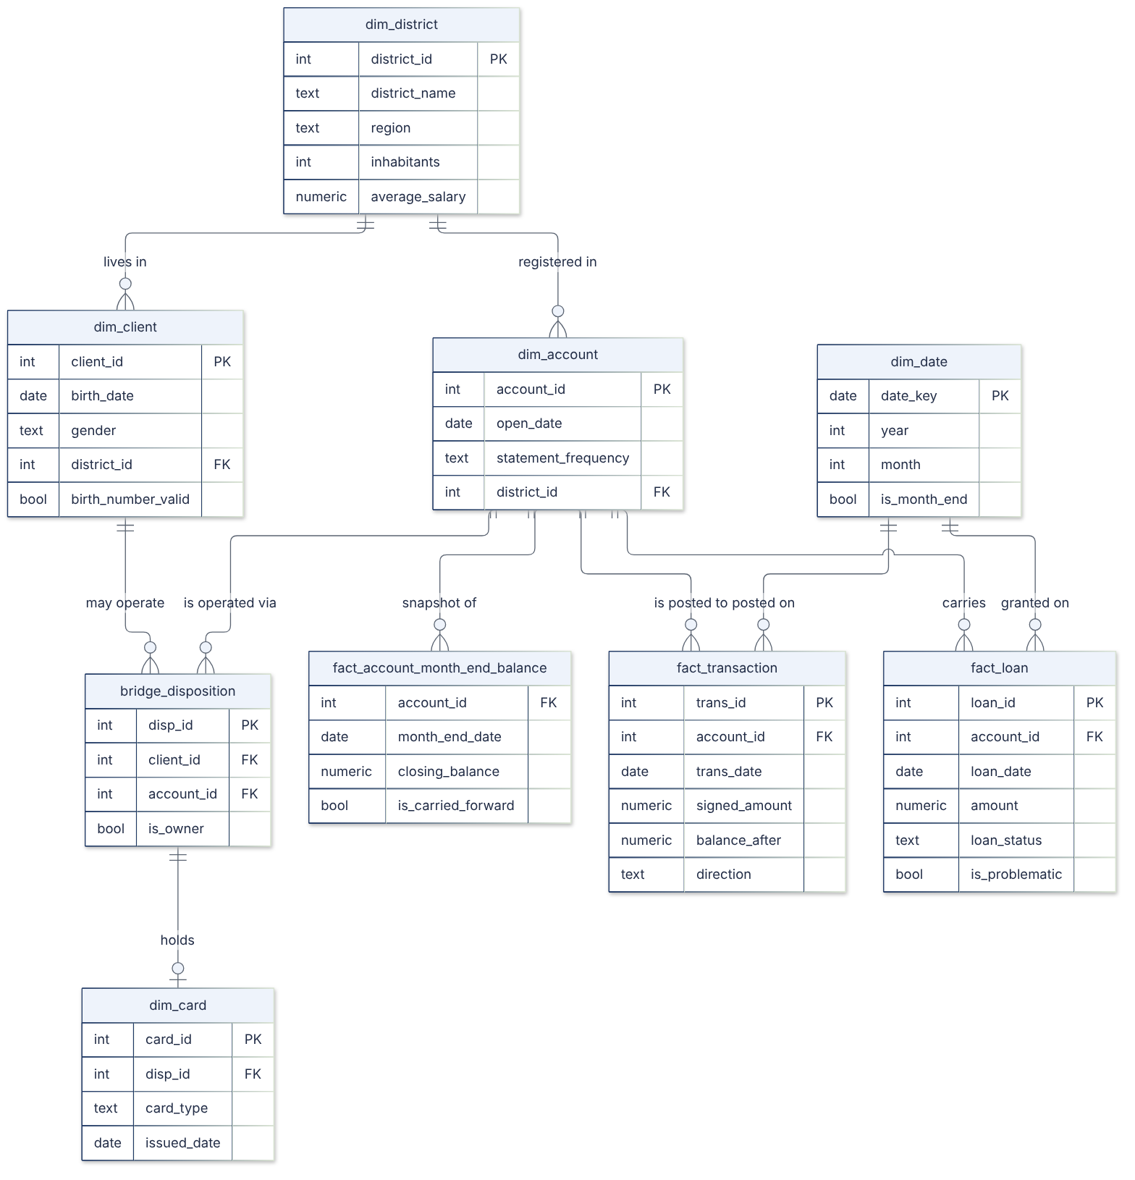
A star schema with one definition per term
5
Term | Decided once in | Definition
Account owner | core.v_account_owner | The OWNER disposition — exactly one per account (block rule)
Problematic loan | fact_loan.is_problematic | Status B or D: 76 of 682 = 11.14% (A4)
Incoming money | fact_transaction.direction | Credits (PRIJEM), unsigned amount (A7)
Month-end balance | fact_account_month_end_balance | Last posting on or before month end; carried forward if none (D019)
Why a star with a bridge
Four grains (client, account, loan, posting); a wide table turns every count into count(distinct), which generated SQL gets wrong quietly. One source, no history: natural keys, no Data Vault (D007).
Notes:
The model: four dimensions from the source tables plus a generated calendar, a disposition bridge, two facts and a derived
month-end balance fact, plus three curated views. The point is not the shape; it is that each business term is decided in
exactly one place, so no query can quietly use another meaning.
Raise it yourself here: the month-end fact breaks same-day ties by the highest transaction id. I disclosed that as a known
limitation. I will show you on a later slide what I found when I went back to it.

Slide 10
A semantic layer the build can refuse
6
What the model is given — and nothing else
The build fails if …
11 entities with grain, key and every column described
12 certified metrics with their time column
19 joins with measured cardinality
A glossary of what each term is and is not
7 data quality caveats with row counts
12 query rules (ai only, one SELECT, half-open dates, never aggregate after a fan-out, say what is missing instead of guessing)
a described column does not exist, or a column is undescribed
a grain is not one row per key
a join's cardinality differs from the declared one
a metric names a column that does not exist
Why a file, not prompt text
A layer that drifted from the schema gives the model confident wrong information it cannot check.
Notes:
The semantic layer is one YAML file rendered into the text the model reads. The model never sees the data, the reference SQL
or the evaluation. What makes it AI-ready is the 'is not' definitions — a disponent is not the owner, incoming is not a net
flow — and the caveats with counts that the model is told to surface.
And it is a build artefact: if a column is renamed or a grain stops holding, the build fails before any answer exists.
Honest note: the pack also names which entity answers which question. That shows the model where to look without numbers,
but it means my evaluation is tuned to these ten questions. I will come back to that.

Slide 11
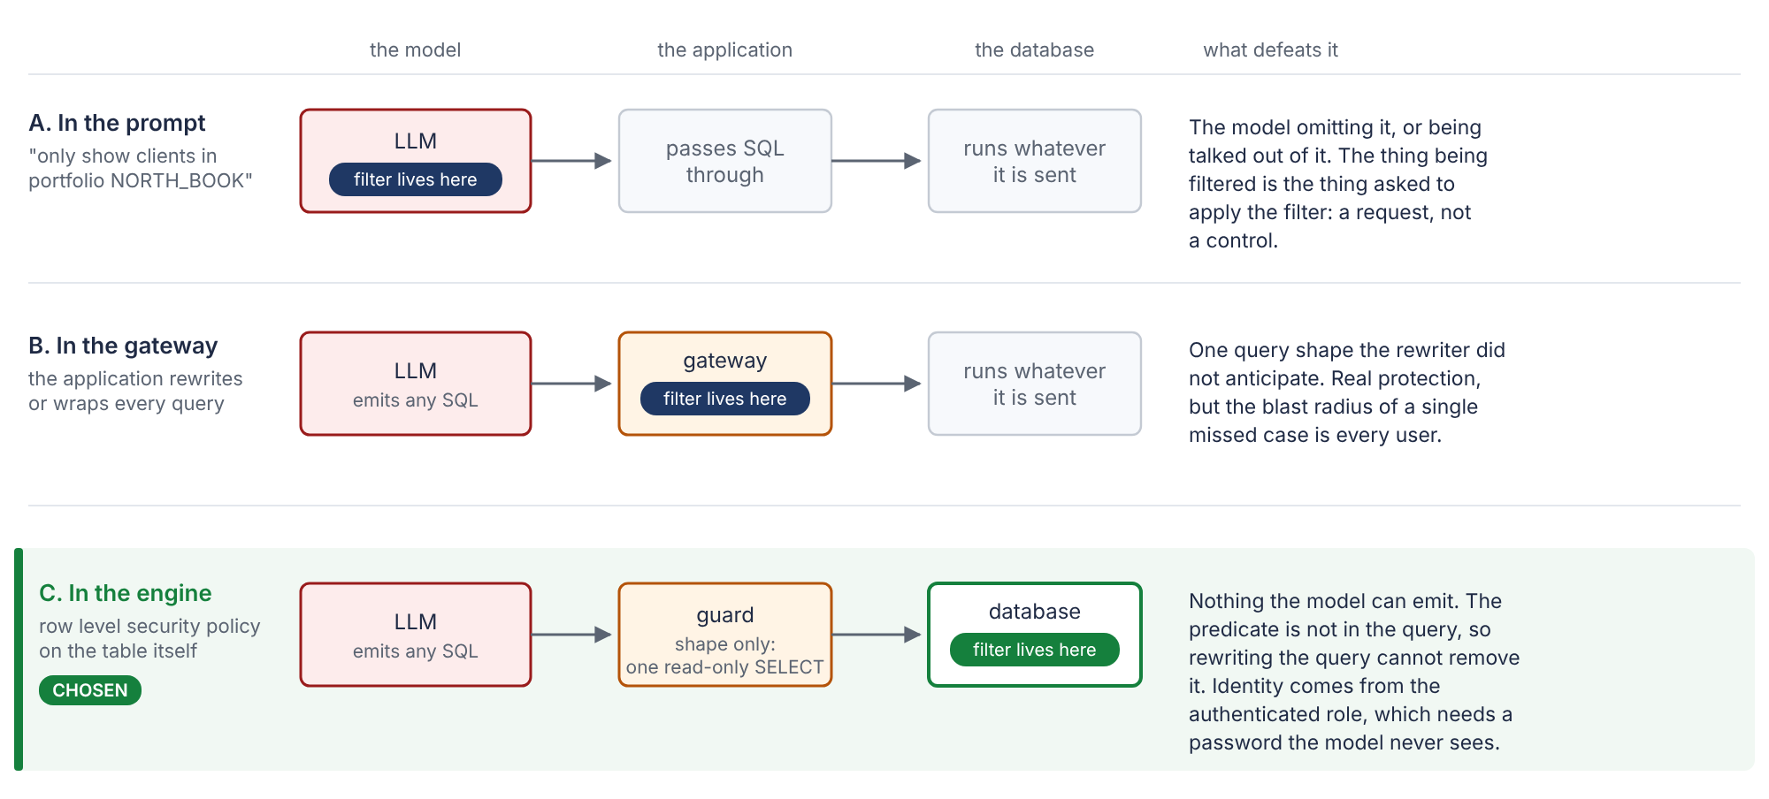
Where the filter sits — and why the model cannot remove it
7
Where
7 RLS policies on the client-bearing core tables; every view between is security_invoker
Why no bypass
The predicate is not in the model's text; identity is session_user; no consumer has BYPASSRLS
Logged in as | Clients | Loans
cro_global (portfolio of every client) | 5,369 | 682
rm_north | 1,481 | 179
rm_south (book + 1 delegated) | 1,387 | 195
rm_unassigned (no portfolio) | 0 | 0
Onboarding
Insert principal + portfolio, create the role, enrol TOTP. Offboarding: one UPDATE
Notes:
Task three asked me to explain; I built and tested it. The filter is a row level security policy on the base tables, so it
sits inside the plan of every statement. Every view in between is security_invoker, so the policy runs as the caller.
The caller is session_user, the role that logged in, which no SQL can change. The model only writes text, and the predicate is
not in that text — there is nothing for it to remove.
The bank-wide risk user is a portfolio of every client, not an exemption, and a new user with no portfolio sees zero, not
everything. Nine bypass attempts in the tests fail. And the bug that taught me to test this way: one view missing
security_invoker returned all 682 loans to a user entitled to none.

Slide 12
Access is data: four sources, two factors
8
Ownership
view + operate on the client and their own accounts
Two factors, enforced by the database
derived
Password, then a TOTP code verified inside PostgreSQL by a function that takes only the code and uses session_user. Single use; five committed failures lock for 15 minutes. Password alone → 0 rows (D026).
Disposition
that one account only — never the owner (D024)
derived
Portfolio
view only on the book (accountability ≠ payment authority)
derived
Limit found at delivery
Delegation
a human decision with grantor, reason and expiry
A direct client can roll back failed guesses and is never locked out. Recorded as a strict expected failure; RLS unaffected.
stored
Grants are derived live (D027): a materialised version once let a new portfolio do nothing until the next rebuild.
Notes:
Access comes from four sources with one shape. Three are derived live from records the bank already keeps — ownership,
dispositions, portfolios — and only delegation is stored, because only delegation is a human decision. Deriving them live came
from a bug: a materialised grant table once made a new portfolio do nothing until the next rebuild.
The second factor is verified by the database, so no application in front can skip it: the right password and no code reads
nothing. One limit I found in the delivery audit and disclosed: the failure counter lives in the caller's transaction, so a
direct client can roll its failed guesses back.

Slide 13
Defence in depth around a dumb and dangerous client
Layer | Enforces | Does not
Isolation | No tools, no files, no database; one turn, one JSON object | make the model right
Semantic layer | Meaning: certified metrics, 'is not' glossary, caveats, query rules | check the model followed it
SQL guard (sqlglot) | One read-only SELECT on ai; no out-of-schema functions; LIMIT ≤ 10,000 | resolve columns or judge meaning
Execution envelope | Read-only transaction, 60 s timeout, at most cap + 1 rows, the user's own 2FA session | —
Row level security | Which rows exist for this user, whatever the SQL says | —
PostgreSQL | An unknown name is an error, recorded — never answered | catch a valid but wrong query
Evaluation | Value-based comparison with independent reference SQL | protect a live user
The guard proves a query is safe to run. It does not prove it answers the question.
Notes:
This is the AI path. The model runs as a pure text completion: no tools, no files, no database — if it could read the tables
it would answer by looking, and I would be testing the agent instead of the semantic layer.
Its SQL is parsed with sqlglot, not matched with a regex, and must be one read-only SELECT on the ai schema with a row cap it
cannot raise. It runs read-only with a timeout, on the user's own two-factor session, so row level security decides the rows.
The sentence on the bottom is the one I want you to remember: the guard proves the query is safe. It says nothing about
whether it is right.

Slide 14
Safe is not the same as correct
“Find male or female loans in Q1 1995.”
A small local model, same layer
SELECT COUNT(*) AS total_loans,
SUM(CASE WHEN T2.gender = 'male' THEN 1 ELSE 0 END) …
FROM ai.loan T1
JOIN ai.account_owner T2 ON T1.account_id = T2.account_id
WHERE T1.loan_date >= '1995-01-01'
AND T1.loan_date < '1995-04-01'
Q10: counted problematic loans instead of a share → 'monthly' (right: after transaction, 18.75%)
Q6: joined to every day of the month → 279 new accounts in January instead of 106
Q7: grouped by age instead of averaging it
All safe. All allowed by the guard. All wrong.
GUARD: ALLOWED
DATABASE: column t2.gender does not exist
Gender lives on ai.client; ai.loan and ai.account_owner expose owner_gender. The metric text had said 'any entity with a gender column'. It failed safely — the dangerous case is valid SQL that is wrong.
Notes:
Here is the proof. This question came through the application. The SQL is one safe SELECT, so the guard allowed it; then the
database rejected it because the column doesn't exist — gender lives on the client, the loan view calls it owner_gender. The
root cause was my semantic layer saying 'any entity with a gender column'.
That one failed safely. The dangerous version is valid SQL that is wrong, and a small local model shows exactly that: counting
instead of a share, a fan-out join, the wrong aggregate. Every one allowed by the guard, because the guard only checks shape.
In the delivered version my intent checker was a prototype. After submitting I built it in — I will show it at the end.

Slide 15
Results — and why 10/10 is narrower than it sounds
What the 10/10 does not show
Recorded on the pack before the semantic audit (29,500 characters); not re-run with Claude at delivery
The pack names which entity answers which question — no hold-out set
One sample per question; one key measure compared
Honest claim: the layer is good enough for a strong model on these ten — not yet proof that it generalises
Claude: first attempt on all ten, about 2 minutes and USD 0.40, every call logged.
Notes:
Results. Claude answered all ten on the first attempt and all ten match independent reference SQL, compared by value, not by
SQL text. The small local model scored six, with two partial and two wrong.
Raise this yourself: that ten out of ten is narrower than it sounds. It was recorded on the pack before the audit, the pack
names the questions, there is no hold-out, one sample each. What it shows is that the semantic layer is good enough for a
strong model on these questions. A hold-out set is the next test — and after delivery I added four new questions on gender
and quarters, which it also answered correctly with verification on.

Slide 16
The ten answers, as delivered
Q | Question | Answer
1 | Clients per region | south Moravia 937 · north Moravia 920 · … (client's own district, all 5,369)
2 | Loans granted per year | 1993 2.62 m (half year) … 1997 peak 30.73 m · total 103,261,740
3 | Share of problematic loans | 76 / 682 = 11.14% (B 31, D 45)
4 | Average loan by owner's card | junior 221,970 (n = 21) · gold 161,881 · no card 148,865 · classic 148,809
5 | Top districts, incoming 1997 | Hl.m. Praha 115.13 m · Karvina 28.51 m · Ostrava 27.69 m …
6 | New accounts per month 1996 | 106 · 104 · 124 · 101 · 91 · 113 · 137 · … · 125 (1,363)
7 | Owner age at loan start | A 37.07 · B 39.60 · C 38.70 · D 37.00
8 | Gold-card owners by gender | male 53 (60.23%) · female 35 (39.77%)
9 | Average balance end Dec 1998 | 43,808.94 over 4,500 accounts (76 carried forward)
10 | Frequency with highest problematic share | after transaction 18.75% (6 of 32 — highest observed, not significant)
Notes:
The ten answers. A few I would comment on if asked. Q1 counts all clients by where they live; places three to five are within
four clients, so the definition matters. Q4: junior card owners borrow most, but on 21 loans to owners averaging seventeen —
I'd flag that, not celebrate it. Q9 is 43,808.94 as delivered. Q10: after-transaction statements have the highest observed
rate, but on 32 loans with a 9-to-35 percent interval — worth watching, not a finding.

Slide 17
What I would challenge myself on
1
The month-end tie-break
Highest trans_id picks the closing posting; right 0.4% of the time where the balance chain decides
Disclosed · fixed after
2
Guard ≠ meaning
A safe query can be wrong; the intent checker was a prototype
Disclosed · fixed after
3
The 10/10 is narrow
Old pack, question labels in the pack, no hold-out, one sample
Partly disclosed
4
Disponent privacy
Sees the owner's card; hidden values shown as 'no card'
Found after delivery
5
Scope
Well beyond a 1–2 day brief: 2FA, web page, deployment guide, agents
Tasks first; what I'd cut
Notes:
Before you ask, here is what I would challenge myself on. The month-end tie-break and the guard are disclosed in the delivery,
and I fixed both afterwards. The evaluation is narrower than ten out of ten suggests. A disponent sees the owner's card and,
for a hidden owner, a 'no card' value that is false — row level security changed the meaning of a column, which is a lesson
in itself. And scope: the tasks came first; the extras were requested; if I had to cut, the deployment guide, then the
simulated agents, then the web page.

Slide 18
My best-looking defect was my own bug
0.4%
55 → 14
+1.53
107
how often the highest id was the true closing posting
material balance breaks once the order is read from the balance chain
CZK change in Q9's average (43,808.94 → 43,810.47)
accounts with a different closing balance, up to 1,200 CZK
Account 3888, 31 Jan 1998 | trans_id | Amount | Balance after
Interest credited | 3,467,643 | +1.30 | 10,501.30
Cash withdrawal — the real last posting | 1,137,901 | −1,200.00 | 9,301.30
What I learned
My report said this account was 'off by exactly 1,200 — a missing posting'. It was my tie-break reading the balance before the withdrawal. A derived check inherits the bugs of what it reads; and 'unknowable' is a hypothesis to test.
Each posting starts at balance_after − amount, so a day's postings form a chain; its end is the closing posting. The source did record the order.
Notes:
This is my favourite mistake. I assumed the source had no intra-day order and broke ties by the highest id. When I went back,
the running balance records the order: each posting starts where the previous one ended. The highest id was right 0.4 percent
of the time. Q9 barely moved — 1.53 CZK — but 107 accounts' closing balances changed.
And the best-sounding defect in my report, an account off by exactly 1,200 with a 'missing posting', was this account: a 1.30
interest credit has a higher id than the withdrawal that came after it. My reconciliation rule read my own wrong balance.
Fifty-five material breaks became fourteen. That is the lesson I would take to any data team.

Slide 19
My checks caught me — twice before delivery
The self-test nearly deleted real data
The filter leaked through one view
Unscoped quarantine view: injected defects excluded real rows — 76 districts instead of 77. The grain checks failed before any deliverable was written.
Three curated views were not security_invoker: ai.loan returned 682 loans to a user entitled to none. Found by logging in and counting.
The demo's own query was wrong
A documented control without a test
sum(DISTINCT amount) as a reflex guard against fan-out dropped 37 loans that share an amount: −4,480,920 CZK. Now pinned by a test.
The lockout was documented for weeks; writing its test at delivery found the rollback gap. Now a strict expected failure.
Notes:
The other side of the same habit: my own checks caught me. The rule self-test that almost deleted real data. The view that
leaked every loan to a user entitled to none — the design was right, the DDL was one setting short, and only counting rows as
the restricted user found it. A demo query that was itself wrong by four and a half million. And the lockout, which I had
documented but never tested — writing the test found the gap. All of these are written down, not quietly fixed.

Slide 20
After delivery: the two fixes, on a separate branch
Not merged into the submission: D028 changes a certified number, and that needs the business to sign off the rule.
D028 · closing posting = end of the balance chain
D029 · verify the intent, not only the shape
 | Delivered | After
Q9 average | 43,808.94 | 43,810.47
Material breaks | 55 | 14
Rounding band | 81 | 70
Ambiguous days marked | — | 42 at book end
The model states metric, periods, grouping and filters next to its SQL
Checked before any database session: every column, the date filter day by day, no fan-out joins
Then EXPLAIN, run under RLS, recompute the certified metric — rows only if both agree
The gender query is refused, naming owner_gender; 10/10 and 4 new questions 4/4, verified
Tested on synthetic postings and against an independent derivation: 180,000+ balances, 0 disagreements.
Notes:
After submitting I fixed the two most important limitations on a separate branch. I did not merge them into the delivery,
because the first changes a certified number, and that is exactly what a governed product should not do without sign-off.
The month-end rule now follows the balance chain and marks the days it cannot order. And the model now has to state its intent
next to its SQL; the SQL is checked against that intent before it runs, and the certified metric is recomputed afterwards.
The verifier's own first run refused two correct answers — a lesson too: a checker needs tests against correct answers.

Slide 21
What breaks at 100,000× the volume
What breaks | Why | What it becomes
Rebuilds | core is CREATE TABLE AS every run: hours rewriting unchanged data | Month-partitioned facts, merge not replace
Rule runs | 124 full scans | Partition-scoped rules; info sampled, block exact
Month-end fact | 32 bn rows rebuilt from scratch | Maintained from last month + new postings
Latency | Ad-hoc SQL over 10 TB; one node; role-per-user pools | Pruning on certified time columns, marts, a gateway doing SET ROLE
Entitlement join | Millions of accounts per large portfolio | A materialised (role, account) set, co-partitioned
Evaluation | Ten questions are not a test set | Hold-out set, frozen samples, monitoring
What does not break: where the filter sits, onboarding as an insert, and the size of the semantic layer.
Notes:
At a hundred thousand times — about a hundred billion postings — everything that is 'rebuild from scratch' becomes 'maintain
incrementally', and the entitlement join becomes a materialised set. A single PostgreSQL node is the wrong host; Citus or a
columnar engine, or a warehouse's row access policies, with the same schemas and policy model.
What doesn't change is the design: the filter stays in the engine, onboarding stays an insert, the semantic layer stays the
same size.

Slide 22
Decisions that are not mine to make
Problematic loan = status B or D
76 of 682 = 11.14% (A4)
Interest counts as incoming money
0.85% of 1997 incoming; same top ten (A7)
Calendar, not fiscal, quarters
There is no fiscal calendar in the source
Repeated identical interest postings
1,081 groups, 157,289.70 CZK: duplicates or not?
Every amount is CZK
No currency column (A19)
Each is written down with what changes if it is wrong, and implemented in one place so it can change in one place.
Notes:
Some definitions are business decisions, and I would rather ask than guess. Problematic as B or D; interest as incoming money;
calendar quarters; and the repeated interest postings — are they duplicates? Each is an assumption with 'what changes if it is
wrong' next to it, and each lives in one place, so a different answer is one change.

Slide 23
Every number traceable, nothing silently repaired, the AI never trusted
The filter sits where the model's text cannot reach it. The weak spots are written down — with the evidence and the fix.
Notes:
To close: every number traces to a command; nothing is silently repaired or dropped; the AI is never trusted with anything it
could get wrong quietly; and the filter sits where the model's text cannot reach it. Where it is weak, I have told you, with the
evidence and the fix. Happy to take questions — and the backup slides cover the decision register, the security residuals and
the Q9 detail.

Slide 24
Backup · the decision register in one line each
D002
PostgreSQL: RLS makes Task 3 real
D014
Placeholders → NULL, original kept
D003
Verified public mirror; counts match
D015
19xx years; failed parse = NULL
D004
Seed defects in a separate schema
D016
Gender and birth date derived, labelled
D005
Claude CLI as a sandboxed completion
D018
Sign resolved once (VYBER is a debit)
D006/17
One code map, code beside label, checked
D019
Month-end decided once (tie-break)
D007
Natural keys: one source, no history
D020
Graded, not gated
D008
Scope the quarantine to stg
D021
A customer IS one client
D009
Filter in the engine; identity = session_user
D023
Customers see what they may operate
D010
Every view security_invoker
D024
A disposition grants the account, not the person
D011
Value-based evaluation
D025
Three identifiers, three exposures
D012
Rebuilding core restores the ai surface
D026
2FA enforced by the database
D013
Never repair in place
D027
Derive grants; store only human decisions
Notes:
Backup. D022 is superseded by D023. D001 (repository at the git root) is omitted. Full text in the study guide, chapter 18.

Slide 25
Backup · security residuals, stated before they are asked
Residual | Status | Fix
Direct client rolls back failed second-factor guesses | Disclosed (strict xfail) | Count attempts outside the caller's transaction, or gateway-only logins
Session bound to backend PID only | A45 | Compare backend_start too
Disponent sees the owner's card and disposition row | Found after delivery | Holder-based card policy; own-row dispositions; tests
Hidden owner fields shown as 'no card' / NULL | Found after delivery | No coalesce over RLS-hidden joins; say 'not visible'
TOTP secrets recoverable; demo shows codes | A44, A46 | Encrypt with an external key; real enrolment
No read audit, no field masking, role-per-user pooling | Recommended | Audit log; masking; pool per role or SET ROLE gateway
Notes:
Backup for security questions. Row level security itself is not affected by any of these: without the second factor a principal reads no rows.

Slide 26
Backup · Q9 under different closing-posting rules
Rule for the closing posting of a busy day | Average at 1998-12-31
Highest trans_id (delivered) | 43,808.94
Balance chain, lowest id where ambiguous (D028, after delivery) | 43,810.47
Balance chain, highest id where ambiguous | 43,810.73
Lowest trans_id only | 43,808.90
What to say
The average is robust to the rule — within 2 CZK. Individual balances are not: 107 accounts differ. That is why the rule had to be fixed, not the average.
Typical wrong answer | Rows | Average
Join on max(date) without a tie-break | 4,707 | 43,508.31
Only accounts with a December posting | 4,424 | 44,209.53
Average of every December posting | 23,553 | 46,908.00
Notes:
Backup for Q9. 76 accounts carry November forward; the average covers all 4,500 accounts with a known balance and counts none as zero.

